Slide 1
Connecting the Standards to the Key Advances Foundational Unit 1
Produced Under U.S. Department of Education Contract No. ED-VAE-13-C-0066 With StandardsWork, Inc.
2016

Slide 2
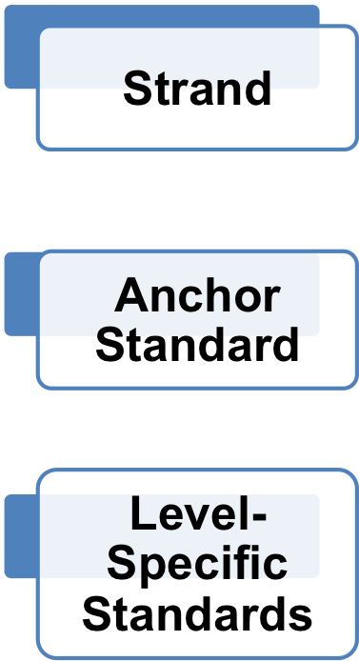
Structure of the Literacy Standards
Four Strands: Reading, Writing, Speaking and Listening, Language
Anchor Standards for Each Strand: 10, 9, 6, and 6
Standards Listed by Level:
A (K-1), B (2-3), C (4-5),
D (6-8), and E (9-12)
Notes:
Big Idea: Every level (A-E) is built on the Anchor Standards. There is structural consistency at each level.
Facilitator Talking Points:
The Anchor Standards were created first, and they are the statements of college and career readiness. You might call them “exit standards” for transitioning out of adult education and into the workforce or on to additional formal training and education.
Reading Standard 1 is always about students using evidence from levels A-E and Reading Standard 2 is always about the theme or central idea from levels A-E.
The standards are clustered into the four strands listed here and are closely interwoven. In fact, many of the standards from different strands are closely interrelated.
The levels were renamed A-E, but here is how you can connect them to the existing Education Functioning Levels:
Beginning Literacy= Level A
ABE 1 = Level B
ABE 2 = Level C
ABE 3 = Level D
ASE 1 = Level E
ASE 2 = Level E with the ability to read more complex text and use evidence more skillfully

Slide 3
Three Key Advances Prompted by the CCR Standards
Text Complexity: Regular Practice With Complex Text (and Its Academic Language)
Evidence: Reading and Writing Grounded in Evidence From Text
Building Knowledge: Building Knowledge Through Content-Rich Nonfiction
Notes:
Big Idea: These three key advances are derived from the CCR Standards for Adult Education in ELA/Literacy.
Facilitator Talking Points:
The key advances represent the most important instructional changes demanded by the CCR Standards for Adult Education.
Key Advance 1: The standards build a staircase of text complexity so that all students are ready for the demands of college- and career-level reading.
Key Advance 2: The standards place a premium on students drawing evidence from texts to support their claims and conclusions about texts.
Key Advance 3: The standards identify reading, researching, and writing about texts as the key to gaining knowledge.
In this unit, we will address the structure and demands of the CCR Standards.
Facilitator Note: Plan for about 15 minutes to introduce the unit (Slides 1-6).

Slide 4
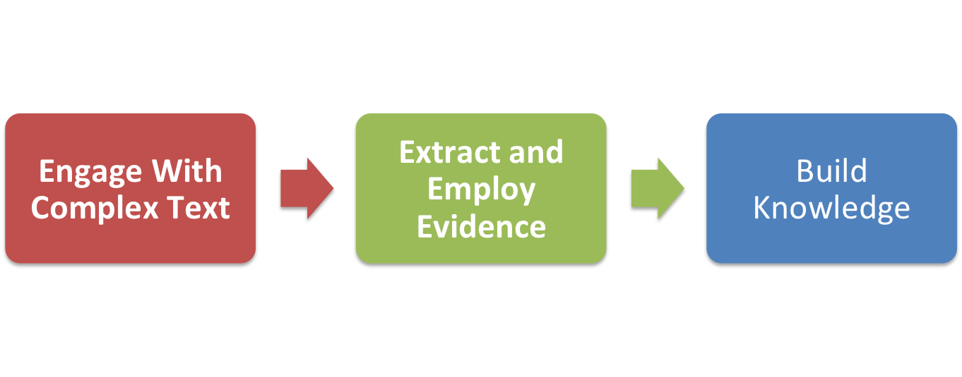
Key Advances Build Toward College and Career Readiness
Notes:
Big Idea: The three key advances are connected and build on one another.
Facilitator Talking Points:
When students engage with complex text and extract and employ evidence from those texts, they gain knowledge, enlarge their experience, and broaden their worldviews.
Students who meet the CCR Standards undertake the close, attentive reading that is essential to understanding complex works.

Slide 5
Unit 1 Objectives Connecting the CCR Standards to the Key Advances
Become familiar with the CCR Standards for ELA/Literacy and how the standards are organized.
Learn how tightly linked the standards are to one another.
Understand in concrete terms how the standards are connected to the three key advances.
Notes:
Big Idea: To give participants time to delve into important parts of the standards and understand how the key advances are derived from the CCR Standards and are linked to one another.
Facilitator Talking Point: The purpose of this unit is to explore the ELA/Literacy CCR Standards—first by working closely with the Anchor Standards and then by seeing how they demonstrate the truth of the advances.
Facilitator Notes:
Read these three objectives for Unit 1 aloud and start the exercise.
You can pause for questions, but know that most will be answered by continuing with the activity.

Slide 6
Hands-On Practice
Now let’s do some work naming the CCR standards . . .
Notes:
Big Idea: The purpose of the first activity is to quickly familiarize participants with the Anchor Standards and demystify them by giving them nicknames.

Slide 7
Materials (Part One)
Directions for Participants
Worksheet: Naming the Standards
Notes:
Big Idea: Make sure each participant has the correct materials before giving directions for the activity.

Slide 8
Directions (Part One)
Circle keywords in each Anchor Standard on the Naming the Standards worksheet before arriving at a nickname.
Assign a one- to five-word nickname for each standard assigned to you. Go with your gut regarding the essential heart of each standard, and don’t overthink your answer.
Compare notes at your table and discuss how each nickname does or does not capture the essence of its standard.
Work Session 45 minutes
Notes:
Big Idea: Give directions for the activity.
Facilitator Talking Point: Circle keywords in each standard before arriving at a nickname.
Facilitator Notes:
Assign a single strand of the standards to each table (i.e., Reading, Writing, Speaking and Listening, or Language). If you have more time, assign two strands to each table of participants.
Encourage participants to tie the standards to what they already know, or to see the one element that unites the standards and may be novel in their experience (e.g., text complexity).
If participants feel stuck on a given standard, ask them some questions to help them discern the meaning. It can also help to provide a frame: “This is the standard.”
Allow about 45 minutes of active work time for this activity so participants don’t feel rushed.

Slide 9
Discussion Questions
What are some of the nicknames created for the standards?
Are there any standards you struggled with?
Notes:
Big Idea: Check on participants’ understanding of the meaning of various Anchor Standards.
Facilitator Notes:
You may not have time to hear from all the tables about what they nicknamed the standards they were assigned, but you should ask to hear from participants who really liked the nickname they created for a given standard.
It is important to give honest feedback if someone offers a nickname that does not reflect the meaning of that standard. The point of this activity is for participants to come to a better understanding of the CCR Standards for ELA/Literacy and to demystify the standards for them. Letting participants leave the activity with misconceptions about a standard will not promote these goals.

Slide 10
Hands-On Practice
Now let’s do some work connecting the
CCR standards to the key advances . . .

Slide 11
Materials (Part Two)
Directions for Participants
Resource: CCR Anchor Standards cards
Notes:
Big Idea: Make sure each participant has the correct materials before giving directions for the activity.
Facilitator Notes:
Ask participants to get up and move around the room to fully participate in this activity.
Be sure to have the poster papers with the three key advances and “other” posted around the room.

Slide 12
Directions (Part Two)
Read your Anchor Standards card. Look at the four categories posted around the room, and ask yourself, “Which key advance does this standard best illustrate or exemplify?”
When you have settled on which category your standard best fits, walk over to stand by that poster.
Read your standard aloud to the other participants and listen to their standard.
Work Session 45 minutes
Notes:
Big Idea: This activity demonstrates to participants how tightly linked the standards are to one another and to the major advances they imply.
Facilitator Talking Point: Once your group forms, read aloud each one of your Anchor Standards. Discuss among yourselves whether you think each standard fits with your key advance or would be better placed under another key advance.
Facilitator Notes:
Check in with the whole group to make sure all instructions are clearly understood before turning the room over to participants.
The activity is simple, but having participants do each of the steps is important to building their understanding and insights regarding the design of these standards.
Some people may decide to move based on the discussion. But support participants to stand their ground if they don’t agree and aren’t convinced there is a better alignment with one of the other advances.

Slide 13
Discussion Questions
What do you notice about the colors of the cards in your key advance? Can you figure out what the colors represent?
What are some rationales that explain why you chose to relate that standard to that key advance?
Did anyone have a hard time deciding which group to pick?
Did anybody wonder about being part of another group? What key advances were the contenders?
How about those of you in the “other” category? What standard do you have? Why did you choose to stand under the “other” sign?
Does anyone from the other advances want to adopt them? If so, make a case for why that standard belongs there.
Notes:
Big Idea: Participants should note that each standard is often related to more than one advance, and that every advance includes standards from different strands (Reading, Writing, Speaking and Listening, and Language).
Facilitator Notes:
These are suggested questions. Go over as many as time permits.
Save time to hear the thoughts of any participants who chose to stand by the “other” category, as their reasoning will deepen the experience for everyone.

Slide 14
Reflections
Each key advance depends on standards from the four strands.
Standards from the four strands come together in aligned instruction to realize the key advances.
Reading Standard 1 (text evidence) and Reading Standard 10 (text complexity) play a special role because they operate whenever students are reading or researching, writing, or speaking about what they have read.
15 minutes
Notes:
Big Idea: Sum up for participants the key takeaway points from the unit—how each key advance draws on all four strands while simultaneously resting on the twin pillars of text complexity and evidence drawn from the text.
Facilitator Talking Points:
The three key advances go to the heart of what identifies the CCR Standards.
Notice how tightly interwoven the strands are (Reading, Writing, Speaking and Listening, and Language—the four colors of the anchor cards). This is how humans learn and use language—they do all of these things together seamlessly. The standards are designed to point to instruction that interweaves all of the strands as well. The fact that the four strands of the ELA/Literacy CCR Standards are interwoven and hard to break apart has important implications for instruction. Reading and listening offer opportunities to take in information, whereas speaking and writing present opportunities to share what has been learned.
The regular practice of language conventions and diligent attention to words enable these other four strands to be done with competence.
No standard is fully met unless students are reading a text of sufficient complexity (Reading Standard 10) and they can provide evidence to support their understanding (Reading Standard 1).

Slide 15
Next Steps
How has participating in this activity changed your thinking about the CCR Standards?
How will you use the information and understanding you have acquired to improve your teaching practice and student learning?
What additional training and tools would strengthen your ability to do so?
Notes:
Big Idea: Ask participants to reflect on and then discuss what they have learned. Ask them how they plan to use what they have learned.

