Slide 1
Selecting Texts Worth Reading Foundational Unit 2
Produced Under U.S. Department of Education Contract No. ED-VAE-13-C-0066 With StandardsWork, Inc.
2016

Slide 2
Three Key Advances Prompted by the CCR Standards
Text Complexity: Regular Practice With Complex Text (and Its Academic Language)
Evidence: Reading and Writing Grounded in Evidence From Text
Building Knowledge: Building Knowledge Through Content-Rich Nonfiction
Notes:
Big Idea: These are the most important instructional changes demanded by the CCR Standards for Adult Education.
Facilitator Talking Points:
The key advances represent the most important instructional changes demanded by the CCR Standards for Adult Education:
Key Advance 1: The standards build a staircase of text complexity so that all students are ready for the demands of college- and career-level reading.
Key Advance 2: The standards place a premium on students drawing evidence from texts to support their claims and conclusions about texts.
Key Advance 3: The standards identify reading, researching, and writing about texts as the key to gaining knowledge.
In this unit, we will address Key Advance 1, TEXT COMPLEXITY.
This unit begins with an overview of text complexity and some of the tools that exist for measuring it.
Following this overview, you will have the opportunity to evaluate text complexity.
Facilitator Note: Plan for about 40 minutes to introduce the unit (Slides 1-17).

Slide 3
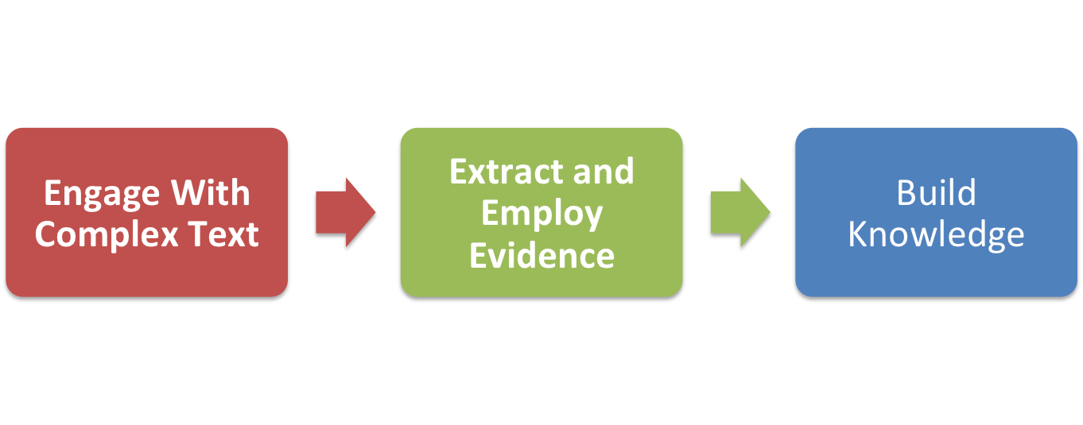
Key Advances Build Toward College and Career Readiness
Notes:
Big Idea: The three advances are connected and build on one another.
Facilitator Talking Points:
When students engage with complex text and extract and employ evidence from those texts, they gain knowledge, enlarge their experience, and broaden their worldviews.
Students who meet the CCR Standards undertake the close, attentive reading that is essential to understanding complex works.

Slide 4
Unit 2 Objectives Selecting Texts Worth Reading
Understand the research base that explains the importance of text complexity to students’ preparedness.
Understand the staircase of complexity and the central role it plays in the CCR Standards for Adult Education.
Understand the features that make a text complex.
Understand how careful consideration of text(s) can yield insights for instruction and deeper understanding of what it takes to comprehend a text.
Notes:
Big Idea: The purpose of this unit is to understand the important role text complexity (and selection of high-quality readings) plays in the CCR Standards for ELA/Literacy.
Facilitator Notes:
Read these four objectives for Unit 2 aloud and move to the next slide to learn more about the rationale for the unit.
Emphasize that this unit is not meant to set an expectation that teachers will have to run a quantitative analysis on every text they give to students to read.
You can pause for questions, but know that most will be answered by continuing with the introductory slide presentation (Slides 1-17).

Slide 5
Rationale for Focusing on Complex Text
Relevance and Importance Based on the Research
The complexity of text that students can read is the greatest predictor of success in college (ACT study).
The gap between the complexity of college and high school texts is huge (four years!).
Too many students are reading at too low a level. (Fewer than 50% of graduates can read sufficiently complex texts.)
Deficiencies deny equal opportunity . . .
Notes:
Big Idea: Focus on why text complexity is so vital to preparing students for college and careers with particular attention to the 2006 ACT study.
Facilitator Talking Points:
Here is key information about the ACT Reading Between the Lines study. I’ll share with you the purpose, process, findings, and also an illustration.
Purpose: Determine what distinguished the reading performance of students likely to succeed in college and not.
Process:
Set benchmark score on the reading test shown to be predictive of success in college (“21”).
Looked at results from a half-million students.
Divided texts into three levels of complexity: uncomplicated, more challenging, and complex.
Recap of Findings:
Question type (main idea, word meanings, details) is NOT the chief differentiator between students scoring above and below the benchmark.
Question level (higher order vs. lower order; literal vs. inferential) is NOT the chief differentiator for student performance either.
What students could read, in terms of its complexity—rather than what they could do with what they read—found to be the greatest predictor of success.
Illustration: Two students can find the main idea or determine word meanings. One enters and succeeds in freshmen courses; the other ends up in remedial courses. What’s the difference? One can find the main idea or determine word meanings in college-level complex texts; the other cannot.

Slide 6
Implications of Focusing on Complex Text on Instruction
The CCR Standards have raised the bar for what students should read and understand at each level.
Passages should be of high quality so they are worthy of close reading.
CCR-aligned questions cannot be asked about passages lacking complexity and fully developed ideas.
Notes:
Big Idea: The standards call for the ability to read and comprehend complex text independently and proficiently, so instruction has to change.
Facilitator Talking Points:
This shift is largely embodied through CCR Reading Standard 10:
CCR Anchor 10: Read and comprehend complex literary and informational texts independently and proficiently. The standards include a staircase of complexity, defining level-specific complexity from Level B through Level E.
The CCR Standards depend on ALL students’ being exposed to high-quality, complex text.
By reading a high-quality, complex text, students increase reading proficiency that carries over to the next reading experience.
It is only by working with rich material over time that students are able to become proficient, confident readers.
Text complexity serves as the basis for being able to ask CCR-aligned questions of the text to extract evidence (the next key advance to be studied in Unit 3).
Determining the instructional moves and implications required by this standard is the work we’ll be doing in the rest of this unit.

Slide 7
What Is Complex Text, Exactly?
Complex sentences
Uncommon vocabulary
Lack of words, sentences, or paragraphs that review or pull things together for the student
Lengthy paragraphs
Text structure that is less narrative and/or mixes structures
Notes:
Big Idea: There are 10 features that make a text complex; a text with more of these features will be more complex.
Facilitator Talking Points:
Complex sentences: sentences with lots of parts to them, or lots of variation in sentence length and styles
Uncommon vocabulary: not likely to be familiar to many students at this level.
Lack of…: the author does not repeat ideas or summarize much. Also may not offer clues to the reader through words and phrases like “next,” “as we just saw,” “in conclusion,” and “because.”
Lengthy paragraphs: long, dense paragraphs
Text structures: Narrative structure is story-like. It is easier to follow than problem and solution or cause and effect. When an author mixes up structures (which textbooks and articles often do), text becomes even trickier to follow.
Of these text features on these two slides, two are by far the source of student difficulty. These qualities, or features of text, can be present in text in any number of ways, 10 factorial ways, actually (factorial =10 x 9 x 8 x 7 … which equals 3,628,800).
Facilitator Note: Show this slide, then show the next slide long enough to read through and define for participants.

Slide 8
What Is Complex Text, Exactly? (Continued)
Subtle and/or frequent transitions
Multiple and/or subtle themes and purposes
Dense information
Unfamiliar settings, topics, or events
Lack of repetition, overlap, or similarity in words and sentences
Notes:
Big Idea: There are 10 features that make a text complex; a text with more of these features will be more complex.
Facilitator Talking Points:
Subtle and/or frequent transitions: The author does not give you clues (next, thus, consequently) before moving to a new idea.
Multiple and/or subtle themes and purposes: The author does not directly state or clearly offer his purpose for writing, or the big ideas are hard to figure out.
Dense information: Informational text tends to pack ideas very tightly, and authors may assume that readers know more about the topic than students might actually know.
Unfamiliar settings, topics, or events: It is harder to visualize and imagine what you have never experienced. This is why contemporary fiction can be read so fast and is considered so enjoyable. Almost everything is familiar.
Lack of repetition, overlap, or similarity in words and sentences: The author keeps moving to new ideas or settings and does not stop to summarize or support what he has just discussed, or he finds new ways to express the same idea. If the reader didn’t understand right away, or doesn’t realize the new phrasing is a restating of the original idea, it is easy in both cases to get lost.

Slide 9
Which Two of These Factors Cause Students the Most Difficulty?
Complex sentences
Uncommon vocabulary
Lack of words, sentences, or paragraphs that review or pull things together for the student
Lengthy paragraphs
Text structure that is less narrative and/or mixes structures
Notes:
Big Idea: Two features of a complex text make a text not just more complex, but also more difficult for students.
Facilitator Talking Points:
Of the text features on the past two slides, two are by far the greatest source of student difficulty, especially for students with deficits in literacy, specifically in the later grades.
Those two are on this slide. Can you guess which two?
After lots of research, it has been found that words have a lot to do with reading—which may come as no surprise!
Eight of these elements can make a text more complicated, but the first two (complex sentences and vocabulary) actually make a text more difficult for students.
Facilitator Notes:
Let participants discuss which are the two text features before divulging the answer. The two are uncommon vocabulary (#1 by a landslide) and complex sentences (#2, and far ahead of the others).
When text is more complex, many features or qualities generally contribute to it being so. But the two most important ingredients that cause challenge for students are the degree to which vocabulary is unfamiliar and how varied and complicated the sentences are. Those two ingredients are what are known as academic language.

Slide 10
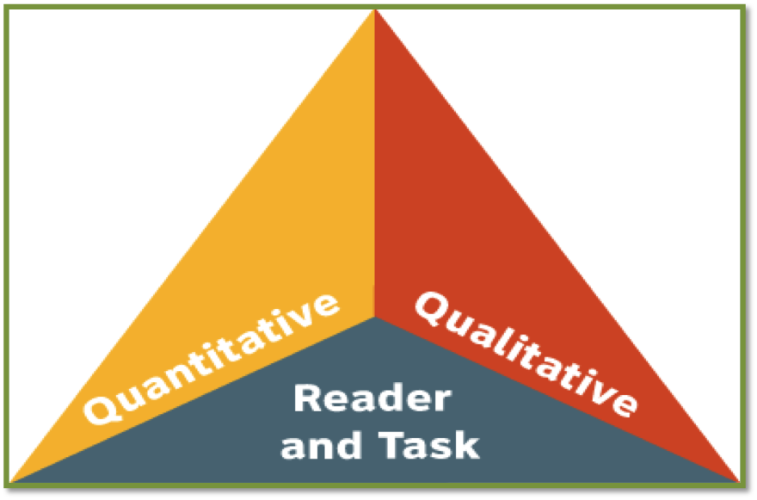
Three-Part System for Measuring Text
Quantitative Scale
Qualitative Measures
Professional Judgment (of Reader and Task)
Notes:
Big Idea: There is a three-part system (three factors) to determine the complexity of a text.
Facilitator Talking Points:
This is the text complexity triangle that the CCR Standards adopted from the Common Core State Standards.
How many of you have seen this before?
This is an equilateral triangle, so each side of it has equal weight.

Slide 11
What Do These Parts Mean? How Do They Work Together?
Quantitative Scale: What a computer can “see” and measure
Qualitative Measures: Text features best judged by human evaluation (structure, language clarity and conventions, knowledge demands, and purpose)
Professional Judgment: What the instructor does with this text to help students read and understand it
Notes:
Big Idea: Three factors work together when making decisions about what complex texts to bring to our students.
Facilitator Talking Points:
The quantitative scale uses computers to judge those things computers are best at analyzing (vocabulary and syntax).
Qualitative measures are needed to address what computers cannot grasp (e.g., purpose, structure, knowledge demands).
Professional judgment is not about the inherent complexity of the text. Rather, it focuses on the instructional moves an instructor needs to make with the text to provide students access to it.
Facilitator Notes:
These explanations are clear, so read them through with participants and make sure any questions and confusions are answered.
Address any questions and confusion.
NOTE: More detail is coming on the next slides.

Slide 12
Quantitative Scale
CCR Levels of Learning | ATOS | Degrees of Reading Power | Flesch-Kincaid | The Lexile Framework | Reading Maturity
B (2nd – 3rd) | 2.75 – 5.14 | 42 – 54 | 1.98 – 5.34 | 420 – 820 | 3.53 – 6.13
C (4th – 5th) | 4.97 – 7.03 | 52 – 60 | 4.51 – 7.73 | 740 – 1010 | 5.42 – 7.92
D (6th – 8th) | 7.00 – 9.98 | 57 – 67 | 6.51 – 10.34 | 925 – 1185 | 7.04 – 9.57
E (9th – 10th) | 9.67 – 12.01 | 62 – 72 | 8.32 – 12.12 | 1050 – 1335 | 8.41 – 10.81
E (11th – CCR)) | 11.20 – 14.10 | 67 – 74 | 10.34 – 14.2 | 1185 – 1385 | 9.57 – 12.00
Notes:
Big Idea: Several tools exist to measure the quantitative value of a text, and each one takes students through a staircase of text complexity from Level B to Level E (or ASE 2).
Facilitator Talking Points:
These are the quantitative tools. Any of the tools works. Each of them has been validated to achieve the requirements of the CCR Standards in a strenuous research study (Nelson et al., 2012). In other words, any of these measures work.
There is a lot of overlap between the top of one level and the beginning of the next because putting a numerical value on words is still a new and inexact science. There is overlap within the scale so that the precision of the scale is not misstated.
Text complexity is not defined solely as reading high school-level texts. The Quantitative Analysis Chart defines the requisite levels of complexity for each educational functioning level by Lexile, ATOS, Flesch-Kincaid, etc.
Note that this chart only identifies text complexity for Levels B through E. That’s because at Level A, students are just learning how to read. It is not appropriate to focus on the complexity of the texts students are reading until they reach Level B.

Slide 13
Qualitative Measures
Notes:
Big Idea: Qualitative measures are best measured through human evaluation of a text’s structure, language, knowledge demands, and purpose.
Facilitator Talking Points:
This is the chart we will be working with during the activity. The features (or qualities) of text that go down the left column are the cluster of features we will be evaluating in the text excerpt.
These are features that have been determined to have a strong bearing on how challenging or easy a text is.

Slide 14
Professional Judgment
“Students who struggle greatly to read texts within (or even below) their text complexity [level] must be given the support needed to enable them to read at an appropriate level of complexity. Even many students on course for college and career readiness are likely to need scaffolding as they master higher levels of text complexity.”
(From Appendix A, p. 9, CCSS – ELA)
Notes:
Big Idea: Students who struggle with reading complex texts must be provided with the proper support so they can access texts in a meaningful way.
Facilitator Talking Points:
This quote comes directly from the Common Core State Standards.
We will look more at this third side of the triangle in Unit 3, Identifying Questions Worth Answering.
It is very important to keep instruction in mind and always consider how we might approach teaching students how to comprehend text as we evaluate it for its appropriateness for the classroom.

Slide 15
Determining Text Complexity
General Rule: Use the quantitative measures to place a text within a band, and qualitative measures to determine if the text is slightly, moderately, very, or exceedingly complex for that level.
Then consider what to do with the qualities of the text through instruction so students can access the ideas and information contained within it (reader and task considerations).
(Navigating Text Complexity)
Notes:
Big Idea: Determining text complexity follows a general rule.
Facilitator Talking Points:
Quantitative and qualitative measures are at once useful and imperfect:
Quantitative measures are less valid for certain kinds of texts (e.g., poetry, drama, and speeches).
Qualitative measures are on a continuum (they are not band-level-specific) and most useful working in conjunction with quantitative measures.
Evaluating the text for its qualities is a necessary step for figuring out how to help students develop a solid understanding of the text.
“Navigating Text Complexity” is a website that seeks to demystify text complexity.

Slide 16
Why Text Complexity Is Essential
Academic vocabulary can be learned only from complex texts.
Mature language skills needed for success can be gained only by working with demanding materials.
Students won’t be prepared by reading simplified texts that have restricted, limited, and/or thin meaning.
There is no evidence that struggling readers catch up by simply increasing the complexity of simpler texts gradually.
Notes:
Big Idea: Access to appropriately complex text for everyone is paramount.
Facilitator Talking Points:
Just because a student READS at a lower level doesn’t mean he or she THINKS at a lower level.
Mature adult students deserve to be exposed to rich and complicated ideas and age-appropriate knowledge that is presented in rich, respectful (well-written) ways.
Comfort with academic language (vocabulary and varied sentence structure) is the gateway to academic and work success, since it is the common language in those settings.
We need to create an experiential staircase for students so they get exposed to these features of rich, complex text—appropriate for their own level of learning.
Our job as educators is NOT to smooth the road for our students but to give them sturdy foundations so they can navigate the bumps in the road. That way, they can start to do these things for themselves.

Slide 17
Hands-On Practice
Now let’s analyze the qualitative features of a text . . .
Notes:
Big Idea: The purpose of this activity is to give participants a chance to work together to practice using these text measurement tools and actually evaluate text.

Slide 18
Materials
Directions for Participants
Worksheet: Qualitative Analysis of Text
Resource: Excerpt from The Words We Live By: Your Annotated Guide to the Constitution
Resource: Eleanor Roosevelt Speaks to the Members of the American Civil Liberties Union
Resource: Quantitative Analysis Chart for Determining Text Complexity
Resource: Qualitative Analysis Rubric for Informational Texts
Notes:
Big Idea: Make sure each participant has the correct materials before giving directions for the activity.
Facilitator Notes:
Hold up the copy of the excerpt from the Monk text, The Words We Live By: Your Annotated Guide to the Constitution, while participants get out their materials.
Let participants go through the materials briefly and notice that they are looking at the same tools that you just walked through on the screen.
Go over the instructions that are shown on the next slide carefully. Reassure everyone! This is challenging. Even those who do it a lot still learn from others and miss features each and every time.

Slide 19
Directions
Read the excerpt from The Words We Live By. Decide whether to read the text aloud at your table while others follow along, or to read silently.
Look at the quantitative measures listed at the top of the Qualitative Analysis of Text worksheet for The Words We Live By. Consult the Quantitative Analysis Chart for Determining Text Complexity to determine in what level of learning the text belongs. When different measures indicate adjacent levels, look at the overlap in ranges between levels to decide in which level to place the text.
Notes:
Big Idea: This activity has several parts. The focus is on finding evidence that supports how hard or easy participants think that particular feature of the text is.
Facilitator Talking Points:
The quantitative bands overlap each other. Different quantitative measures consider slightly different variables of text difficulty, so that is why we are looking at two measures when determining a text’s complexity.
Bear in mind that the quantitative measure lets you know at what level the text belongs, but the qualitative analysis gives you information about how hard the text will be for your students and where you will need to pay attention when you are teaching the text.
Facilitator Notes:
This work is the foundation for success for the units that follow. Investing the time participants need to study the excerpts carefully will be repaid with richer understanding for everything that follows.
You may want to ask someone at each table to read the text aloud while others follow along, or you may have the participants read silently.
Be sure all instructions are clearly understood before turning the room over to participants.

Slide 20
Directions (Continued)
Review the Qualitative Analysis Rubric for Informational Texts. For each category or text feature (structure, language clarity and conventions, knowledge demands, and purpose), provide evidence in the blank space for why you think the text is or is not especially challenging in that category. Share your insights with a partner.
Notes:
Big Idea: This activity has several parts. The focus is on finding evidence that supports how hard or easy they think that particular feature of the text is.

Slide 21
Directions (Continued)
Share your evidence with other participants at your table and discuss any points of agreement or disagreement. Rather than discussing the rating itself, focus on the evidence from the text that supports your rating on the qualitative rubric:
What did you read in the text that made you think about it in this way?
Can you point to a specific example?
Why does [refer to the specific example] seem to be more moderately complex rather than very complex?
Notes:
Big Idea: What’s most important is the evidence from the text that supports participants’ ratings on features within the qualitative rubric.
Facilitator Notes:
Deep insights occur when participants compare notes on what they see and the reasoning others have applied. For this reason, working with a partner succeeds best when each individual takes some time with the text alone first and then compares notes with his or her partner.
This learning accelerates when the table comes together to compare notes.
Rather than discussing the rating itself, focus the discussion at the tables on the evidence from the text that supports their rating on the qualitative rubric:
What did you read in the text that made you think about it in this way?
Can you point to a specific example?
Why does [refer to the specific example] seem to be more moderately complex rather than very complex?
Ask group members to see if they can move to consensus on their placements and why. It is OK if participants disagree as long as their judgments are well-reasoned and well-supported.

Slide 22
Directions (Continued)
At your table, assign placement ratings in each category, and finally an overall placement of how complex the text is when you consider all its features. Remember, you are thinking about this text for a certain level of adult education students, so consider how challenging it is for students at that level.
Explain your overall placement for how complex the text is in the bottom row of the chart.
Now repeat the exercise for the second resource: Eleanor Roosevelt Speaks to the Members of the American Civil Liberties Union.
Work Sessions 1 and 2 45 minutes each
Notes:
Big Idea: What’s most important is the evidence from the text that supports participants’ ratings on features within the qualitative rubric.
Facilitator Notes:
Initial work session will concentrate on: The Words We Live By: Your Annotated Guide to the Constitution.
Second work session will concentrate on: Eleanor Roosevelt Speaks to the Members of the American Civil Liberties Union.
Hold up the copy of the Roosevelt’s speech, while participants get out their materials.
Go over the instructions again that begin on slide 19.

Slide 23
Reflections
Did analyzing the text in this careful way help you notice what would be difficult for students at this level?
How would you help students navigate the challenges this text presents?
What type of supports might be needed?
10 minutes
Notes:
Big Idea: Solicit from participants ways they could use it in adult education classrooms.
Facilitator Talking Points:
Great work on a challenging task! Although this activity was difficult, one of the many benefits of learning how to analyze texts for complexity is being able to support our students. Understanding what makes a text qualitatively complex will help you design instruction that will provide students with the supports they need to handle the challenging aspects of a particular text.
Any thoughts about how you might address the text features you saw as particularly challenging for students through instructional design?
This unit is not meant to set an expectation that a teacher will have to run a quantitative analysis on every text given to students to read. Rather, it is for you to become aware of what makes a text complex and to understand the staircase of complexity within the CCR Standards.
For many titles, a Lexile is readily available. You need only log in to https://lexile.com and type in the name of the text.
You should insist that publishers provide you with quantitative measures of complexity of the texts contained within textbook resources.
Keep in mind this general rule: Use the quantitative measures to place a text within a level, and qualitative measures to determine if the text is slightly, moderately, very, or exceedingly complex for that level.
Facilitator Notes:
Review the three-part system for measuring text: quantitative scale, qualitative measures, and professional judgment of reader and task.

Slide 24
Next Steps
How has participating in this activity changed your thinking about the CCR Standards?
How will you use the information and understanding you have acquired to improve your teaching practice and student learning?
What additional training and tools would strengthen your ability to do so?
Notes:
Big Idea: Ask participants to discuss what they have learned and to think ahead about how they plan to use what they have learned.

