Slide 1
IET Design Camp Technical Assistance supported by the U.S. Department of Education, Office of Career, Technical and Adult Education (OCTAE)
WELCOME!
Orientation

Slide 2
Meeting Recording Notice
This session will be recorded, including any audio, visuals, participants, and other information sent, verbalized, or utilized. By joining this meeting, you automatically consent to such recordings. Any participant who prefers to participate via audio only should disable their video camera so only their audio will be captured. Video and/or audio recordings of any session shall not be transmitted to an external third party without permission.

Slide 3
Design Camp Trainers

Slide 4
Agenda
Introduction
Getting to know the Virtual Classroom
Setting the Stage
Trainer and Participant Introductions
Quality IET Programs
WIOA IET Definition and Requirements
Four Phases of the IET Design Process
IET Design Camp Overview
Structure
IET Toolkit Tour
Wrap-Up

Slide 5
Getting Familiar with the Virtual Classroom
Make sure you are signed into the Zoom desktop client rather than through the browser version.
We recommend using your computer for audio to facilitate participation.
Please mute your microphone and turn on your camera.
During the webinar, chat the entire group for questions and comments related to the content.
If you experience problems during the webinar, message or email __________ at ________________________.

Slide 6
Focus on IET Programs
Increasing Adults’ Opportunities for Employment and/or Further Education
Wages rise and unemployment decreases as education and training attainment levels are reached.
Unemployment rates and earnings by educational attainment, 2020
Educational attainment | Median Usual weekly earnings | Unemployment rate
Master’s degree | $1,545 | 4.1%
Bachelor degree | $1,305 | 5.5%
Associate degree | $938 | 7.1%
Some college, no degree | $877 | 8.3%
High school diploma | $781 | 9%
Less than a high school diploma | $619 | 11.7%
TOTAL | $1,029 | 7.1%
Note: Data are for persons ages 25 and over. Earnings are for full-time wage and salary workers.
Source: Current Population Survey, U.S. Department of Labor, U.S. Bureau of Labor Statistics
If all U.S. adults were at least a Level 3 in literacy proficiency, the U.S. would generate an additional $2.2 trillion in annual income which represents 10% of the gross domestic product.
(https://www.barbarabush.org/wp-content/uploads/2020/09/BBFoundation_GainsFromEradicatingIlliteracy_9_8.pdf)
Orientation
6

Slide 7
IET Programs Revolutionize Career and Education Pathways for Adult Learners
Expanding the availability and quality of IET programs available to adult learners in our state is important to support learner and economic growth by addressing skills needs of employers.

Slide 8
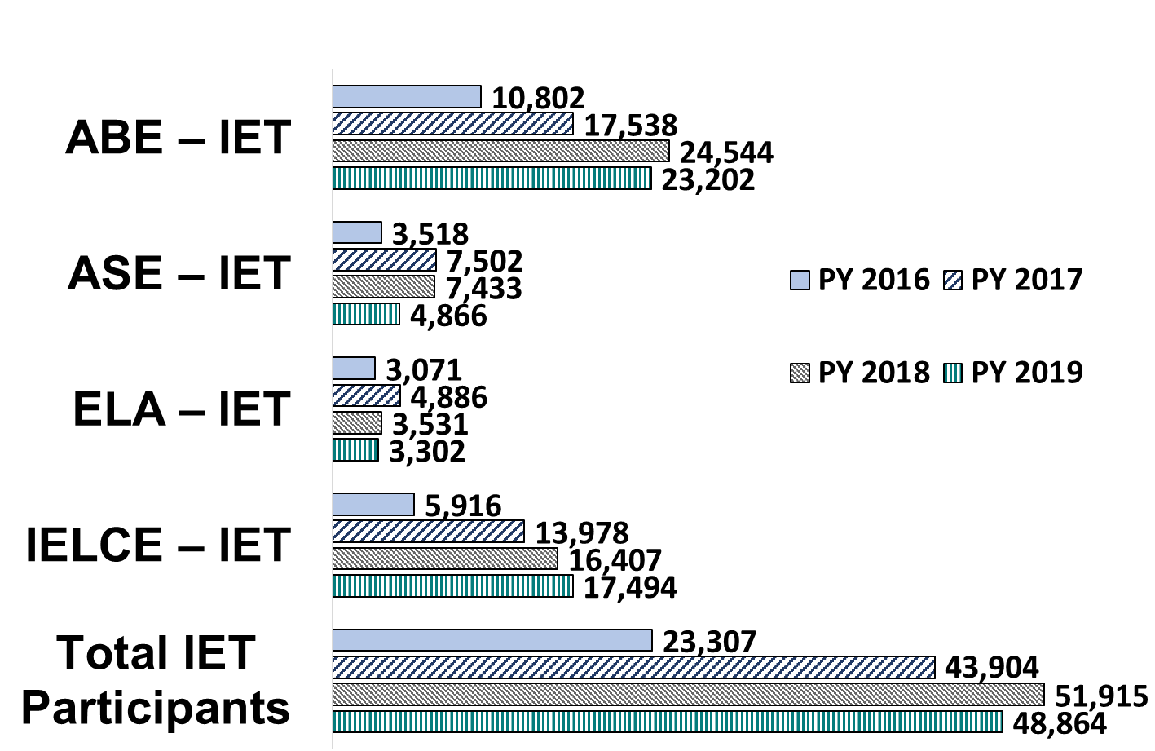
Enrollment Trend in IET Programs
Across the country, total IET participation reported for PY 2019 was 48,864, which was a decrease of 3,051 participants or 5.88% less than PY2018.
This represents a decreased rate less than half that of the total enrollment decline.
Orientation
8

Slide 9
Our Charge to You:
Bring your best thinking and collaboration to this work.
Share ideas and insights.
Take advantage of “time away” with colleagues.
Orientation
9

Slide 10
Breakout Group Meet and Greet
Share a little about yourself with your peers:
Name
Agency/Organization
Role
One thing you hope gain from the Design Camp
15 mins.

Slide 11
Quality IET Programs
What is IET?
Three Integrated Components
Educational and Career Advancement
Breakout Group Activity – Is it an IET?
IET Program Design Process and Guiding Principles

Slide 12
Poll: Participation in IET
Which aspect or aspects of IET development and/or delivery have you participated in?
Identifying an IET program
Designing a program
Administering a program
Serving as an instructor
Serving as an industry subject matter expert (SME)
Practicing continuous improvement/evaluating a program
Other
None

Slide 13
Group Discussion: What is IET?
“…a service approach that provides adult education and literacy activities concurrently and contextually with workforce preparation activities and workforce training for a specific occupation or occupational cluster for the purpose of educational and career advancement.”
(34 CFR §463.35)
What is meant by the phrase “concurrently and contextually?”
Please share your thoughts.

Slide 14
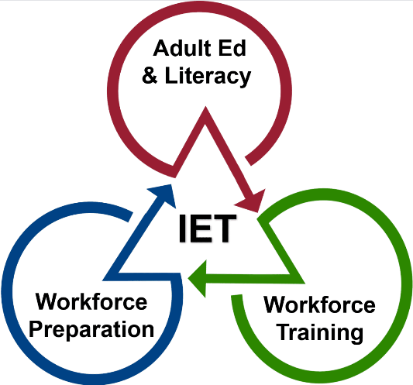
IET Component Integration
Adult education and literacy activities, workforce preparation activities, and workforce training activities must:
Each be of sufficient intensity and quality
Be based on the most rigorous research available, particularly with respect to improving reading, writing, mathematics, and English proficiency of eligible individuals
Occur simultaneously within the overall scope of the IET program
Use occupationally relevant instructional materials
This alignment integration is organized through a single set of learning objectives that identifies specific adult education content standards, workforce preparation skills, and workforce training competencies.
Notes:
NOTE: This slide has 1 build (click). See Facilitator Guide.

Slide 15
Educational and Career Advancement
The purpose of IET programs is to support learners’ educational and career advancement.
To help achieve that:
The adult education component of the program must be aligned with the state’s content standards for adult education.
The IET program must be part of a career pathway.

Slide 16
Breakout Group Activity #1
Is it an IET?
Review a sample adult education program.
Discuss the aspects of the program that meet WIOA regulations and state policies for an IET.
What makes or would make it an IET program?
Document the evidence (or lack of evidence) in each.
Be prepared to share your group's reasoning.
20 mins.

Slide 17
Is it an IET?
17

Slide 18
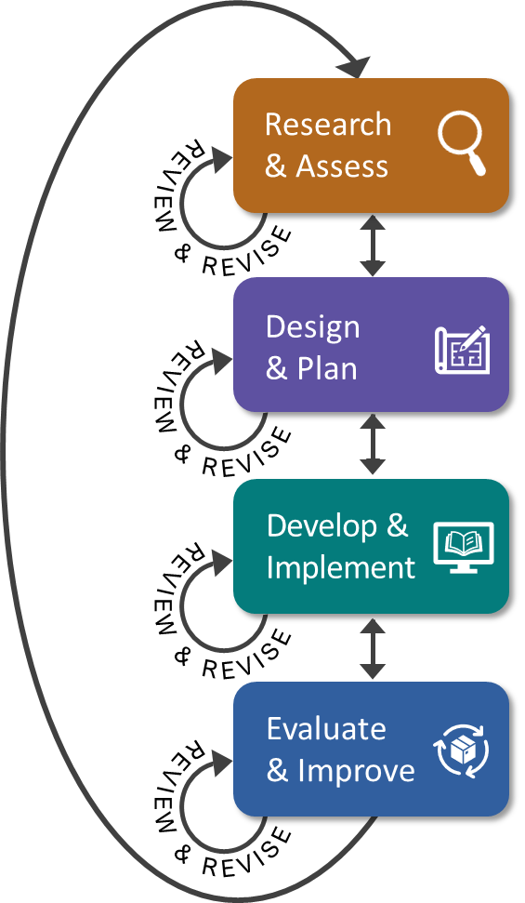
The IET Program Design Process
Four iterative phases

Slide 19
3 Guiding Principles of IET Program Design

Slide 20
Questions?
Quality IET Programs
Orientation
20

Slide 21
IET Design Camp Overview
What is the IET Design Camp?
Design Camp Structure
Materials and Where to Find Them
Cohort Training Format
Expectations – Yours and Ours

Slide 22
What is the IET Design Camp?
It is:
A foundational IET design training series that introduces and aligns with the IET Toolkit.
A participatory and collaborative learning experience.
An opportunity to explore and share resources, challenges, and successes.
A launching pad to help you develop and refine an IET program.
It is not:
Designed for you to leave with a new IET program in place.
Intended as training for curriculum design.
Train-the-Trainer
22

Slide 23
Design Camp Structure
WEEK 1 | WEEKS 2 & 3 | WEEKS 4 & 5 | WEEKS 6 & 7 | WEEKS 8 & 9
Orientation | Phase 1: Research and Assess | Phase 2: Design and Plan | Phase 3: Develop and Implement | Phase 4: Evaluate and Improve
MONDAY Toolkit reading assignment | MONDAY Toolkit reading assignment | MONDAY Toolkit reading assignment | MONDAY Toolkit reading assignment | MONDAY Toolkit reading assignment
TUESDAY Training Webinar | TUESDAY Training Webinar | TUESDAY Training Webinar | TUESDAY Training Webinar | TUESDAY Training Webinar
 | WED – MON Team Activity | WED – WED Team Activity | WED – WED Team Activity | WED – WED Team Activity
 | TUESDAY Cohort Discussion | THURSDAY Cohort Discussion | THURSDAY Cohort Discussion | THURSDAY Closing Session

Slide 24
Design Camp Materials
Notes:
NOTE: This screen has 2 builds (clicks). See Facilitator Guide.

Slide 25
Cohort Training Format
Purpose:
Peer-to-peer discussions about concepts covered in the training sessions and how to apply them.
Cohort Assignments:
[ENTER COHORT ASSIGNMENTS]
Meeting dates:
[ENTER DATES AND TIMES]
Orientation
25

Slide 26
Poll: Train the Trainer Design Camp Materials
Which of the following categories do you fall in regarding the IET Design Camp materials?
Select 1:
I have downloaded the Design Camp Materials and read the Getting Started section of the IET Toolkit.
I have read the Getting Started section of the IET Toolkit but have not yet downloaded all Design Camp Materials.
I have downloaded the Design Camp Materials but have not yet read the Getting Started section of the IET Toolkit.
I have not yet downloaded the materials or read the Getting Started section of the IET Toolkit but plan to do so right away.

Slide 27
What You Can Expect of Us
Engaging, interactive training.
Comprehensive toolkit to support your design work.
Opportunities to connect with your peers.
Cohort support while you apply what you’ve learned.

Slide 28
What We Expect of You
Be on time and attend all sessions.
Actively participate in discussions and activities.
Set aside time to do reading and team activities.
Share challenges and successes; learn together.

Slide 29
Questions?
IET Design Camp Overview
Orientation
29

Slide 30
IET Toolkit Tour
Organization
Self-Assessment
Desk Aids and Tools
Orientation

Slide 31
Tour of the IET Toolkit
Organization

Slide 32
Tour of the IET Toolkit - 2
Self-Assessment
An opportunity for you to:
Reflect on where you may need to focus
Reflect on your IET program development, implementation, sustainability, and experience
Identify strengths and opportunities for growth
Generate thoughts on what you want to learn or challenges you have had

Slide 33
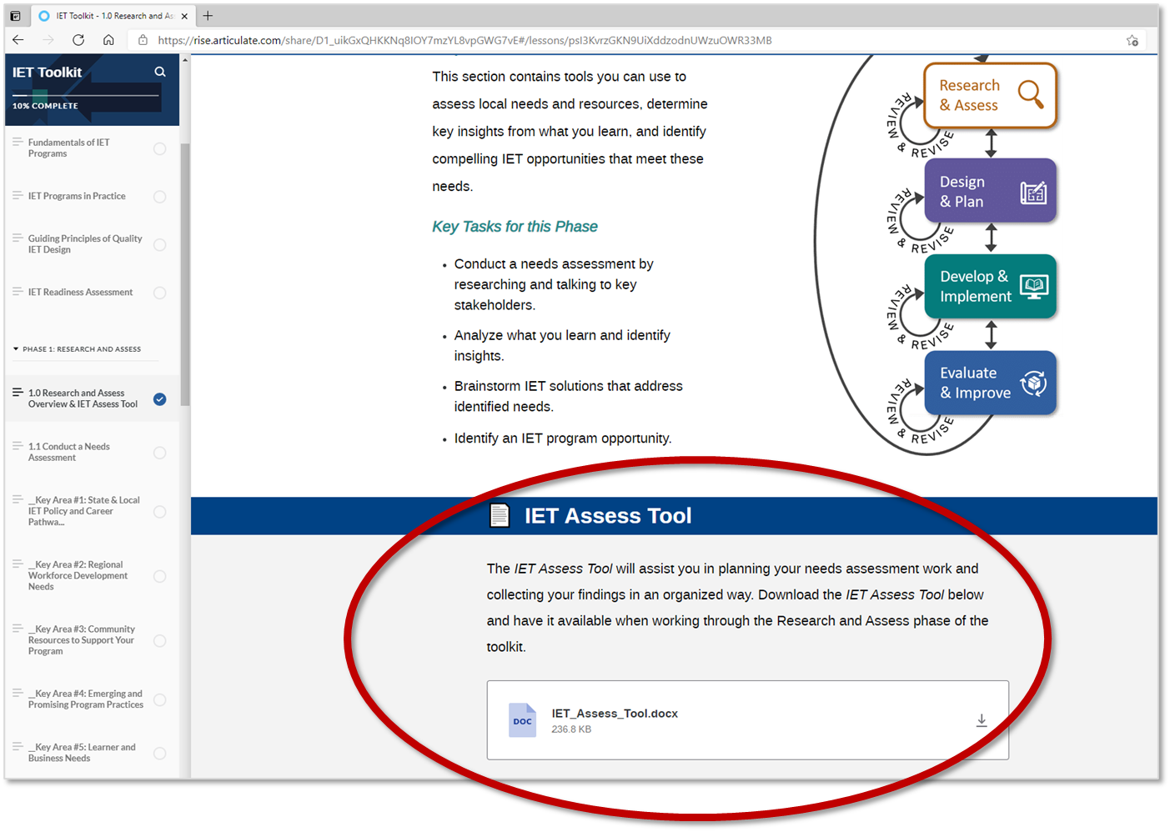
Tour of the IET Toolkit - 3
Desk Aids and Tools

Slide 34
Wrap-Up
Key Takeaways
Reflections/Questions
Next Steps

Slide 35
Key Takeaways
4
IET is “a service approach that provides adult education and literacy activities concurrently and contextually with workforce preparation activities and workforce training for a specific occupation or occupational cluster for the purpose of educational and career advancement.“
Four iterative IET program design phases: 1) Research and Assess; 2) Design and Plan; 3) Develop and Implement; and 4) Evaluate and Improve.
The IET Design Camp provides foundational training and SME support over nine weeks; each training block consists of a Toolkit reading assignment, training session, team activity, and cohort discussion.
The IET Toolkit will support your development of a customized IET program to address your community's learners' and businesses' needs.
Notes:
This screen has 4 builds (clicks). See Facilitator Guide or Tech Run of Show.

Slide 36
Group Discussion
What will you take away from today’s session?
What other questions do you have?

Slide 37
Poll: What Is an IET Program?
Which statement most reflects your level of understanding of IET programs after reading the IET Toolkit Getting Started section and participating in this Orientation session?
Select 1:
The information covered confirmed my understanding of IET, as I already had a solid understanding of it.
I now have a better understanding of the definition of an IET program and its requirements.
I’m still not quite sure I fully understand the definition of IET and its requirements.

Slide 38
Next Steps
Individual Assignment (before [ENTER DATE]):
Download the IET Design Camp Materials from [enter location of materials].
Take the Self-Assessment in the IET Toolkit.
Phase 1: Research and Assess
IET Toolkit:
Read Section 1.0 Research and Assess in the IET Toolkit.
Review the Assess Tool and Note-Taking Tool.
Take notes and write down your questions about the Research and Assess phase in your Participant Guide.
Training Session – [ENTER DATE AND TIME]
Team Activity – [ENTER DATE RANGE]
Cohort Discussions – [ENTER DATE AND TIME]
Orientation
38

