Slide 1
IET Design Camp
WELCOME!
Phase 1: Research and Assess
Phase 1: Research and Assess

Slide 2
Meeting Recording Notice
Meeting Recording Notice
This session will be recorded, including any audio, visuals, participants, and other information sent, verbalized, or utilized. By joining this meeting, you automatically consent to such recordings. Any participant who prefers to participate via audio only should disable their video camera so only their audio will be captured. Video and/or audio recordings of any session shall not be transmitted to an external third party without permission.
Phase 1: Research and Assess
2

Slide 3
Virtual Classroom Reminders
Make sure you are signed into the Zoom desktop client rather than through the browser version.
If your Internet speed is slow, you may need to keep your camera off to improve quality.
We recommend using your computer for audio to facilitate participation.
Please mute your microphone and turn on your camera.
During the webinar, chat the entire group for questions and comments related to the content.
Remember to take notes in your Participant Guide!
If you experience problems during the webinar, message or email __________ at ________________________.
Phase 1: Research and Assess
3

Slide 4
Agenda
Introduction
Overview of the Research and Assess Phase
Key Tasks
Breakout Group Activity: Reflecting on your current process
Understanding Community Needs
Plan and Conduct a Needs Assessment
Five Key Research Areas
Identify Insights and Brainstorm Solutions
Wrap-Up

Slide 5
Today’s Trainers
Phase 1: Research and Assess

Slide 6
IET Design Camp
WEEK 1 | WEEKS 2 & 3 | WEEKS 4 & 5 | WEEKS 6 & 7 | WEEKS 8 & 9
Orientation | Phase 1: Research and Assess | Phase 2: Design and Plan | Phase 3: Develop and Implement | Phase 4: Evaluate and Improve
MONDAY Toolkit reading assignment | MONDAY Toolkit reading assignment | MONDAY Toolkit reading assignment | MONDAY Toolkit reading assignment | MONDAY Toolkit reading assignment
TUESDAY Training Webinar | TUESDAY Training Webinar | TUESDAY Training Webinar | TUESDAY Training Webinar | TUESDAY Training Webinar
 | WED – MON Team Activity | WED – WED Team Activity | WED – WED Team Activity | WED – WED Team Activity
 | TUESDAY Cohort Discussion | THURSDAY Cohort Discussion | THURSDAY Cohort Discussion | THURSDAY Closing Session
Phase 1: Research and Assess
6

Slide 7
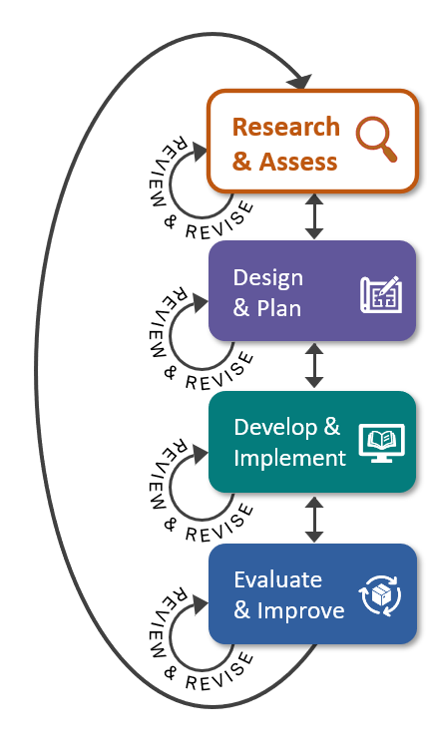
Key Tasks for Research & Assess Phase
Conduct a needs assessment
Analyze results and identify key insights
Brainstorm IET solutions
Select an IET program opportunity

Slide 8
Group Discussion: Reflect on Your Reading
What activity in the Research and Assess phase of the IET Toolkit is new to your process of selecting an IET program to develop?
Please share your thoughts with the group.

Slide 9
Poll: Your Research Activities
Think about your current process for selecting an IET program. Which of the key areas of research do you feel most confident about?
You may choose more than one.
State and Local IET Policy and Career Pathways Options
Regional Workforce Development Needs
Community Resources to Support your Program
Emerging and Promising Practices in IET Programs
Learner and Business Needs

Slide 10
Breakout Group Activity #1
Reflecting on Your Current Process
Share your answers to the following question:
What process did you use to identify the industry/sector focus of your most recent IET OR other training program?
10 min.

Slide 11
Understanding Community Needs
Importance of Conducting Research to Assess Needs
Building Programs that Complement Existing Resources and Offerings
A Repeatable Process
Phase 1: Research and Assess

Slide 12
Importance of Conducting Research to Assess Community Needs
Understanding community needs strengthens IET program design by:
Focusing resources on programs that are good for learners, business, and program partners.
Building programs that complement existing community and state resources and offerings.
Creating new or opening more career pathways to adult learners.
Phase 1: Research and Assess
12

Slide 13
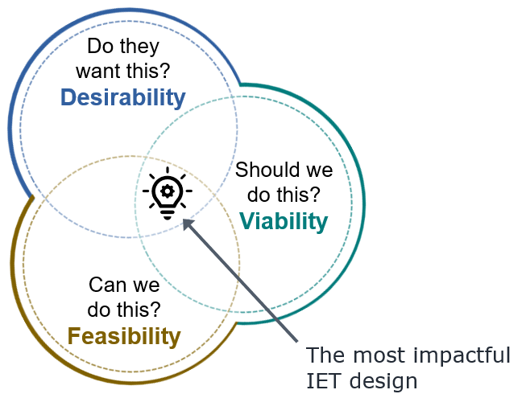
Developing Impactful IET Programs
By understanding our community’s needs, we can develop quality, high-impact IET programs. . .
Phase 1: Research and Assess
13

Slide 14
Complementing Other Community Offerings
. . . and we can select IET programs that complement other community offerings.
Phase 1: Research and Assess
14

Slide 15
A Repeatable Process
The process will give you insights into:
Unmet needs your community might have that IET can help address.
Learner populations you might serve.
Learner needs you might address through the IET program design.
Funding opportunities you might access.
Industries and occupations you might target.
Innovative or promising IET programs can inspire your work.

Slide 16
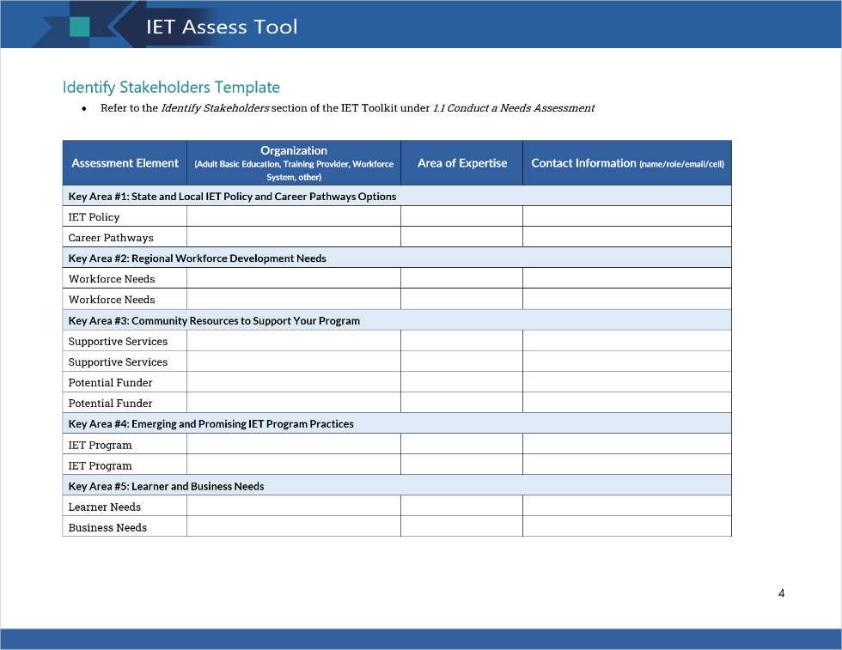
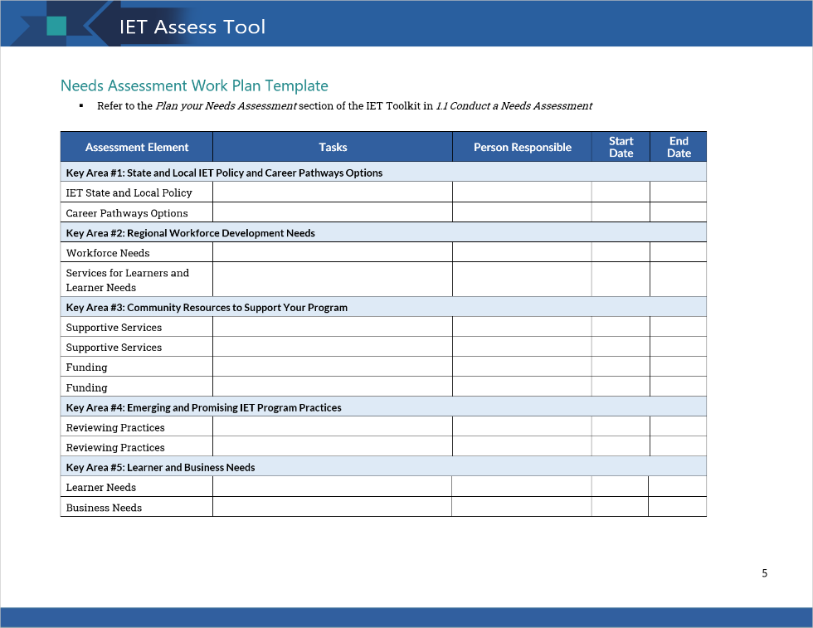
IET Assess Tool

Slide 17
Understanding Community Needs
Questions?
Phase 1: Research and Assess
17

Slide 18
Plan and Conduct a Needs Assessment
What is a Needs Assessment?
Five Key Areas to Assess
Activity: Explore Key Areas and Practice Applying Concepts
Phase 1: Research and Assess

Slide 19
What is a Needs Assessment?
The process of collecting and analyzing information to inform the development of an effective IET program that will address community and learner needs.
IDENTIFY the information you need.
Gather the information.
Identify key themes and insights.
APPLY what you learned to select your IET program.
Note: Consider the level of effort you/your team can invest—light touch vs. deep dive.
Phase 1: Research and Assess
19

Slide 20
Five Key Areas of Research
Community Resources to Support your Program
State and Local IET Policy and Career Pathways Options
Learner and Business Needs
Regional Workforce Development Needs
Emerging and Promising Practices in IET Programs
Phase 1: Research and Assess
20

Slide 21
Breakout Group Activity #2
Explore Key Areas to Assess
For your assigned Key Area, discuss each question and brainstorm answers.
Who do you need to talk to and why? What would this look like for you? (5 min)
What questions do you need to ask? (5 min)
What challenges do you think you will encounter in assessing needs in this area and how might you resolve those challenges? (5 min)
15 min.
Phase 1: Research and Assess
21
Notes:
Add

Slide 22
A Deeper Dive into the Five Key Areas
State and Local IET Policy and Career Pathways Options
Regional Workforce Development Needs
Community Resources to Support your Program
Emerging and Promising Practices in IET Programs
Learner and Business Needs
Phase 1: Research and Assess

Slide 23
1) State IET Policy and Career Pathways
Some Key Policy Questions to Answer:
Does our state have any requirements for IET programs? If so, what are they, and where are they documented?
Does our state or local area provide funding for IET, either through federal funds, specific appropriations from state budgets, or private sector funds?
Where can we find our state’s adult education content standards?
Some Key Career Pathways Questions to Answer:
What career pathway efforts and/or other adult education training programs are under way in our community?
How can an IET program become part of an existing career pathway program to serve adult learners?

Slide 24
2) Regional Workforce Development Needs
Some Key Questions to Answer:
What are the important and growing industry sectors in our region and who are the significant employers in these sectors?
Which businesses are having trouble hiring and retaining workers with the right skills, and what specific challenges are they facing?
What skills and credentials do these businesses value?
What programs/organizations currently provide education and training for adult learners as they prepare for and enter in-demand occupations?
What gaps exist in regional services to adult learners?

Slide 25
3a) Community Resources: Training Providers
Some Key Questions to Answer:
Who are the high-quality training providers in my region?
Who are potential, high-quality virtual training providers?
Which providers are accessible to my learners (public transit accessible, etc.)?
Which training providers are supportive of the integration goals of IET? Are they willing and able to invest the time to integrate technical and academic components into the IET program?

Slide 26
3b) Community Resources: Funding and Learner Supports
Some Key Questions to Answer:
What funding sources are available to support IET in this community and state?
What services are available in our community to support learner success?
What are the requirements and procedures for accessing them?
Who provides them, and what relationships might you need to build, or what partnerships might you need to establish, to help your learners access them?

Slide 27
4) Emerging and Promising Practices in IET Programs
Some Key Questions to Answer:
What are some key features of successful IET programs or other workforce development programs that we might want to consider for our IET program designs? What made those features effective in other programs?
What are some lessons IET providers or other workforce development providers have learned that we can factor into our work?

Slide 28
5) Learner and Business Needs
Learner Needs
What are the educational and career goals of potential learners?
What types of curriculum design and delivery strategies work best?
What experiences outside the classroom (both positive and negative) impact learner success?
What ideas do learners have about how IET programs should be designed?
Business Needs
How do local employers recruit and hire for the occupations you might target with an IET program?
What challenges do people in that occupation have that make it difficult for them to succeed on the job?
What makes employees successful in these companies?
How do employees advance in their career in these companies?

Slide 29
Plan and Conduct a Needs Assessment
Questions?
Phase 1: Research and Assess
29

Slide 30
Identify Insights and Brainstorm Solutions
Synthesize Needs Assessment Data
Second Round of Reflection: Questions to Answer
Brainstorm Solutions and Select an IET
Phase 1: Research and Assess

Slide 31
Synthesize Needs Assessment Data
To synthesize is to:
Combine ideas, insights, and perspectives by reflecting on the information
Merge elements to gain an evolving understanding
TIPS
Use the Needs Assessment Research section of the Assess Tool to capture findings.
Use the data collected in the Notetaking Tool.
Capture any relevant state policies that govern IET activities.
First Round of Reflection
Look for:
Patterns in the data
Interesting/unexpected feedback
Topics or ideas that need further investigation/discussion

Slide 32
Second Round of Reflection
Reflecting with Partners
Questions to answer:
What unmet needs does our community (including business, employers, and workforce development partners) have that IET can help address?
What learner populations might we serve?
What learner needs might we address?
What funding opportunities might we access?
What industries and occupations might we target?
What innovative or promising IET programs can inspire our work?
What partners do we need for this work?

Slide 33
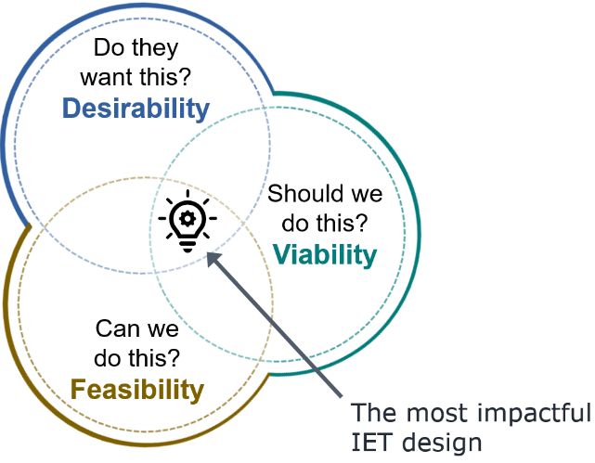
Brainstorm Solutions and Select an IET
Involve the design team and key stakeholders.
Start by allowing all ideas without analyzing them.
Discuss each brainstormed option and identify the most desirable, viable, and feasible options. Consider:
Which are good for learners, business, and program partners.
Which are or will be able to be part of a new or existing career pathway.
Select the option(s) that will best meet the community needs and complement existing community and state resources and offerings.

Slide 34
Identify Insights and Brainstorm Solutions
Questions?
Phase 1: Research and Assess
34

Slide 35
Wrap-Up
Key Takeaways
Reflections/Questions
Next Steps
Phase 1: Research and Assess

Slide 36
Key Takeaways
Quality IET programs respond to community and learner needs.
There are five areas of research that can help with IET program selection:
State and Local IET Policy and Career Pathways Options
Regional Workforce Development Needs
Community Resources to Support your Program
Emerging and Promising Practices in IET Programs
Learner and Business Needs
Conduct a needs assessment to gather information to help you understand community and learner needs, identify insights, and select a viable, feasible, and desirable IET program.
Phase 1: Research and Assess

Slide 37
Group Discussion
Reflect on what you learned today.
Did you gain any new ideas that might help you in this work?
How might the ideas and approaches discussed today impact your work?
What challenges do you anticipate in conducting these activities to inform your IET program selection process?
Phase 1: Research and Assess

Slide 38
Poll: Relevance
How prepared do you feel you are to incorporate what you have learned today into your practice?
Select 1:
I feel very prepared.
I feel somewhat prepared.
I may need more training/support first.
Phase 1: Research and Assess

Slide 39
Next Steps
Phase 1: Research and Assess
Team Activity ([ENTER DAYS TO COMPLETE])
Use the IET Assess Tool to complete the following:
Draft a preliminary list of key stakeholders for your IET program—both those you currently engage and new stakeholder relationships.
Identify and assess gaps in your understanding of your community’s needs (learners and employers).
Identify steps you can take to fill in those gaps.
Cohort Discussions – [ENTER DATE AND TIME]

Slide 40
Next Steps (cont.)
Phase 2: Design and Plan
Individual Assignment (before next training session on [ENTER DATE and TIME]):
Read Section 2.0 Design and Plan in the IET Toolkit
Review the IET Planning Tool and all desk aids for the section
Take notes and write down your questions about the Design and Plan phase in your Participant Guide
Next Training Session – [ENTER DATE AND TIME]

