Slide 1
IET Design Camp – Cohort Meeting #1
Phase 1: Research and Assess

Slide 2
Quick Reminders
Make sure you are signed into the Zoom desktop client rather than through the browser version.
If your Internet speed is slow, you may need to keep your camera off to improve quality.
We recommend using your computer for audio to facilitate participation.
Please mute your microphone and turn on your camera.
During the webinar, chat the entire group for questions and comments related to the content.
Remember to take notes in your Participant Guide!
If you experience problems during the webinar, message or email __________ at ________________________.
Phase 1: Research and Assess Cohort
2

Slide 3
Agenda
Introduction (10 Minutes)
Key Takeaways from the Research and Assess Phase
Where You’ve Been: Team Activity
What's Next:
Individual Assignment for next meeting
Today's Cohort Discussion
Wrap-Up – from your breakout group
Cohort Discussion (65 Minutes)

Slide 4
IET Design Camp
WEEK 1 | WEEKS 2 & 3 | WEEKS 4 & 5 | WEEKS 6 & 7 | WEEKS 8 & 9
Orientation | Phase 1: Research and Assess | Phase 2: Design and Plan | Phase 3: Develop and Implement | Phase 4: Evaluate and Improve
MONDAY Toolkit reading assignment | MONDAY Toolkit reading assignment | MONDAY Toolkit reading assignment | MONDAY Toolkit reading assignment | MONDAY Toolkit reading assignment
TUESDAY Training Webinar | TUESDAY Training Webinar | TUESDAY Training Webinar | TUESDAY Training Webinar | TUESDAY Training Webinar
 | WED – WED Team Activity | WED – WED Team Activity | WED – WED Team Activity | WED – TUES Team Activity
 | TUESDAY Cohort Discussion | THURSDAY Cohort Discussion | THURSDAY Cohort Discussion | TUESDAY Closing Discussion

Slide 5
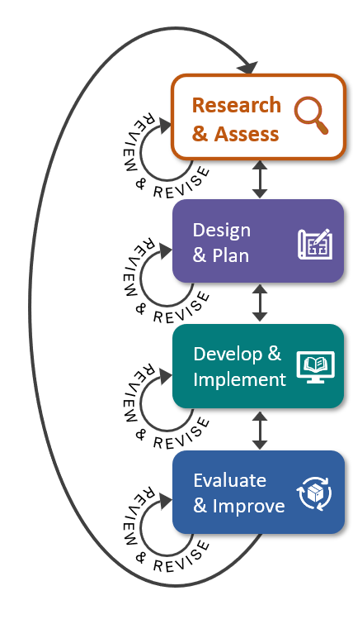
Key Tasks for Research & Assess Phase
Conduct a needs assessment
Analyze results and identify key insights
Brainstorm IET solutions
Select an IET program opportunity

Slide 6
Key Takeaways
Quality IET programs respond to community and learner needs.
Five areas of research that can help with IET program selection:
State and Local IET Policy and Career Pathways Options
Regional Workforce Development Needs
Community Resources to Support your Program
Emerging and Promising Practices in IET Programs
Learner and Business Needs
Conduct a needs assessment to gather information to help you understand community and learner needs, identify insights, and select a viable, feasible, and desirable IET program.
Phase 1: Research and Assess Cohort

Slide 7
Where You’ve Been – Team Activity
Since we last met, you used the IET Assess Tool to complete the following:
Draft a preliminary list of key stakeholders for your IET program – both those you currently engage and new stakeholder relationships.
Identify and assess gaps in your understanding of your community’s needs (learners and employers).
Identify steps you can take to fill in those gaps.

Slide 8
Share Your Thoughts on the Team Activity
On this emoji scale, how are you feeling about the team activity you did this week?
1
2
3
4
Awesome, we’ve got this!
Working hard and making progress!
The jury’s still out.
YIPES, this is a lot!
Does anyone want to share what you picked and why?

Slide 9
Individual Assignment
Phase 2: Design and Plan
Before the next meeting on [INSERT DATE and TIME]:
Read Section 2.0 Design and Plan in the IET Toolkit.
Review the IET Planning Tool and all desk aids for the section.
Take notes and write down your questions about the Design and Plan phase in your Participant Guide.

Slide 10
Cohort Discussion #1
Research and Assess
Breakout discussions will focus in on the Research and Assess Phase of IET development.
Your facilitators want to support the topics that are most important to you and encourage idea and solution sharing.
60–65 mins.

