Slide 1



IET Design Camp
WELCOME!
Phase 2: Design and Plan

Slide 2
Meeting Recording Notice
This session will be recorded, including any audio, visuals, participants, and other information sent, verbalized, or utilized. By joining this meeting, you automatically consent to such recordings. Any participant who prefers to participate via audio only should disable their video camera so only their audio will be captured. Video and/or audio recordings of any session shall not be transmitted to an external third party without permission.
Phase 2: Design and Plan
2

Slide 3


Virtual Classroom Reminders
Make sure you are signed into the Zoom desktop client rather than through the browser version.
We recommend using your computer for audio to facilitate participation.
Please mute your microphone and turn on your camera.
During the webinar, chat the entire group for questions and comments related to the content.
If you experience problems during the webinar, message or email __________ at ________________________.
Phase 2: Design and Plan
3

Slide 4
Agenda
Session Introduction
  Review Phase 1: Research and Assess
  Key Tasks for Phase 2
Form a Design Team and Define the IET Program
  IET Planning Tool
  Design Team Composition and Team Purpose statement
  IET Program Goals and Outcomes
Design the Program Structure
  Key Decision Points
  Instructional Delivery Approaches
Plan the Learner Experience
  Phases of the Learner Experience
Create an Evaluation Plan for Continuous Improvement
Session Wrap-Up

Slide 5
Today’s Trainers

Slide 6





IET Design Camp
WEEK 1 | WEEKS 2 & 3 | WEEKS 4 & 5 | WEEKS 6 & 7 | WEEKS 8 & 9
Orientation | Phase 1: Research and Assess | Phase 2: Design and Plan | Phase 3: Develop and Implement | Phase 4: Evaluate and Improve
MONDAY Toolkit reading assignment | MONDAY Toolkit reading assignment | MONDAY Toolkit reading assignment | MONDAY Toolkit reading assignment | MONDAY Toolkit reading assignment
TUESDAY Training Webinar | TUESDAY Training Webinar | TUESDAY Training Webinar | TUESDAY Training Webinar | TUESDAY Training Webinar
 | WED – MON Team Activity | WED – WED Team Activity | WED – WED Team Activity | WED – WED Team Activity
 | TUESDAY Cohort Discussion | THURSDAY Cohort Discussion | THURSDAY Cohort Discussion | THURSDAY Closing Session
Phase 2: Design and Plan
6

Slide 7

Review of Phase 1: Research and Assess
  Quality IET programs respond to community and learner needs​.
  There are five areas of research that can help with IET program selection:​
  State and Local IET Policy and Career Pathways Options ​
  Regional Workforce Development Needs ​
  Community Resources to Support your Program ​
  Emerging and Promising Practices in IET Programs ​
  Learner and Business Needs​
  Conduct a needs assessment to gather information to help you understand community and learner needs, identify insights, and select a viable, feasible, and desirable IET program. ​
Phase 2: Design and Plan
7

Slide 8

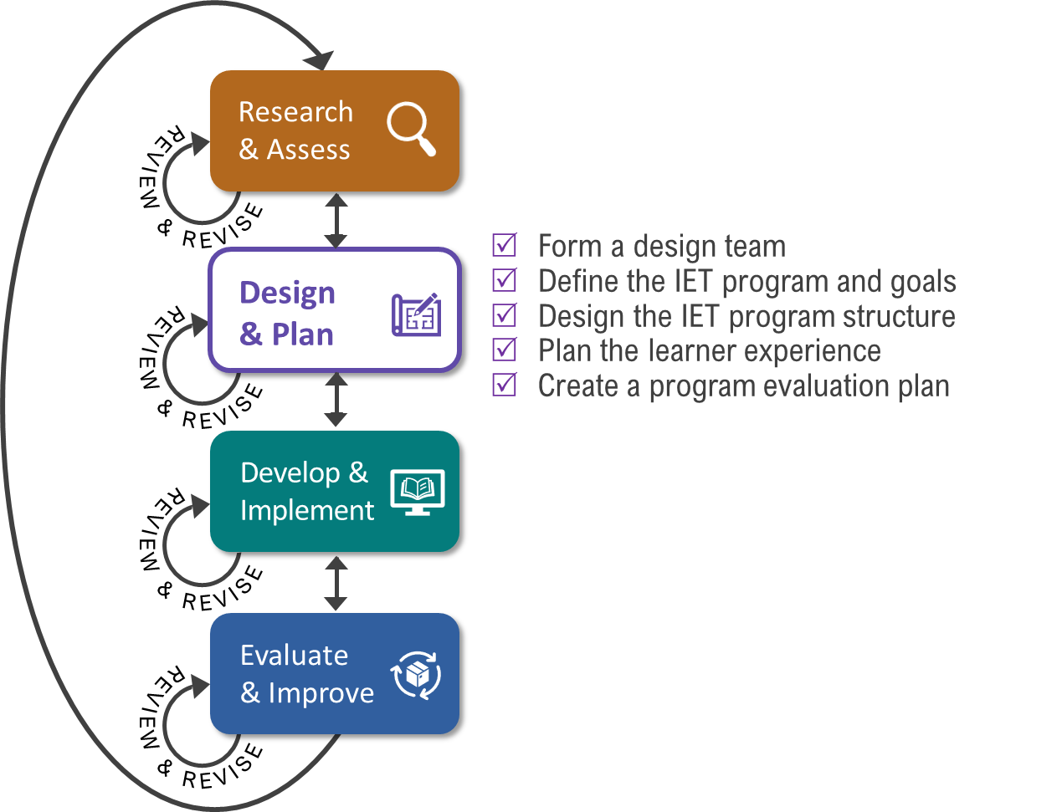
Key Tasks for Design & Plan Phase

Slide 9
Group Discussion:
Reflect on Your Reading
In reading the Design and Plan phase section of the IET Toolkit, what stood out as new or interesting to you?
Overall, what are your thoughts on the IET Planning Tool?
Please share your thoughts with the group.

Slide 10
Poll: IET Involvement
Who is typically involved in the design of your IET program?
Choose 1:
Only ABE staff/instructors are involved
ABE staff/instructors and technical training provider
A team of people from diverse partner agencies
It depends on the IET program focus/goals
I’m not sure/I don’t know
Phase 2: Design and Plan

Slide 11

Form a Team and Define the
IET Program and Goals
IET Planning Tool
Design Team Composition and Purpose Statement
IET Program Goals and Outcomes
Key Decision Points
Phase 2: Design and Plan
11

Slide 12
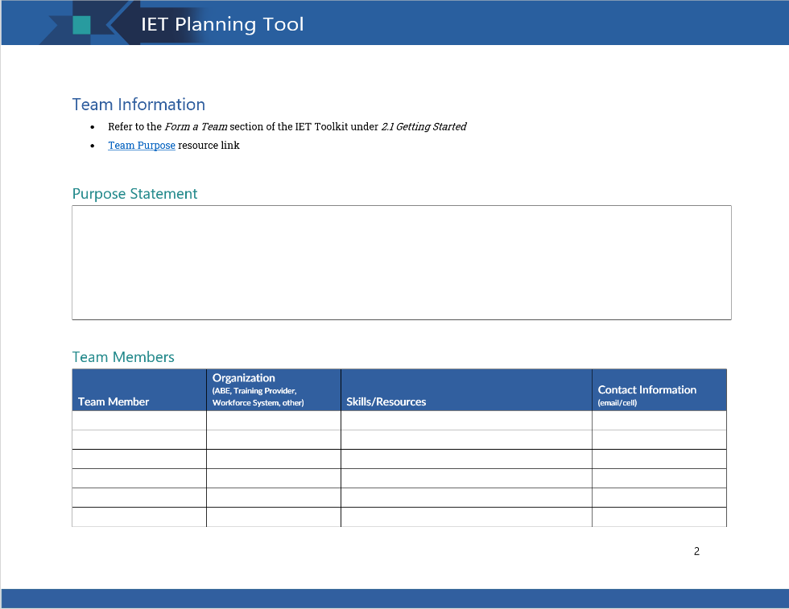
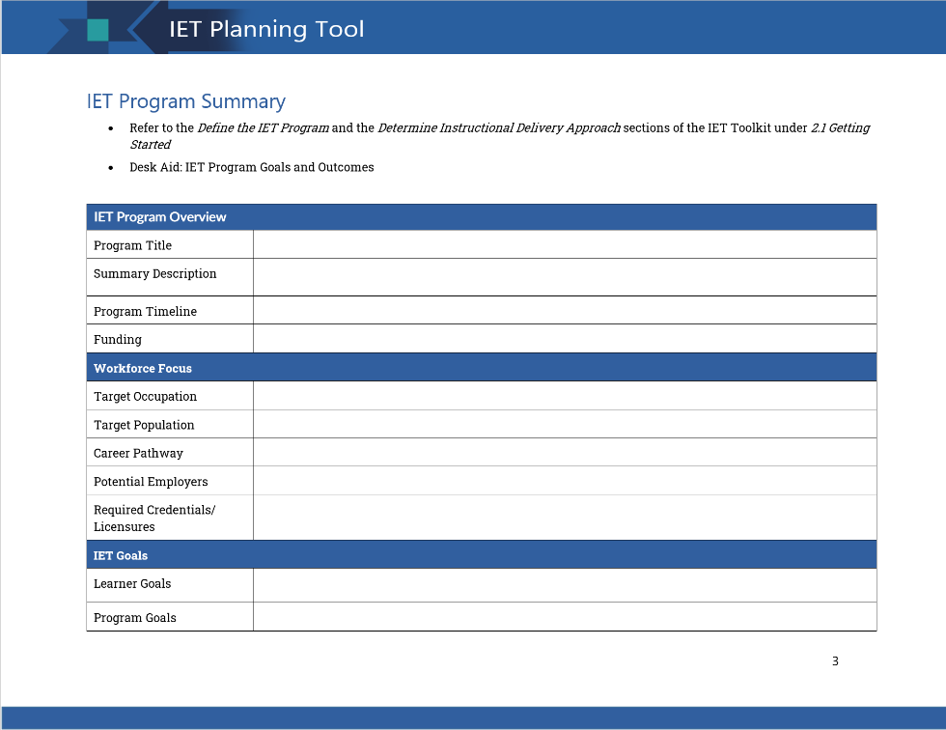
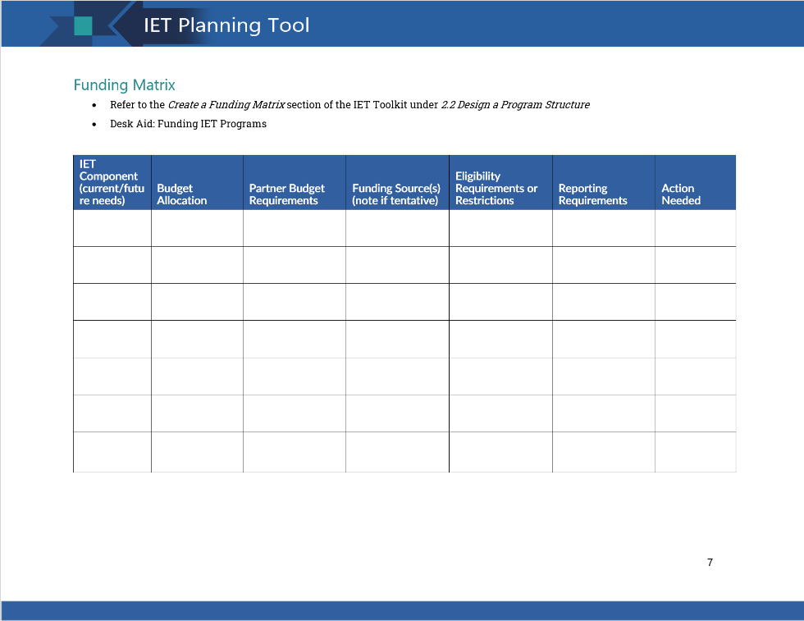
IET Planning Tool

Slide 13


Design Team Composition
Why a Design Team?
To inform your IET program design and ensure it connects to a viable career pathway
Potential Design Team Members
  Postsecondary education and training providers (e.g., community colleges, technical schools, apprenticeships) ​
  Workforce Development Board or American Job Center representatives ​
  Community-based organizations​
  Health and human services providers ​
  Local and state government officials
  Employers​

Slide 14
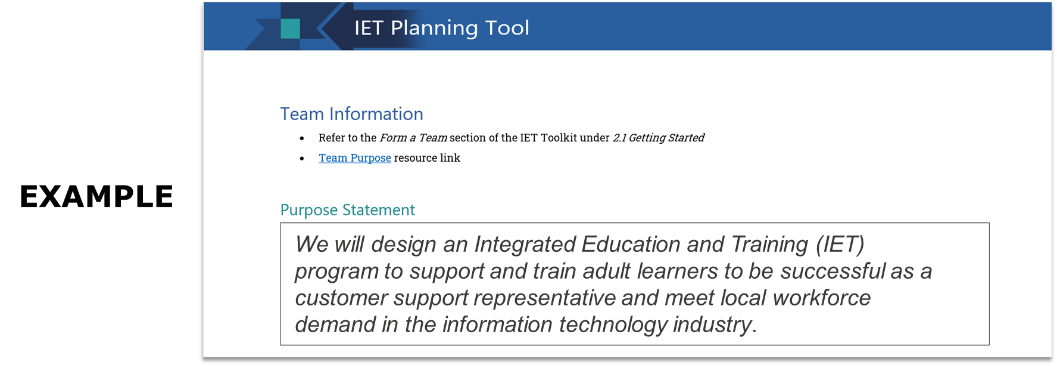
Team Purpose Statement
A team purpose statement clarifies the need for and expectations of the team to potential members, including:
What the team will do
For whom
Why
Notes:
This slide has 1 build (click).

Slide 15
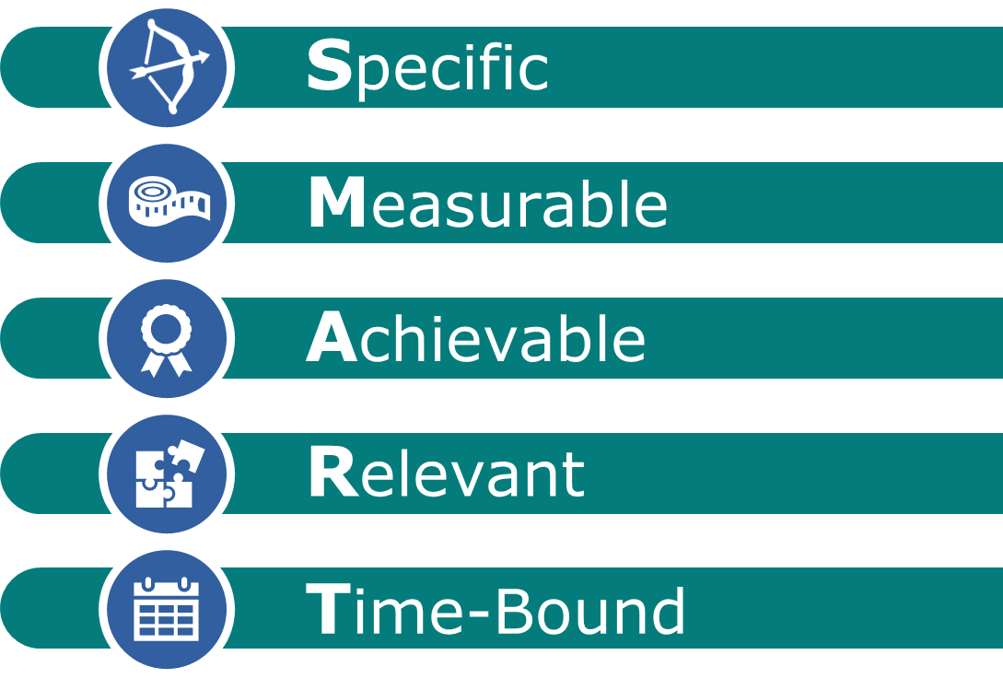

IET Goals and Outcomes: SMART Goals
SMART Goals are:

Slide 16

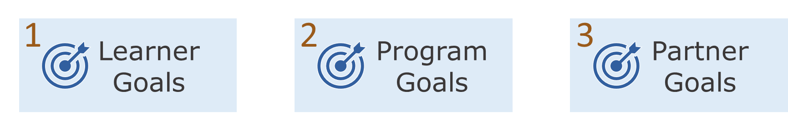
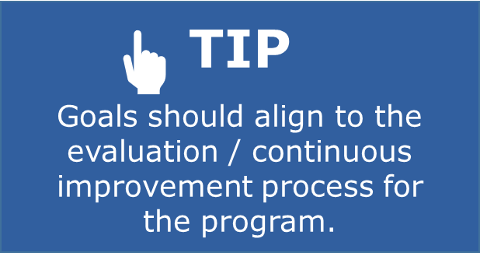
Three Types of IET Goals

Slide 17
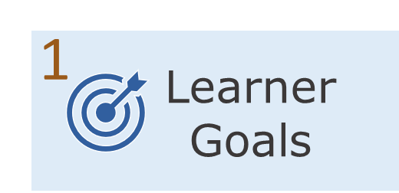
Three Types of IET Goals (cont.)
Learner goals describe expected successful workforce and academic outcomes for the target population.
  Example: Learners will gain the academic and technical skills required to attain Manufacturing Technician Level 1 Certification upon successful completion of the 12-week session.

Slide 18
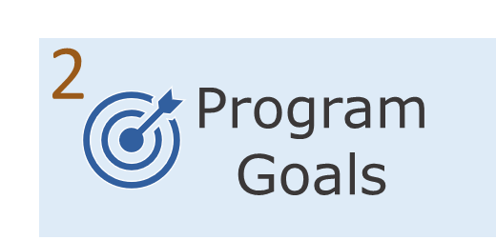
Three Types of IET Goals (cont. 1)
Program goals describe the overall desired outcomes of the program.
  Example: The Manufacturing Technician IET program will prepare learners at NRS levels 4 or 5 to achieve HSE testing readiness, obtain a Manufacturing Technician Level 1 certificate, transferrable postsecondary credits, and secure employment within 6 months of program completion.
Can you identify the 5 components of a SMART goal?
Please share your responses with the group.

Slide 19
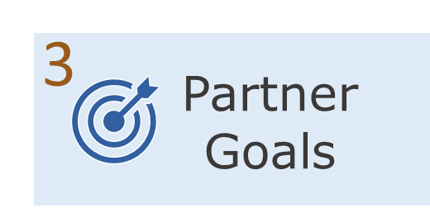
Three Types of IET Goals (cont. 2)
Partner goals focus on engagement or outcomes important to partners.
  Example: Each term, the American Job Center will provide Individual Training Accounts (ITA) to fund the training component and co-enroll learners into Title I, where they will also receive individualized career services that prepare learners to apply, interview and obtain employment in the target IET occupation upon completion of the IET.

Slide 20
Breakout Group Activity #1
What does a successful IET program look like?
  Brainstorm and come to a consensus on two or three sentences that describe a successful IET program.
  Be prepared to share your statement.
15 min.
Phase 2: Design and Plan

Slide 21
Design a Sustainable Program Structure
Key Decision Points
Common Instructional Delivery Approaches
Considerations When Going Virtual
Digital Supports
Phase 2: Design and Plan

Slide 22


Key Decision Points
Important IET program decision points include: ​
IET program instructional delivery approach ​
How to plan for sustainability of the program
Funding mechanisms to support the IET program ​
Communication plan ​
Program policies ​
Partner agreements ​
Success requires a nimble structure. ​

Slide 23
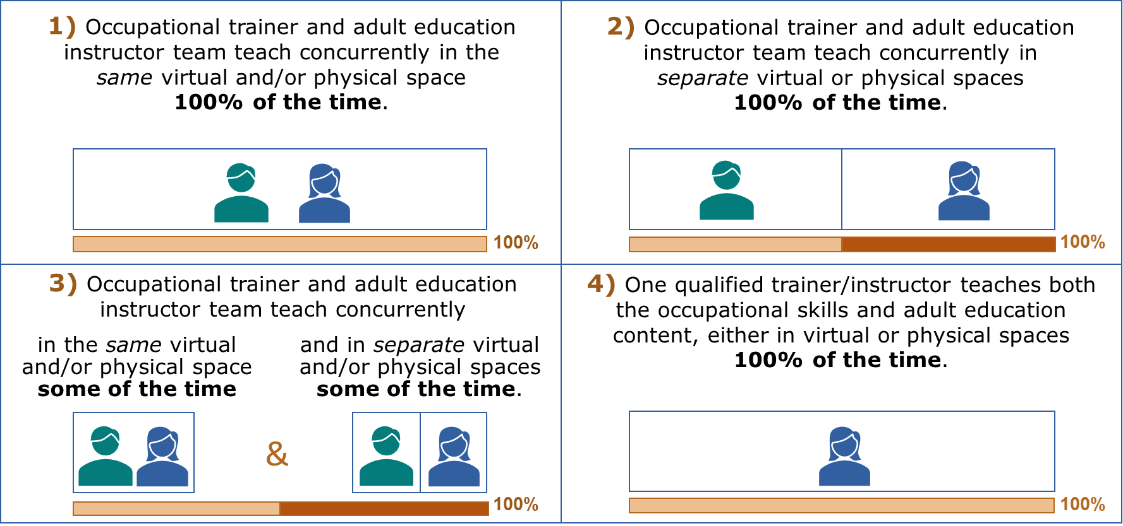
Four Common Instructional Delivery Approaches

Slide 24
Poll: Delivery Approach
Which delivery approach are you using in your programs?
Choose 1:
  Occupational trainer and adult education instructor team teach concurrently in the same virtual and/or physical space 100% of the time.
  Occupational trainer and adult education instructor deliver instruction concurrently while in separate virtual or physical spaces 100% of the time.
  Occupational trainer and adult education instructor team teach concurrently in the same virtual and/or physical space some of the time and in separate spaces some of the time.
  One qualified trainer/instructor teaches both the occupational skills and adult education content, either in virtual or physical spaces 100% of the time.
  We haven’t selected a delivery approach yet.

Slide 25

Considerations When Going Virtual
Select the appropriate learning platform.
Explore new ways to engage students prior to enrollment.
Ensure broadband and computer access
for participants.
Support teaching and learning success by:
  Providing the necessary supports for learners with disabilities (WebAIM).
  Incorporating equity minded practices for teaching online (Harris and Wood webinar).
  Creating a centralized site for both faculty and student learning resources.

Slide 26

Digital Supports
Consider providing digital supports beyond the classroom, such as:
  Virtual Job Shadow – A platform for career exploration and connecting one-on-one https://www.virtualjobshadow.com/
  Virtual Advising – An example from Northern Virginia Community College https://www.nvcc.edu/virtualadvising/
  Mini Digital Literacy Orientation – A short lesson on how to actively participate in an online/virtual class

Slide 27
Group Discussion:
Supporting Virtual Learning Ideas
In what innovative ways have you adapted your programs to support virtual learning?
Please share your
ideas with the group.

Slide 28
Plan the Learner Experience
Activity: Consider the Learner Experience
Stages of the Learner Experience
Phase 2: Design and Plan

Slide 29
Breakout Group Activity #2
What does a successful IET learner experience look like?
  Putting yourself in the shoes of a learner, consider the learner profile in Appendix B of your Participant Guide.
  Brainstorm a list of key considerations from the learner’s perspective and some possible learner supports to address them.
  Be prepared to share one key consideration and learner support idea with the larger group after the breakout session.
15 min.

Slide 30
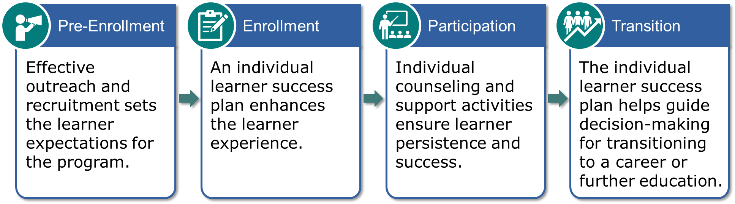
Four Stages of the Learner Experience

Slide 31

1: Pre-Enrollment
Outreach and Recruitment
Develop outreach strategies that reach your target audience and ensure equitable access.
Survey existing outreach materials for ideas or use focus groups to gather feedback.
Convey the value of in-demand jobs and the acquisition of industry-recognized and/or postsecondary credentials to prospective adult learners.
Design your materials with language that speaks to multiple audiences and uses visuals to convey messages.
Leverage partnerships to increase learner outreach and recruitment.

Slide 32
Group Discussion:
Outreach and Recruitment Strategies
What outreach and recruitment strategies do you use to effectively reach your target learners?
Please share your strategies with the group.

Slide 33

2: Enrollment
Ensure the applicant meets enrollment criteria and identifies types of supports needed.
Consider:
  An individual learner success plan that includes elements that support learner needs, accessibility needs, and college and career planning, as appropriate.
  Enrollment criteria, including required assessment(s) for entry and passing score(s).
  Program registration intake forms that incorporate the individual learner success plan.
  Learner materials to distribute during intake.

Slide 34

3: Participation
Ensure learners have the necessary support to persist and succeed in the IET program.
Consider:
  Individual counseling to address learners’ unique challenges.
  Direct learner activities that are comprehensive, well integrated, and supported by quality tools.
  Tracking systems that support ongoing monitoring and documentation of attendance, services, and outcomes.
  Effective policies, practices, and infrastructures that support staff and partners.
  A cohort or mentoring program for learners.

Slide 35
Group Discussion:
Persistence and Success
What learner supports have you found to be most effective in promoting persistence and success?
Please share your ideas with the group.

Slide 36

4. Transition Support for Career Planning and Further Education or Training
Ensure that program participants understand the IET career pathway and strategies for a smooth transition to continued training or employment.
Integrate into programs in three ways:
  Include intentional activities that orient learners to the full career pathway, including on ramps, off ramps, transferrable skills to other industries, etc.
  Provide counseling customized to individual learners, including goal setting and transitional supports.
  Integrate support activities into the curriculum, e.g., bring industry representatives into the classroom or provide job shadow experiences.

Slide 37
Group Discussion:
Career Planning and Transition Support
How can your partners support learners’ career planning and transition to employment or further education/training?
How could you engage partners to assist in this effort?
Please share your ideas with the group.

Slide 38
Create an Evaluation Plan
Importance of Embedding Evaluation
Evaluation Plan Template
Phase 2: Design and Plan

Slide 39
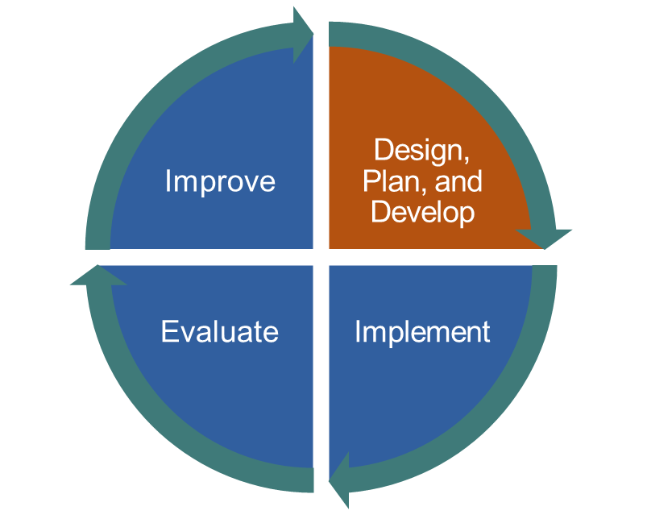
Importance of Embedding Evaluation
A well-designed program evaluation plan will help to:
Identify program goals and research questions.
Guide data collection, analysis, and reporting.
Support continuous improvement and sustainability efforts.
Comply with WIOA program reporting requirements.

Slide 40
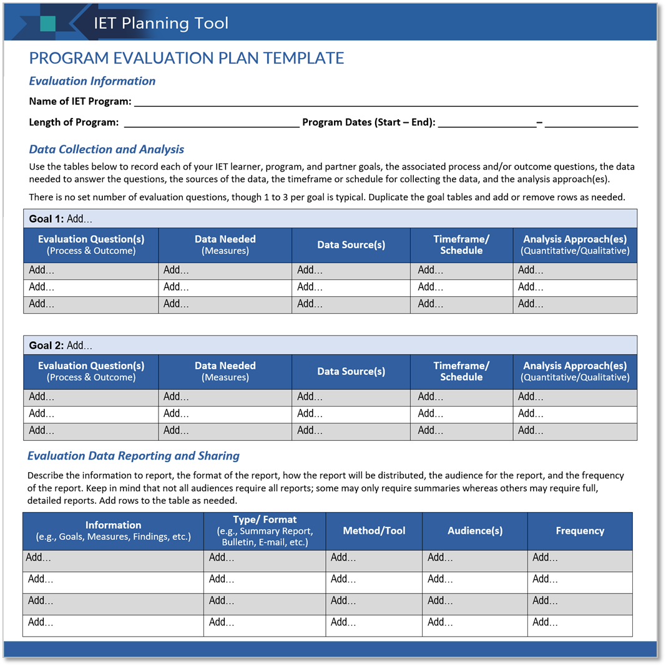
Program Evaluation Plan Template

Slide 41
Session Wrap-Up
Key Takeaways
Reflections/Questions
Next Steps

Slide 42



Key Takeaways
A strong design team and articulated learner, program, and partner goals position the IET program to meet business and learner needs.
Analyzing and planning for the learner experience is an important step in designing an IET program that supports learners.
The IET program structure should be flexible in adapting to changes in funding, staffing, and business and learner needs.
There are four stages of the learner experience: pre-enrollment, enrollment and intake, participation, and transition to a career or additional education or training opportunities.
An evaluation plan lays out how you will monitor the progress your program is making and the process you will use to inform program improvement efforts.
Phase 2: Design and Plan

Slide 43

Group Discussion
Reflect on today’s topics.
What one thing from today’s session do you plan to apply to your IET design process going forward?
What lingering questions do you have about the topics we discussed today?

Slide 44

Poll: Confidence Level
How prepared do you feel you are to incorporate what you have learned about designing and planning an IET program into your practice?
Select 1:
I feel very prepared.
I feel somewhat prepared.
I may need more training/support first.
Phase 1: Research and Assess

Slide 45
Next Steps
Phase 2: Design and Plan
Team Activity ([ENTER DAYS TO COMPLETE])
  Choose at least one of the following activities from the IET Planning Tool:
  Think about your IET Design Team. Do you have the right people, perspectives, and skills on your team currently? What is missing and how might you go about adding it to your team? Draft your team’s purpose statement.
  Reflect on your existing IET Program goals. What are they? Are they SMART? Do they cover learner, program, and partner goals. Brainstorm goals or refine your existing goals.
  Consider the learner experience. Brainstorm key components of the learner experience or discuss opportunities to refine and strengthen your current approach.
Cohort Discussions – [ENTER DATE AND TIME]

Slide 46
Next Steps (cont.)
Phase 3: Develop and Implement
Individual Assignment (before next training session on [ENTER DATE AND TIME):
Read Section 3.0 Develop and Implement in the IET Toolkit.
Review all desk aids for the section.
Take notes and write down your questions about the Develop and Implement phase in your Participant Guide.
Next Training Session – [ENTER DATE AND TIME]

