Slide 1
IET Design Camp – Cohort Meeting #2
WELCOME!
Phase 2: Design and Plan

Slide 2
Quick Reminders
Make sure you are signed into the Zoom desktop client rather than through the browser version.
We recommend using your computer for audio to facilitate participation.
Please mute your microphone and turn on your camera.
During the webinar, chat the entire group for questions and comments related to the content.
If you experience problems during the webinar, message or email __________ at ________________________.
Phase 2: Design and Plan
2

Slide 3
Agenda
Session Introduction
Key Takeaways and Areas of Interest from the Design and Plan Phase
Where You’ve Been: Team Activity
What's Next: Individual Assignment for next meeting
Today's Cohort Discussion
Phase 2 Discussion Topics
Session Wrap-Up – from your breakout rooms
Phase 2: Design and Plan
3

Slide 4
IET Design Camp
WEEK 1 | WEEKS 2 & 3 | WEEKS 4 & 5 | WEEKS 6 & 7 | WEEKS 8 & 9
Orientation | Phase 1: Research and Assess | Phase 2: Design and Plan | Phase 3: Develop and Implement | Phase 4: Evaluate and Improve
MONDAY Toolkit reading assignment | MONDAY Toolkit reading assignment | MONDAY Toolkit reading assignment | MONDAY Toolkit reading assignment | MONDAY Toolkit reading assignment
TUESDAY Training Webinar | TUESDAY Training Webinar | TUESDAY Training Webinar | TUESDAY Training Webinar | TUESDAY Training Webinar
 | WED – MON Team Activity | WED – WED Team Activity | WED – WED Team Activity | WED – WED Team Activity
 | TUESDAY Cohort Discussion | THURSDAY Cohort Discussion | THURSDAY Cohort Discussion | THURSDAY Closing Session
Phase 2: Design and Plan
4

Slide 5
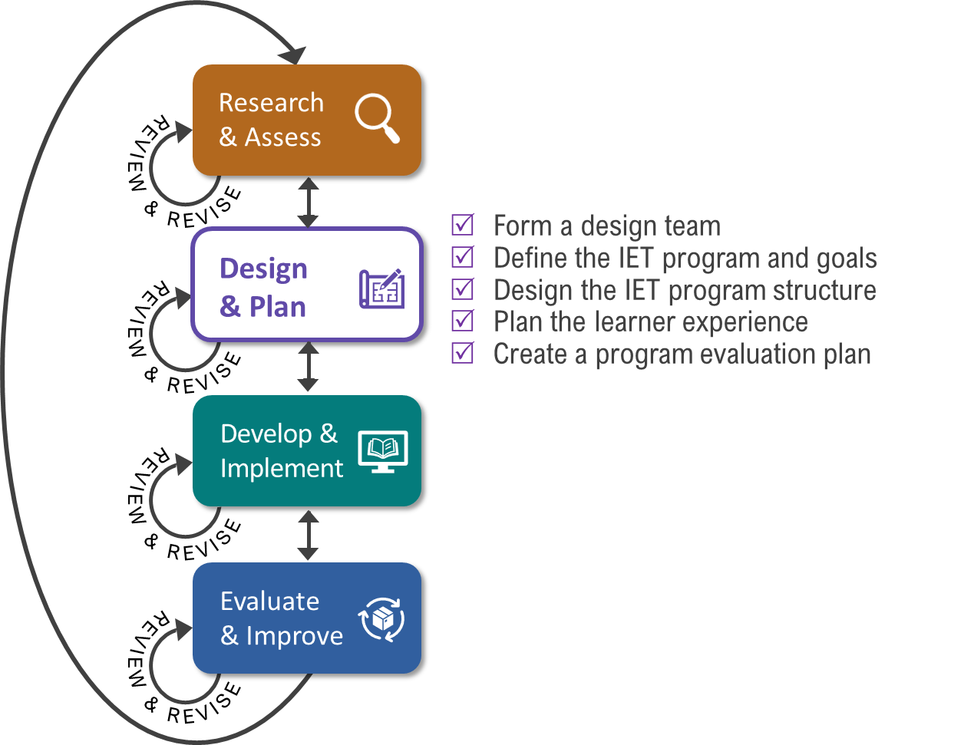
Key Tasks for Design & Plan Phase

Slide 6
Key Takeaways
A strong design team and articulated learner, program, and partner goals position the IET program to meet business and learner needs.
Analyzing and planning for the learner experience is an important step in designing an IET program that supports learners.
The IET program structure should be flexible in adapting to changes in funding, staffing, and business and learner needs.
There are four phases of the learner experience: pre-enrollment, enrollment and intake, participation, and transition to a career or additional education or training opportunities.
An evaluation plan lays out how you will monitor the progress your program is making and the process you will use to inform program improvement efforts.
Phase 2: Design and Plan

Slide 7
Incorporating College and Career Planning
ABOUT ME
My Skills
My Experience
My Education
My Employability Skills
ABOUT THE JOB/CAREER
Skills
Experience
Training/Education
Employability Skills
WHAT ELSE DO I NEED TO GET THE JOB/CAREER?
Skills
Experience
Training/Education
Employability Skills
Have learners map the IET onto a career pathway
Develop a mindset: Intentionally incorporate planning for career goals (next steps, viability, additional training or education).
*Template from Pathway to Success: Curriculum Guide, Pennsylvania Department of Corrections, 2017 (Hamilton & Toso)
Phase 2: Design and Plan
7

Slide 8
Promoting Digital Literacy
Digital literacy skills are the skills associated with using technology to enable users to find, evaluate, organize, create, and communicate information. (WIOA and the Museum and Library Services Act of 2010.)
Basic Computer Skills
Network Literacy
Digital Problem Solving
Information Literacy
Media Literacy
Phase 2: Design and Plan
8

Slide 9
Where You’ve Been – Team Activity
Over the last week, you used the IET Planning Tool to complete at least one of the following:
Think about your IET Design Team. Do you have the right people, perspectives, and skills on your team currently? What is missing and how might you go about adding it to your team? Draft your team’s purpose statement.
Reflect on your existing IET Program goals. What are they? Are they SMART? Do they cover learner, program, and partner goals. Brainstorm goals or refine your existing goals.
Consider the learner experience. Brainstorm key components of the learner experience or discuss opportunities to refine and strengthen your current approach.
Phase 2: Design and Plan
9

Slide 10
Poll: Team Activity
Which team activity did you tackle over the last week?
Select one:
I/We thought about our IET Design Team.
I/We reflected on our existing IET Program Goals.
I/We discussed the learner experience.
I/We tackled two or more activities.
I/We didn't get to the team activity this week.
Phase 2: Design and Plan

Slide 11
Individual Assignment
Phase 3: Develop and Implement
Before the next meeting on [INSERT DATE and TIME]:
Read Section 3.0 Develop and Implement in the IET Toolkit.
Review the desk aids for the section.
Take notes and write down your questions about the Develop and Implement phase in your Participant Guide.
Phase 2: Design and Plan
11

Slide 12
Cohort Discussion #2
Design and Plan
Discussion Topics:
Which team activity did you choose?
What did you learn?
What questions did it raise for you?
Ask questions and share ideas!
60–65 mins.
Phase 2: Design and Plan
12

