Slide 1
Observations in English Language Arts/Literacy Classrooms

Slide 2
Welcome to the Classroom Observation Training!
Notes:
Big idea: Kick off the training!

Slide 3
Disclaimer
This presentation was produced and funded in whole with Federal funds from the U.S. Department of Education under contract number ED-991990018C0040 with StandardsWork, Inc. Ronna Spacone serves as the Contracting Officer’s Representative. There is content on the slides and additional content in the Slide Notes throughout the presentation. The content of this presentation does not necessarily reflect the views or policies of the U.S. Department of Education nor does the mention of trade names, commercial products, or organizations imply endorsement by the U.S. Government.
Notes:
Big idea: Make audience aware of contract information.
Facilitator talking points:
Please read through this slide for information about the contract.
Facilitator notes:

Slide 4
A Little Bit About You – Poll
What is your experience with classroom observation systems? (Select all that apply.)
I have observed classrooms using a standardized tool.
I have been observed teaching using a standardized tool.
I have not been involved in either.
Notes:
Big idea: To understand participants’ familiarity with observation tools or rubrics.
Facilitator talking points:
Please take a moment to select the answer that best represents your experience with observation tools or rubrics.
Facilitator notes:
Create a poll or ask participants to share their answers in the chat.
After poll results are shared, note any trends based on participant responses. For example, “I see that many of you have been observed but are new to observing lessons using a tool or rubric.”

Slide 5
Purpose of the SIA 2.0 Classroom Observation System
Monitor how well lesson content and instructional practices are aligned with the demands of state-adopted standards.
Determine how lessons can be improved to promote higher and deeper levels of student learning.
Determine how lessons can be more relevant to adult learners.
Identify priorities for professional development to strengthen standards-based instruction.
Notes:
Big idea: Explain the purposes and benefits of the observation system.
Facilitator talking points:
This is a tool for professional growth and for making entire programs stronger by:
Highlighting what is strong about lesson content and instructional practices, and
Targeting the needs that the lesson gaps reveal.
Facilitator notes:

Slide 6
Principles of the SIA 2.0 Classroom Observation System
The Observation System is designed to:
Review alignment of teaching practices against the demands of state academic standards.
Identify needed improvements and best practices to share with instructors.
Develop an accurate portrait of instructional practices in a discipline for an entire program.
It is distinct from formal, summative teacher performance evaluations! (It does not judge individual instructors.)
Notes:
Big idea: Review the principles—what the tool is for and what it is not for.
Facilitator talking points:
This is an observation tool that reveals effective—and less effective—teaching practices.
It also can be used to understand the curriculum choices recurring across multiple classrooms within a program.
This is a different type of observation system than we are used to. It is not an evaluation and certainly not meant to judge the merit or performance of a specific instructor. It is a learning tool to make everyone stronger.
Facilitator notes:

Slide 7
Three Basic Questions to Answer
How well aligned are lessons to the demands of state-adopted standards?
How can instructional practices be improved to promote higher and deeper levels of student learning?
Based on data from observations, what are some PD priorities to strengthen standards-based instruction?
Notes:
Big idea: Review the goals of the observation system.
Facilitator talking points:
You will explore, with observers you are training, the relationship between the key instructional advances for ELA/literacy and the elements of the Classroom Observation Tool.
Goals of observations are to:
Strengthen lessons to align with the demands of state standards.
Help teachers improve their practice.
Focus on instructional practices that will optimize student engagement that leads to high levels of student learning.
Facilitator notes:

Slide 8
Overview of SIA 2.0 Classroom Observation Training
Week 1: Introduce the SIA 2.0 Classroom Observation Tool and what constitutes good evidence (virtual training session)
Week 2: Practice observation with full-length ELA/Literacy lesson video (team-based assignment)
Week 3: Prepare for live classroom observations (virtual training session)
Weeks 4–7: Conduct live classroom observations (site-based assignment)
Week 8: Debrief live classroom observations and plan for next steps for site-based implementation (virtual training session)
Notes:
Big idea: Preview the overview of the entire observation training.
Facilitator talking points:
The training will span 8 weeks. There will be a combination of virtual training sessions (like this one) and site- and team-based assignments that you will complete with your team.
Facilitator notes:
Read through the slide.

Slide 9
Session Overview
Introduction to the SIA 2.0 Observation Tool:
Review Core Actions 1–5 of the SIA 2.0 Observation Tool
Apply the Observation Tool to the SIA 2.0 Short ELA/Literacy Video
Preview Week 2 Team-based Assignment
Notes:
Big idea: Preview with participants the overview of activities for the day.
Facilitator talking points:
There are three main segments for today’s training.
You will learn about the features of the observation tool then practice with the tool using a short video during today’s session.
This will be followed by another opportunity to practice with a longer video next week with your state team.
Facilitator notes:
Read through the slide.

Slide 10
Meeting Norms and Expectations
Be present and engage fully in all activities.
Ask questions through the chat or by raising your hand.
Put cameras on whenever possible.
Prepare for productive struggle.
Respectfully challenge one another and withhold judgments for differing perspectives or learning styles.
Notes:
Big idea: Revisit with participants the norms to which we will adhere as we proceed through the trainings.
Facilitator talking points:
Everyone will be expected to engage no matter your role.
After reading through the norms, ask if there are any comments or questions.
Remind participants that they can do so through the chat or by raising their hand.
Let participants know that they will be working in whole and small teams with assigned coaches. We’ll be using the workbook.
Facilitator notes:
Read through the slide.

Slide 11
Introducing SIA 2.0 CLASSROOM OBSERVATION for ELA/Literacy

Slide 12
SIA 2.0 Observation: Five-Part System
Notes:
Big idea: Outline the five parts of the system.
Facilitator talking points:
As you can see, the SIA 2.0 Observation System has five parts.
During this training, we will concentrate on the first three parts, with most of the focus going to conducting observations.
If there is interest, we will hold a follow-up training on the last two parts to show how to aggregate data and develop program-wide PD.
Facilitator notes:

Slide 13
Tools and Resources
Classroom Observation Tool for English Language Arts/Literacy
English Language Arts/Literacy Classroom Observation Resource Package
Observation Checklist
ELA/Literacy Core Actions and Guiding Questions
ELA/Literacy Core Actions and Matching Summaries

Slide 14
SIA 2.0 Classroom Observation: Five Core Actions to Observe
Lesson content is rigorous and relevant for the level defined by the state-adopted standards.
Learning activities are text-specific and cognitively demanding.
Lesson content and activities productively engage students.
Lesson content is intentionally sequenced to develop students’ skills and knowledge.
Students’ levels of understanding are checked throughout the lesson, and instruction is adjusted accordingly.
Notes:
Big idea: This process is based on five Core Actions to observe in the classroom presentation of a lesson. Here are three of them.
Facilitator talking points:
Here you see the action statements that we will explore in this training.
Facilitator notes:
Ask participants to follow along by reviewing their copies of the SIA 2.0 Classroom Observation Tool on page 1.
Read the language of each Core Action. No discussion is necessary yet.

Slide 15
Let’s Review the ELA/Literacy Classroom Observations Resource
Notes:
Big idea: Provide an overview of the ELA/Literacy Classroom Observations Resource.
Facilitator talking points:
This resource contains the main resources you will use over the coming weeks.
It contains:
Blank Observation Tool
Aggregation document and instructions—this will not be part of the training but will be a resource for implementing observations in your programs.
Facilitator notes:
Provide participants with access to the resource.

Slide 16
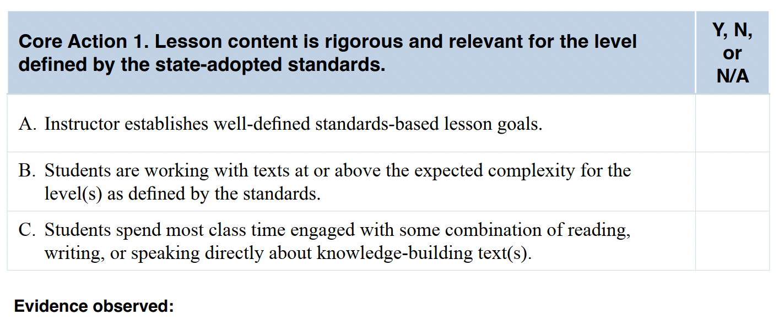
Core Action 1
Notes:
Big idea: Review the indicators that make up Core Action 1.
Facilitator talking points:
Ask participants to follow along in their workbooks.
Participants should reference the CCR standards or think about their own standards.
You can look at the questions that go along with every Core Action.
Facilitator notes:
Click through and read the indicators for this Core Action.
Read each indicator aloud. This is meant to be supportive of those with varying learning styles. We don’t usually read all slides, but the indicators for each Core Action are worth saying aloud.
Participants will have time to think through each one during their group time, so there is no need to linger on any one of them.
The final click reminds them to always use evidence of what they observe in their observations.

Slide 17
Let’s Review the Text Complexity Resources
When planning instruction, instructors should focus deeply on appropriately complex text for the level, rather than choosing lower-level texts.
The standards recently adopted by states detail the quantitative and qualitative demands for appropriately complex texts across levels.
When educators apply text complexity considerations when selecting texts for instruction, students gain strong foundations in critically important areas.
Notes:
Big idea: Introduce the text complexity resources.
Facilitator talking points:
Quantitative and qualitative resources for determining text complexity help determine the types of texts important in preparing adult learners for success in college, careers, and life.
You should learn to identify the types of texts that are—and are not—at the recommended level of complexity for the level.
Students should spend the majority of their time on appropriately complex texts.
General Rule: Use the quantitative measures to place a text within a band. Use qualitative measures to determine if the text is slightly, moderately, very, or exceedingly complex for that level. Then consider what to do with the qualities of the text. You can do this through instruction so students can access the ideas and information contained within it (reader and task considerations).
Facilitator notes:
Provide folks with the text complexity resources found on pages 4-6: https://lincs.ed.gov/publications/pdf/ccr/ELA_Unit_2_Materials/ELA_Unit_2_Part_Matr.pdf

Slide 18
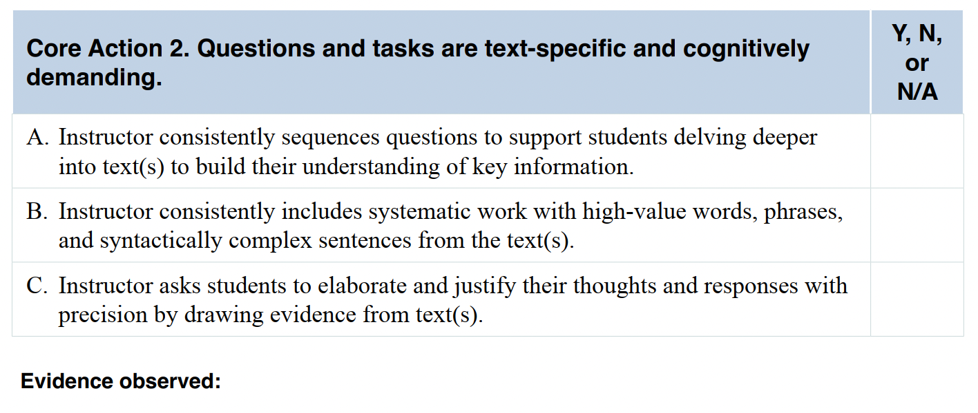
Core Action 2
Notes:
Big idea: Review the indicators that make up Core Action 2.
Facilitator talking points:
Ask participants to follow along in their workbooks.
Facilitator notes:
As you click through the indicators, read each one and move on.
Participants will have time to think through each one during their breakout times.

Slide 19
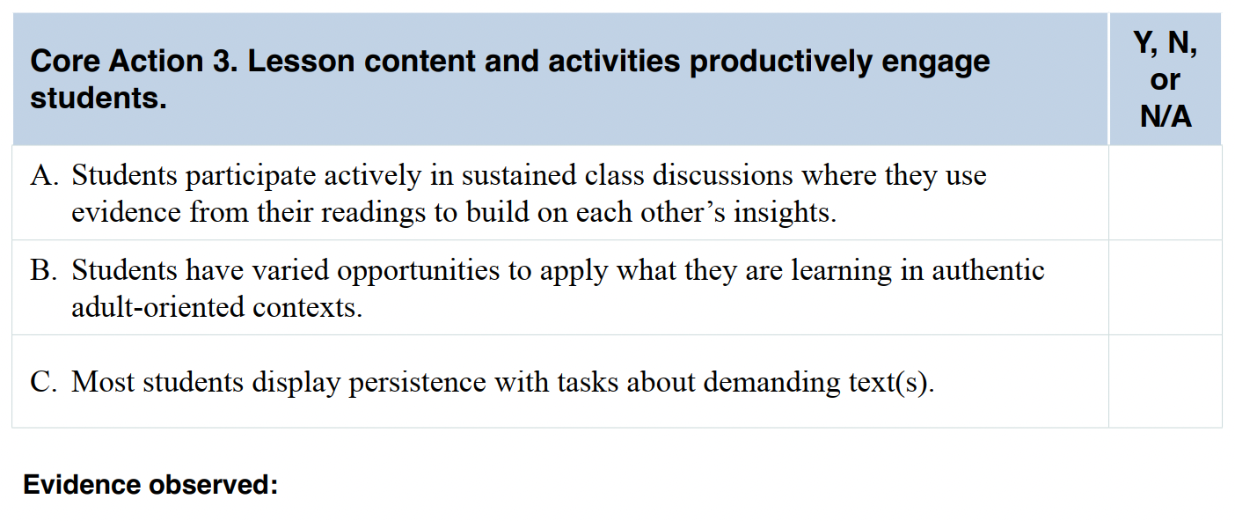
Core Action 3
Notes:
Big idea: Review the indicators that make up Core Action 3.
Facilitator talking points:
Ask participants to follow along in their workbooks.
Facilitator notes:
As you click through the indicators, read each one and move on.
Participants will have time to think through each one during their breakout times.

Slide 20
Guiding Questions
Notes:
Big idea: Introduce participants to the ELA/Literacy Core Actions and Guiding Questions.
Facilitator talking points:
These are questions you should ask yourself when determining if the indicators of the Core Action are present.
We will be referencing this resource throughout.
In fact, it will be useful in the team breakout session coming right up as you think through examples and non-examples.
Facilitator notes:
Make sure participants have a copy of the Guiding Questions to guide their reflections.

Slide 21
Team Time
Discuss Core Actions 1, 2, and 3
Think about your instruction or instruction you’ve observed in your program. For each Core Action:
Decide as a team on one example that would make you think each indicator was evident.
Decide as a team on one example that would make you think each indicator was not evident (i.e., a non-example).
Share your team’s example and non-example on the Padlets.
Choose a reporter to share your team’s reflections for the whole group debrief.
25 minutes
Notes:
Big idea: Discuss Core Actions 1-3 in teams.
Facilitator talking points:
The goal is for each team to decide on one example and non-example for each indicator.
For example:
A non-example of Core Action 1B: Students are working with texts that are well below the expected complexity for the level as defined by the standards.
A non-example for Core Action 1C: Most class time is spent with only the instructor reading or speaking directly about the text(s).
You can reference the Guiding Questions doc when thinking about examples and non-examples.
This exercise is a precursor to observing and substantiating your findings with evidence.
Please identify a “reporter” for your team who will share during the whole group debrief.
Facilitator notes:
Read instructions for the activity from the slide.
Specific instructions for how to use the Padlet will be shared on the next slide.

Slide 22
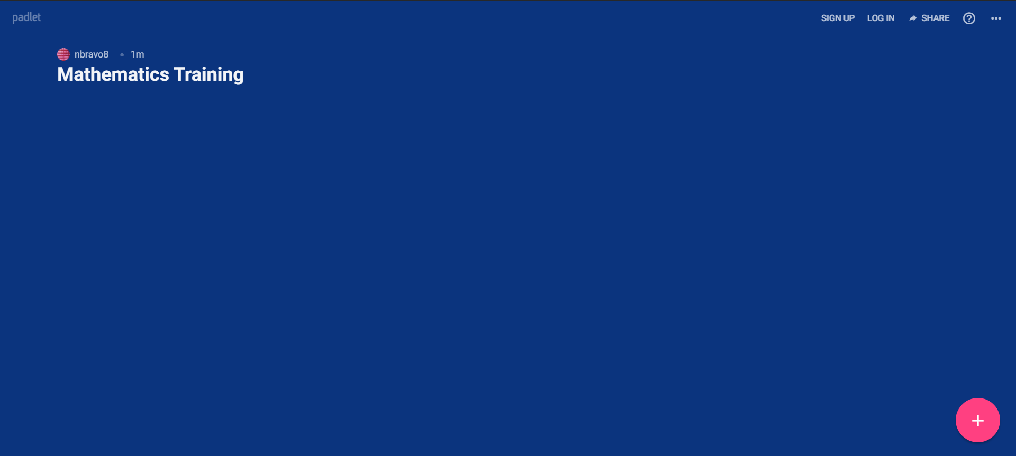
Using Padlets
At the bottom right-hand corner of your screen, click on the plus sign. This will allow you to post something.
A post will come up where you can type your thoughts. The other icons give you the following options: upload, link, search, and snap.
Clicking on the three dots to the right will give you the options above along with others.
Notes:
Big idea: Show people how to use Padlets.
Facilitator talking points:
Read instructions for how to use Padlet from the slide.
Facilitator notes:
Screen share as needed.

Slide 23
Welcome Back!
Notes:
Big idea: Bring state teams back together and debrief the work session.
Facilitator talking points:
Facilitator notes:
Click on this slide before breakout groups return to the main room.

Slide 24
Whole Group Debrief
Review: Look across the examples and non-examples from the other teams. (7 minutes)
Chat (with a pause): What did you notice? What did you wonder? (2 minutes)
Reflection: Let’s have a couple of team reporters share what their teams noticed and wondered about Core Actions 1, 2, and 3. (6 minutes)
15 minutes
Notes:
Big idea: Whole group debrief.
Facilitator talking points:
Everyone is welcome to chat responses.
Remind teams that their “reporter” will share the team reflections.
Facilitator notes:
We are introducing the chat (with a pause). Participants will be given 1 minute to type their responses in the chat box and will wait for the facilitator to select enter/send.
The purpose of the chat (with a pause) is to allow everyone to express their thoughts. Sometimes thinking stops if we think someone has already provided the “answer.”

Slide 25
Core Action 4
Notes:
Big idea: Review the indicators that make up Core Action 4.
Facilitator talking points:
Ask participants to follow along in their workbooks.
Facilitator notes:
As you click through the indicators, read each one and move on.
Participants will have time to think through each one during their breakout times.

Slide 26
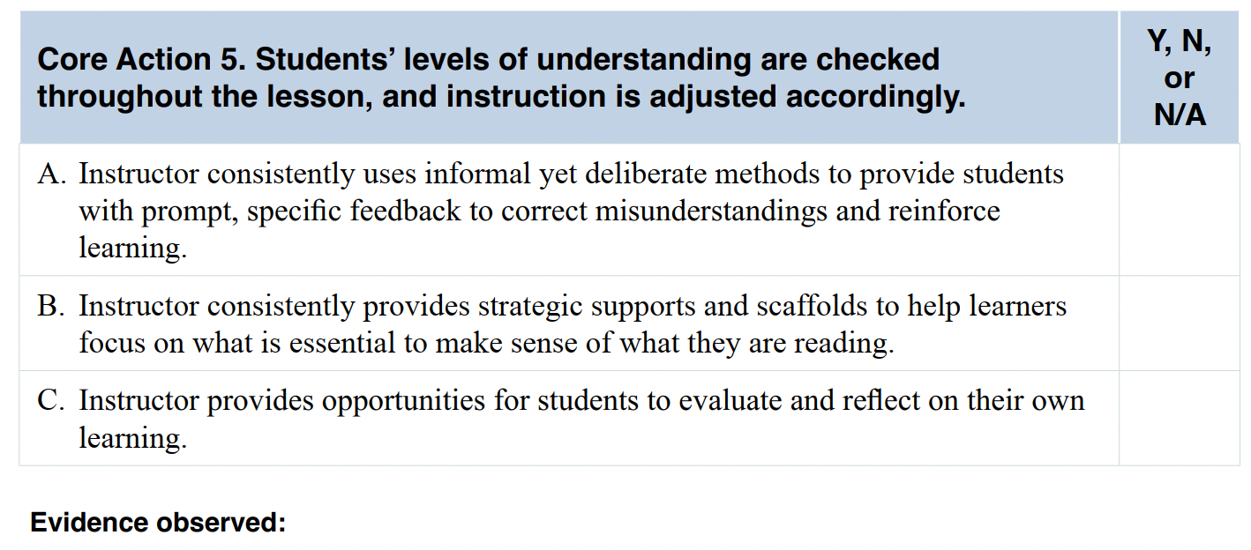
Core Action 5
Notes:
Big idea: Review the indicators that make up Core Action 5.
Facilitator talking points:
Ask participants to follow along in their workbooks.
Facilitator notes:
As you click through the indicators, read each one and move on.
Participants will have time to think through each one during their breakout times.

Slide 27
Team Time
Discuss Core Actions 4 and 5
Think about your instruction or instruction you’ve observed in your program. For each core action:
Decide as a team on one example that would make you think each indicator was evident.
Decide as a team on one example that would make you think each indicator was not evident.
Share your team’s examples and non-examples in the Padlets.
Choose a reporter for the whole group debrief.
25 minutes
Notes:
Big idea: Discuss Core Actions 4-5 in teams.
Facilitator talking points:
Read instructions for the activity from the slide.
The goal is for each team to decide on at least one example and non-example for each indicator.
A non-example for Core Action 5A: The teacher just marks homework/assignments right or wrong and provides a grade with no feedback.
You can reference the Guiding Questions doc when thinking about examples and non-examples.
This exercise is a precursor to observing and substantiating your findings with evidence.
Please identify a “reporter” for your team who will share during the whole group debrief.
Facilitator notes:
Read instructions for the activity from the slide.
Specific instruction for how to use the Padlet is on slide 22.

Slide 28
Welcome Back!
Notes:
Big idea: Bring state teams back together and debrief the work session.
Facilitator talking points:
Facilitator notes:
Click on this slide before breakout groups return to the main room.

Slide 29
Whole Group Debrief
Review: Look across the examples and non-examples from the other teams. (7 minutes)
Chat (with a pause): What did you notice? What did you wonder? (2 minutes)
Reflection: Let’s have a couple of team reporters share what their teams noticed and wondered about Core Actions 4 and 5. (6 minutes)
15 minutes
Notes:
Big idea: Whole group debrief.
Facilitator talking points:
Everyone is welcome to chat responses.
Remind teams that their “reporter” will share the team reflections.
Facilitator notes:
Participants will be given 1 minute to type their responses in the chat box and will wait for the facilitator to select enter/send.
The purpose of the chat (with a pause) is to allow everyone to express their thoughts. Sometimes thinking stops if we think someone has already provided the “answer.”

Slide 30
Let’s Use the SIA 2.0 Observation Tool With Video Lesson 1
Watch the lesson video.
As you observe the lesson, individually make notes for Core Actions 1, 2, and 3.
Fill out an Observation Tool, using the ELA/Literacy Core Actions and Guiding Questions as a guide.
25 minutes
Notes:
Big idea: Provide an opportunity for participants to apply what they’ve learned about Core Actions 1, 2, and 5 to a video lesson.
Facilitator talking points:
You have the opportunity to put your training into action by watching a video and taking notes on the Core Actions (and indicators) you observe.
Notice that we are only asking you to opine on Core Actions 1, 2, and 3. This is because this is a short lesson, and Core Actions 4 and 5 are not applicable.
Please remember that no lesson is perfect.
Think about the Guiding Questions doc that was discussed and reviewed earlier.
Facilitator notes:
Make sure participants have a clean copy of the Observation Tool to take notes while watching the first video.

Slide 31
Video #1 ELA/Literacy Lesson: 20 Minutes
Notes:
Big idea: Watch a short video.
Facilitator talking points:
We’ll now take 20 minutes to watch the ELA/literacy lesson.
Have your Observation Tool out. Remember you can take notes on what you observe on a separate piece of paper if you prefer.
Watch for teacher moves and student responses.
You will have time after the video to decide whether you think certain indicators are present or not present.
You’ll be reflecting on Core Actions 1, 2, and 3 only as this is a short video. (Core Actions 4 and 5 are not applicable.)
Facilitator notes:
Participants will watch the video.

Slide 32
Team Time
After watching the lesson video, individually review your notes and rate each indicator in Core Actions 1, 2, and 3. In addition, for Core Action 1, review the lesson in the lesson. (15 minutes)
In your group, be prepared to share the ratings and evidence for indicators you thought were particularly evident. (Use the ELA/Literacy Core Actions and Guiding Questions to direct your discussions.) (30 minutes)
45 minutes
Notes:
Big idea: Discuss indicators in Core Actions 1, 2, and 3 seen in the video.
Facilitator talking points:
Individually you will watch the video, collect evidence, and rate.
After 15 minutes, you will go into team time to share your observations and evidence.
Facilitator notes:
Give participants time to rate each indicator.
They should do this in a blank Observation Tool.

Slide 33
Welcome Back!
Notes:
Big idea: Bring state teams back together and debrief the work session.
Facilitator talking points:
Facilitator notes:
Click on this slide before breakout groups return to the main room.

Slide 34
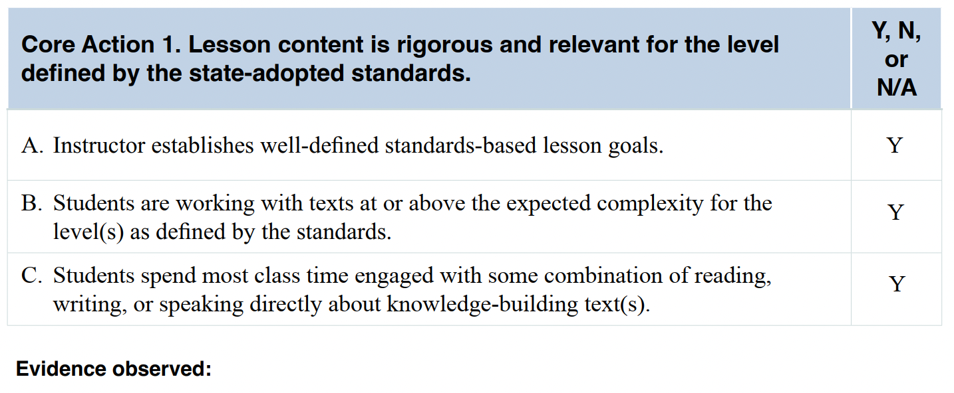
Sample Answers for Core Action 1
Chat (with a pause): How do these ratings compare to yours?
Notes:
Big idea: Share ratings for Core Action 1 across teams.
Facilitator talking points:
Ask participants to compare their ratings with the sample ratings using the chat (with a pause).
You can follow along in the doc that shows the relevant portion of the Resource Package.
Facilitator notes:
Give participants a few minutes to review the sample ratings.
Facilitator should note how teams’ ratings compared to the example ratings.
Go over the evidence and determine if differences in ratings are because of a difference in evidence.
Ask for clarifying questions.
Share evidence observed by SIA 2.0 team:
Indicator A.
Since this video is an excerpt of a longer lesson, it does not capture the instructor’s sharing of goals and objectives with students. However, Donnie discusses the lesson objectives during interview clips and explains why working with claims and evidence is an important skill for students to learn [at 00:02:12:00]. Donnie also refers to relying on evidence to identify claims for and against tween cell phone use during the whole-class discussion. For example, he reminds students to consider evidence not just against but also for tween cell phone use: “I’m hearing an awful lot of cons. I know for every con there is a pro. Is there a pro that is not up here that someone wants to share?” [at 00:14:05:00]. This underscores for students the importance of considering all the evidence to make sound decisions.
During the lesson, students engage in a blend of reading, writing, speaking, and listening tasks. They read and discuss a text about tweens owning cell phones, and they write down evidence for and against that use.
The following CCR standards are listed in the lesson plan and targeted in the lesson:
Cite several pieces of textual evidence to support analysis of what the text says explicitly as well as inferences drawn from the text (Reading Standard 1 – High Intermediate Level, Informational Text).
Determine a theme or central idea of a text and how it is conveyed through particular details; provide a summary of the text distinct from personal opinions or judgments (Reading Standard 2 – High Intermediate Level, Informational Text).
Analyze a case in which two or more texts provide conflicting information on the same topic and identify where the texts disagree on matters of fact or interpretation (Reading Standard 9 – High Intermediate Level, Informational Text).
Read and comprehend complex literary and informational texts independently and proficiently (Reading Standard 10 – High Intermediate/Low Adult Secondary Level, Informational Text).
Engage effectively in a range of collaborative discussions (one-on-one, in groups, and teacher-led) with diverse partners, building on others’ ideas and expressing their own clearly (Speaking and Listening Standard 1 – High Intermediate Level, Informational Text).
Indicator B.
The lesson plan does offer contextual and complexity-level information about the text that students read and discuss: “Do kids need their own cell phones?” – Time for Kids: 1000L; High Intermediate Level.
Indicator C.
The entire activity is dedicated to the text that students read. Appropriate time is spent providing directions for the various parts of this activity, such as organizing for partner reading and preparing “snowballs” for sharing evidence.
This text relates conceptually to the two other texts included in the lesson plan. All three relate to the advantages and risks associated with using new technologies.

Slide 35
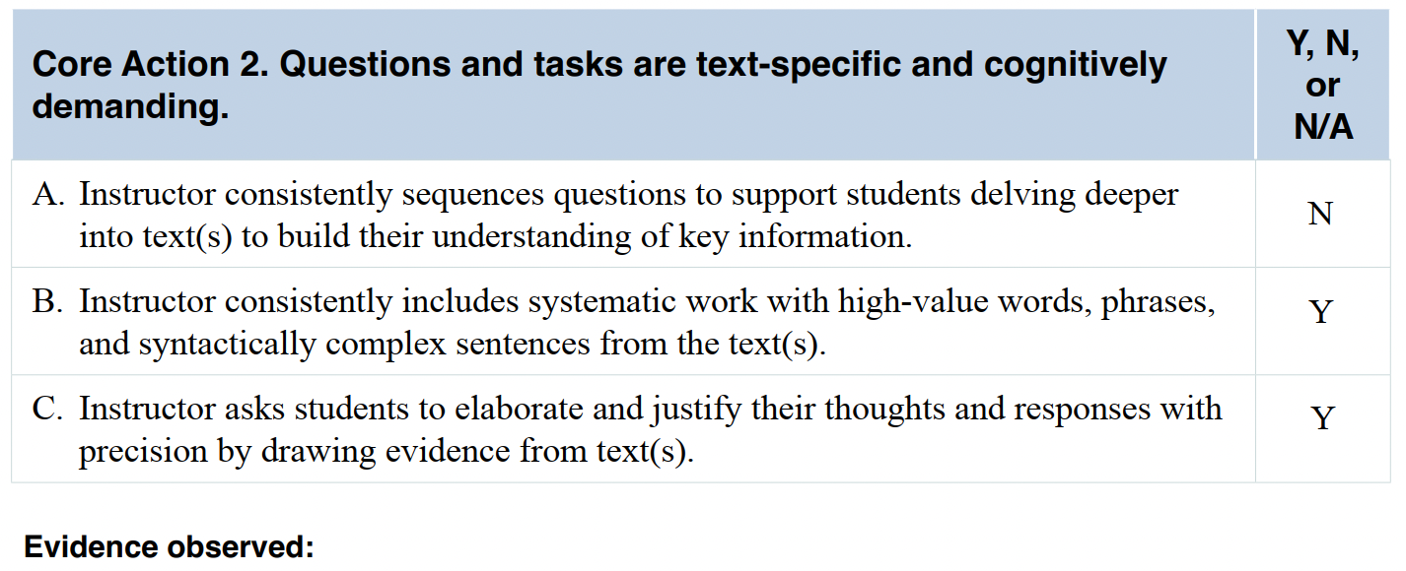
Sample Answers for Core Action 2
Chat (with a pause): How do these ratings compare to yours?
Notes:
Big idea: Share ratings for Core Action 2 across teams.
Facilitator talking points:
Ask participants to compare their ratings with the sample ratings using the chat (with a pause).
Encourage participants to follow along in the doc that shows the relevant portion of the Resource Package.
Facilitator notes:
Facilitator should note how teams’ ratings compared to the example ratings.
Go over the evidence and determine if differences in ratings are because of a difference in evidence.
Ask for clarifying questions.
Share evidence observed by SIA 2.0 team:
Indicator A.
Although the task is text-based, the video segment does not include students answering a series of text-based comprehension questions.
Rarely can students answer Donnie’s questions with just a “yes” or “no.” They are required to discuss evidence for and against tweens owning cell phones. As Donnie facilitates the whole-group discussion, he encourages students to build on one another’s comments. At one point, he asks students to share an evidence statement from their own text annotations to further the discussion [00:14:18:00].
Indicator B.
When reading the article with a partner, students are expected to pay attention to the words, phrases, and sentences as they annotate the text. They underline specific statements of evidence in favor of tweens owning cell phones, and they circle statements against it. Students then select statements from the article to write on their half-sheets of paper during the “snowball” activity to share during the whole-group discussion.
Indicator C.
Regularly throughout the lesson, Donnie reminds students to refer to the text to complete the task. For example, Donnie redirects a student who wants to share a personal comment. After this redirection, the student then successfully shares evidence from the text in her response during the whole-group discussion [at 00:12:25:00]. Donnie also encourages precision from students. When he mentions that they mostly seem to be providing evidence against tweens owning cell phones, he asks students to provide evidence in favor [at 00:14:05:02].

Slide 36
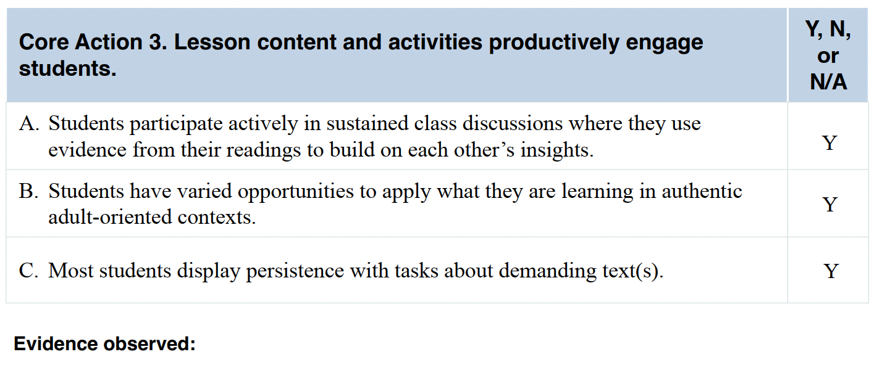
Sample Answers for Core Action 3
Chat (with a pause): How do these ratings compare to yours?
Notes:
Big idea: Share ratings for Core Action 3 across teams.
Facilitator talking points:
Ask participants to compare their ratings with the sample ratings.
You can follow along in the doc that shows the relevant portion of the Resource Package.
Facilitator notes:
Facilitator should note how teams’ ratings compared to the example.
Go over the evidence and determine if differences in ratings are because of a difference in evidence.
Ask for clarifying questions.
Share evidence observed by SIA 2.0 team:
Indicator A.
The small-group discussion, independent task of writing evidence, and whole-class discussion of the evidence ensured that students had the opportunity to participate in the lesson. Students are animated—they are interested in the topic and engaged in both the small-group and whole-class discussions. They underline, circle, and share evidence from the text they are reading with one another.
The annotation activity, “snowball” activity, and group sharing provide students with multiple ways to build on one another’s evidence and insights. There are laughter and smiles from students during the “snowball fight” [at 00:07:50:00]. The activity is dominated by student talk and discussion. There is no lecture. Donnie walks around the room and provides prompting and guidance when needed. During the whole-class discussion, Donnie gathers pro and con evidence from students and places it in a graphic organizer [at 00:09:15:00].
Indicator B.
Donnie selects a practical, real-world topic for discussion that is interesting and connected to many students’ daily lives: whether to provide tweens with cell phones. Donnie begins by asking whether he should buy his 8-year-old daughter a cell phone, which is immediately relevant to many students in the class. Several yell “no” and hold up red cards [at 00:00:58:00]. The “snowball” activity and evidence charting let students consider evidence from both sides of the argument. Some students continued to have strong feelings about the topic, though. The text-based discussion gives students an opportunity to practice using evidence that is so essential to sound decision-making.
The topic of the lesson examines the role of convenient technology in our daily lives. The video segment showcases a text about tween cell phones that was previously published. It appears in an established publication, Time for Kids.
Indicator C.
All students appear to be engaged in the discussion, involved in the reading activities, and attentive throughout the lesson. There are no instances of students being off-task. Moreover, Donnie circulates the room during student work time. This provides opportunities for students to ask for help when needed or for Donnie to help them stay on-task. For example, a student asks, “What should we underline again?” and Donnie repeats the instructions [at 00:03:11:00].

Slide 37
Let’s Discuss!
Let’s take 10 minutes to review the sample evidence for Core Actions 1, 2, and 3.
Now let’s hear from a couple of teams about the evidence you found and noted to support your ratings:
How is your evidence different from or similar to the sample evidence?
Notes:
Big idea: Share our evidence and ratings.
Facilitator talking points:
Now that we’ve compared the ratings for these Core Actions, we want to give you some individual work time. Compare your evidence with the sample.
Remember that there can be many “right” answers. But while the evidence may be different, there should be agreement on the general findings and ratings.
We’re going to take 10 minutes for you to compare what you found with those of the example workbook.
Take some notes about what you see as the same and different. Then we’ll ask you to share your findings when we come back together.
[After work time] Now let’s hear from a couple of teams about their comparison…
Facilitator notes:

Slide 38
QUESTIONS & CLARIFICATIONS

Slide 39
Preview of the Week 2 Assignments
Individually:
Watch the full SIA video without looking at the completed observation in the Resource Package.
Collect evidence, make notes, and assign ratings for all five Core Actions using the observation tool.
Prepare to meet and share your observations with your state team and coach.
Notes:
Big idea: Prepare for team assignment to watch the video.
Facilitator talking points:
Prepare participants for Week 2 work.
Facilitator notes:
Address any questions that come through the chat.
Make sure they don’t look at the Resource Package prior to their observations so they aren’t influenced by the sample answers provided there.
They could review the lesson plan to determine the goals of the lesson and the targeted standards.

Slide 40
Preview of Week 2, cont’d.
Then meet as a state team with your coach to:
Discuss your ratings and notes with each other using the ELA/Literacy Core Actions and Guiding Questions resource.
Notice points of agreement and reach a consensus about points of disagreement.
Be prepared to share your findings during the next training session. Select someone who will share on behalf of the team.
Any questions?
Notes:
Big idea: Prepare for team-based assignment.
Facilitator talking points:
Prepare participants for Week 2 work.
Facilitator notes:
Address any questions that come through the chat.

Slide 41
An Additional Week 2 Assignment: Select Instructors to Observe
To prepare for the site-based observations you will conduct in a couple of weeks:
Select at least two participants you will want to observe.
Make initial overtures in person or via email to prospective observees.
Let them know you are participating in a national training to gain experience in using a standardized observation tool.
Include the goals of the observation system.
If they agree to being observed, let them know you will be in to observe them in about four weeks.
Notes:
Big idea: Select participants for observation.
Facilitator talking points:
Take time to gather volunteers to be observed.
Be sure to explain to them that you are part of a national training program.
Facilitator notes:

Slide 42
Thank you!

