Slide 1
Observations in
English Language Arts/Literacy
Classrooms

Slide 2
Welcome Back to Session Two of the Classroom Observation Training!
Notes:
Big idea: Kick off the training!

Slide 3
Disclaimer
This presentation was produced and funded in whole with Federal funds from the U.S. Department of Education under contract number ED-991990018C0040 with StandardsWork, Inc. Ronna Spacone serves as the Contracting Officer’s Representative. There is content on the slides and additional content in the Slide Notes throughout the presentation. The content of this presentation does not necessarily reflect the views or policies of the U.S. Department of Education nor does the mention of trade names, commercial products, or organizations imply endorsement by the U.S. Government.
Notes:
Big idea: Make audience aware of contract information.
Facilitator talking points:
Please read through this slide for information about the contract.
Facilitator notes:

Slide 4
Session Two Overview
Check our knowledge of the meaning of the five Core actions
Share findings for Core Actions 1–5 for the full lesson video
Prepare for site-based live classroom observations
Notes:
Big idea: Preview with participants the overview of activities for the day.
Facilitator talking points:
There are two main segments for today’s training.
You will share findings from last week’s team-based assignment and prepare for the site-based live classroom observations over the next couple of weeks.
Facilitator notes:
Read through the slide.

Slide 5
Meeting Norms and Expectations
Be present and engage fully in all activities.
Ask questions through the chat or by raising your hand.
Put cameras on whenever possible.
Prepare for productive struggle.
Respectfully challenge one another and withhold judgments for differing perspectives or learning styles.
Notes:
Big idea: Revisit with participants the norms to which we will adhere as we proceed through the trainings.
Facilitator talking points:
Everyone will be expected to engage no matter your role.
After reading through the norms, ask if there are any comments or questions.
Remind participants that they can do so through the chat or by raising their hand.
Let participants know that they will be working in whole and small teams with assigned coaches. We’ll be using the workbook.
Facilitator notes:
Read through the slide.

Slide 6
SIA 2.0 Observation: Five-Part System
Notes:
Big idea: Show the five-part system again.
Facilitator talking points:
As a reminder, the SIA 2.0 Observation System has five parts.
We are concentrating on the first three parts in this training, with most of the focus going to conducting observations.
If there is interest, we will hold a follow-up training on the last two parts to show how to aggregate data and develop program-wide PD.
Facilitator notes:

Slide 7
Tools and Resources
Classroom Observation Tool for English Language Arts/Literacy
English Language Arts/Literacy Classroom Observation Resource Package
Observation Checklist
ELA/Literacy Core Actions and Guiding Questions
ELA/Literacy Core Actions and Matching Summaries

Slide 8
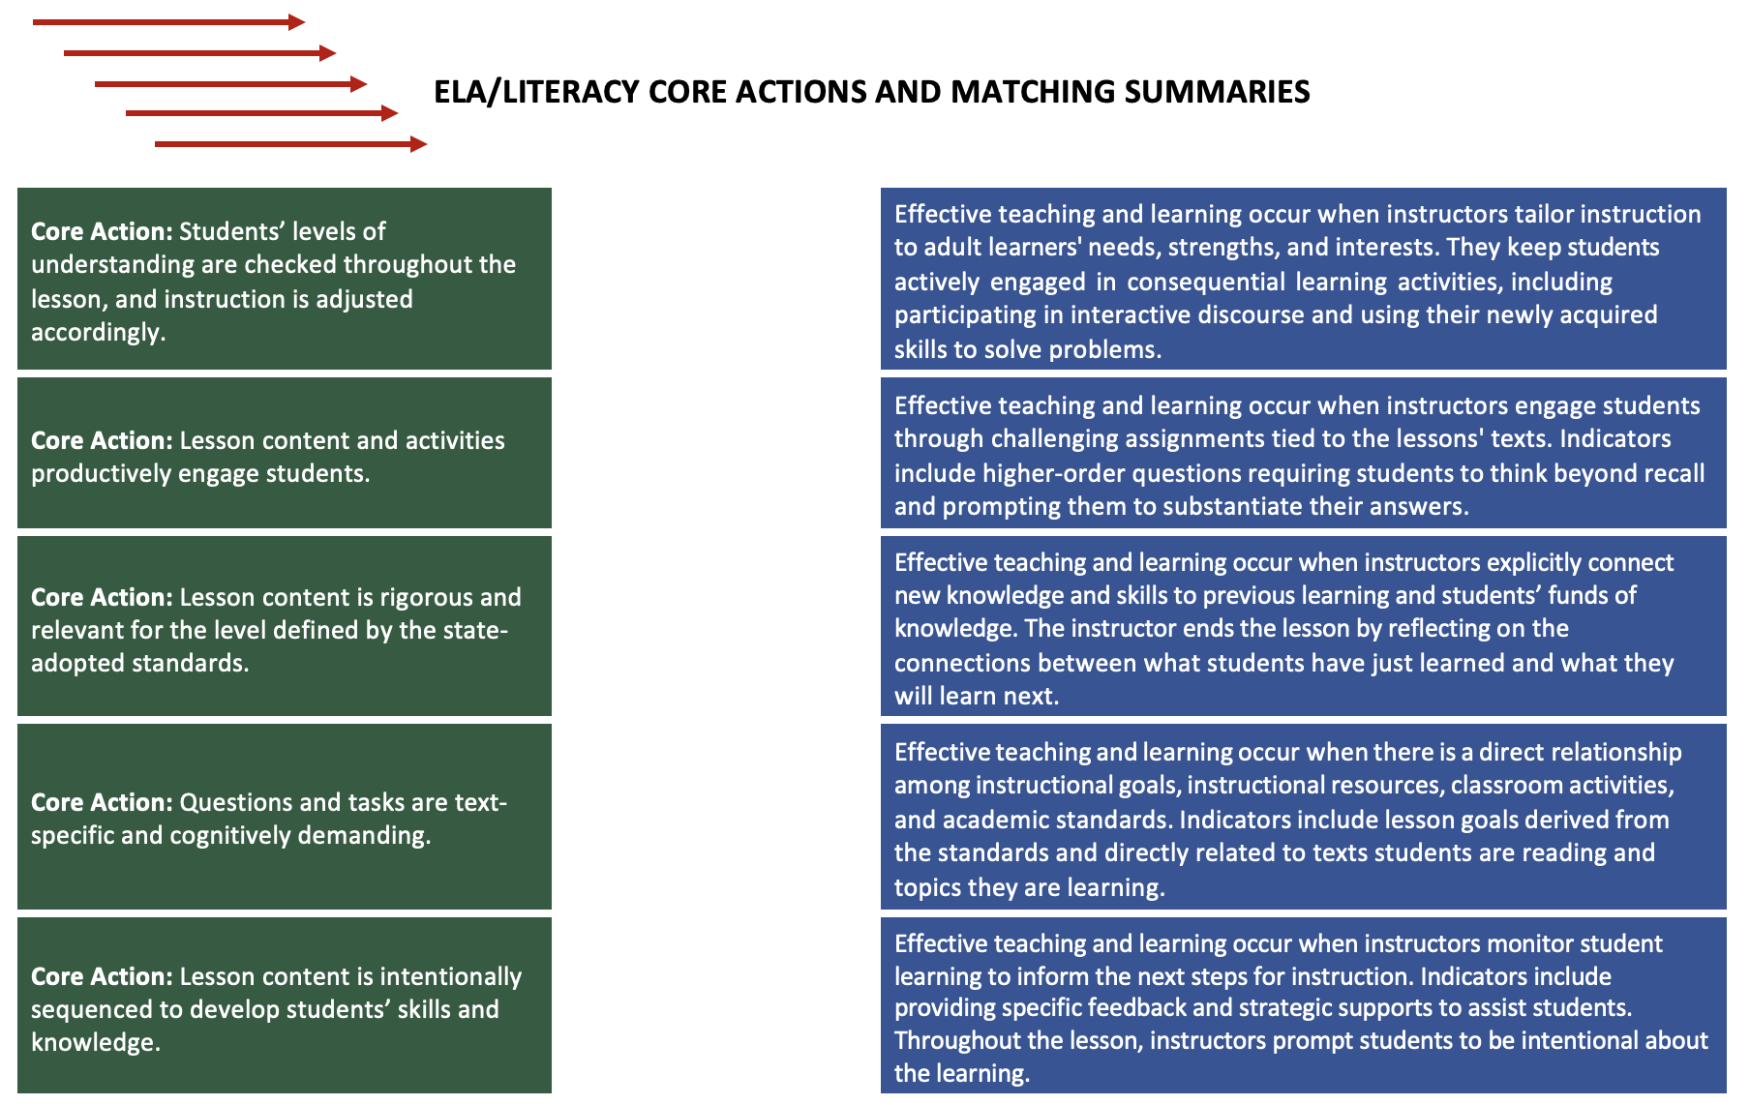
Team Exercise
Notes:
Big idea: Teams will work to match each core action to its summary.
Facilitator talking points:
We’re going to send you into teams to review your understanding of each core action.
This will help to make sure you understand the essence of what you will be observing in classrooms.
Facilitator notes:
Make sure everyone has the Exercise: ELA/Literacy Core Action and Matching Summaries.

Slide 9
Team Time
In your teams, work together to match each Core Action to its summary.
10 minutes
Notes:
Big idea: Provide an activity for team members to secure their understanding of the meaning of each Core Action.
Facilitator talking points:
Introduce the matching activity to the teams.
Tell them to use the arrows to match Core Action with each summary.
Facilitator notes:
Direct participants to the activity, ELA/Literacy Core Actions and Guiding Questions.

Slide 10
CORE ACTIONs 1–5 FINDINGS FOR THE FULL LESSON VIDEO

Slide 11
Core Action 1 – Poll
Select the indicators that you thought were evident in the lesson:
Indicator A
Indicator B
Indicator C
Notes:
Big idea: Participants share the indicators they thought were evident in watching the video.
Facilitator talking points:
Chat the indicators you thought were evident.
Then we’ll hear from a couple of teams for additional detail.
Facilitator notes:
Let participants know they can select more than one answer.
Ask each participant to participate in the poll.

Slide 12
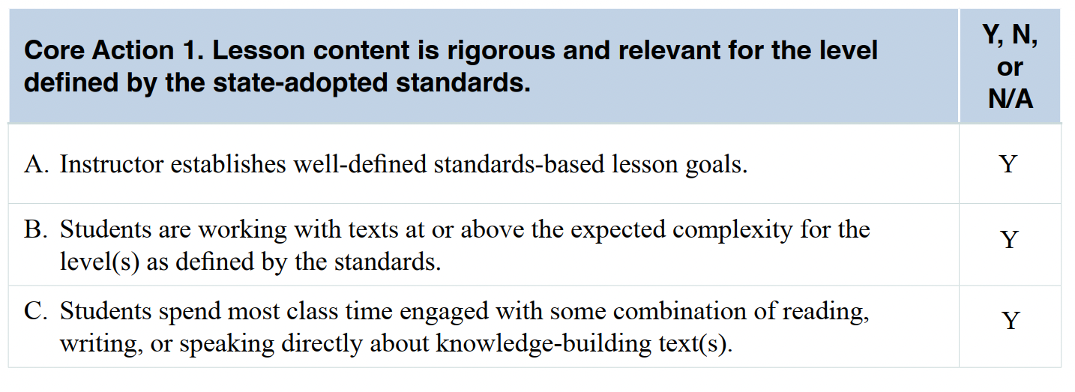
Compare Your Ratings & Evidence to the Sample Ratings for Core Action 1
5 minutes
Notes:
Big idea: Share ratings for Core Action 1 across teams.
Facilitator talking points:
Ask participants to take 5 minutes to compare their ratings with the sample ratings.
Facilitator notes:
Give participants a few minutes to review the evidence.
Go over the evidence in the Resource Package. Determine if differences in ratings are because of a difference in evidence.
Facilitator should note how teams’ ratings compared to what they got.
Evidence observed:
Indicator A:
Sarah defines the lesson’s goals and identifies “I can …” statements for students [at 00:06:31:00]. Throughout the lesson, Sarah refers to lesson objectives. The activities of the lessons tie closely to the established goals of the lesson. Sarah presents various statements for students to label as claims or evidence. Sarah also urges students to find evidence to support the claim in each of the three texts students read and discuss.
Sarah lists all of the CCR standards reflected in her lesson:
Cite several pieces of textual evidence to support analysis of what the text says explicitly as well as inferences drawn from the text (Reading Standard 1 – High Intermediate Level, Informational Text).
Determine a theme or central idea of a text and how it is conveyed through particular details; provide a summary of the text distinct from personal opinions or judgments (Reading Standard 2 – High Intermediate Level, Informational Text).
Explain how an author uses reasons and evidence to support particular points in a text, identifying which reasons and evidence support which point(s) (Reading Standard 8 – Low Intermediate Level, Informational Text).
Read and comprehend complex literary and informational texts independently and proficiently (Reading Standard 10 – High Intermediate/Low Adult Secondary Level, Informational Text).
Engage effectively in a range of collaborative discussions (one-on-one, in groups, and teacher-led) with diverse partners, building on others’ ideas and expressing their own clearly (Speaking and Listening Standard 1 – High Intermediate Level, Informational Text).
Indicator B:
The texts were evaluated for complexity. The lesson plan offers the following information:
“Don’t You Dare Eliminate the Penny” – Forbes: High Intermediate/Low Secondary Level
“Should We Get Rid of the Penny? 8 Reasons to Keep It vs. Eliminate It” – MoneyCrashers.com: High Intermediate/Low Secondary Level
“Can We All Just Agree That Pennies Are Stupid and Need to Be Retired?” – The Huffington Post: High Intermediate /Low Secondary Level
The three texts are conceptually related to eliminating the U.S. penny and are designed to build knowledge about the topic.
Indicator C:
The entire lesson time relates to what students are reading, including the initial practice to identify claims and evidence. Sarah reads the first of three texts out loud as students follow along and annotate their copies. She then models how to find the claim in the text. She spends very little time providing instructions or making transitions, including as students move from whole-group to small-group to individual work.
Students engage in a blend of reading, writing, speaking, and listening tasks. In a whole or small group, students read and discuss the texts about eliminating the U.S. penny. To answer the questions about the third text and to complete the exit slip, students also write.

Slide 13
Share Findings for Core Action 1
Let’s have a couple of teams share their ratings and the evidence that supports those ratings.
Did anyone have different ratings or evidence that they would like to share?
Notes:
Big idea: Discuss the findings for Core Action 1.
Facilitator talking points:
Let’s have a couple of teams share their ratings and evidence. Ask for selected team reporters to share.
Did anyone have different ratings or evidence that they would like to share?
Let’s talk through what differences there are in the ratings and if they are because of a difference in evidence.
Ask for clarifying questions.
Facilitator notes:
Based on the poll results, we will know if there are differences in the ratings.
The facilitator can call on people who had different answers.
Remind participants that they were asked to select someone who will report out on their behalf.

Slide 14
Core Action 2 – Poll
Select the indicators that you thought were evident in the lesson:
Indicator A
Indicator B
Indicator C
Notes:
Big idea: Participants share the indicators they thought were evident in watching the video.
Facilitator talking points:
Chat the indicators you thought were evident.
Then we’ll hear from a couple of teams for some additional detail.
Facilitator notes:
Participants can select more than one answer.
All participants can participate in the poll.

Slide 15
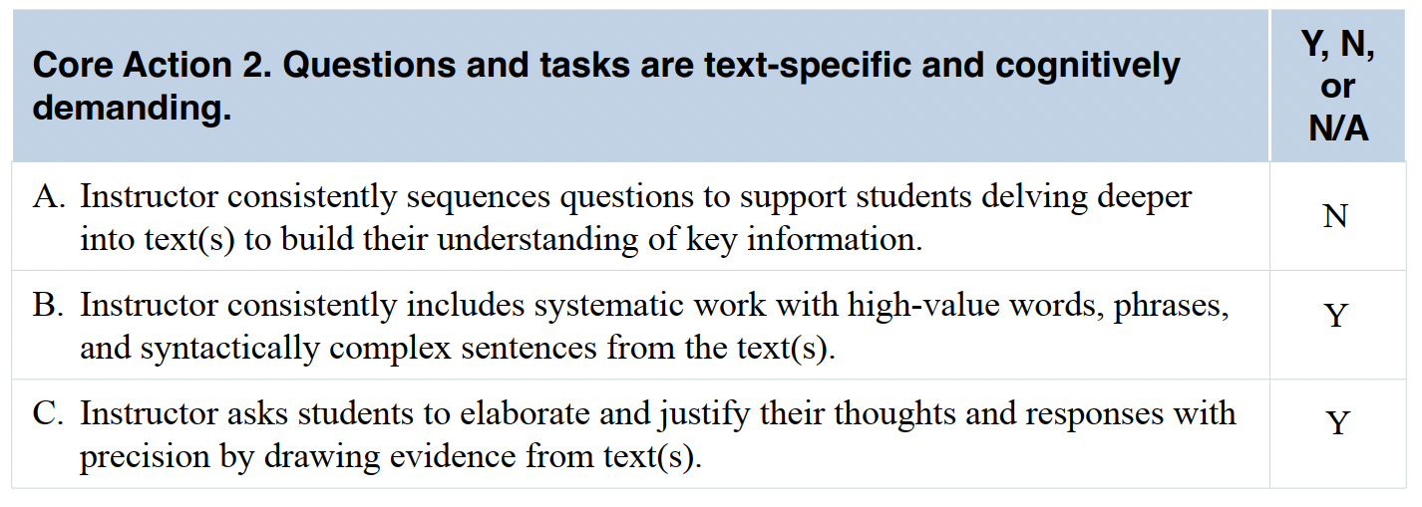
Compare Your Ratings & Evidence to the Sample Ratings for Core Action 2
5 minutes
Notes:
Big idea: Share ratings for Core Action 2 across teams.
Facilitator talking points:
Ask participants to take 5 minutes to compare their ratings with the sample ratings.
Facilitator notes:
Facilitator should note how teams’ ratings compared to what they got.
Go over the evidence in the Resource Package. Determine if differences in ratings are because of a difference in evidence.
Ask for clarifying questions.
Evidence observed:
Indicator A:
Questions are not sequenced to support students delving deeper into the texts. Additional text-based questions could have been developed to further support students’ understanding of The Huffington Post text. There is, however, a mix of questions and tasks that reinforce comprehension of each text and build knowledge about eliminating the penny.
Indicator B:
During the evidence-sorting task, students interact with the words, phrases, and sentences of the MoneyCrashers.com article. When students work independently or in pairs on The Huffington Post questions, they must address specific words, phrases, and sentences from the text.
Indicator C:
Rarely can students answer questions with just a “yes” or “no”—elaboration or justification is required. During the final activity, on The Huffington Post article, the questions are open-ended. They call for reflection (rather than recall) as well as evidence about the words, sentences, and ideas in the text.
The instructor also invites students to follow up on one another’s comments. For example, during the practice session on claims versus evidence and the discussion on fast food, Sarah asks, “Does anyone have a different opinion?” After students discuss, Sarah summarizes their points [at 00:11:34:00]. As Sarah works with students, she often asks questions rather than providing answers. For example, as she moves from group to group, she asks students questions to help them clarify their thinking and progress through the activity.
Students cannot answer the questions Sarah poses without referring to the text. Sarah also encourages precision from student responses. For example, during the group activity, Sarah works with several groups to review the evidence statements to decide which ones support the claim. This prompts students to reflect more deeply on their responses [at 00:23:45:00]. As another example, near the end of the group activity, Sarah checks a group’s chart and asks, “Why did you keep this one? Does that relate?” Students rethink their response and remove the evidence from the chart [at 00:35:20:00].

Slide 16
Share Findings for Core Action 2
Let’s have a couple of teams share their ratings and the evidence that supports those ratings.
Did anyone have different ratings or evidence that they would like to share?
Notes:
Big idea: Discuss the findings for Core Action 2.
Facilitator talking points:
Let’s have a couple of teams share their ratings and evidence. Ask for selected team reporters to share.
Did anyone have different ratings or evidence that they would like to share?
Let’s talk through what differences there are in the ratings and if they are because of a difference in evidence.
Ask for clarifying questions.
Facilitator notes:
Based on the poll results, we will know if there are differences in the ratings.
Call on people who had different answers.
Remind participants that they were asked to select someone who will report out on behalf of the team.

Slide 17
Core Action 3 – Poll
Select the indicators that you thought were evident in the lesson:
Indicator A
Indicator B
Indicator C
Notes:
Big idea: Participants are sharing the indicators they thought were evident in watching the video.
Facilitator talking points:
Chat the indicators you thought were evident.
Then we’ll hear from a couple of teams for some additional detail.
Facilitator notes:
Participants can select more than one answer.
All participants can participate in the poll.

Slide 18
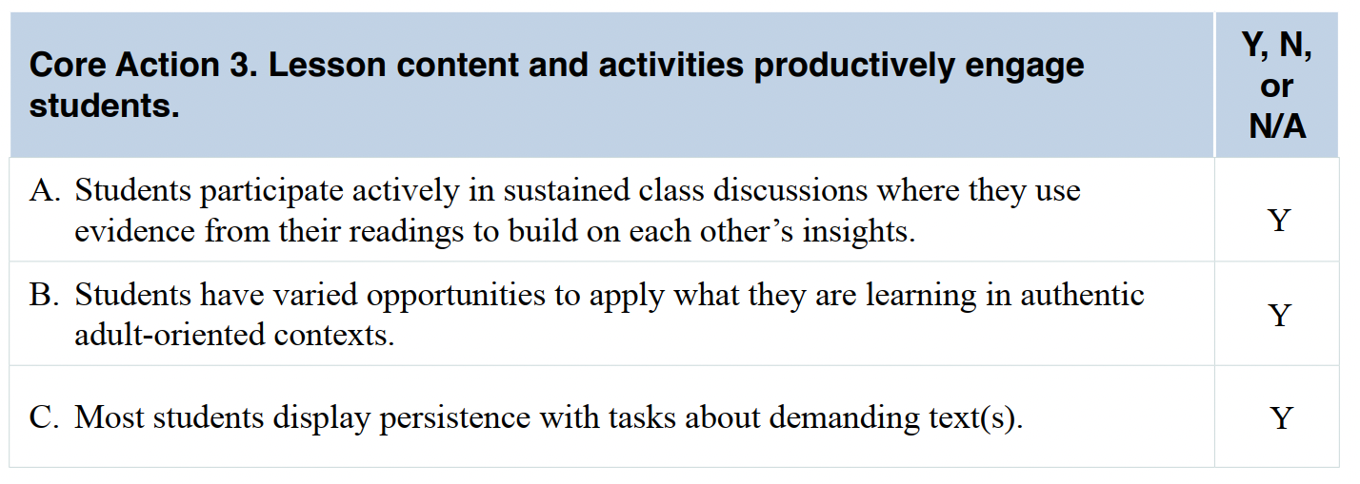
Compare Your Ratings & Evidence to the Sample Ratings for Core Action 3
5 minutes
Notes:
Big idea: Share ratings for Core Action 3 across teams.
Facilitator talking points:
Ask participants to take 5 minutes to compare their ratings with the sample ratings.
Facilitator notes:
Facilitator should note how teams’ ratings compared to what they got.
Go over the evidence in the Resource Package. Determine if differences in ratings are because of a difference in evidence.
Ask for clarifying questions.
Evidence observed:
Indicator A:
The combination of whole-class, small-group, and independent or partner work ensures that all students could actively participate in the lesson. Students are interested and are sometimes animated. They are engaged from the start as they decide whether to throw away the pennies placed strategically on the floor around the room. The buzz at each table is evident when students work together to find the claim and its supporting evidence. The lesson is dominated by student talk and discussion; there is no lecture. Even the initial activity to help students distinguish between claims and evidence is conducted through a participatory activity. In the lesson as a whole, Sarah talks about 35% of the time while students talk about 65% of the time.
Students consistently refer to the text during discussions and collaborative activities. During the small-group activity, students make decisions about which evidence does and does not support the claim [at 00:21:18:00].
Indicator B:
Sarah explicitly ties the lesson objectives to students’ goals and interests. She calls out the difference between reading and understanding, asking students to think about their own experiences doing so. Students immediately relate to this question, which adds relevance to the lesson [at 00:01:12:00]. In addition, at the beginning of the lesson, Sarah relates the importance of finding claims and evidence to practical, everyday activities. These activities include comparison shopping or buying a car or home [at 00:02:29:00]. Sarah further engages students in the topic by strategically placing pennies around the room and by starting a discussion about their value [at 00:06:45:00]. The small-group evidence-sorting activity also provides students with a creative opportunity to engage with evidence from the text.
Given the topic of the lesson—the debate over the elimination of the penny from U.S. currency—these articles provide useful information to students. All three texts were previously published in established outlets such as Forbes and The Huffington Post.
Indicator C:
Students remain engaged and on-task throughout the lesson. There were no instances of students being off-task. Even when a student offers a story about a man paying car taxes in all pennies, the story relates to the topic.

Slide 19
Share Findings for Core Action 3
Let’s have a couple of teams share their ratings and the evidence that supports those ratings.
Did anyone have different ratings or evidence that they would like to share?
Notes:
Big idea: Discuss the findings for Core Action 3.
Facilitator talking points:
Let’s have a couple of teams share their ratings and evidence. Ask for selected team reporters to share.
Did anyone have different ratings or evidence that they would like to share?
Let’s talk through what differences there are in the ratings and if they are because of a difference in evidence.
Ask for clarifying questions.
Facilitator notes:
Based on the poll results, we will know if there are differences in the ratings.
Call on people who had different answers.
Remind participants that they were asked to select someone who will report out on behalf of the team.

Slide 20
Core Action 4 – Poll
Select the indicators that you thought were evident in the lesson:
Indicator A
Indicator B
Indicator C
Notes:
Big idea: Participants share the indicators they thought were evident in watching the video.
Facilitator talking points:
Chat the indicators you thought were evident.
Then we’ll hear from a couple of teams for some additional detail.
Facilitator notes:
Participants can select more than one answer.
All participants can participate in the poll.

Slide 21
Compare Your Ratings & Evidence to the Sample Ratings for Core Action 4
5 minutes
Notes:
Big idea: Share ratings for Core Action 4 across teams.
Facilitator talking points:
Ask participants to take 5 minutes to compare their ratings with the sample ratings.
Facilitator notes:
Facilitator should note how teams’ ratings compared to what they got.
Go over the evidence in the Resource Package. Determine if differences in ratings are because of a difference in evidence.
Ask for clarifying questions.
Evidence observed:
Indicator A:
At the beginning of the lesson, Sarah reminds students of a past lesson on claims and evidence.
Indicator B:
There are no extension texts or research projects connected with this lesson, although there are three texts on the same topic. This enables students to build knowledge and vocabulary, which seems appropriate for the nature of this lesson.
Indicator C:
Sarah asks students to complete an exit slip to identify the author’s claim and two pieces of supporting evidence, which fulfills the lesson objectives. Sarah says that future lessons will evaluate evidence and determine if a source is valid or reliable.

Slide 22
Share Findings for Core Action 4
Let’s have a couple of teams share their ratings and the evidence that supports those ratings.
Did anyone have different ratings or evidence that they would like to share?
Notes:
Big idea: Discuss the findings for Core Action 4.
Facilitator talking points:
Let’s have a couple of teams share their ratings and evidence. Ask for selected team reporters to share.
Did anyone have different ratings or evidence that they would like to share?
Let’s talk through what differences there are in the ratings and if they are because of a difference in evidence.
Ask for clarifying questions.
Facilitator notes:
Based on the poll results, we will know if there are differences in the ratings.
Call on people who had different answers.
Remind participants that they were asked to select someone who will report out on behalf of the team.

Slide 23
Core Action 5 – Poll
Select the indicators that you thought were evident in the lesson:
Indicator A
Indicator B
Indicator C
Notes:
Big idea: Participants share the indicators they thought were evident in watching the video.
Facilitator talking points:
Chat the indicators you thought were evident.
Then we’ll hear from a couple of teams for some additional detail.
Facilitator notes:
Participants can select more than one answer.
All participants can participate in the poll.

Slide 24
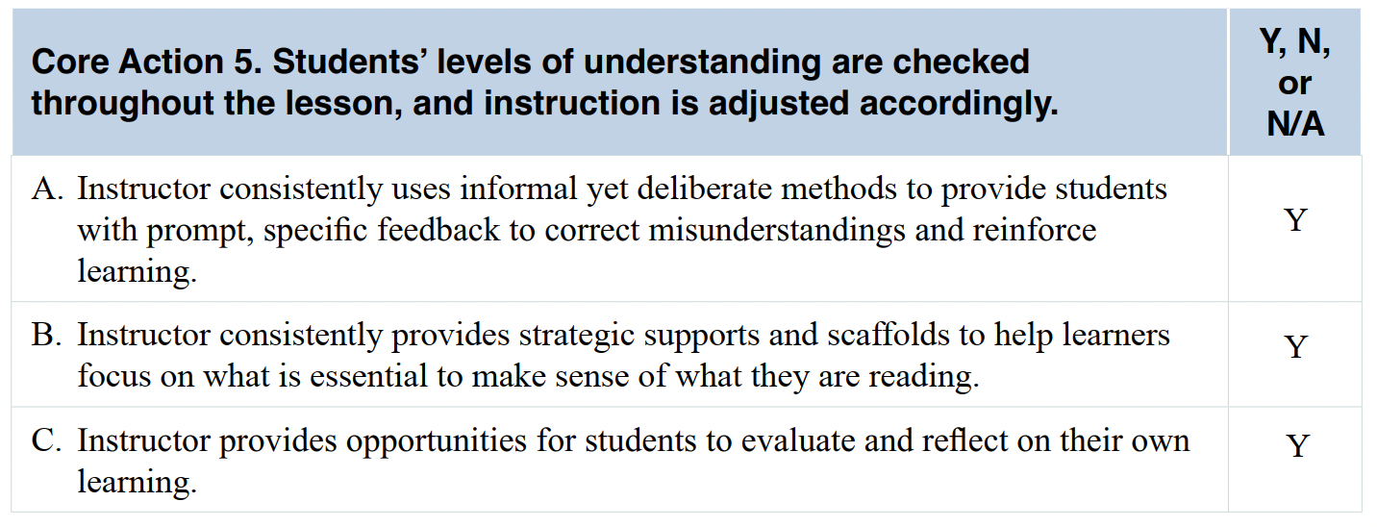
Compare Your Ratings & Evidence to the Sample Ratings for Core Action 5
5 minutes
Notes:
Big idea: Share ratings for Core Action 5 across teams.
Facilitator talking points:
Ask participants to take 5 minutes to compare their ratings with the sample ratings.
Facilitator notes:
Facilitator should note how teams’ ratings compared to what they got.
Go over the evidence in the Resource Package. Determine if differences in ratings are because of a difference in evidence.
Ask for clarifying questions.
Share evidence observed by SIA 2.0 team:
Indicator A:
When students are working individually or in groups, Sarah circulates. Sarah checks student understanding in several ways:
During whole-class discussions, by asking, “Is everyone following me?” [at 00:03:18:00].
During group work, by walking the room and noticing what’s written on the chart paper, and by interacting with small groups.
At the end of the class, by giving students an exit slip. The exit slip asks for the author’s claim and two pieces of supporting evidence from the final text [at 00:50:27:00].
As Sarah moves from group to group, she often asks students questions to guide their thinking rather than providing them with the “right” answers. For example, she asks, “How do you know that?” [at 00:24:56:00], and there are several other examples throughout this activity. Sarah provides prompt and specific feedback during the small-group evidence-sorting activity. She corrects the group’s misunderstanding and tells students that there is only one claim in the set. She then prompts them to read all the sentence strips to figure out which one states an opinion.
Indicator B:
Sarah provides support when it is needed. As Sarah moves from group to group, students ask her questions or call her to their table to explain or clarify the task. When a student says he sometimes forgets text he just read, Sarah summarizes it with him, letting the student finish his thought [at 00:34:07:00].
Indicator C:
The exit slip includes reflection questions [at 00:50:27:00]: “After reading these texts, do you want to eliminate the penny from our currency or not? What evidence convinced you? Name one thing you learned today about claims and evidence. Name something you still need help with.”

Slide 25
Share Findings for Core Action 5
Let’s have a couple of teams to share their ratings and the evidence that supports those ratings.
Did anyone have different ratings or evidence that they would like to share?
Notes:
Big idea: Discuss the findings for Core Action 5.
Facilitator talking points:
Let’s have a couple of teams share their ratings and evidence. Ask for selected team reporters to share.
Did anyone have different ratings or evidence that they would like to share?
Let’s talk through what differences there are in the ratings and if they are because of a difference in evidence.
Ask for clarifying questions.
Facilitator notes:
Based on the poll results, we will know if there are differences in the ratings.
Call on people who had different answers.
Remind participants that they were asked to select someone who will report out on behalf of the team.

Slide 26
SIA 2.0 Observation: Five-Part System
Notes:
Big idea: Show the graphic as a reminder.
Facilitator talking points:
Now that you are going to conduct classroom observations yourself, we are going to review the pre-observation preparations and post-observation coaching.
Facilitator notes:

Slide 27
Conduct Site-Based Observations
Over the next four weeks, conduct two (and preferably more) observations at your site(s).
Hold pre-observation sessions with the instructors who have agreed to be observed.
Individually, collect evidence, make notes, and assign ratings for all five Core Actions on the Observation Tool.
Hold individual post-observation coaching with participating staff (who are interested) to share your reflections.
Notes:
Big idea: Address any remaining questions and prepare participants for the next session.
Facilitator talking points:
Ask for remaining questions.
Review expectations for Weeks 4 through 7.
Team members who are close geography-wise or from the same program, may be able to observe the same teacher(s). That way you can compare one another’s observations.
Team members who are not close geography-wise will likely choose to observe different teachers. There, the focus will be on what the observation data tells them about how to support teachers.
Facilitator notes:

Slide 28
Conduct Site-Based Observations, cont’d.
Regroup as a state team with your coach to answer two questions about every observation you conduct:
What positive feedback would you provide to the instructor?
What support would you provide to the instructor?
Be prepared to discuss your experiences observing at the next virtual training sessions. What worked well? What were your challenges? What did you learn?
Notes:
Big idea: Address any remaining questions and prepare participants for the next session.
Facilitator talking points:
Ask for remaining questions.
Review expectations for Weeks 4 through 7.
Team members who are close geography-wise or from the same program, may be able to observe the same teacher(s). That way you can compare one another’s observations.
Team members who are not close geography-wise will likely choose to observe different teachers. There, the focus will be on what the observation data tells them about how to support teachers.
Facilitator notes:

Slide 29
PREPARE FOR SITE-BASED OBSERVATIONS

Slide 30
Launch Pre-Observation Procedures
Hold pre-observation meeting(s) with teachers to:
Explain the purpose and principles of the SIA 2.0 Classroom Observation System.
Discuss the specific classes and levels that will be observed.
Review the SIA 2.0 Observation Tool and answer any questions.
Reassure staff that observations will be used to support teachers’ growth and will not result in individual personnel evaluations.
Notes:
Big idea: Explain the importance of holding a pre-observation meeting with staff.
Facilitator talking points:
The observation system works best when it is well understood by both observers and those being observed.
Let those who you are observing know what the purpose and principles are and are not.
If helpful, share the videos from the training with instructors to help make the Core Actions and indicators come to life. Instructors also are likely to get ideas from watching another instructor in action. Just experiencing this process will prompt them to reflect on their own practice and to consider—and perhaps sharpen—elements of their lesson delivery.
If the teacher you are observing wants to see your ratings and write-ups after the observation, be prepared to share them.
Facilitator notes:
Direct participants to the Observation Checklist that is discussed in the next several slides.

Slide 31
Launch Pre-Observation Procedures, cont’d.
Prepare to:
Arrive early and stay in the classroom for the entire lesson to observe the arc of the lesson, including its setup, flow, and conclusion.
Assume the role of researcher collecting observational data on teaching practices, not evaluating teacher performance.
Bring a copy of the standards for the level and content area. Also, bring a copy of the SIA 2.0 Classroom Observation Tool and additional resources you may want for notetaking.
Notes:
Big idea: Review observation procedures that will help to ensure positive and effective observation experiences.
Facilitator talking points:
Remind participants of the goal of observations.
The Classroom Observation System does not judge the merit of instructors.
The procedures on this slide and the following slides are designed to help you prepare for classroom observations and the meetings with teachers that will follow. They include a series of before-, during-, and post-observation reminders. Importantly, they are intended to ensure that you and the teachers you are observing have a positive and collaborative learning experience.
Facilitator notes:
Review the procedures.
The procedures are meant to create conditions for respectful non-judgmental data collection.
Ask if anyone has questions about the procedures.

Slide 32
Conduct Observations
During the observation:
Support the natural atmosphere of the classroom, taking your cues from the teacher. That includes, for example, minimizing your interaction with students unless the teacher invites you to do otherwise.
Pay attention to students’ verbal and nonverbal responses, including how they are constructing their understanding, their strategies for solving problems, and any patterns of student error.
Focus on teacher-student interactions, including types of student engagement and how the teacher encourages engagement.
Notes:
Big idea: Describe important considerations when conducting observations of staff.
Facilitator talking points:
If observations are a new practice, despite efforts to allay fears, instructors still may have concerns that could affect teaching and learning during the observation. This is normal.
Over time, as observations become a welcome and usual practice, anxieties about them should subside.
Conduct a second observation to get reliable data if the lesson seemed atypical.
Facilitator notes:
Review the procedures.
Ask if anyone has questions about them.

Slide 33
Conduct Observations, cont’d
Immediately following the observation:
Review notes and record your evidence and final thoughts on a clean observation tool while observations are fresh in your mind.
If you find you need additional information to check your observations or to better interpret them, ask the teacher for clarification.
Notes:
Big idea: Describe important considerations when conducting observations of staff.
Facilitator talking points:
It’s important to capture your thoughts and evidence soon after your observation.
Doing so also allows you to check in with the teacher you observed, if necessary.
Facilitator notes:
Review the procedures.
Ask if anyone has questions about them.

Slide 34
Launch Post-Observation Procedures
Out of courtesy, ask the instructors you observed if they would like you to share your reflections with them.
If so, conduct post observation debriefings:
Begin by stating the purpose and agenda for the discussion: to debrief the observation and promote an exchange of information.
Notes:
Big idea: Hold a post-observation meeting with the staff you observed.
Facilitator talking points:
Out of courtesy, ask the instructors who you observed if they would like you to share your observations and reflections with them.
If they say “yes,” follow the recommendations in the Observation Checklist.
Facilitator notes:
Review the procedures.
Ask if anyone has questions about them.

Slide 35
Launch Post-Observation Procedures, cont’d.
Begin on a positive note by discussing the strengths observed and then move to areas of instruction that could be strengthened:
Speak explicitly and concretely about the Core Actions and indicators observed.
Inquire about those indicators not observed to determine the reasons why (e.g., perhaps some did not apply to the specific lesson observed).
Provide an opportunity for the participating staff member to reflect on your observations and thoughts.
Notes:
Big idea: Hold a post-observation meeting with the staff you observed.
Facilitator talking points:
Since this is just a practice run, there is no need to coach further or think through what additional PD could strengthen the instructor’s practice.
Remember, a central purpose of presenting major findings is to celebrate instructors’ strengths. It also increases their awareness of standards-based teaching, identifies learning areas that need improvement, and elicits ways to address those weaknesses.
Facilitator notes:
Direct participants again to a copy of the Observation Checklist here.
Review the procedures.
Ask if anyone has questions about them.

Slide 36
Launch Post-Observation Procedures, cont’d.
Agree on future learning:
Ask which areas of the teaching and learning practices the teacher wants to know more about.
Think through PD priorities for continuous improvement.
Notes:
Big idea: Give participating staff an opportunity to reflect on your observations.
Facilitator talking points;
It’s important to create a give and take about your observations.
Again, you’re only practicing here, so make this discussion low-key.
When you incorporate observations into your programs, you will want to offer some coaching, provide staff with targeted PD opportunities, and conduct follow-up observations.
Facilitator notes:
Read through the slide.

Slide 37
Team Time
In your teams, discuss preparations to complete observations over the next four weeks:
Will you coordinate as a whole team or work individually? What makes the most sense?
Look at your calendar. When could you schedule time in classrooms over the next few weeks?
How and when are you going to review the data from observations together with your coach?
20 minutes
Notes:
Big idea: Prep for Weeks 4, 5, 6, and 7.
Facilitator talking points:
You will need to decide in your teams how many observations you want and will be able to complete, either as a group or individually.
Discuss these questions and put a plan together.
Facilitator notes:
Break into teams.

Slide 38
Preparing for Our Next Virtual Session
Be prepared to discuss the following questions about your observations to share at our next virtual training session:
What did you learn?
What did you notice?
What challenges did you encounter?
Notes:
Big idea: Review key findings from site-based observations & prepare to share with other state teams.
Facilitator talking points:
This is an opportunity to reflect on what was learned during the site-based observation process.
Remind participants to feel prepared to share their responses to the prompts. They should also be prepared to ask questions of other state teams when they return to the next virtual session.
Facilitator notes:

Slide 39
QUESTIONS & CLARIFICATIONS

Slide 40
Thank you!

