Slide 1
Observations in
Mathematics Classrooms

Slide 2
Welcome to the
Classroom Observation Training!
Notes:
Big idea: Ronna Spacone kicks off the training!

Slide 3
Disclaimer
This presentation was produced and funded in whole with Federal funds from the U.S. Department of Education under contract number ED-991990018C0040 with StandardsWork, Inc. Ronna Spacone serves as the Contracting Officer’s Representative. There is content on the slides and additional content in the Slide Notes throughout the presentation. The content of this presentation does not necessarily reflect the views or policies of the U.S. Department of Education nor does the mention of trade names, commercial products, or organizations imply endorsement by the U.S. Government.
Notes:
Big idea: Make audience aware of contract information.
Facilitator talking points:
Please read through this slide for information about the contract.
Facilitator notes:

Slide 4
A Little Bit About You – Poll
What is your experience with classroom observation systems? (Mark all that apply.)
I have observed classrooms using a standardized tool.
I have been observed teaching using a standardized tool.
I have not been involved in either.
Notes:
Big idea: To understand participants’ familiarity with observation tools or rubrics.
Facilitator talking points:
The Poll will appear on the screen.
Please take a moment to select the answer that best represents your experience with observation tools or rubrics.
Facilitator notes:
After poll results are shared, note any trends based on participant responses. For example, “I see that many of you have been observed but are new to observing lessons using a tool or rubric.”

Slide 5
Purpose of the SIA 2.0 Classroom Observation System
Monitor how well lesson content and instructional practices are aligned with the demands of state-adopted standards.
Determine how lessons can be improved to promote higher and deeper levels of student learning.
Determine how lessons can be more relevant to adult learners.
Identify priorities for professional development to strengthen standards-based instruction.
Notes:
Big idea: Explain the purposes and benefits of the observation system.
Facilitator talking points:
This is a tool for professional growth and for making entire programs stronger by:
Highlighting what is strong about lesson content and instructional practices, and
Targeting the needs that the lesson gaps reveal.
Facilitator notes:

Slide 6
Principles of the SIA 2.0 Classroom Observation System
The Observation System is designed to:
Review alignment of teaching practices against the demands of state academic standards.
Identify needed improvements and best practices to share with instructors.
Develop an accurate portrait of instructional practices in a discipline for an entire program.
It is distinct from formal, summative teacher performance evaluations! (It does not judge individual instructors.)
Notes:
Big idea: Review the principles—what the tool is for and what it is not for.
Facilitator talking points:
This is an observation tool that reveals effective—and less effective—teaching practices.
It also can be used to understand the curriculum choices recurring across multiple classrooms within a program.
This is a different type of observation system than we are used to. It is not an evaluation and certainly not meant to judge the merit or performance of a specific instructor. It is a learning tool to make everyone stronger.
Facilitator notes:

Slide 7
Three Basic Questions to Answer
How well aligned are lessons to the demands of state-adopted standards?
How can instructional practices be improved to promote higher and deeper levels of student learning?
Based on data from observations, what are some PD priorities to strengthen standards-based instruction?
Notes:
Big idea: Review the goals of the observation system.
Facilitator talking points:
You will explore, with observers you are training, the relationship between key instructional advances for mathematics and elements of the Classroom Observation Tool.
Goals of observations are to:
Strengthen lessons to align with the demands of state standards.
Help teachers improve their practice.
Focus on instructional practices that will optimize student engagement that leads to high levels of student learning.
Facilitator notes:

Slide 8
Overview of SIA 2.0 Classroom Observation Training
Week 1: Introduce the SIA 2.0 Classroom Observation Tool and what constitutes good evidence (virtual training session)
Week 2: Practice observation with full-length lesson video (team-based assignment)
Week 3: Prepare for live classroom observations (virtual training session)
Weeks 4–7: Conduct live classroom observations (site-based assignment)
Week 8: Debrief live classroom observations and plan for next steps for site-based implementation (virtual training session)
Notes:
Big idea: Preview the overview of the entire observation training.
Facilitator talking points:
The training will span 8 weeks. There will be a combination of virtual training sessions (like this one) and site- and team-based assignments that you will complete with your team.
Facilitator notes:
Read through the slide.

Slide 9
Session Overview
Introduction to the SIA 2.0 Observation Tool:
Review Core Actions 1–5 of the SIA 2.0 Observation Tool
Apply the Observation Tool to the SIA 2.0 Short Math Video
Preview Week 2 Team-based Assignment
Notes:
Big idea: Preview with participants the overview of activities for the day.
Facilitator talking points:
There are three main segments for today’s training.
You will learn about the features of the Observation Tool and then practice with the tool using a short video during today’s session.
This will be followed by another opportunity to practice with a longer video next week with your state team.
Facilitator notes:
Read through the slide.

Slide 10
Meeting Norms and Expectations
Be present and engage fully in all activities.
Ask questions through the chat or by raising your hand.
Put cameras on whenever possible.
Prepare for productive struggle.
Respectfully challenge one another and withhold judgments for differing perspectives or learning styles.
Notes:
Big idea: Revisit with participants the norms to which we will adhere as we proceed through the trainings.
Facilitator talking points:
Everyone will be expected to engage no matter your role.
After reading through the norms, ask if there are any comments or questions.
Remind participants that they can do so through the chat or by raising their hand.
Let participants know that they will be working in whole and small teams with assigned coaches. We’ll be using the workbook.
Facilitator notes:
Read through the slide.

Slide 11
Introducing SIA 2.0 CLASSROOM OBSERVATION for mathematics

Slide 12
SIA 2.0 Observation: Five-Part System
Notes:
Big idea: Outline the five parts of the system.
Facilitator talking points:
As you can see, the SIA 2.0 Observation System has five parts.
During this training, we will concentrate on the first three parts, with most of the focus going on conducting observations.
If there is interest, we will hold a follow-up training on the last two parts to show how to aggregate data and develop program-wide PD.
Facilitator notes:

Slide 13
Tools and Resources
Classroom Observation Tool for Mathematics
Mathematics Classroom Observation Resource Package
Observation Checklist
Mathematics Core Actions and Guiding Questions
Mathematics Core Actions and Matching Summaries

Slide 14
SIA 2.0 Classroom Observation: Five Core Actions to Observe
Lesson content is rigorous and relevant for the level defined by the state-adopted standards.
Learning activities are cognitively demanding and maximize opportunities for students to master the lesson content.
Lesson content productively engages students.
Lesson content is intentionally sequenced to develop students’ skills and knowledge.
Students’ levels of understanding are checked throughout the lesson, and instruction is adjusted accordingly.
Notes:
Big idea: This process is based on five Core Actions to observe in the classroom presentation of a lesson. Here are three of them.
Facilitator talking points:
Here you see the action statements that we will explore in this training.
Facilitator notes:
Ask participants to follow along by reviewing their copies of the SIA 2.0 Classroom Observation Tool on page 1.
Read the language of each Core Action. No discussion is necessary yet.

Slide 15
Let’s Review the Math Classroom Observations Resource
Notes:
Big idea: Provide an overview of the Math Classroom Observations Resource.
Facilitator talking points:
This resource contains the main resources you will use over the coming weeks.
It contains:
Blank Observation Tool
Aggregation document and instructions—this will not be part of the training but will be a resource for implementing observations in your programs.
Facilitator notes:
Provide participants with access to the resource.

Slide 16
Core Action 1
Notes:
Big idea: Review the indicators that make up Core Action 1.
Facilitator talking points:
Ask participants to follow along in their workbooks.
Participants should reference the CCR standards or think about their own standards. They should also reference the major work of the level in their packet.
You can look at the questions that go along with every Core Action.
Facilitator notes:
Click through and read the indicators for this Core Action.
Read each indicator aloud. This is meant to be supportive of those with varying learning styles. We don’t usually read all slides, but the indicators for each Core Action are worth saying aloud.
Participants will have time to think through each one during their group time, so there is no need to linger on any one of them.
The final click reminds them to always use evidence of what they observe in their observations.

Slide 17
Let’s Review the Major Work of the Level (MWOTL) Resource
When planning instruction, instructors should focus deeply on the MWOTL, rather than racing to cover topics in a mile-wide, inch-deep curriculum. (See link to doc in the chat.)
The standards recently adopted by states require educators to significantly narrow and deepen the way time and energy is spent in the math classroom.
When educators apply an MWOTL approach to teaching and learning, students gain strong foundations in critically important areas.
Notes:
Big idea: Introduce the Major Work of the Level Document.
Facilitator talking points:
The major work of the level (MWOTL) identifies the most important mathematics in preparing adult learners for success in college, careers, and life.
You should learn to identify the topics that are—and are not—major topics for the various standards’ levels. Of course, you have a reference doc.
Students should spend their time on the three aspects of rigor. These are conceptual understanding, procedural skill and fluency, and the ability to apply what they learn to solve math problems inside and outside the classroom.
Facilitator notes:
Provide folks with a link to the MWOTL doc: https://lincs.ed.gov/publications/pdf/ccr/Math_Unit_1_Materials/Math_1_part_mat.pdf

Slide 18
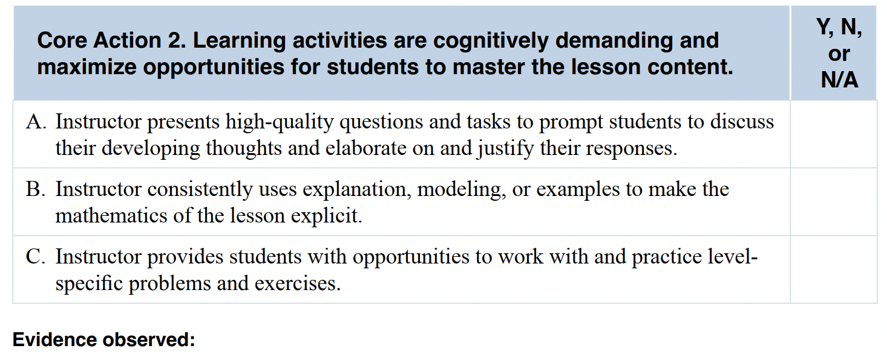
Core Action 2
Notes:
Big idea: Review the indicators that make up Core Action 2.
Facilitator talking points:
Ask participants to follow along in their workbooks.
Facilitator notes:
As you click through the indicators, read each one and move on.
Participants will have time to think through each one during their breakout times.

Slide 19
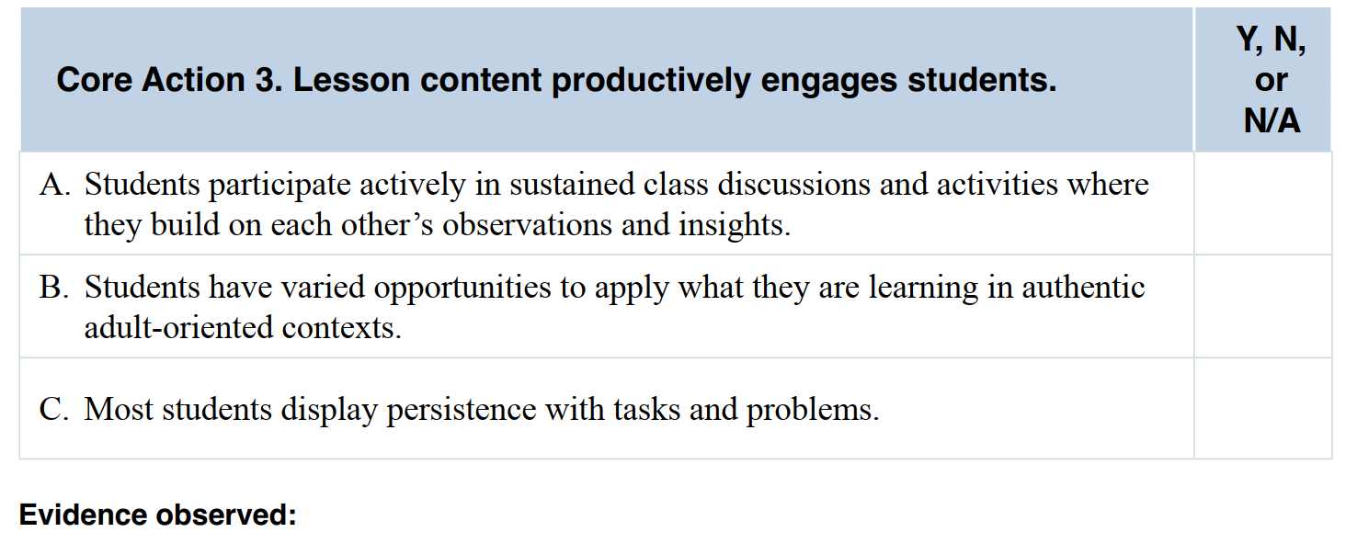
Core Action 3
Notes:
Big idea: Review the indicators that make up Core Action 3.
Facilitator talking points:
Ask participants to follow along in their workbooks.
Facilitator notes:
As you click through the indicators, read each one and move on.
Participants will have time to think through each one during their breakout times.

Slide 20
Guiding Questions
Notes:
Big idea: Introduce participants to the Mathematics Core Actions and Guiding Questions.
Facilitator talking points:
These are questions you should ask yourself when determining if the indicators for each Core Action are present.
We will be referencing this resource throughout.
In fact, it will be useful in the team breakout session coming right up as you think through examples and non-examples.
Facilitator notes:
Make sure participants have a copy of the Guiding Questions to guide their reflections.

Slide 21
Team Time
Discuss Core Actions 1, 2, and 3.
Think about your instruction or instruction you’ve observed in your program. For each Core Action:
Decide as a team on one example that would make you think each indicator was evident.
Decide as a team on one example that would make you think each indicator was not evident (i.e., a non-example).
Share your team’s example and non-example on the Padlets.
Choose a reporter to share your team’s reflections for the whole group debrief.
25 minutes
Notes:
Big idea: Discuss Core Actions 1-3 in teams.
Facilitator talking points:
The goal is for each team to decide on one example and non-example for each indicator.
For example:
A non-example of Core Action 1A: The lesson has goals, but they are not part of the MWOTL.
A non-example for Core Action 1B: You are observing the lesson and students are using a mathematical practice because they were told to or it was the practice of the week, but it doesn’t actually align with the standards they are learning.
You can reference the Guiding Questions doc when thinking about examples and non-examples.
This exercise is a precursor to observing and substantiating your findings with evidence.
Please identify a “reporter” for your team who will share during the whole group debrief.
Facilitator notes:
Read instructions for the activity from the slide.
Specific instruction for how to use the Padlet is on slide 22.

Slide 22
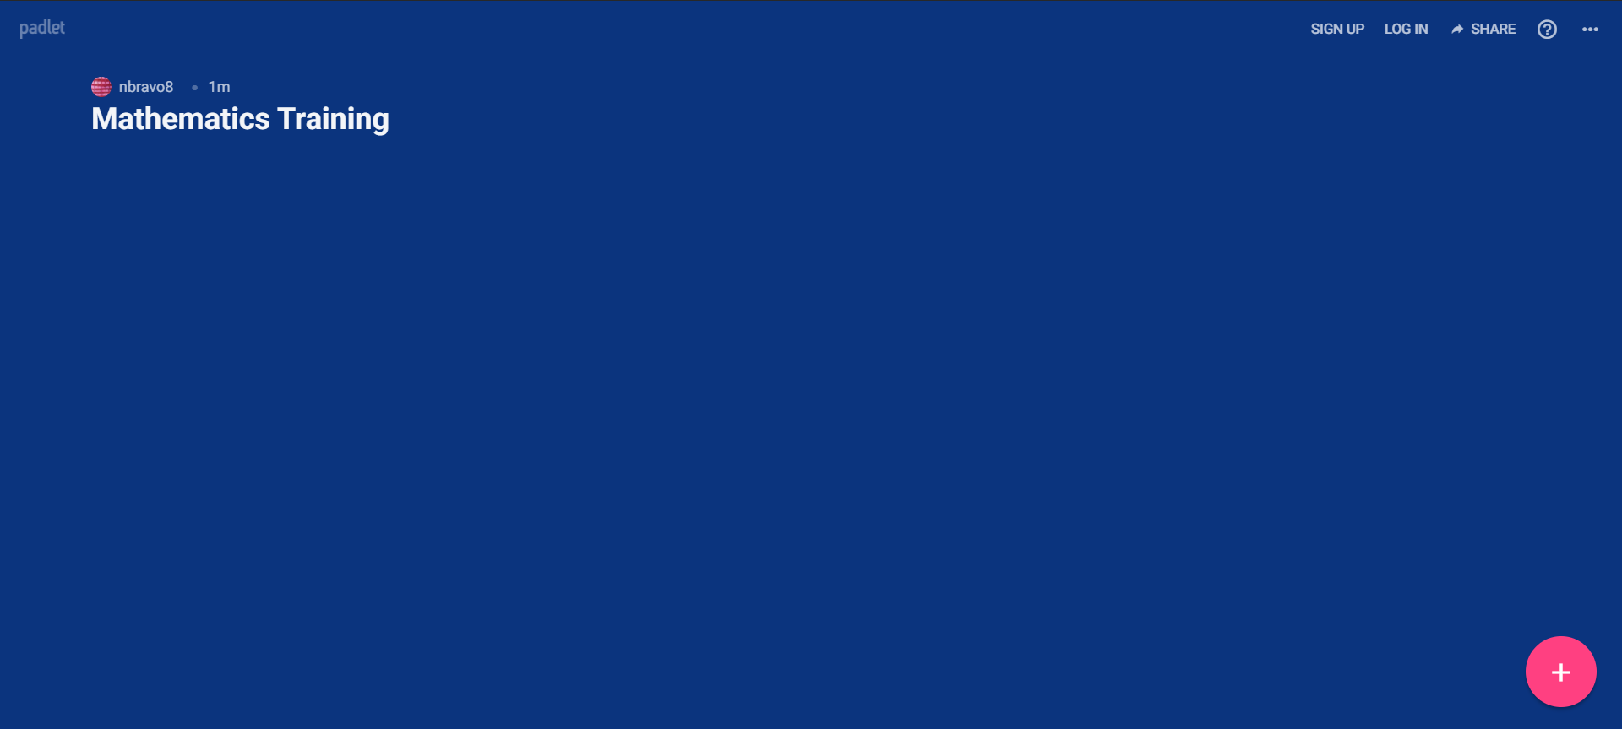
Using Padlets
At the bottom right-hand corner of your screen, click on the plus sign. This will allow you to post something.
A post will come up where you can type your thoughts. The other icons give you the following options: upload, link, search, and snap.
Clicking on the three dots to the right will give you the options above along with others.
Notes:
Big idea: Show people how to use Padlets.
Facilitator talking points:
Read instructions for how to use Padlet from the slide.
Facilitator notes:
Screen share as needed.

Slide 23
Welcome Back!
Notes:
Big idea: Bring state teams back together and debrief the work session.
Facilitator talking points:
Facilitator notes:
Click on this slide before breakout groups return to the main room.

Slide 24
Whole Group Debrief
Review: Look across the examples and non-examples from the other teams. (7 minutes)
Chat (with a pause): What did you notice? What did you wonder? (2 minutes)
Reflection: Let’s have a couple of team reporters share what their teams noticed and wondered about Core Actions 1, 2, and 3. (6 minutes)
15 minutes
Notes:
Big idea: Whole group debrief.
Facilitator talking points:
Everyone is welcome to chat responses.
Remind teams that their “reporter” will share the team reflections.
Facilitator notes:
We are introducing the chat (with a pause). Participants will be given 1 minute to type their responses in the chat box and will wait for the facilitator to select enter/send.
The purpose of the chat (with a pause) is to allow everyone to express their thoughts. Sometimes thinking stops if we think someone has already provided the “answer.”

Slide 25
Core Action 4
Notes:
Big idea: Review the indicators that make up Core Action 4.
Facilitator talking points:
Ask participants to follow along in their workbooks.
Facilitator notes:
As you click through the indicators, read each one and move on.
Participants will have time to think through each one during their breakout times.

Slide 26
Core Action 5
Notes:
Big idea: Review the indicators that make up Core Action 5.
Facilitator talking points:
Ask participants to follow along in their workbooks.
Facilitator notes:
As you click through the indicators, read each one and move on.
Participants will have time to think through each one during their breakout times.

Slide 27
Team Time
Discuss Core Actions 4 and 5
Think about your instruction or instruction you’ve observed in your program. For each Core Action:
Decide as a team on one example that would make you think each indicator was evident.
Decide as a team on one example that would make you think each indicator was not evident.
Share your team’s examples and non-examples in the Padlets.
Choose a reporter for the whole group debrief.
25 minutes
Notes:
Big idea: Discuss Core Actions 4-5 in teams.
Facilitator talking points:
Read instructions for the activity from the slide.
The goal is for each team to decide on at least one example and non-example for each indicator.
A non-example for Core Action 5A: The teacher just marks homework/assignments right or wrong and provides a grade with no feedback.
You can reference the Guiding Questions doc when thinking about examples and non-examples.
This exercise is a precursor to observing and substantiating your findings with evidence.
Please identify a “reporter” for your team who will share during the whole group debrief.
Facilitator notes:

Slide 28
Welcome Back!
Notes:
Big idea: Bring state teams back together and debrief the work session.
Facilitator talking points:
Facilitator notes:
Click on this slide before breakout groups return to the main room.

Slide 29
Whole Group Debrief
Review: Look across the examples and non-examples from the other teams. (7 minutes)
Chat (with a pause): What did you notice? What did you wonder? (2 minutes)
Reflection: Let’s have a couple of team reporters share what their teams noticed and wondered about Core Actions 4 and 5. (6 minutes)
15 minutes
Notes:
Big idea: Whole group debrief.
Facilitator talking points:
Everyone is welcome to chat responses.
Remind teams that their “reporter” will share the team reflections.
Facilitator notes:
Participants will be given 1 minute to type their responses in the chat box and will wait for the facilitator to select enter/send.
The purpose of the chat (with a pause) is to allow everyone to express their thoughts. Sometimes thinking stops if we think someone has already provided the “answer.”

Slide 30
Let’s Use the SIA 2.0 Observation Tool With Video Lesson 1
Watch the lesson video.
As you observe the lesson, individually make notes for Core Actions 1, 2, and 5.
Fill out an Observation Tool, using the Mathematics Core Actions and Guiding Questions as a guide.
25 minutes
Notes:
Big idea: Provide an opportunity for participants to apply what they’ve learned about Core Actions 1, 2, and 5 to a video lesson.
Facilitator talking points:
You can put your observation training into action by watching a video and taking notes on the Core Actions (and indicators) you observe.
Notice that we are only asking you to opine on Core Actions 1, 2, and 5. This is because this is a short lesson, and Core Actions 3 and 5 are not applicable.
Please remember that no lesson is perfect.
Think about the Guiding Questions doc that was discussed and reviewed earlier.
Facilitator notes:
Make sure participants have a clean copy of the Observation Tool to take notes while watching the first video.

Slide 31
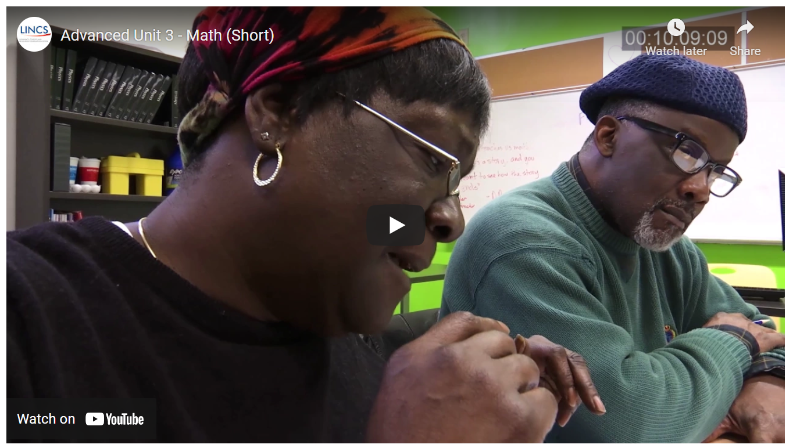
Video #1 Math Lesson: 20 Minutes
Notes:
Big idea: Watch a short video.
Facilitator talking points:
We’ll now take 20 minutes to watch the math lesson.
Have your Observation Tool out. Remember you can take notes on what you observe on a separate piece of paper if you prefer.
Watch for teacher moves and student responses.
You will have time after the video to decide whether you think certain indicators are present or not present.
You’ll be reflecting on Core Actions 1, 2, and 5 only as this is a short video. (Core Actions 3 and 4 are not applicable.)
Facilitator notes:
Participants will watch the video.

Slide 32
Team Time
After watching the lesson video, individually review your notes and rate each indicator in Core Actions 1, 2, and 5. In addition, for Core Action 1, review the lesson. (15 minutes)
In your group, be prepared to share the ratings and evidence for indicators you thought were particularly evident. (Use the Mathematics Core Actions and Guiding Questions to direct your discussions.) (30 minutes)
45 minutes
Notes:
Big idea: Discuss indicators in Core Actions 1, 2, and 5 seen in the video.
Facilitator talking points:
Individually you will watch the video, collect evidence, and rate.
The links to the lesson and the guiding questions are in the chat.
After 15 minutes, you will go into team time to share your observations and evidence.
Facilitator notes:
Give participants time to rate each indicator.
They should do this on a blank Observation Tool.

Slide 33
Welcome Back!
Notes:
Big idea: Bring state teams back together and debrief the work session.
Facilitator talking points:
Facilitator notes:
Click on this slide before breakout groups return to the main room.

Slide 34
Sample Answers for Core Action 1
Chat (with a pause): How do these ratings compare to yours?
Notes:
Big idea: Share ratings for Core Action 1 across teams.
Facilitator talking points:
Ask participants to compare their ratings with the sample ratings using the chat (with a pause).
You can follow along in the doc that shows the relevant portion of the Resource Package.
Facilitator notes:
Give participants a few minutes to review the sample ratings.
Facilitator should note how teams’ ratings compared to the ratings.
Go over the evidence and determine if differences in ratings are because of a difference in evidence.
Ask for clarifying questions.
Share evidence observed by SIA 2.0 team:
Indicator A:
All the CCR standards listed in William’s lesson plan are reflected, at least partially, in his lesson:
Generate a number or shape pattern that follows a given rule. Identify apparent features of the pattern that were not explicit in the rule itself. (4.OA.5)
Write simple expressions that record calculations with numbers and interpret numerical expressions without evaluating them. (5.OA.2)
Understand that a function is a rule that assigns to each input exactly one output. The graph of a function is the set of ordered pairs consisting of an input and the corresponding output. (8.F.1)
All three standards targeted in this lesson are central to students’ learning.
During the lesson, students engage in a variety of tasks and activities that reflect the standards. William addresses the concept of a function as a rule that assigns each input exactly one output during the lesson. He also encourages students to identify patterns they notice in the table. For example, during the first activity, students are given a rule (two operations) and must complete a table. The table has some inputs missing for corresponding outputs, and vice versa. Students report out their answers from their completed worksheet [at 00:11:39:00].
William presents the lesson goals to students at the beginning of the video segment. During this introduction, we also see interview footage of him explaining the lesson goals.
Indicator B:
Standards for Mathematical Practice are identified in the lesson plan and reflected in the lesson. Specifically, MP.8: Look for and express regularity in repeated reasoning. To elicit these habits of mind, students must complete a function table based on a two-operation rule during the first activity. They begin to learn how to find the output based on the given rule and use it to find the input based on a given output.
Indicator C:
Since this lesson's focus is to introduce and explore two-operation rules for functions, conceptual understanding is the primary goal. This lesson expands on the previous lesson, where students identified an input or output based on a one-operation rule. William asks questions to check student understanding. He first works through a problem with the group and then has students complete the remaining problems with a partner. He then has students report out to make sure they understand.

Slide 35
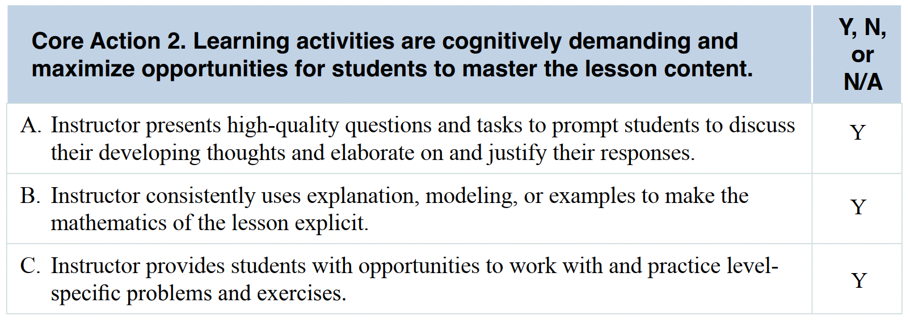
Sample Answers for Core Action 2
Chat (with a pause): How do these ratings compare to yours?
Notes:
Big idea: Share ratings for Core Action 2 across teams.
Facilitator talking points:
Ask participants to compare their ratings with the sample ratings using the chat (with a pause).
Encourage participants to follow along in the doc that shows the relevant portion of the Resource Package.
Facilitator notes:
Facilitator should note how teams’ ratings compared to the example ratings.
Go over the evidence in and determine if differences in ratings are because of a difference in evidence.
Ask for clarifying questions.
Indicator A:
William makes the initial activity challenging by asking students to find an input from its output; this activity requires students to work backward [at 00:02:36:00]. Moreover, some of the partner activities include decimals, which also can be challenging.
William shows students upfront how to find an output given the two-operation rule. Once many students demonstrate that they have a foundational understanding, the class plays a round of “the function game." This game asks students to identify another ordered pair for an unknown rule when given a single ordered pair [at 00:13:16:00]. Students call out their guesses until William writes several ordered pairs in the table on the board. Eventually, many students show they are able to find the pattern.
Students discuss the problems productively. William often asks probing questions to move students forward in their thinking. For example, when a student answers the question during the initial activity, William encourages him to elaborate on the answer [at 00:02:07:00].
William often encourages students to justify and elaborate on their responses. When students work in small and whole groups, William asks questions rather than just impart information. His questions require more than a “yes” or “no” answer from students; he does not simply give students answers. He leads them to the correct answers. He often tries to clarify students' understanding, asking them to explain how they got their answers. In his interview, William describes his intentionality to lead through questions [at 00:06:03:00].
Indicator B:
During the whole-group discussions, William uses explanation, modeling, and examples. When he introduces the concept of finding the input/output based on a two-operation rule, William builds from previous knowledge of doing so with one operation. After showing an example, he has students work on tables with their partners. He also asks many questions throughout.
Indicator C:
The problems and activities presented are appropriate for Low/Middle Intermediate-level students and match the standards at that level. William presents a variety of problems during the short segment. William works through an example of finding the input/output based on a two-operation rule with students. Then they complete a few problems on their own and report out. They also play “the function game” [at 00:13:16:00]. All students are participating and are engaged in each of these activities and in-class discussions. Students ask questions, discuss, and volunteer answers throughout the lesson.

Slide 36
Sample Answers for Core Action 5
Chat (with a pause): How do these ratings compare to yours?
Notes:
Big idea: Share ratings for Core Action 5 across teams.
Facilitator talking points:
Ask participants to compare their ratings with the sample ratings.
You can follow along in the doc that shows the relevant portion of the Resource Package.
Facilitator notes:
Facilitator should note how teams’ ratings compared to the example ratings.
Go over the evidence and determine if differences in ratings are because of a difference in evidence.
Ask for clarifying questions.
Indicator A:
William checks for student understanding in numerous ways: any time students work with a partner, he circulates, checks their work, and asks questions.
As noted, William more often leads students to the correct answers through questioning than by providing them. For example, when a student checks an answer using the opposite operation instead of applying the original operation, William asks questions to clarify the process. He then leads the student toward correcting his answer [at 00:04:54:00]. During whole class discussions, William calls on several different students; students are comfortable volunteering.
William provides specific feedback to students throughout the lesson to correct misunderstandings. For example, when a student has trouble completing a whole-group example, he first walks her through that example. Then walks her through two additional examples using a series of questions [at 00:07:38:00].
Throughout the lesson, William allows students plenty of time to express their answers and ideas. For example, when a student starts down the wrong path, William gives him time to express his answer before going back and addressing the misconception [at 00:04:54:00].
Indicator B:
During the whole-group discussion, William responds to a student who has a misunderstanding when "checking" his answer [at 00:04:54:00]. He also provides supplemental instruction to a student who has trouble working independently through the problems [at 00:07:38:00]. In both instances, he works with them until they understand the content.
Indicator C:
Although William does not explicitly ask students to reflect on their learning as a group, this video is only a segment and does not show the lesson's close.

Slide 37
Let’s Discuss!
Let’s take 10 minutes to review the sample evidence for Core Actions 1, 2, and 5.
Now let’s hear from a couple of teams about the evidence you found and noted to support your ratings:
How is your evidence different from or similar to the sample evidence?
Notes:
Big idea: Share our evidence and ratings.
Facilitator talking points:
Now that we’ve compared the ratings for these Core Actions, we want to give you some individual work time. Compare your evidence with the sample.
Remember that there can be many “right” answers. But while the evidence may be different, there should be agreement on the general findings and ratings.
We’re going to take 10 minutes for you to compare what you found with those of the example workbook.
Take some notes about what you see as the same and different. Then we’ll ask you to share your findings when we come back together.
[After work time] Now let’s hear from a couple of teams about their comparison…
Facilitator notes:

Slide 38
QUESTIONS & CLARIFICATIONS

Slide 39
Preview of the Week 2 Assignments
Individually:
Over the next week, watch the full SIA video without looking at the completed observation in the Resource Package.
The link to the lesson is in the chat.
Collect evidence, make notes, and assign ratings for all five Core Actions using the observation tool.
Prepare to meet and share your observations with your state team and coach.
Notes:
Big idea: Prepare for team assignment to watch the video.
Facilitator talking points:
Prepare participants for Week 2 work.
Facilitator notes:
Address any questions that come through the chat.
Make sure they don’t look at the Resource Package prior to their observations so they aren’t influenced by the sample answers provided there.
They could review the lesson plan to determine the goals of the lesson and the targeted standards.

Slide 40
Preview of Week 2, cont’d.
Then meet as a state team with your coach to:
Discuss your ratings and notes with each other using the Mathematics Core Actions and Guiding Questions resource.
Notice points of agreement and reach a consensus about points of disagreement.
Be prepared to share your findings during the next training session. Select someone who will share on behalf of the team.
Any questions?
Notes:
Big idea: Prepare for team-based assignment.
Facilitator talking points:
Prepare participants for Week 2 work.
Facilitator notes:
Address any questions that come through the chat.

Slide 41
An Additional Week 2 Assignment: Select Instructors to Observe
To prepare for the site-based observations you will conduct in a couple of weeks:
Select at least two participants you will want to observe.
Make initial overtures in person or via email to prospective observees.
Let them know you are participating in a national training to gain experience on using a standardized observation tool.
Include the goals of the observation system.
If they agree to being observed, let them know you will be in to observe them in about four weeks.
Notes:
Big idea: Select participants for observation.
Facilitator talking points:
Take time to gather volunteers to be observed.
Be sure to explain to them that you are part of a national training program.
Facilitator notes:

Slide 42
Thank you!

