Slide 1
Introducing the Participant Workbook and Model Curriculum for English Language Arts/Literacy 2022
State-Based Curriculum Review

Slide 2
Welcome!

Slide 3
Disclaimer
This presentation was produced and funded in whole with Federal funds from the U.S. Department of Education under contract number ED-991990018C0040 with StandardsWork, Inc. Ronna Spacone serves as the Contracting Officer’s Representative. There is content on the slides and additional content in the Slide Notes throughout the presentation. The content of this presentation does not necessarily reflect the views or policies of the U.S. Department of Education nor does the mention of trade names, commercial products, or organizations imply endorsement by the U.S. Government.
Notes:
Big idea: Make audience aware of contract information.
Facilitator talking points:
Please read through this slide for information about the contract.
Facilitator notes:
Allow 10-15 seconds or so for participants to review this slide for information about the contract (no need to read through).

Slide 4
Today’s Agenda
Icebreaker
Introduction to the ELA/Literacy Participant Workbook
Orientation to the Model Curriculum
Next Steps
Notes:
Big idea: Introduce the agenda for today’s session.
Facilitator talking points:
Today, we are going to take some time to introduce the Participant Workbook that we will be using to do our review work.
Then, we will introduce you to the model curriculum we will be using.
We will also share with you our process for identifying a representative sample of the model curriculum. You will be selecting a representative sample of the curriculum you have chosen to review as well.
Facilitator notes:
Read the talking points to explain the agenda for today’s session (no need to read the slide bullets).

Slide 5
Meeting Norms and Expectations
Be present and engage fully.
Ask questions.
Prepare for productive struggle.
Consider differing perspectives.
Create and maintain a safe space for professional learning.
Be mindful of different learning styles.
Notes:
Big idea: Share with participants the norms and expectations that will guide us as we proceed through the trainings.
Facilitator talking points:
After reading through the agreements, ask if there are any comments or questions.
Remind participants that they can do so through the chat box or verbally.
Facilitator notes:
Six clicks.
Read through the slide, clicking for each statement.

Slide 6
Ice Breaker
Choose one option from the following:
One word that describes what you most like to do to relax;
Something that comes from, is made in, or stands for your place of birth;
Your favorite song;
What body of water do you think best represents your personality (or just your favorite type of water form and why); or
A book you’ve read in the past year that you liked and why.

Slide 7
SIA 2.0 ELA/Literacy Workbook
Notes:
Big idea: Introducing the State-Based Curriculum Review Participant Workbook for ELA/Literacy
Facilitator talking points:
In the next few slides, we will look at the components of the Workbook we will be using in this pilot work.
You’ll see how it’s structured and how we’ll be working to fill it in during the course of the sessions to come.
Facilitator notes:
No clicks.

Slide 8
The Participant Workbook Is Anchored in the Instructional Shifts
The three key instructional shifts are based on evidence of what is most important for students to learn to be prepared for college and careers.
Text Complexity: Does the curriculum provide regular practice with complex text (and its academic language)?
Evidence: Does the curriculum provide reading, writing and speaking grounded in evidence from text?
Knowledge: Does the curriculum build knowledge through content-rich nonfiction?
Notes:
Big idea: The protocol focuses on these three instructional shifts that represent what is most important for students to learn to be prepared for postsecondary opportunities.
Facilitator talking points:
The key instructional shifts correlate closely to critical aspects of the College and Career Readiness (CCR) Standards for Adult Education and other college and career readiness state standards.
The curriculum review protocol is anchored in the key instructional shifts. It’s what is meant by standards-aligned curriculum. So, as we move from standards to curriculum, it is important to know if the curriculum being used includes the most critical aspects of CCR standards. Those are from adult education or your state’s K-12 standards. That’s why the instructional shifts are expressed as questions.
The shifts are based on research about what students need to be prepared for college and most new century jobs.
Facilitator notes:
Three clicks.
Read the first three talking points before clicking.
Then click to show the key shifts one at a time as you read the slide.

Slide 9
Five Research-Based Dimensions of Quality for ELA/Literacy Curriculum
Close Reading of Complex Text
Building Academic Language
Volume of Reading to Build Knowledge
Evidence-Based Discussions
Evidence-Based Writing
Notes:
Big idea: Introduce the five dimensions of quality for ELA/Literacy curriculum.
Facilitator talking points:
These dimensions are not listed or numbered in any priority order, although the first dimension is an anchor for the other dimensions.
The five dimensions are all important, though the first dimension is key because it sets the requirement for reading complex texts that the others incorporate.
The five dimensions of the Curriculum Review Tool offer you a structure to capture information about the key instructional shifts in ELA/Literacy.
Next, your team will do an activity so you can reflect on how this review tool’s dimensions connect to the three key shifts.
Facilitator notes:
Five clicks.
Read the first talking point and then click through and read the titles of the dimensions.
Then read the second and third talking points.
The next slide provides instructions for the breakout work session.
There is a sixth dimension: Foundational Reading Skills. It is presented as an optional training session, perhaps with a different group from your state participating.
You have access to the criteria for Foundational Reading Skills in the Appendix of this Workbook.

Slide 10
Breakout Session
Now it’s your turn!
Use the Curriculum Review Activity document to reflect on how the dimensions of quality relate to the three key instructional shifts.
You’ll have about 20 minutes for the activity and to share your thoughts with one another.
Take time to raise questions about anything that comes up as you make connections.
Then, we’ll regroup and debrief.
Notes:
Big idea: Getting set up for the work session.
Facilitator talking points:
Now we're going to send you to a breakout room to partner with 1 or 2 team members. This is an opportunity to think about how the dimensions of quality in the Protocol are derived from, and connect to, the key instructional shifts.
In a minute, you will see a pop-up to join the breakout room with one or two teammates. Click on “join” and you will be moved into the breakout room.
Then for the next 20 minutes, we want you and your partners to review the Word document. Look at the five dimensions and decide how they relate to the instructional shifts in college and career readiness standards:
Note that the doc includes arrows for you to connect shifts to the dimensions of quality.
It also asks you to make notes about your rationales.
Make sure to make a note of any questions about the shifts or the dimensions that come up. This way you can share with the whole team when we return to debrief.
As you are thinking about these connections, remember that there are no wrong answers!
Facilitator notes:
Use the first two talking points to explain what is happening.
Read the remaining talking points to explain the breakout session.

Slide 11
Whole Group Debrief
Let’s go through your reflections on how the dimensions of quality connect to the key instructional shifts.
What questions or insights came up in the breakout rooms that you would like to share?
Notes:
Big idea: Time for participants to share their thoughts with one another.
Facilitator talking points:
Did your team find that some matches were almost perfect (1:1 correspondence), while others were more of a “partial” match?
Who is willing to share your connections and your rationales?
Did others have different answers?
What questions and insights came up during your breakout session?
You can share verbally or use the chat box to do that now.
Facilitator Note:
Be prepared to review the “sample” answer sheet.
Use the first talking point to jumpstart the conversation.
Read the next three talking points.
Prompt individual teams if time passes.

Slide 12
Format of the Workbook’s Curriculum Review Protocol for ELA/Literacy
Each dimension includes two types of criteria:
Content criteria detail the demands of high-quality college and career readiness standards. They are also the foundation of sound instruction for English learners (ELs).
EL support criteria name research-based instructional supports that bridge learning gaps and make content in academically rigorous classes comprehensible for ELs.
Notes:
Big idea: Offer further introduction to the contents of the curriculum review protocol within the Participant Workbook.
Facilitator talking points:
The curriculum review process is used to review curriculum that can guide all students’ learning.
This includes Adult Basic Education (ABE) and Adult Secondary Education (ASE) students and English learners.
The content criteria and the scaffolding and supports for each dimension will be explored in more detail in the Participant Workbook.
Facilitator notes:
One click.
Read through the text of the first criteria before clicking to show EL support criteria.
Then read all the talking points.

Slide 13
Workbook Pages for Dimension 1’s Content Criteria
Notes:
Big idea: Show screenshot of the Participant Workbook for Dimension 1 to showcase the format.
Facilitator talking points:
During the first training session, you will concentrate on the content criteria for Dimension 1.
Let’s look at page 2 of the Participant Workbook to see Dimension 1’s content criteria. You can see that there are three content criteria in this dimension. Two are captured on this slide. The third is on the next slide.
Each content criterion is followed by a set of guiding questions. These are not a checklist. They are designed to help you understand what the criterion means and guide your search for evidence in the curriculum.
You will be filling out two workbooks during the course of our time together: one for our model curricula and one for the curriculum they selected to review.
During sessions, you will be working with you to find evidence for each dimension criterion by criterion with a model curriculum we’ve selected.
Between sessions, you will apply the same section of the workbook to curricular materials of their own choosing.
Facilitator notes:
Encourage your team to read this in their own Participant Workbook since it is easier to see how all three criteria are laid out on one page.

Slide 14
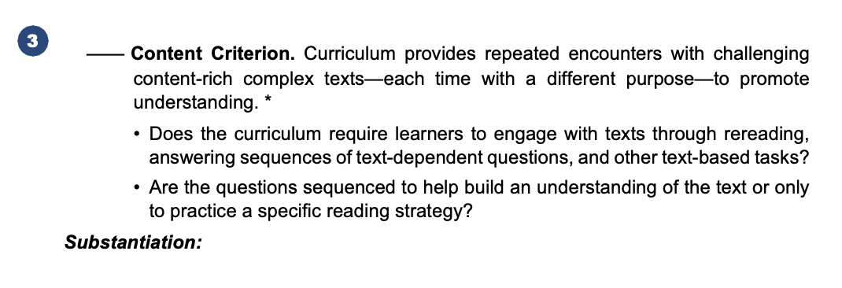
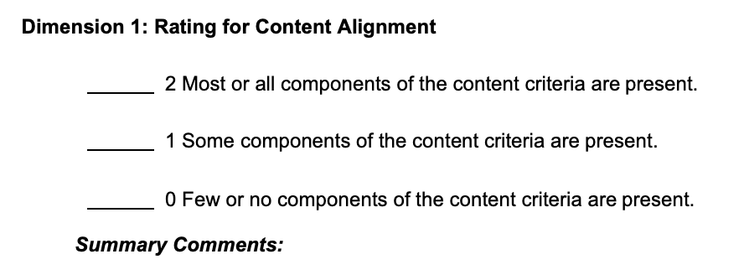
Workbook Pages for Dimension 1’s Content Criteria, cont’d.
Notes:
Big idea: Show screenshot of the Participant Workbook for Dimension 1.
Facilitator talking points:
This is a continuation of the content criteria for Dimension 1.
Note content criterion #3 has an asterisk by it. It indicates that this criterion is a research-based best practice in reading as well as a proven English learner support.
Note the rating system:
The difference between “most,” “some,” and “few” might seem hard to determine at first. Their differences usually become quite clear when you are looking at the actual curriculum and discussing what you each think.
As you gather and discuss the evidence you find for each criterion, you will begin to understand the nuances of the point rating system.
In some cases, there will be elements of all the criteria present but some elements may be absent.
Your professional judgment will be an important part of your team discussion and final decision. Ask yourself, “How crucial are the missing elements? Can the gaps be easily filled by an instructor?”
It will be important to keep a record of how you came to the rating decision. So don’t forget to record key points in your decision under “Summary Comments” in the Participant Workbook.
Facilitator notes:
The summary comments are on the top of page 3 in the Participant Workbook.
Make sure your team turns the page to see that they are responsible for commenting on how they reached their overall rating.
The idea that they are calibrating together and coming to agreement around each criterion is central. Make sure you emphasize this is group work and group learning frequently through the orientations.

Slide 15
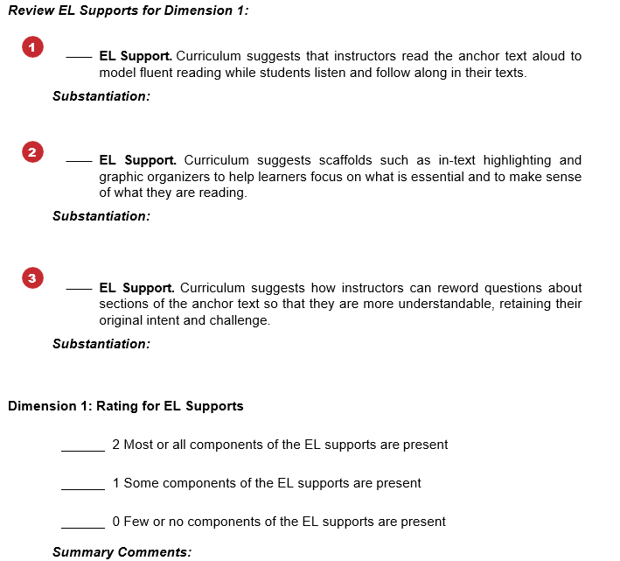
Workbook Pages for Dimension 1’s English Learner (EL) Supports
Notes:
Big idea: We are also looking for English learner supports in the materials we examine. These are the supports that are connected to the idea of providing ELs access to complex text.
Facilitator talking points:
Here you see the Participant Workbook pages for Dimension 1’s EL supports.
This is on page 3 of the workbook. Turn to your own workbook and read through the supports.
You will work to find evidence of these supports in the same way you will for the content criteria. You’ll look in the curricular materials and discuss your findings as a team.
The ratings for EL supports are identical to the content criteria ratings you just examined.
Facilitator notes:
Remind your team that during the training sessions, they would look back and see content criterion 3 (asterisked*) on page 2. They should figure out in what way it is supportive of English learners as part of their rating consideration.

Slide 16
The Curriculum Review Process
Together, we will review the meaning of the content criteria for each dimension.
Then with your team, we will ask you to search the model curriculum for evidence that each criterion is met.
You will place a checkmark next to each criterion for which you find evidence. You will add a brief comment that substantiates your check mark (or the lack thereof).
Once you have reviewed all the content criteria for that dimension, you will assign a rating of 0, 1, or 2 points.
We will ask you to follow the same steps to rate the EL support criteria for each dimension.
Notes:
Big idea: Describe the review process.
Facilitator talking points:
With your team, we will ask you to search the model curriculum for evidence that each criterion is met. Following each content criterion, you will find a set of “guiding questions” that are included to help you better understand the intent of the criterion.
Use this workbook to analyze the extent to which the provided model curriculum aligns to the evidence-based criteria of the curriculum review tool.
Use another copy of this workbook to assess the alignment of the curriculum from your state that you have chosen to review.
Your team lead will maintain a master copy of your team’s consensus ratings and summary findings.
Once your consensus review is complete, decide, in conjunction with your state leadership, how and with whom to share the review materials.
Note that some content criteria are indicated with an asterisk (*). These also are research-based EL supports. When rating for EL support, therefore, you will consider all the EL support criteria as well as the asterisked content criteria for the dimension.
Facilitator notes:

Slide 17
Determine the Curriculum’s Overall Ratings and Recommendations
Once you have reviewed and rated all five dimensions of quality, you will:
Determine an overall rating for content alignment by adding the total points assigned to each dimension’s content criteria. The highest possible score would be 10 points (2 points per dimension).
Determine an overall rating for EL supports by adding the total points assigned to each dimension’s EL support criteria. The highest possible score would be 10 points (2 points per dimension).
Summarize your comments and recommendations, including the key strengths and weaknesses of the curriculum you reviewed.
Then document any recommendations regarding the continued use of the curriculum in your program(s).
Notes:
Big idea: Present the last steps in the curriculum review process.
Facilitator talking points:
Remember, it is unlikely that any curriculum will contain every content criterion and every EL support included in this review tool.
Think through how important the missing criteria are to your overall rating.
Is their absence so critical that you cannot assign an overall rating of Well Aligned or Well Supported?
Alternatively, how easily could you and your fellow adult educators fill in the gaps in the curriculum?
Facilitator notes:
Four clicks.
Click through the slide bullets to explain the steps of the review process.
Then use the talking points for additional information.
Pause to ask for questions.

Slide 18
Overall Curriculum Ratings
Notes:
Big idea: Review the overall curriculum ratings.
Facilitator talking points:
We won’t be looking for a perfect curriculum; we will be looking for a strong curriculum.
For both the content criteria and the EL support criteria, add up the total points assigned to each dimension’s content criteria. The highest possible score would be 10 points (2 points per dimension).
In this way we can determine whether the curriculum is Well Aligned, Somewhat Aligned, or not Aligned.
And we can determine whether English learners are Well Supported, Somewhat Supported, or Not Supported by the curriculum.
Facilitator notes:
Use the talking points to explain the Overall Rating scale.

Slide 19
Orientation to the Model Curriculum

Slide 20
Why We Chose EL Education as Our Model Curriculum
EL Education is:
Highly rated as being closely aligned to college and career readiness standards;
A free and open curriculum; and
Supportive of English leaners.
EL Education’s Grade 5 Module 1, Unit 1:
The unit is built upon the Universal Declaration of Human Rights (UDHR); and
The topic is relevant to the lives of many adult students.
Notes:
Big idea: Explain how the unit we selected from EL Education meets our criteria.
Facilitator talking points:
Though designed for use by 5th graders, the maturity and relevance of the topic allows for these lessons to be easily applied to adult students.
This program is highly rated for alignment to the same standards as the CCR for ABE and other challenging state academic standards. It will be useful to examine what that means as we go through the training.
This program is also considered supportive of English learners. Examining the kinds of supports it incorporates will help build our vision for what materials could provide for ABE students, including English learners.
Facilitator notes:

Slide 21
Let’s Take a Look at the Curriculum
Notes:
Big idea: Get a high-level overview of Unit One—Building Background Knowledge: Human Rights.
Facilitator talking points:
This link takes you to the overview for 5th grade Module 1, Unit 1.
Take several minutes to scroll through and read how the unit is organized and what it is about.
Facilitator notes:
Put this link into the chat: https://curriculum.eleducation.org/curriculum/ela/grade-5/module-1/unit-1
Have participants spend 4 minutes quietly scrolling through the page and reading.
After they have had a chance to read the description of how the unit works, go to the next slide for discussion questions.

Slide 22
What Did You Notice?
What is the name of the whole unit?
Is there evidence:
Of activities that encourage discussion? Where?
That complex text will be used? Where?
Of supports for English learners? Where?
That a volume of reading is available? Where?
That students will have chances to write during the unit?
Notes:
Big idea: See that this curriculum contains many of the ingredients that the training will be focused on, starting with the title itself.
Facilitator talking points:
I’m going to ask a series of questions about the overview page you just scanned.
You’ll get a chance to answer in the chat or out loud.
We’ll discuss the answers briefly one at a time and answer any questions.
Facilitator notes:
The goal is to activate participants and let them discuss these materials for a few minutes.
Tell the group to scroll down past the content connections and SEL to get to the academic heart of the materials in this unit.
The fact that the entire unit is titled “Building Background Knowledge: Human Rights” is evidence that knowledge building is valued in these materials. But we will be taking a deeper dive in the weeks to come to see evidence of other dimensions of alignment.
Make sure to allow time for questions.

Slide 23
EL Education – Materials for the Review
For getting a quick overview of the unit:
EL Education G.5 M1 U1 Unit-at-a-Glance.
These documents are used in every dimension:
Teacher Guide
Teacher Supporting Materials
Used only in Dimension 1:
Text Analyses of Esperanza Rising
Used only in Dimension 4:
Classroom Protocols Document
Notes:
Big idea: Identify the documents needed for our sample review.
Facilitator talking points:
Except for the overview webpage we just examined, these are large documents, but they are well organized and labeled.
Coaches will always be available to help you navigate.
Take a couple of minutes to navigate now to the Teacher Guide.
Facilitator notes:
Make sure participants all have these documents available to scan as we continue.

Slide 24
Teacher Guide
Notes:
Big idea: Expose participants to the Teacher Guide so they can start to see how to navigate it.
Facilitator talking points:
The Teacher Guide contains all the lessons and supporting materials for Module 1.
It is large! That’s why we’re focusing primarily on Unit 1. But there will be times we look at the other two modules for evidence for some dimensions.
This is the beginning of the Table of Contents. It is found on pages 3-5 of the PDF.
We’ll be relying heavily on the Table of Contents and on the search functions available for .pdf documents.
I want to be sure you know how to navigate EL Education’s large PDF documents.
There is a page number at the top of the navigation bar. You can type in the page number you want to move to, and the PDF will move to that page.
When you find it, type an “8” into the page number navigator. It should take you to the Module-at-a-Glance.
I will help you navigate in the weeks to come until you’re comfortable with how these resources are organized.
Facilitator notes:
Have participants take a minute or two to scroll through the Table of Contents. They can see what resources this unit contains and how it is organized.
Some participants may not be familiar with how to navigate a large PDF file.
This screenshot is small. It may be easier to share your screen and show where the page navigator is at the top of the Teacher Guide.
Ask participants to type in “8” to go to the Module-at-a-Glance, which is located on page 8 of the Teacher Guide.

Slide 25
Teacher Supporting Materials
Notes:
Big idea: Understand what is contained in the Teacher Supporting Materials.
Facilitator talking points:
This resource contains all the specific templates, questions, activities, and directions that each lesson in Module 1 calls for.
For this resource, the Table of Contents is not as helpful. It is simply a list of every lesson in the three units of Module 1.
You will use this resource to examine how the curriculum handles all the ELA activities and supports mentioned in each lesson overview.
The lessons themselves are in the Teacher Guide, but they refer to specific resources that are in this packet.
Let’s look at one example and practice using the navigation bar by going to page 24.
Facilitator notes:
It will be even more important for participants to be comfortable navigating via the page number navigation bar for this resource.
If they go to page 24 and scroll through at least page 26, they’ll see a sample of academic and domain-specific vocabulary charts.
Have participants examine these for a moment. Then see what they notice about the resource. Can they tell which lesson it’s associated with? (It runs in large font along the left side of each page.) These are all from Lesson 4.

Slide 26
That Was a Quick Tour of the Model
At our next session, we will start digging into the specifics of each dimension.
Before then, if you haven’t already, you need to select a curriculum in use in your state to examine alongside the model.
There are more details on the following slide of what to consider.
Notes:
Big idea: This is the end of our orientation to the EL Education materials.
Facilitator talking points:
That’s the completion of our orientation to EL Education.
You’ll be investigating it in much more depth in the coming weeks of the training.
The other important part of this training is to apply these same criteria to a curriculum your instructors commonly use.
You’ll need to pick that before we start the training sessions.
There are more details on the next slide.
Facilitator notes:
Advance to the next slide for specific guidance for selecting materials to review.

Slide 27
Select a Representative Sample of Your Curriculum
Select a sample that…
Addresses all aspects of English Language Arts and is relevant to the lives of adult students.
Is big enough to get a clear picture of what the whole curriculum has to offer; but
Is small enough to be handled easily; and
Is readily available to educators in your state.
Notes:
Big idea: Share the process used to select a valid sample from a larger curriculum.
Facilitator talking points:
When you need to select a small sample of your curriculum…
Make sure the section you select addresses the breadth of ELA.
Select a large enough section of the curriculum to give you a good picture of the whole. This could depend on how the whole curriculum is designed.
If most units and lessons are set up the same way, it might be enough to look at just one unit.
If there is a lot of variety in the formatting across lessons and units. It would be best to select a cross-section of the whole that includes most of the variations.
Also, make sure your selection is small enough that it can be easily handled in the time you have to do the review work. This could be just 1 or 2 units or perhaps about 10% of the whole curriculum.
Make sure to find a sub-section that is readily available to all participants.
Facilitator notes:
Four clicks.
Read the first talking point and then click to begin the animated bullet points (one click for each of the four bullets).

Slide 28
Our Work Together
We will always have between-session work to apply the learning from each webinar to your chosen curriculum.
We will also think through how to sustain this work when the training ends.
Notes:
Big idea: Remind participants about their in-between work session with their coach.
Facilitator talking points:
Facilitator notes:
Two clicks.
Read and click through the slide contents; use the bullets as your talking points.

Slide 29
Let’s Recap Our Preparations
We have worked to become comfortable with the tools and the technology.
We have reviewed the components of the ELA/Literacy Workbook.
We have reviewed the team expectations (e.g., meeting times, attendance, assignments).
Two questions:
Have you selected a curriculum to review as a team?
Shall we schedule our standing, in-between work sessions now?
Notes:
Big idea: Recap the work that has occurred thus far with their coaches.
Facilitator talking points:
Regarding comfort, remind them you’ll be there to support their use of the Participant Workbook.
Regarding selection of a curriculum, we’ll share what state teams have selected.
Regarding the Participant Workbook, let participants know that we will review it in more detail during this session and work with it throughout the sessions.
Regarding expectations, let participants know that we’ll be talking about that in more detail later in the presentation.
Facilitator notes:
Read through the slide.

Slide 30
Our Next Session
We will begin our deep dive into Dimension 1.
Notes:
Big idea: Provide date and topic of the next virtual training session.
Facilitator talking points:
On this slide you see information about our next session
Facilitator notes:
Read the bullets. Emphasize the date and time of the next session.

Slide 31
Thank you and see you soon!

