Slide 1
Reasoning and Communicating with Mathematics (Part 1)
State-Based Curriculum Review

Slide 2
Welcome back!

Slide 3
Disclaimer
This presentation was produced and funded in whole with Federal funds from the U.S. Department of Education under contract number ED-991990018C0040 with StandardsWork, Inc. Ronna Spacone serves as the Contracting Officer’s Representative. There is content on the slides and additional content in the Slide Notes throughout the presentation. The content of this presentation does not necessarily reflect the views or policies of the U.S. Department of Education nor does the mention of trade names, commercial products, or organizations imply endorsement by the U.S. Government.
Notes:
Big idea: Make audience aware of contract information.
Facilitator talking points:
Please read through this slide for information about the contract.
Facilitator notes:
Allow 10-15 seconds or so for participants to review this slide for information about the contract (no need to read through).

Slide 4
Let’s Hear From You!
Type your response to this question in the group chat:
CHAT: In a sentence, what were your biggest takeaways or challenges related to your experience reviewing your local curriculum for Dimension 2: Mathematical Progressions and Connections?
We’ll ask everyone to hit “enter” at the same time so…
WAIT to hit “enter”!
Notes:
Big idea: Use the chat feature to better understand participants’ background knowledge on this topic.
Facilitator talking points:
Highlights of our last session: In our last session, we reviewed the sample curriculum and rated it for Dimension 2.
Reasoning is the foundation of the study of mathematics. Students need to be able to strategize about how to:
solve a problem,
determine the quantities involved,
follow a logical path toward a solution,
change course if necessary, make a table or diagram, recognize patterns,
select and use the appropriate tools, and
communicate our process and findings.
Use the group chat to answer this question about your experience reviewing your own materials. Do this for how well it makes clear connections between the concepts.
At the end of this presentation, we will ask you to share one or two things you learned during this session.
Facilitator notes:
Read the first two talking points and then pause to allow time for participants to enter their thoughts in the group chat. Do not have them hit “enter” until they’ve had time to enter their responses.
Coaches should read and comment on the chat entries along with the presenter.
Talk about the highlights from the last session before moving to the next slide—today’s agenda.

Slide 5
Agenda
Overview of Dimension 3 and its research base in mathematics
Introduction to the content criteria for Dimension 3
Breakout work session with your team
Review of substantiations and ratings in the Example Workbook
Next steps and final questions
Notes:
Big idea: Introduce the agenda for today’s session.
Facilitator talking points:
Today, we are going to start with an overview of the third dimension and the research that supports it.
Then, we will go through the content criteria for Dimension 3.
You will have a chance to practice using the criteria with our sample curriculum in a breakout session with your team. Then you will compare your findings with the Example Workbook.
Facilitator notes:
Read the slide bullets to explain the agenda for today’s session.

Slide 6
Meeting Norms and Expectations
Be present and engage fully.
Ask questions.
Prepare for productive struggle.
Consider differing perspectives.
Create and maintain a safe space for professional learning.
Be mindful of different learning styles.
Notes:
Big idea: Share with participants the norms we will adhere to as we proceed through the trainings.
Facilitator talking points:
These are the norms we will use for all of our work together.
Facilitator Notes:
Read the talking point and then read the six bulleted statements on the slide.
After reading through the norms, ask if there are any comments or questions.
Remind participants that they can do so through the chat box or verbally.

Slide 7
Research Base for Dimension 3
Research from NCTM (2000 and 2015), the NRC (2001), and the ACT National Curriculum Survey (2016) shows that:
The Standards for Mathematical Practice rest on “processes and proficiencies” with established significance in mathematics education.
When Standards for Mathematical Practice are connected to content, deeper understanding can occur, enabling students to extend their understanding to new problem situations and contexts.
Notes:
Big idea: Share the rationale and research behind the importance of emphasizing reasoning and communicating with mathematics.
Facilitator talking points:
We need to emphasize that reasoning and communicating with mathematics are dependent upon each other. We must communicate our reasoning so it exists outside of our own thoughts, and any communication with mathematics must involve reasoning mathematically. (Notice that we intentionally titled this Reasoning And Communicating WITH Mathematics so that there would be no confusion with “communication about mathematics.”)
If mathematics is to be useful to students, they must understand the foundational concepts and be able to apply these concepts to their lives. This can only happen if students learn to successfully reason mathematically. The Standards for Mathematical Practice describe and embody the reasoning and communication skills that students need to be well versed in.
Research by the NCTM (National Council of the Teachers of Mathematics), the NRC (National Research Council), and the ACT (American College Testing) validate this.
The study of mathematics is not a set of procedures that students should memorize and repeat.
Facilitator notes:
Read the first three talking points and then review the bullet points.
Read the last talking point after the slide bullets.

Slide 8
What Does This Research Mean for High-Quality Curriculum?
It means students will regularly be asked to:
Apply the mathematics they are learning to new problems in new ways;
Construct viable mathematical arguments and critique the reasoning of their peers; and
Not just learn how to get the answer but also learn how to learn.
Notes:
Big idea: Draw a connection between the research and what we should be seeing in the curriculum.
Facilitator talking points:
For students to understand, remember, and apply the mathematics they learn, they must develop strong reasoning and processing skills. These are embodied in the Standards for Mathematical Practice.
Facilitator notes:
Read the bullets on the slide.
Then, use the talking point to explain the reasons for attending to mathematical communication.

Slide 9
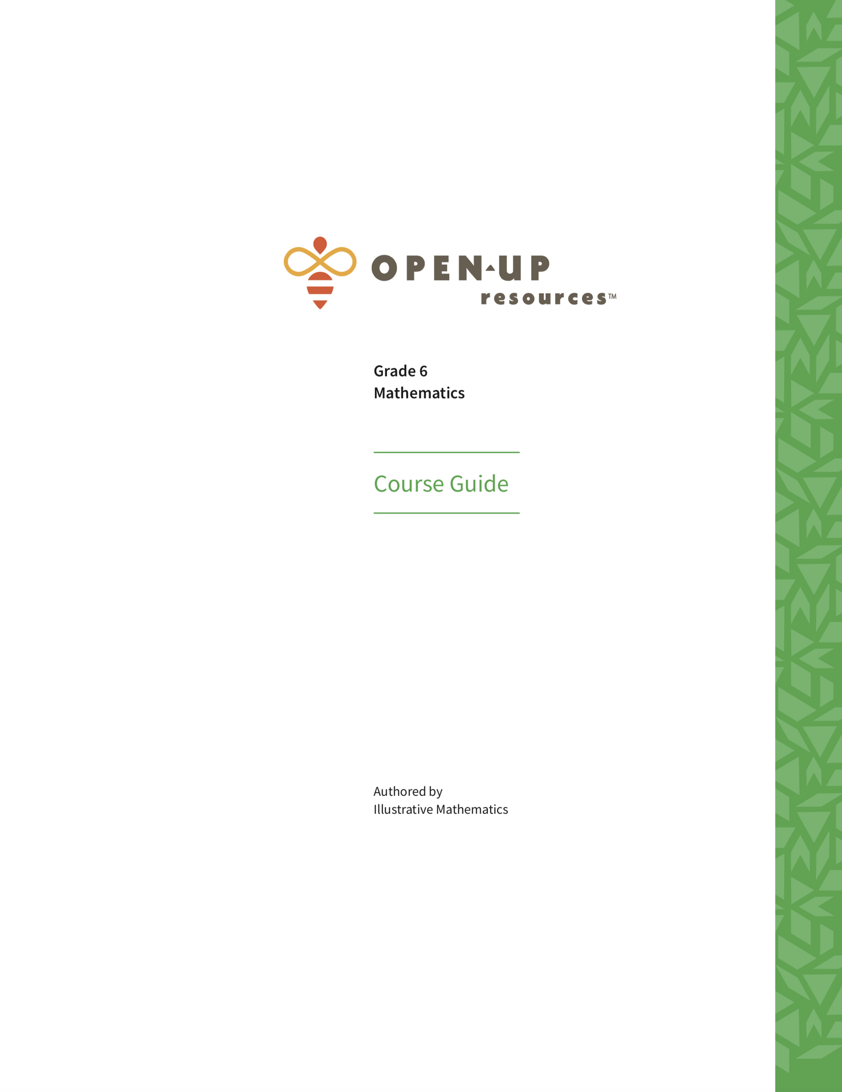
Illustrative Mathematics
Notes:
Big idea: Reintroduce Illustrative Mathematics and the selected unit.
Facilitator talking points:
For this session, we will continue our focus on the model unit: Grade 6, Unit 3.
This time we are looking specifically for evidence of an emphasis on reasoning and communicating with mathematics.
Facilitator notes:
Read the talking points as participants view the covers for the two documents.
Make sure all participants have these documents ready for this session.

Slide 10
All Standards for Mathematical Practice Include Reasoning
MP.1 Make sense of problems and persevere in solving them.
MP.2 Reason abstractly and quantitatively.
MP.3 Construct viable arguments and critique the reasoning of others.
MP.4 Model with mathematics.
MP.5 Use appropriate tools strategically.
MP.6 Attend to precision.
MP.7 Look for and make use of structure.
MP.8 Look for and express regularity in repeated reasoning.
Notes:
Big idea: Introduce the resource, the Standards for Mathematical Practice, contained within their Participant Workbook.
Facilitator talking points:
Here are the titles for the eight Mathematical Practices that are important for all students to eventually master. Notice that all titles start with a verb, leading us to the conclusion that these are ”active” requirements. They ask us to DO something rather than to simply KNOW something. The actual descriptors are quite dense and filled with examples in order to clarify the meaning of each.
While all eight practices relate to reasoning with mathematics, there are a few that require more attention in this part of the dimension. You can read about all eight of the practices in the provided resource, but now, let’s look more closely at MP.1, MP.2, and MP.4.
Facilitator notes:
Remind participants of the titles of the Mathematical Practices and review the talking points to lead to the next step in understanding these requirements.
The underlining serves to highlight the three focus Practices.
The last talking point leads to the next slide.

Slide 11
MP.1 Make sense of problems and persevere in solving them
Explain the meaning of a problem and look for entry points to its solution.
Analyze givens, constraints, relationships, and goals.
Plan a solution pathway rather than simply jumping into a solution attempt.
Consider analogous problems and try special cases and simpler forms of the original problem in order to gain insight into its solution.
Monitor and evaluate progress and change course if necessary.
Notes:
Big idea: Explain the reasoning aspects of Mathematical Practice 1: Make sense of problems and persevere in solving them.
Facilitator talking points:
We have reduced each of the practices’ descriptions from paragraphs to several bullets. Begin by scanning through the bullets to get the gist of the first practice. This practice is pivotal for reasoning.
This practice is probably the most self-explanatory; it covers all aspects of problem-solving, from finding an entry point to explaining your findings.
For our Dimension 3 work, let’s look for evidence of problems that leave room for the students to make sense themselves and to persevere.
Facilitator notes:
As participants review the bullets, use the talking points to further explain the connection to Dimension 3.
Ask for questions or comments.
Other comments to make:
Make conjectures about the form and meaning of a solution.
Transform algebraic expressions or change the viewing window on their graphing calculator to get the information they need.
Explain correspondences between representations.
Graph data and search for regularity or trends.

Slide 12
MP.2 Reason abstractly and quantitatively
Make sense of quantities and their relationships in problem situations.
Decontextualize and then re-contextualize.
Create a coherent representation of the problem at hand by:
Considering the units involved.
Attending to the meaning of quantities, not just how to compute them.
Knowing and flexibly using different properties of operations and objects.
Notes:
Big idea: Explain Mathematical Practice 2: Reason abstractly and quantitively.
Facilitator talking points:
This practice refers to making sure students can “see” the mathematical quantities involved in a situation and break it down to extract the mathematics (decontextualize).
They also have to understand the procedures required to answer the question. Then, after performing the mathematical procedures, they should be able to make sense of their findings. They must return the results to the context of the situation, including using the appropriate units (re-contextualize).
For our work in Dimension 3, we will look for problems placed in complicated situations and that require isolating the quantities to solve. In our model unit, that would likely be problems involving rates or unit rates.
Facilitator notes:
As participants review the bullets, use the talking points to further explain the connection to Dimension 3.
Ask for questions or comments.

Slide 13
MP.4 Model with mathematics
Apply known mathematics to solve problems arising in everyday life, society, and the workplace.
Make assumptions and approximations to simplify a complicated situation.
Identify important quantities in a practical situation and map their relationships using a variety of such tools.
Analyze those relationships mathematically to draw conclusions.
Interpret mathematical results in the context of the situation and reflect on whether the results make sense.
Improve the model if it has not served its purpose.
Notes:
Big idea: Explain Mathematical Practice 4: Model with mathematics and its connection to reasoning.
Facilitator talking points:
Modeling with mathematics requires that students are able to apply the mathematics they know to solve un-scaffolded questions from everyday life.
This practice is particularly difficult to understand. We often confuse MP.4 with MP.1, or with simply drawing a diagram or building a model. Many teachers say that they have only begun to feel comfortable with mathematical modeling after months of studying and discussing this practice. As our work progresses, we will spend time making sure you begin to understand the difference between “modeling the mathematics” and “modeling with mathematics.” Your coaches have had much experience with this distinction as well as all the practices. They will be a good resource if you have questions.
Modeling with mathematics requires reasoning with mathematics.
For our work in Dimension 3, we will look for SOME opportunities for students to independently solve a problem presented in a real situation. It is important to remember that students need to learn how to model with mathematics. This happens through starting with a well-scaffolded problem and then moving to slowly taking away the scaffolds. We should see many more problems that are presented with support before we see one that leaves the process completely to the student. For this reason, we often will see only a few examples of true modeling with mathematics in a unit.
Facilitator notes:
As participants to review the bullets, use the talking points to further explain the connection to Dimension 3.
Ask for questions or comments.

Slide 14
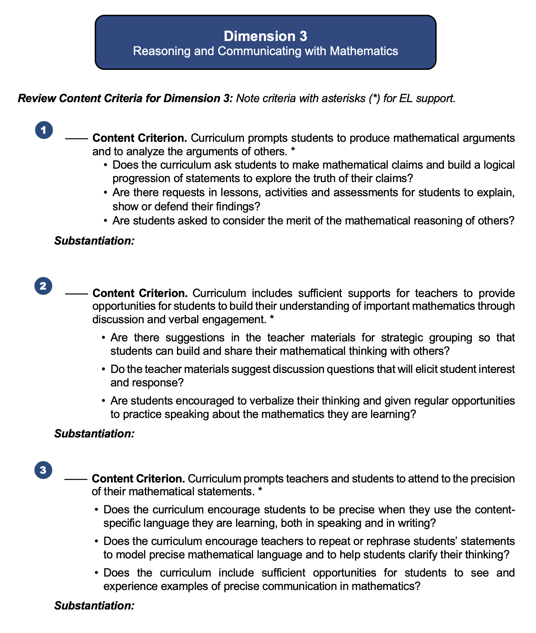
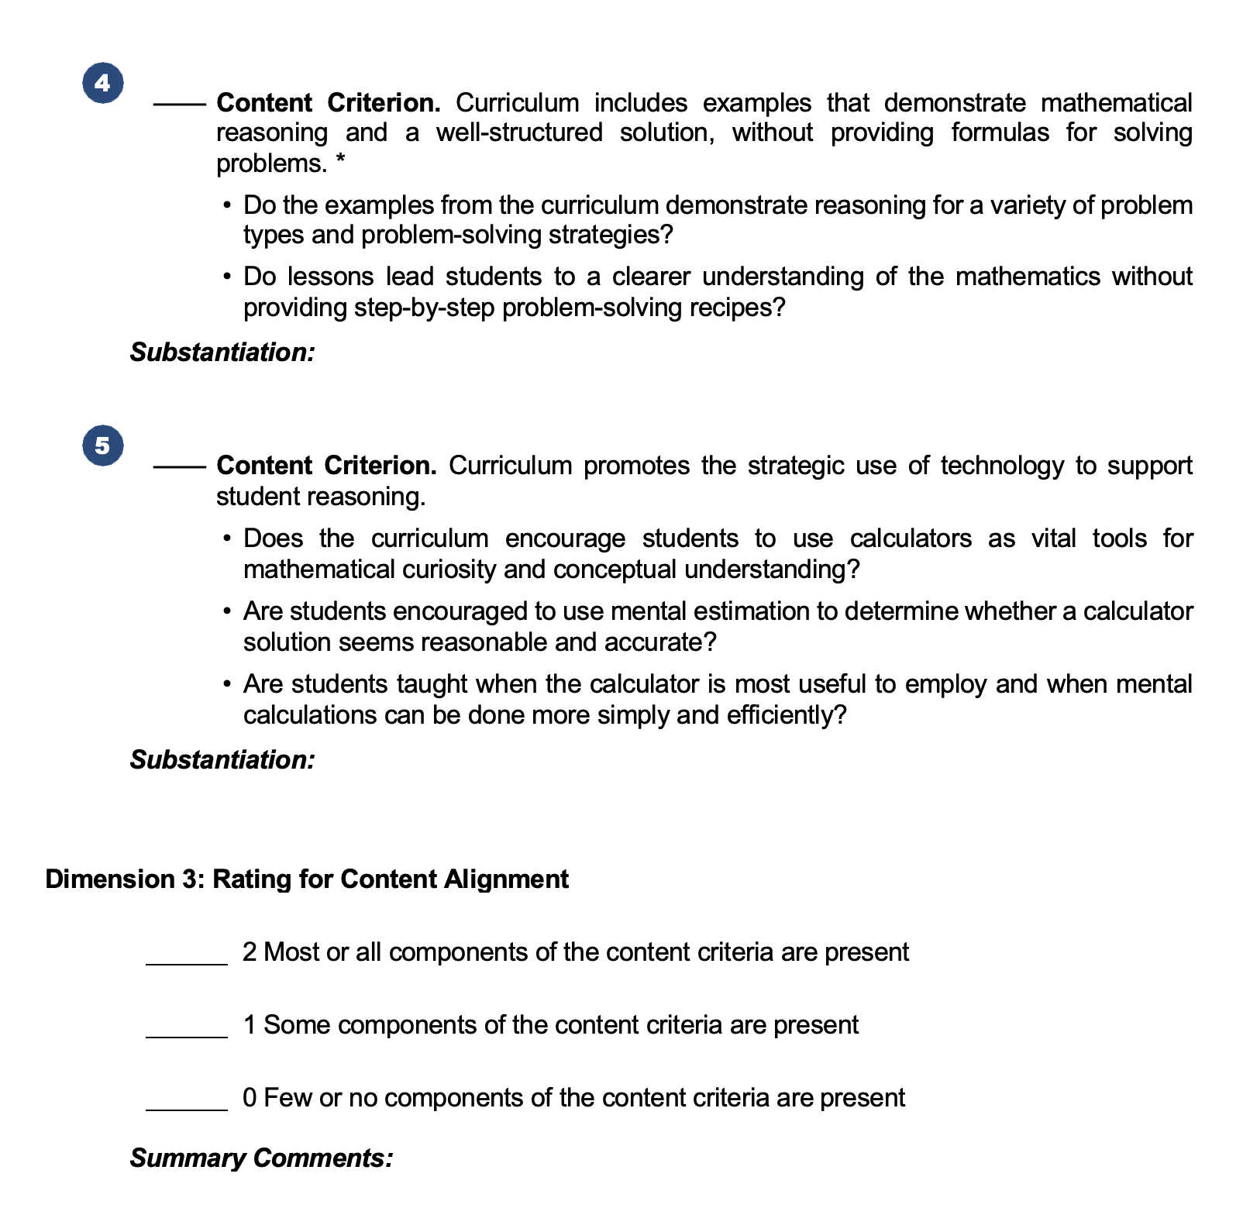
Dimension 3: Reasoning and Communicating with Mathematics
Notes:
Big idea: Show an overview of the Curriculum Review Protocol (within the Participant Workbook) for Dimension 3.
Facilitator talking points:
Here you see the first two workbook pages for Dimension 3. Part 1 of Dimension 3 is primarily focused on using mathematical reasoning.
Each content criterion is followed by a set of guiding questions. These are designed to help you understand what the criterion means and to guide your search for evidence in the curriculum.
Make a note that four of these content criteria are asterisked, indicating that they are also key supports for ELs.
Following the criteria is a rating scale.
For this session, we will concentrate only on the content criteria for Dimension 3. In the next session, we will attend to the EL support criteria. And remember that we will also consider the four asterisked criteria as we rate for EL supports for this dimension.
Facilitator notes:
Read the talking points while participants view the slide and locate the correct pages in their Participant Workbook.
Point out the arrows and ovals that highlight the criteria and guiding questions, asterisks, and rating scale.

Slide 15
Content Alignment Criteria
Notes:
Big idea: Move participants’ attention to the Content Alignment Criteria.
Facilitator talking points:
Facilitator notes:

Slide 16
Dimension 3: Content Criterion 1
Curriculum prompts students to produce mathematical arguments and to analyze the arguments of others.*
Ask Yourself:
Does the curriculum ask students to make mathematical claims and build a logical progression of statements to explore the truth of their claims?
Are there requests in lessons, activities, and assessments for students to explain, show, or defend their findings?
Are students asked to consider the merit of the mathematical reasoning of others?
Notes:
Big idea: Provide guiding questions to help participants review elements of Dimension 3’s first content criterion in the curriculum.
Facilitator talking points:
Here is the first content criterion for this dimension.
Note that this content criterion has an asterisk(*), indicating that it is also a key support for ELs.
These questions will help us determine whether the intent of this criterion is met in the curriculum.
Where might you look, in any set of materials, for answers to these questions? Use the group chat to share any questions or comments that come to you as you read the guiding questions.
Don’t forget to make a note of the places you found evidence for a criterion under “Substantiation” in the Participant Workbook. Some evidence that you already found in earlier searches might also apply here.
Facilitator notes:
Read the first talking point and then the criterion.
Read the second talking point, calling attention to the asterisk.
After the third talking point, read the guiding questions.
After the fourth talking point, take a moment and then ask for some ideas for where participants might look for answers to these questions. Use the “Where to look” ideas to guide them in the right direction.
Where to look: Look in assignments or practice sets that include problems asking students to defend their solution. When looking at lesson introductions, there might be examples provided to show students how to present an argument.
Use the last talking point to remind participants that they must provide details about where in the curriculum they find evidence of the criterion. Earlier searches might also be useful here.

Slide 17
Dimension 3: Content Criterion 2
Curriculum includes sufficient supports for teachers to provide opportunities for students to build their understanding of important mathematics through discussion and verbal engagement.*
Ask Yourself:
Are there suggestions in the teacher materials for strategic grouping so that students can build and share their mathematical thinking with others?
Do the teacher materials suggest discussion questions that will elicit student interest and response?
Are students encouraged to verbalize their thinking and given regular opportunities to practice speaking about the mathematics they are learning?
Notes:
Big idea: Provide guiding questions to help participants review elements of Dimension 3’s second content criterion in the curriculum.
Facilitator talking points:
Here is the second criterion for this dimension.
Note that this content criterion has an asterisk(*), indicating that it is also a key support for ELs.
The questions you see here can help us determine whether the intent of this criterion is met in the curriculum.
Where might you look, in any set of materials, for answers to these questions? Use the group chat to share any questions or comments that come to you as we read the guiding questions.
When you find evidence of the criterion in the curriculum, make a note of the places you found it under “Substantiation” in the Participant Workbook.
Facilitator notes:
Read the first talking point and then the criterion.
Read the second talking point, calling attention to the asterisk.
After the third talking point, read the guiding questions.
After the fourth talking point, take a moment and then ask for some ideas for where participants might look for answers to these questions. Use the “Where to look” ideas to guide them in the right direction.
Where to look: Start with the teacher resources where lesson instructions might include encouragement to have students speak their mathematical thinking.
Use the last talking point to remind participants that they must provide details about where in the curriculum they find evidence of the criterion. Earlier searches might also be useful here.

Slide 18
Dimension 3: Content Criterion 3
Curriculum prompts teachers and students to attend to the precision of their mathematical statements.*
Ask Yourself:
Does the curriculum encourage students to be precise when they use the content-specific language they are learning, both in speaking and in writing?
Does the curriculum encourage teachers to repeat or rephrase students’ statements to model precise mathematical language and to help students clarify their thinking?
Does the curriculum include sufficient opportunities for students to see and experience examples of precise communication in mathematics?
Notes:
Big idea: Provide guiding questions to help participants review elements of the third content criterion in the dimension.
Facilitator talking points:
Here is the third criterion for this dimension.
Note that this content criterion has an asterisk(*), indicating that it is also a key support for ELs.
The questions you see here can help us determine whether the intent of this criterion is met in the curriculum.
Where might you look, in any set of materials, for answers to these questions? Enter your ideas for the whole group in the group chat.
When you find evidence of the criterion in the curriculum, make a note of the places you found it under “Substantiation” in the Participant Workbook.
Facilitator notes:
Read the first talking point and then the criterion.
Read the second talking point, calling attention to the asterisk.
After the third talking point, read the guiding questions
Read the fourth talking point, take a moment and then ask participants to enter in the group chat their ideas about where they might look for answers to these questions. Use the “Where to look” ideas to guide them in the right direction.
Where to look: Start with the lesson introductions. There may be references to important vocabulary for the lesson that might be new to the student. Look for evidence of precise mathematical language in examples used in the lessons and the “scripts” provided in teacher-facing materials.
Use the last talking point to remind participants that they must provide details about where in the curriculum they find evidence of the criterion.

Slide 19
Dimension 3: Content Criterion 4
Curriculum includes examples that demonstrate mathematical reasoning and a well-structured solution, without providing formulas for solving problems.*
Ask Yourself:
Do the examples from the curriculum demonstrate reasoning for a variety of problem types and problem-solving strategies?
Do lessons lead students to a clearer understanding of the mathematics without providing step-by-step problem-solving recipes?
Notes:
Big idea: Provide guiding questions to help participants review elements of Dimension 3’s fourth content criterion in the curriculum.
Facilitator talking points:
Here is the fourth criterion for this dimension.
Notice that this one also has an asterisk(*).
We can ask ourselves some questions to help us determine whether the intent of this criterion is met.
Where might you look, in any set of materials, for answers to these questions? Enter your ideas for the whole group in the group chat.
When you find evidence of the criterion in the curriculum, make a note of the places you found it under “Substantiation” in the Participant Workbook.
Facilitator notes:
Read the first talking point and then the criterion.
Read the second talking point, calling attention to the asterisk.
After the third talking point, read the guiding questions.
After the fourth talking point, take a moment and then ask for some ideas for where participants might look for answers to these questions. Use the “Where to look” ideas to guide them in the right direction.
Where to look: Look through the lessons for examples that are not prescriptive — that don’t give step-by-step rules for how to solve a type of problem. Look for a variety of examples, possibly showing different ways of working out the solution.
Use the last talking point to remind participants that they must provide details about where in the curriculum they find evidence of the criterion. Earlier searches might also be useful here.

Slide 20
Dimension 3: Content Criterion 5
Curriculum promotes the strategic use of technology to support student reasoning.
Ask Yourself:
Does the curriculum encourage the use of technology as vital for mathematical curiosity and conceptual understanding?
Does the curriculum provide opportunities and encouragement for students to use appropriate tools to assist in understanding and finding a solution to a problem?
Are students taught when the calculator is most useful to employ and when mental calculations can be done more simply and efficiently?
Notes:
Big idea: Provide guiding questions to help participants review elements of Dimension 3’s fifth content criterion in the curriculum.
Facilitator talking points:
Here is the fifth content criterion for this dimension. (No asterisk this time)
The questions you see here can help us determine whether the intent of this criterion is met in the curriculum.
Where might you look, in any set of materials, for answers to these questions? Enter your ideas for the whole group in the group chat.
When you find evidence of the criterion in the curriculum, make a note of the places you found it under “Substantiation” in the Participant Workbook.
Facilitator notes:
Read the first talking point and then the criterion.
After the second talking point, read the guiding questions.
After the third talking point, take a moment and then ask for some ideas for where participants might look for answers to these questions. Use the “Where to look” ideas to guide them in the right direction.
Where to look: Try looking in the teacher-facing materials for suggestions about how to use, or not use, calculators, computer programs, or apps. You might find suggestions that students try calculations without a calculator or to use a program to visualize a graph.
Use the last talking point to remind participants that they must provide details about where in the curriculum they find evidence.

Slide 21
Rating for Content Alignment
2 Points: Most or all components of the content criteria are present.
1 Point: Some components of the content criteria are present.
0 Points: Few or no components of the content criteria are present.
Notes:
Big idea: Prepare the participants to use the rating system for this dimension.
Facilitator talking points:
This is a reminder of the point system we use for rating the dimension against its content criteria.
By now you know how to recognize the difference between “most,” “some,” and “few.” Your professional judgment will be an important part of your team discussion and final decision. Ask yourself, “How crucial are the missing elements? Can the gaps be easily filled by an instructor?”
It is important to keep a record of how you came to the rating decision. Don’t forget to record key points in your decision under “Summary Comments” in the Participant Workbook.
Facilitator notes:
Since this is the fourth time participants have used this rating scale, there should be few, if any, questions about what the descriptors mean.
With the last talking point, remind participants to write their summary comments under the rating for the dimension.

Slide 22
Breakout Time: 45 minutes
Your turn to work with your team:
Examine the evidence in the curriculum for each of these content criteria.
Check the content criteria that are evident and cite in your notes where you found evidence.
Discuss the evidence you found for all the content criteria with your team and agree upon a rating for the dimension.
When we reconvene, we will ask you to share comparisons of your rating, criteria checks, substantiations, and commentary.
Notes:
Big idea: Apply Dimension 3 content criteria to our common sample curriculum from Illustrative Mathematics in your team.
Facilitator talking points:
Now you get the next 45 minutes to try this with your team.
Here are your instructions for the breakout time.
When we come back together, we will get to see the filled-in Example Workbook. Keep in mind that we will ask you to compare your rating, checks, and comments with the example. Then we’ll ask a couple of teams to share their findings. Choose a reporter and be prepared for that.
Don’t forget that we have four asterisked (*) criteria in Dimension 3 that we will need to consider in our next session together.
Facilitator notes:
Read the first two talking points and then the instructions for the breakout time.
Read the third talking point and check to remind them that they need to select a ”reporter” for their group. They will be asked both poll questions and chat questions about comparisons between their responses and the Example Workbook.
Use the fourth talking point to remind participants that the asterisked content criteria will need to be considered when rating the dimension for EL supports.
Check to make sure the instructions are clear. Click to the next slide for a list of the materials participants will need for the breakout.

Slide 23
Breakout Materials
Your copy of the Participant Workbook (p. 7)
Curriculum: Illustrative Mathematics:
Grade 6 Course Guide
Grade 6, Unit 3 Teacher Guide
Resource: Standards for Mathematical Practice
Notes:
Big idea: Check that everyone has the correct materials to conduct the review.
Facilitator talking points:
These are the materials you will need to have at hand during this breakout session.
Facilitator notes:
Before sending the teams to their breakout, check to make sure everyone has the correct materials.
Leave this slide on the screen as groups go to their breakout sessions.

Slide 24
Welcome Back!
Notes:
Big idea: Bring state teams back together and debrief the work session.
Facilitator talking points:
Facilitator notes:
Click to this slide before the groups return from their breakout sessions.

Slide 25
Let’s Hear From You!
POLL: What is your rating for Dimension 3 Content Alignment?
O 2 points: Most or all components of the content criteria are present.
O 1 point: Some components of the content criteria are present.
O 0 points: Few or no components of the content criteria are present.
Notes:
Big idea: Share everyone’s rating of Dimension 3.
Facilitator talking points:
Now that you’ve had a chance to find evidence for the criteria, let’s see if we agree on the dimension content rating.
Please enter your rating for Dimension 3 content alignment.
Let’s see how your Dimension 3 content ratings compare with the example review.
Facilitator notes:
Briefly review the dimension rating scale and then read the first talking point.
Create a poll or ask participants to enter their ratings in the chat.
Allow a minute for reporters to enter their answer.
Use the third talking point to summarize the results of the poll.
Example Workbook Dimension 3 Content Alignment Rating: 2 points.

Slide 26
Let’s Hear From You!
POLL: Did you check (as present) the same criteria as in the Example Workbook?
O Yes, I checked the same criteria as the example.
O No, I checked one or more criteria differently than the example.
Notes:
Big idea: Share our evidence and ratings.
Facilitator talking points:
Now let’s compare the individual checks your team decided to give for the criteria in this dimension with those checked in the example.
Did your checks match those of the example? Or did you check one or more criteria differently?
Facilitator notes:
Allow a minute for participants to enter their answer to the poll and then review the results.
Example Workbook Dimension 3 Content Criteria: All five content criteria were checked.
Click to the next slide for a discussion of the substantiations for this dimension.

Slide 27
Let’s Discuss!
Let’s take 5 minutes to review the Example Workbook that contains the substantiations for the content criteria.
Then in the group chat, share your answer to this question:
CHAT: How do your substantiations compare to the example?
Then let’s hear from you about the evidence you found and noted in your Summary Comments.
Notes:
Big idea: Share our evidence and ratings.
Facilitator talking points:
Now that we’ve compared the rating and checks for this part of the dimension, we want to give you some individual work time. Compare your substantiations and summary comments with those in the Example Workbook.
Remember that there can be many “right” answers. But while substantiations may be different, there should be agreement on the general findings and ratings.
We’re going to take 5 minutes for you to compare what you found with those of the Example Workbook.
Take some notes about what you see as the same and different. Then we’ll ask you to share your findings in chat when we come back together.
[After work time] Let’s have everyone type one or two sentences in the group chat to describe how your substantiations compared. Feel free to share a specific commonality or difference.
Now let’s hear from a couple of teams about their comparison…
Facilitator notes:
Use the first four talking points to bring attention to the Example Workbook with substantiations and commentary.
Pause (5 minutes) for participants to compare and make some notes about what they found.
After the 5-minute comparison time, read the fifth talking point and comment on interesting chats as they appear.
Read the last talking point and select one or two states to share verbally. You might select based on a chat statement that needs to be clarified or one that is especially insightful or unique.

Slide 28
Let’s Chat!
Type your response and comments in the group chat:
CHAT: What is something you have learned today (or better understand) about reasoning and communicating with mathematics?
We’ll ask everyone to hit “enter” at the same time so…
WAIT to hit “enter”!
Notes:
Big idea: Check for understanding using the chat feature.
Facilitator talking points:
We’d love to hear about what you learned today, in just a sentence or two, about reasoning and communicating with mathematics.
Everyone take about 2 minutes to type in the group chat, but don’t hit “enter” until I tell you to. We want everyone’s chats to happen at once so we can scroll through and see what everyone is thinking.
OK, everyone can hit “enter” and read through all the responses.
Facilitator notes:
Read the first and second talking points and then pause for about 2 minutes.
After the pause, read the third talking point and discuss the highlights of the chats.
Coaches should read, monitor their own state participation, and comment about the chats along with the presenter.

Slide 29
Next Steps
We will focus on EL Supports for Dimension 3 to:
Examine the sample curriculum from Illustrative Mathematics for its attention to EL supports, related to communicating with mathematics.
Notes:
Big idea: Provide date and topic of the next virtual training session.
Facilitator talking points:
Here you see information about the next session.
We will put you back into your breakout sessions if you would like to meet with your coach for up to 30 more minutes.
Facilitator notes:
Read the first talking point and the slide bullets. Emphasize the date and time of the next session.
Use the second talking point to offer more coaching time if any participants have questions.

Slide 30
Thank you!

