Slide 1
Reasoning and Communicating with Mathematics (Part 2)
State-Based Curriculum Review

Slide 2
Welcome back!

Slide 3
Disclaimer
This presentation was produced and funded in whole with Federal funds from the U.S. Department of Education under contract number ED-991990018C0040 with StandardsWork, Inc. Ronna Spacone serves as the Contracting Officer’s Representative. There is content on the slides and additional content in the Slide Notes throughout the presentation. The content of this presentation does not necessarily reflect the views or policies of the U.S. Department of Education nor does the mention of trade names, commercial products, or organizations imply endorsement by the U.S. Government.
Notes:
Big idea: Make audience aware of contract information.
Facilitator talking points:
Please read through this slide for information about the contract.
Facilitator notes:
Allow 10-15 seconds or so for participants to review this slide for information about the contract (no need to read through).

Slide 4
Let’s Hear From You!
Share your answer to this question:
On a scale of 1 to 5, how much do you know about effective mathematical communication for English learners (ELs)?
1 (not much)
2
3
4
5 (a great deal)
Notes:
Big idea: Use a poll to better understand participants’ background knowledge on this topic.
Facilitator talking points:
Reasoning and communicating with mathematics naturally go together, since one’s reasoning must be communicated in order to be understood by others. Naturally, the specific and technical language used in expressing mathematical thinking can be a stumbling block for English learners. So, in this part of Dimension 3, we will focus primarily on how communicating with mathematics can be supported for English learners.
Answer this question about your current level of knowledge of effective communication with mathematics, as it relates to ELs.
Don’t forget that at the end of this presentation, we will ask you to share one or two things you learned during the session.
Highlights of our last session: In our last session (Dimension 3, Part 1) we reviewed the sample curriculum. We rated it for alignment to the content criteria for Reasoning and Communicating with Mathematics. [Add anything here that came up during the last session.]
Facilitator notes:
Read the first talking point.
Create a poll or ask participants to enter their ratings in the chat.
Read the second talking point and pause for participants to respond to the poll.
Point out interesting poll results.
Read the third talking point to remind participants that at the end of the session, we will be asking them to share something they learned.
Use the fourth talking point to highlight what we did in the last session.
Click to the next slide for today’s agenda.

Slide 5
Agenda
Review of Dimension 3 content criteria
Introduction to the English learner (EL) support criteria for Dimension 3
Breakout work session with your team
Review of substantiations and ratings in the Example Workbook
Next steps and final questions
Notes:
Big idea: Introduce the agenda for today’s session.
Facilitator talking points:
Today, we are going to start with a review of the first part of the third dimension.
Then, we will go through the EL support criteria for Dimension 3.
You will have a chance to practice using the criteria with our sample curriculum in a breakout session with your team. Then compare your findings with the Example Workbook.
Facilitator notes:
Read the slide bullets to explain the agenda for today’s session.

Slide 6
Meeting Norms and Expectations
Be present and engage fully.
Ask questions.
Prepare for productive struggle.
Consider differing perspectives.
Create and maintain a safe space for professional learning.
Be mindful of different learning styles.
Notes:
Big idea: Share with participants the norms we will adhere to as we proceed through the trainings.
Facilitator talking points:
These are the norms we will use for all of our work together.
Facilitator notes:
Read the talking point and give a few moments for participants to read through the six statements.
After time for reading through the norms, ask if there are any comments or questions.
Remind participants that they can do so through the chat box or verbally.

Slide 7
Review of Part 1 for Dimension 3
Content criteria for Dimension 3 emphasize:
Producing and analyzing mathematical arguments.*
Building mathematical understanding through discussion.*
Using precise, specialized mathematical language.*
Showing examples of one’s reasoning.*
Promoting the strategic use of technology.
Four content criteria are asterisked (*), indicating EL supports, so we will review our findings in Part 1 as we rate the EL support levels.
Content criteria for Dimension 3 emphasize:
Producing and analyzing mathematical arguments.*
Building mathematical understanding through discussion.*
Using precise, specialized mathematical language.*
Showing examples of one’s reasoning.*
Promoting the strategic use of technology.
Four content criteria are asterisked (*), indicating EL supports, so we will review our findings in Part 1 as we rate the EL support levels.
Notes:
Big idea: Review the content criteria the teams used in the last session together and when doing their homework.
Facilitator talking points:
In our last session (Dimension 3, Part 1), we reviewed the sample curriculum and rated it against the content criteria for Dimension 1. We found …
It is important that, despite splitting the dimension for training purposes, we keep the connections between the content and EL support criteria in mind.
As we complete the Part 2 work and rating, we may review both parts and possibly update our summary notes for Part 1.
Let’s quickly review the content criteria for this dimension.
Facilitator notes:
Read the first talking point to highlight the observations and insights from the previous session [to be inserted in the first talking point after the Part 1 session].
Read the remaining talking points and then the slide bullets with short criteria descriptors.
With the final bullet, remind participants that the asterisked content criteria will need to be included in the EL support rating for this dimension.

Slide 8
What Does Dimension 3 Mean for High-Quality Curriculum?
It means EL students are regularly asked to:
Participate actively in class through collaborations and discussions;
Share their understanding and findings with precision, so others can follow their thinking; and
Experience precise mathematical communication through speaking, listening, and reading.
Notes:
Big idea: Explain the importance of communicating in mathematics to solidify learning.
Facilitator talking points:
In order for students to be able to use the mathematics they learn, they must have opportunities to explain and defend their findings. Sometimes understanding comes as part of the communication process.
And in order for mathematical communication to be understood and useful to others, it must be precise and follow mathematics community conventions. Therefore, students need to be exposed to those conventions in their classrooms and in their lessons.
EL students need more support in the area of communicating with mathematics. We would expect to find these supports for EL students in a high-quality curriculum.
Facilitator notes:
Read all three talking points to explain the reasons for attending to mathematical communication.
Then read the slide bullets.

Slide 9
Illustrative Mathematics
Notes:
Big idea: We continue to use Illustrative Mathematics and the selected unit.
Facilitator talking points:
For this session we will, again, focus on the model unit: Grade 6, Unit 3.
This time, we will look closely for evidence of the EL support criteria for Dimension 3.
Facilitator notes:
Read the talking points first.
Make sure all participants have these documents ready for this session.

Slide 10
Standards for Mathematical Practice
MP.1 Make sense of problems and persevere in solving them.
MP.2 Reason abstractly and quantitatively.
MP.3 Construct viable arguments and critique the reasoning of others.
MP.4 Model with mathematics.
MP.5 Use appropriate tools strategically.
MP.6 Attend to precision.
MP.7 Look for and make use of structure.
MP.8 Look for and express regularity in repeated reasoning.
Notes:
Big idea: Reintroduce the resource and the particular practices that pertain to mathematical communication.
Facilitator talking points:
Here are the eight practices that are important for all students to eventually master. You have the resource with the full text for each descriptor available to use during this session. It is in Appendix C of your Participant Workbook.
The Standards for Mathematical Practice include several relevant practices that we have underlined. One of them asks that students use precise and accurate language (MP.6). Another one asks that students present an argument and critique the arguments of others (MP.3). Clearly, these practices relate specifically to mathematical communication.
For this part of Dimension 3, we will want to keep those two practices in mind, but there are also other communication-related practices. For example, students are asked to explain their problem-solving strategies and displays (MP.1) and model with mathematics (MP.4). They also need to “express” the regularity in patterns they find (MP.8).
Some of the evidence you found relating to those practices in Part 1 of Dimension 3 might be useful again here.
It will be very important to remember that in mathematics, some communication is verbal, and some is nonverbal. Fluency with mathematical language requires both writing and speaking about your mathematical reasoning. We need to see that both types of communication are emphasized.
Facilitator notes:
Underlining on MP.3 and MP.6 is there for emphasis.
Use the talking points to explain why these two Practices will be important to this dimension. There is no need to read the slide.

Slide 11
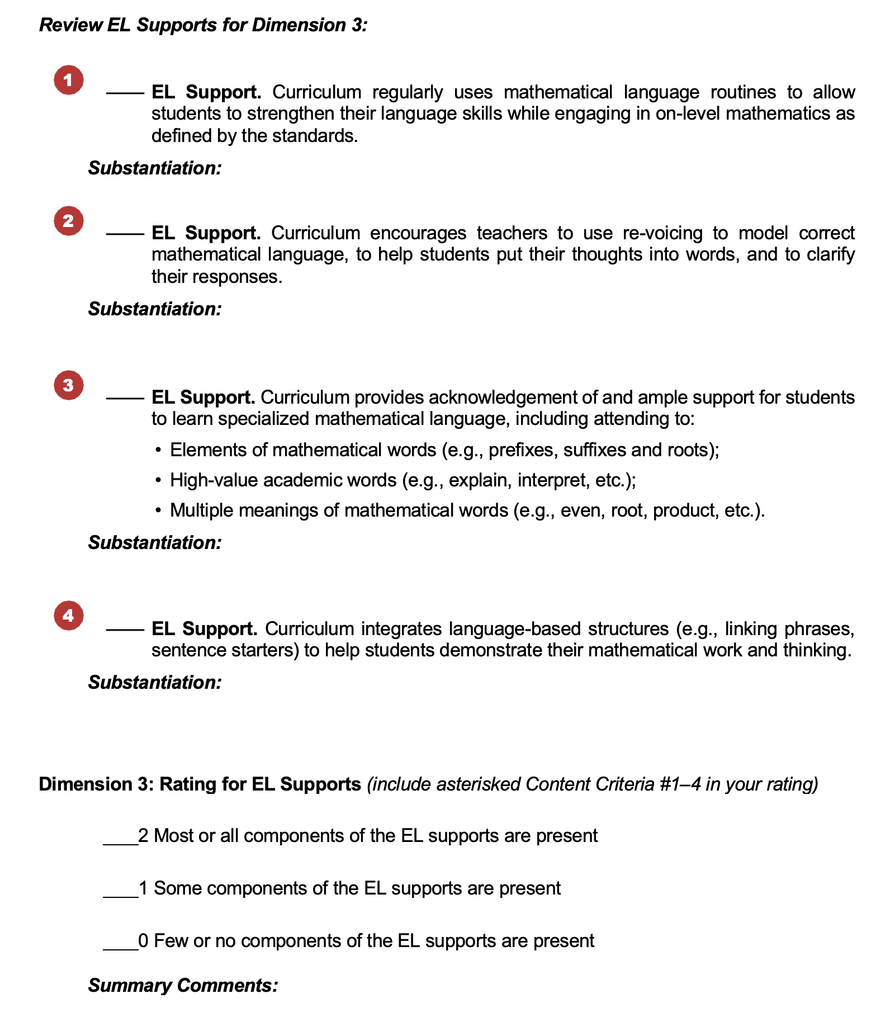
Dimension 3: Reasoning and Communicating with Mathematics
Notes:
Big idea: Show an overview of the Curriculum Review Protocol (from the Participant Workbook) for Dimension 3 EL supports.
Facilitator talking points:
Here you see the page from your Participant Workbook containing the EL support criteria for Dimension 3.
The four criteria are followed by our rating scale.
For this session, our primary focus will be on mathematical communication.
Facilitator notes:
Start with the first talking point, then point out the four EL support criteria and rating scale.
Read the last two talking points to draw attention to the EL support section of the workbook.

Slide 12
Dimension 3: EL Support Criteria
Curriculum regularly uses mathematical language routines to allow students to strengthen their language skills while engaging in on-level mathematics as defined by the standards.
Curriculum encourages teachers to use re-voicing to model correct mathematical language, to help students put their thoughts into words, and to clarify their responses.
Notes:
Big idea: Share the EL support criteria for this dimension.
Facilitator talking points:
To begin, let’s look at the first two EL support criteria.
As you read the criteria, ask yourself: “Where might we look in the curriculum to find evidence of this criterion?”
There are two more EL support criteria for this dimension we need to consider…
Facilitator notes:
Read the first talking point and ask participants to locate the EL support criteria for this dimension in their participant materials.
Read the second talking point and then read the two criteria.
Use the third talking point to continue to the next slide, showing the third and fourth criteria. Discussion will take place after viewing all four.
To make sure the meaning of the criteria is clear to the participants, use these guiding questions to steer the discussion – the first pair for Criterion 1 and the second pair for Criterion 2.
Guiding Questions to ensure understanding:
Does the curriculum encourage teachers to promote understanding through such instructional strategies as thoughtfully sequenced questions, strategic pairing of students, and multiple reads of text?
Are students encouraged to ask questions and share their thinking, using both written and oral language, including use of home language or translanguaging? (Translanguaging is allowing use of a multilingual person’s full language repertoire rather than keeping a narrow focus on a single language)
Are teachers encouraged to model accurate mathematical language for students?
Do teacher-facing materials make specific suggestions for how students can be encouraged to precisely express their mathematical understanding verbally?

Slide 13
Dimension 3: EL Support Criteria, cont’d.
Curriculum provides acknowledgement of and ample support for students to learn specialized mathematical language, including attending to:
Elements of mathematical words (e.g., prefixes, suffixes, and roots);
High-value academic words (e.g., explain, interpret, etc.); and
Multiple meanings of mathematical words (e.g., even, root, product, etc.).
Curriculum integrates language-based structures (e.g., linking phrases, sentence starters) to help students demonstrate their mathematical work and thinking.
Notes:
Big idea: Share the EL supports criteria for this dimension (cont’d.)
Facilitator talking points:
Here are the third and fourth EL supports criteria for Dimension 3. For this dimension, we also have three asterisked (*) content criteria in this cluster: Content Criterion #1, #2, #3, #4.
Read and think about what evidence of all four of these criteria would look like.
In your search for evidence of these criteria, consider this:
Can you think of how these particular content criteria relate to the needs of ELs and fit into this cluster? (ELs need support in accessing the technical language of mathematics. The curriculum provides definitions and specialized meanings for words; the teacher provides support with opportunities to practice their language and corrections of imprecise language. ELs can improve both their understanding and communication of their understanding of the content.)
Share in the chat any thoughts you’ve had on what the evidence might look like and where you might look for it in the curriculum.
Don’t forget to make a note of the places you found evidence for a criterion under “Substantiation” in the Participant Workbook. Some evidence that you already found in earlier searches might also apply here.
Facilitator notes:
Read the first two talking points then give 2-3 minutes of quiet time for reading and absorbing.
After the third and fourth talking points, ask for ideas in the group chat about where they might look for the answers to these questions. Use the “Where to look” ideas to guide them in the right direction.
Where to look: Check in the lesson and activity introductions and in the Grade 6 Course Guide and in the Grade 6, Unit 3 Teacher Guide. Look specifically for evidence that the mathematical vocabulary that is specific to the lesson is explained and used properly.
To make sure the meaning of the criteria is clear to the participants, use these guiding questions to steer the discussion. The first set of three is for Criterion 3, and the second pair is for Criterion 4.
Guiding Questions to ensure understanding:
Does the curriculum point out elements of mathematical words (e.g., prefixes, suffixes, and roots) so that students are able to decipher meaning of important vocabulary words on their own?
Does the curriculum draw attention to high-value academic words (e.g., explain, interpret, etc.)?
Are the specific mathematical definitions of words with multiple meanings explained (e.g., even, root, product, etc.)?
Does the curriculum offer techniques such as using sentence frames/starters, linking words, transitional phrases, and role-plays to help students express their mathematical understanding?
Does the curriculum refer to learners’ home languages as assets for learning academic content and English simultaneously?

Slide 14
Rating for EL Supports
2 Points: Most or all components of the EL supports are present.
1 Point: Some components of the EL supports are present.
0 Points: Few or no components of the EL supports are present.
Notes:
Big idea: Prepare participants to use the rating system for this dimension.
Facilitator talking points:
As you search and record substantiation of your evidence, remember that you will be asked to rate the dimension and provide summary comments.
This is a reminder of the rating system we use for rating the dimension against its EL support criteria.
By now you know how to recognize the difference between “most,” “some,” and “few.” Your professional judgment will be an important part of your team discussion and final decision. Ask yourself, “How crucial are the missing elements? Can the gaps be easily filled by an instructor? Can a simple revision to the curriculum improve its alignment with the criteria?”
You will consider all the EL support criteria for Dimension 3, as well as the asterisked content criteria we examined in the last session. Also consider the asterisked content criteria (#1, #2, #3, #4) when you rate this dimension.
Remember that it is possible to award the curriculum with a 2 rating even when there are ways it could be better. Sometimes it helps the rating process to consider the difficulty of making revisions or additions to the curriculum to achieve a 2 rating.
It is important to keep a record of how you came to the rating decision. Don’t forget to record key points in your decision under “Summary Comments” in the Participant Workbook.
Facilitator notes:
Review the rating descriptors and use the talking points to remind participants of how the rating system will work.
Some participants might want to quantify the ratings: “at least 90%” or “more than 60% of the lessons,” for example. Resist that temptation. After they use it to look through the materials, they will begin to see how the differences are revealed through discussion of the evidence.
With the last talking point, remind participants to take notes along the way for their summary comments.

Slide 15
Breakout Time: 45 minutes
Scan the curriculum for evidence of each of the EL supports, including the asterisked content criteria.
Discuss with your team and agree on whether there is evidence in the curriculum for each EL support criterion.
Check those for which you found evidence and determine the “weight” of the missing supports or parts of supports.
Make notes about your findings.
Together, assign a rating for the dimension’s EL supports. (Include the asterisked content criteria.)
When we reconvene, we will ask you to share comparisons of your rating, criteria checks, substantiations, and commentary.
Notes:
Big idea: Apply Dimension 3 EL support criteria to our common sample from Illustrative Mathematics.
Facilitator talking points:
Now you get the next 45 minutes to try this with your team.
Here are your instructions for the breakout time.
When we come back together, we will get to see the filled-in Example Workbook. Keep in mind that we will ask you to compare your rating, checks, substantiations, and comments with the example. Then we’ll ask a couple of teams to share their findings. Choose a reporter and be prepared for that.
Don’t forget that we need to consider the asterisked content criteria when we rate for EL supports in this dimension.
Facilitator notes:
Read the first two talking points and then the instructions for the breakout time.
Read the third talking point and check to remind them that they need to select a ”reporter” for their group. They will be asked both poll questions and chat questions about comparisons between their responses and the Example Workbook.
Check to make sure the instructions are clear. Click to the next slide for a list of the materials participants will need for the breakout.

Slide 16
Breakout Materials
Your copy of the Participant Workbook (p. 9)
Curriculum: Illustrative Mathematics:
Grade 6 Course Guide
Grade 6, Unit 3 Teacher Guide
Resource: Standards for Mathematical Practice
Notes:
Big idea: Check that everyone has the correct materials.
Facilitator talking points:
These are the materials you will need to have on hand during this breakout session.
Facilitator notes:
Before sending the teams to their breakout rooms, check to make sure everyone has the correct materials.
Leave this slide on the screen as groups go to their breakout sessions.

Slide 17
Welcome Back!
Notes:
Big idea: Bring state teams back together and debrief the work session.
Facilitator talking points:
Facilitator notes:
Click on this slide before breakout groups return to the main room.

Slide 18
Let’s Hear From You!
POLL: What is your rating for Dimension 3 EL Supports?
O 2 points: Most or all components of the criteria are present.
O 1 point: Some components of the criteria are present.
O 0 points: Few or no components of the criteria are present.
Notes:
Big idea: Share everyone’s rating of Dimension 3 before getting started.
Facilitator talking points:
Now that you’ve had a chance to find evidence for the criteria, let’s see if we agree on the dimension rating.
Use the chat box to enter your rating for Dimension 3 EL supports.
Let’s see how your ratings compare with the example review…
Facilitator notes:
Briefly review the dimension rating scale and then read the first talking point.
Create a poll or ask participants to enter their ratings in the chat.
Allow a minute for them to enter their answer.
Use the third talking point to summarize the results of the poll.
Example Workbook Dimension 3 EL Supports Rating: 2 points. (Some possible improvements are noted but seem to require fairly simple modifications.)

Slide 19
Let’s Hear From You!
POLL: Did you check (as present) the same criteria as in the Example Workbook?
O Yes, I checked the same criteria as the example.
O No, I checked one or more criteria differently than the example.
Notes:
Big idea: Share our evidence and ratings.
Facilitator talking points:
Now let’s compare the individual checks your team decided to give for the criteria in this dimension with those checked in the example.
Did your checks match those of the example? Or did you check one or more criteria differently?
Facilitator notes:
Allow a minute for participants to enter their answer to the poll and then review the results.
Example Workbook Dimension 3 EL Support Criteria: One EL support criterion (#3) cannot be fully checked. #1, #2, and #4 are checked.
Click to the next slide for a discussion of the substantiations for this dimension.

Slide 20
Let’s Discuss!
Let’s take 5 minutes to review the Example Workbook that contains the substantiations for the EL support criteria.
Then in the group chat, share your answer to this question:
CHAT: How do your substantiations compare to the example?
Then we want to hear from you about the evidence you found and noted in your Summary Comments.
Notes:
Big idea: Share our evidence and ratings.
Facilitator talking points:
Now that we’ve compared the rating and checks for this part of the dimension, we want to give you some individual work time. Compare your substantiations and summary comments with those in the Example Workbook.
Remember that there can be many “right” answers. But while substantiations may be different, there should be agreement on the general findings and ratings.
We’re going to take 5 minutes for you to compare what you found with those of the Example Workbook.
Take some notes about what you see as the same and different. Then we’ll ask you to share your findings in chat when we come back together.
[After work time] Let’s have everyone type one or two sentences in the group chat to describe how your substantiations compared. Feel free to share a specific commonality or difference.
Now let’s hear from a couple of teams about their comparison…
Facilitator notes:
Use the first four talking points to bring attention to the Example Workbook with substantiations and commentary.
Pause (5 minutes) for participants to compare and make some notes about what they found.
After the 5-minute comparison time, read the fifth talking point and comment on interesting chats as they appear.
Read the last talking point and select one or two participants to share verbally. You might select based on a chat statement that needs to be clarified or one that is especially insightful or unique.

Slide 21
Let’s Chat!
In the group chat, type your answer to this question in a sentence or two:
CHAT: What is something you have learned today (or understand better) about communication with mathematics in general and supporting EL students in particular?
We’ll ask everyone to hit “enter” at the same time so…
WAIT to hit “enter”!
Notes:
Big idea: Check for understanding using the chat feature.
Facilitator talking points:
We’d love to hear about what you learned today, in just a sentence or two, about reasoning and communicating with mathematics.
Everyone take about 2 minutes to type in the group chat, but don’t hit “enter” until I tell you to. We want everyone’s chats to happen at once so we can scroll through and see what everyone is thinking.
OK, everyone can hit “enter” and read through all the responses.
Facilitator notes:
Read the first and second talking points and then pause for about 2 minutes.
After the pause, read the third talking point and discuss the highlights of the chats.
Coaches should read, monitor their own state participation, and comment aloud along with the presenter.

Slide 22
Next Steps
We will focus on content criteria for Dimension 4 to:
Examine the sample curriculum from Illustrative Mathematics for its inclusion of quality mathematical tasks and applications.
Notes:
Big idea: Provide date and topic of the next virtual training session.
Facilitator talking points:
Here you see information about the next session.
We will put you back into your breakout sessions if you would like to meet with your coach for up to 30 more minutes.
Facilitator notes:
Read the first talking point and the slide bullets. Emphasize the date and time of the next session.
Use the second talking point to offer more coaching time if any participants have questions.

Slide 23
Thank you!
Notes:
Big idea: Closing slide
Facilitator talking points:
This is the final slide participants will see before the meeting is ended.
Facilitator notes:

