Slide 1
Quality Mathematical Tasks
State-Based Curriculum Review

Slide 2
Welcome back!

Slide 3
Disclaimer
This presentation was produced and funded in whole with Federal funds from the U.S. Department of Education under contract number ED-991990018C0040 with StandardsWork, Inc. Ronna Spacone serves as the Contracting Officer’s Representative. There is content on the slides and additional content in the Slide Notes throughout the presentation. The content of this presentation does not necessarily reflect the views or policies of the U.S. Department of Education nor does the mention of trade names, commercial products, or organizations imply endorsement by the U.S. Government.
Notes:
Big idea: Make audience aware of contract information.
Facilitator talking points:
Please read through this slide for information about the contract.
Facilitator notes:
Allow 10-15 seconds for participants to review this slide for information about the contract (no need to read through).

Slide 4
Let’s Hear From You!
Type your response and comments in the group chat. We’ll ask everyone to enter their responses at the same time.
CHAT: Thus far, have you found ample English learner (EL) supports in the curriculum you’re reviewing?
We’ll ask everyone to hit “enter” at the same time so...
WAIT to hit “enter”!
Notes:
Big idea: Use the chat feature to better understand participants’ background knowledge on this topic.
Facilitator talking points:
Being able to solve mathematical problems presented in their natural context is the ultimate reason for learning mathematics. The language used in presenting mathematical problems can be a stumbling block for all students, and particularly for English learners. In Dimension 4, we will focus on how the curriculum supports students in dealing with all kinds of mathematical tasks, including complex problem solving.
Use the group chat to answer these questions about reviewing your own materials for how well they support English learners.
At the end of this presentation, we will ask you to share one or two things you learned during the session.
Highlights of our last session: In our last session (Dimension 3, Part 2), we reviewed the sample curriculum. We rated it for alignment to the criteria for EL supports in Reasoning and Communicating with Mathematics. [Add anything here that came up during the last session.]
Facilitator notes:
Read the first two talking points and then pause to allow time for participants to enter their thoughts in the group chat. Have them pause before hitting “enter.”
Coaches should read and comment on the chat entries along with the presenter.
Talk about the highlights from the last session before moving to the next slide—today’s agenda.

Slide 5
Agenda
Overview of Dimension 4 and its research base
Introduction to the content criteria for Dimension 4
Breakout work session #1 with your team
Review of substantiations and rating of content criteria in the Example Workbook
Introduction to the English learner (EL) support criteria for Dimension 4
Breakout work session #2 with your team
Review of substantiations and ratings in the Example Workbook
Next steps and final questions
Notes:
Big idea: Introduce the agenda for today’s session.
Facilitator talking points:
Today, we are going start with an overview of the fourth dimension and the research that supports it.
Then, we will go through the content criteria for Dimension 4.
You will have a chance to practice using the criteria with our sample curriculum in a breakout session with your team. Then, you will compare your findings with the Example Workbook.
Then, we will repeat that process with the EL support criteria for Dimension 4. We will have two breakout sessions today.
Facilitator notes:
Read the talking points to explain the agenda for today’s session.
The underlining emphasizes and reminds participants that we will be reviewing for both parts of the dimension and will have two breakout sessions.

Slide 6
Meeting Norms and Expectations
Be present and engage fully.
Ask questions.
Prepare for productive struggle.
Consider differing perspectives.
Create and maintain a safe space for professional learning.
Be mindful of different learning styles.
Notes:
Big idea: Share with participants the norms we will adhere to as we proceed through the trainings.
Facilitator talking points:
These are the norms we have been using use for all of our work together.
Facilitator notes:
Read the talking point and then allow a few moments for participants to read the six statements.
After reading through the norms, ask if there are any comments or questions.
Remind participants that they can do so through the chat box or verbally.

Slide 7
Research Base for Dimension 4
Research published by the National Research Council (2001 and 2012) shows that:
Students must be encouraged and assisted to engage regularly in thinking, reasoning, and sense-making in the mathematics classroom.
When students solve problems, they gain a deeper understanding of the mathematics and an ability to demonstrate complex thinking, reasoning, and communication skills.
Mathematical competency depends on more than simply storing knowledge; it must be represented and organized so it can be retrieved and applied.
Notes:
Big idea: Share the research behind focusing on quality tasks and applications.
Facilitator talking points:
Ensuring that all students have opportunities to think, plan, and solve quality mathematical tasks is key to them truly and deeply understanding the critical mathematical concepts. That deep understanding will make it possible for them to transfer their classroom knowledge and experience to their lives and to 21st Century jobs.
Research by the NRC (National Research Council) validate this in multiple ways.
Facilitator notes:
Read the two talking points and then the slide bullets.
Citations:
Improving Adult Literacy: Options for Practice and Research, National Academies Press – National Research Council, 2012 https://www.nap.edu/catalog/13242/improving-adult-literacy-instruction-options-for-practice-and-research
Adding It Up: Helping Children Learn Mathematics, National Academies Press– National Research Council, 2001 https://www.nap.edu/read/9822/chapter/1

Slide 8
What Does Research on Quality Tasks Mean for High-Quality Curriculum?
The inclusion of high-quality mathematical tasks in curriculum:
Encourages flexible reasoning skills that can carry over into all parts of the students’ lives;
Teaches students to use math flexibly; and
Prepares students to “think on their feet” — something highly regarded in the professional world.
Notes:
Big idea: Explain that the important shift to deep learning must include applying the mathematics students learn.
Facilitator talking points:
For students to effectively use the mathematics they learn, they must have opportunities to apply it to real situations relevant to their lives.
Students with these skills can use their problem-solving skills for math class as well as for solving problems in their lives.
Facilitator notes:
Read the talking points.
Then read the three bullets on the slide to explain the reasons for emphasizing reasoning in math curriculum.

Slide 9
What Are Mathematical Tasks?
Mathematical tasks…
are practice worksheets, word problems, applications, or modeling opportunities that focus students' attention on particular mathematical ideas and that…
provide opportunities to develop or use a particular mathematical habit of mind.
Notes:
Big idea: Explain the meaning of “quality mathematical task.”
Facilitator talking points:
For those of us who are teaching mathematics, we may think we know what a “mathematical task” is. However, we might be surprised to find that the definition goes far beyond simply a math problem or even a “word problem.” Let’s start with a basic definition …
These statements define any mathematical task. The definition is quite open-ended. A mathematical task might have a high or low cognitive demand.
For a task to be considered of high quality, there are more requirements …
Facilitator notes:
Start with the first talking point and then read the two defining bullets.
Then read the second talking point before defining what “quality” means for a mathematical task.
After the third talking point, move to the next slide to further define “quality tasks.”

Slide 10
What Are Mathematical Tasks? (cont’d.)
Quality mathematical tasks:
Have well-defined purposes;
Offer reasonable chances of fulfilling their purposes when used appropriately;
Provide ways for students to step into the task even when the route to a solution may initially be unclear; and
Are applicable to a wide range of students (i.e., “rich” tasks).
Notes:
Big idea: Explain the meaning of “quality mathematical task.” (continued)
Facilitator talking points:
The “purposes” in the first two bullets might include practicing a skill, becoming fluent with operations, improving logical thinking, or building a repertoire of strategies. It can also include making connections to other disciplines, deepening conceptual understanding, reaching a better understanding of our world, making predictions, or becoming more efficient.
“Rich” tasks are defined as accessible to all learners. Other features of rich tasks include “real-life” application, multiple approaches/representations possible, requires collaboration/discussion, encourages engagement/curiosity/creativity, and provides opportunities for extension.
The level of cognitive demand is not necessarily a measure of quality. Cognitive demand can be different for the same task with different level students.
Some examples of both high and low cognitive demand mathematical tasks are:
Fill in a multiplication facts table.
Build a 2-D net that can be folded into a 3-D figure.
Make a bar graph from a set of data.
Create a tessellation.
Determine how many 4”x12” tiles are needed to tile your shower.
Make and test a conjecture about the future population of your city, based on tables of population for the past 20 years.
Facilitator notes:
Start by reading the four defining slide bullets.
Then read the talking points exemplifying some possible purposes for tasks, defining “rich” tasks, and describing examples of quality tasks.

Slide 11
Illustrative Mathematics
Notes:
Big idea: Reintroduce Illustrative Mathematics and the selected unit.
Facilitator talking points:
For this session, we will continue our focus on the model unit: Grade 6, Unit 3.
This time we are looking specifically for evidence of an emphasis on the quality of tasks and applications.
Facilitator notes:
Make sure all participants have these documents ready for this session.

Slide 12
Standards for Mathematical Practice
MP.1 Make sense of problems and persevere in solving them.
MP.2 Reason abstractly and quantitatively.
MP.3 Construct viable arguments and critique the reasoning of others.
MP.4 Model with mathematics.
MP.5 Use appropriate tools strategically.
MP.6 Attend to precision.
MP.7 Look for and make use of structure.
MP.8 Look for and express regularity in repeated reasoning.
Notes:
Big idea: Reintroduce the Standards for Mathematical Practice.
Facilitator talking points:
Here are the eight practices that are important for all students to eventually master.
Since we will be focusing on application in this session, we should keep MP.1 and MP.4 most particularly in mind.
MP.1 involves all the phases of problem solving, from planning a path to solutions to explaining results. MP.4 requires independent work with un-scaffolded problems from everyday life, society, and work.
Facilitator notes:
Use the talking points to explain why these two underlined practices will be particularly important to this dimension.

Slide 13
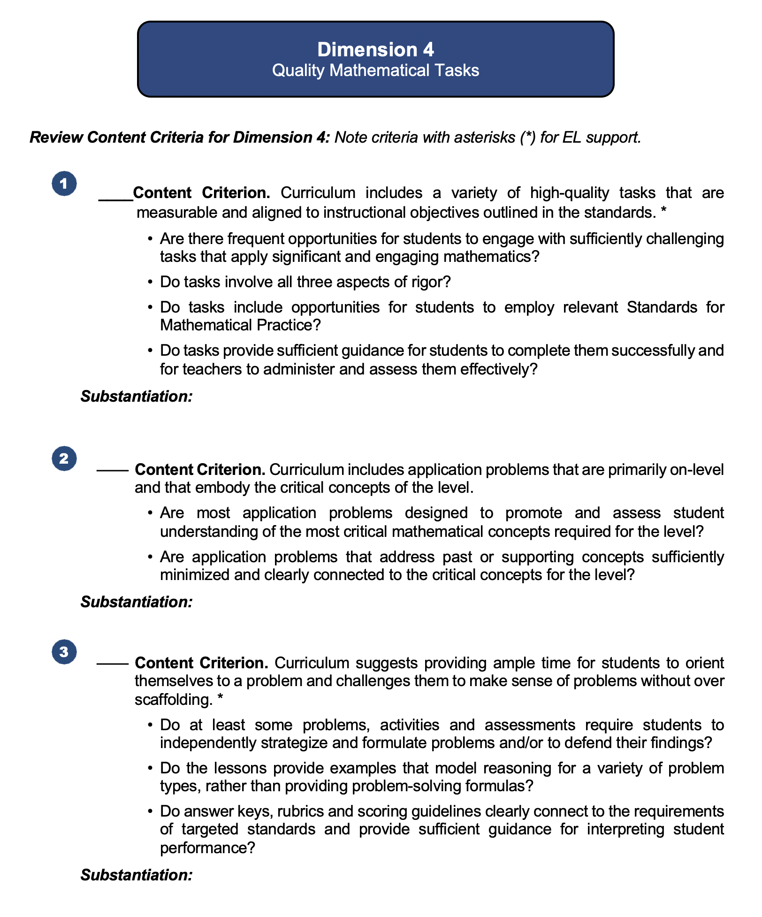
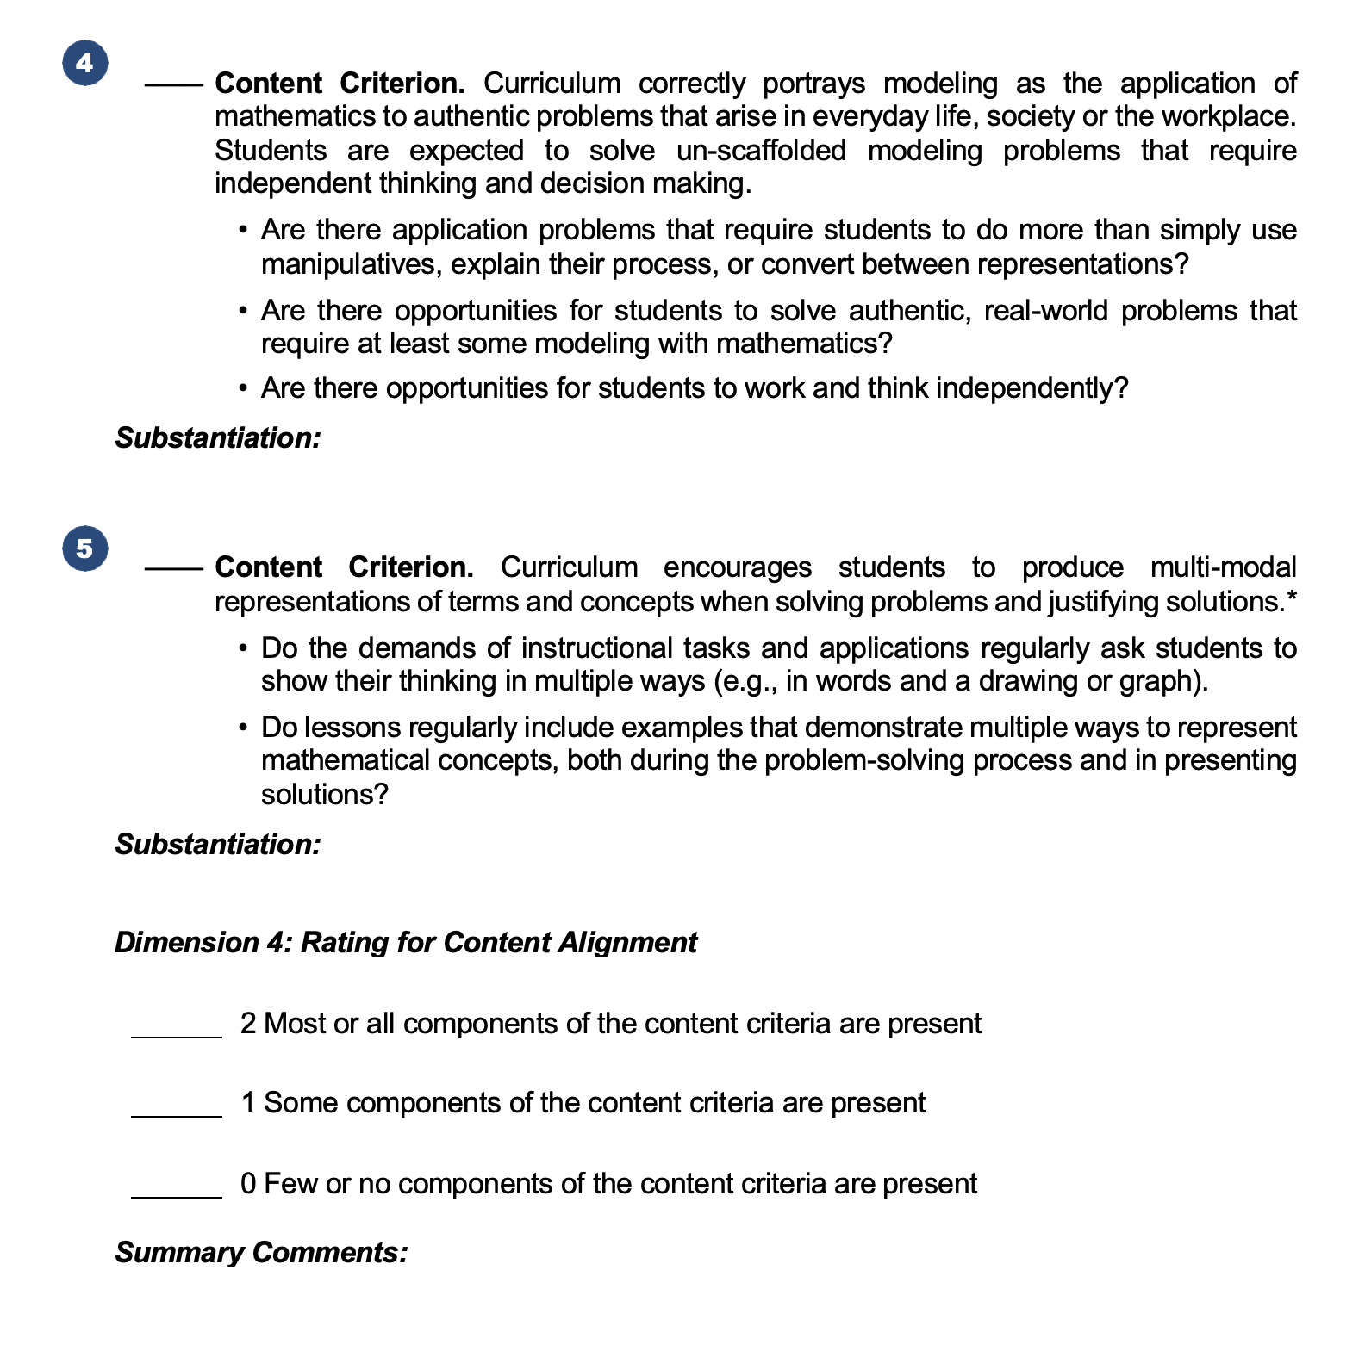
Dimension 4: Quality Mathematical Tasks
Notes:
Big idea: Show an overview of the Curriculum Review Protocol (from the Participant Workbook) for Dimension 4.
Facilitator talking points:
Here you see the content criteria pages of your Participant Workbook for Dimension 4. This dimension addresses the types and quality of problems that students are asked to solve in the curriculum.
Each content criterion is followed by a set of guiding questions. These are designed to help you understand what the criterion means and to guide your search for evidence in the curriculum.
Notice that three of the criteria have an asterisk, indicating that they are also key supports for ELs.
Both the content and EL support criteria are followed by a rating scale.
For this session’s first part, we will concentrate on the content criteria for Dimension 4 and look at the EL support criteria later. Let’s take a closer look at the content criteria.
Facilitator notes:
After reading the first three talking points, point out the criteria, asterisks, and rating scale.

Slide 14
Content Alignment Criteria
Notes:
Big idea: Move participants’ attention to the Content Criteria.
Facilitator talking points:
Facilitator notes:

Slide 15
Dimension 4: Content Criterion 1
Curriculum includes a variety of high-quality tasks that are measurable and aligned to instructional objectives outlined in the standards.*
Ask Yourself:
Are there frequent opportunities for students to engage with sufficiently challenging tasks that apply significant and engaging mathematics?
Do tasks involve all three aspects of rigor?
Are there frequent opportunities for students to engage with sufficiently challenging tasks that apply significant and engaging mathematics?
Do tasks involve all three aspects of rigor?
Notes:
Big idea: Provide guiding questions to help participants review elements of Dimension 4’s first content criterion in the curriculum.
Facilitator talking points:
Here is the first content criterion for this dimension.
Note that this content criterion has an asterisk(*). This indicates that while this is an important criterion for all students, it is also a key support for ELs. Can you think of how these criteria relate to the needs of ELs and fits into this cluster? (Offering a wide variety of tasks provides a good foundation of understanding and encourages flexible thinking for all students. Making sure tasks are measurable and aligned to the standards allows for good feedback for students. It also provides a strong connection to the concepts students have been learning.)
We have four guiding questions to help you understand the criterion. These questions will help us determine whether the intent of this criterion is met in the curriculum. We will start with the first two questions.
Facilitator notes:
Read the first talking point and then the criterion.
Then read the second talking point, calling attention to the asterisk.
After the third talking point, read the guiding questions aloud.
Then click to the next slide to see the next two guiding questions.

Slide 16
Dimension 4: Content Criterion 1, cont’d.
Do tasks include opportunities for students to employ relevant Standards for Mathematical Practice?
Do tasks provide sufficient guidance for students to complete them successfully and for teachers to administer and assess them effectively?
Notes:
Big idea: Provide guiding questions to help participants review elements of Dimension 4’s first content criterion in the curriculum (cont’d).
Facilitator talking points:
Here are the next two guiding questions for the first criterion.
Where might you look, in any set of materials, for answers to these questions? Use the group chat to share any questions or comments that come to you as you read the guiding questions.
Don’t forget to make a note of the places you found evidence for a criterion under “Substantiation” in the Participant Workbook. Some evidence that you already found in earlier searches might also apply here.
Facilitator notes:
Read the first talking point and then the two guiding questions.
After the second talking point, take a moment and then ask for some ideas for where participants might look for answers to these questions. Use the “Where to look” ideas to guide them in the right direction.
Where to look: Look in assignments or assessments that have problem that require that students apply the mathematics they are learning. Make note of tasks or problems that address concepts on the critical concepts for the level.
Use the last talking point to remind participants that they must provide details about where in the curriculum they find evidence of the criterion. Evidence found in earlier searches might also be useful here.

Slide 17
Dimension 4: Content Criterion 2
Curriculum includes application problems that are primarily on-level and that embody the critical concepts of the level.
Ask Yourself:
Are most application problems designed to promote and assess student understanding of the most critical mathematical concepts required for the level?
Are application problems that address past or supporting concepts sufficiently minimized and clearly connected to the critical concepts for the level?
Notes:
Big idea: Provide guiding questions to help participants review elements of Dimension 4’s second content criterion in the curriculum.
Facilitator talking points:
Here is the second content criterion.
The questions you see here can help us determine whether the intent of this criterion is met in the curriculum.
Where might you look, in any set of materials, for answers to these questions? Use the group chat to share any questions or comments that come to you as you read the guiding questions.
Don’t forget to make a note of the places you found evidence for a criterion under “Substantiation” in the Participant Workbook. Some evidence that you already found in earlier searches might also apply here.
Facilitator notes:
Read the first talking point and then the criterion.
After the second talking point, read the two guiding questions.
After the third talking point, have participants think and then ask for ideas for how/where they might look for the answers to these questions. Use the “Where to look” ideas to guide them in the right direction.
Where to look: Look in assignments or assessments that have problem that require that students apply the mathematics they are learning. Make note of tasks or problems that address the critical concepts for the level and those that address concepts from previous or future levels.
Use the last talking point to remind participants that they must provide details about where in the curriculum they find evidence of the criterion. Evidence found in earlier searches might also be useful here.

Slide 18
Dimension 4: Content Criterion 3
Curriculum suggests providing ample time for students to orient themselves to a problem and challenges them to make sense of problems without over scaffolding.*
Ask Yourself:
Do at least some problems, activities, and assessments require students to independently strategize and formulate problems and/or to defend their findings?
Do the lessons provide examples that model reasoning for a variety of problem types, rather than providing problem-solving formulas?
Do answer keys, rubrics, and scoring guidelines clearly connect to the requirements of targeted standards and provide sufficient guidance for interpreting student performance?
Notes:
Big idea: Provide guiding questions to help participants review elements of Dimension 4's third content criterion in the curriculum.
Facilitator talking points:
Here is the third criterion for this dimension.
Notice that this criterion also has an asterisk(*) and is associated with the EL support criteria in the Instructional Routines cluster. Can you think of how these criteria relate to the needs of ELs and fits into this cluster? (Over-scaffolding problems does not allow ELs to develop their ability to persevere in problem solving. Challenging them to make sense of the word problems themselves increases their understanding of both the content and the language.)
The questions you see here can help us determine whether the intent of this criterion is met in the curriculum.
Where might you look, in any set of materials, for answers to these questions? Enter your ideas for the whole group in the group chat.
Don’t forget to make a note of the places you found evidence for a criterion under “Substantiation” in the Participant Workbook. Some evidence that you already found in earlier searches might also apply here.
Facilitator notes:
Read the first talking point and then the criterion.
Read the second talking point, calling attention to the asterisk.
After the third talking point, read the guiding questions.
Read the fourth talking point and allow a moment for participants to share some ideas for where participants might look for answers to these questions. Use the “Where to look” ideas to guide them in the right direction.
Where to look: Look in the lesson introductions and examples for problem-solving instruction. This suggests students will be allowed enough think time and that does not overprescribe the strategies or methods used to reach a solution. Check both the teacher- and student-facing materials. Also look at any scoring guidelines and whether they give attention to alternate solution paths or common errors.
Use the last talking point to remind participants that they must provide details about where in the curriculum they find evidence of the criterion. Evidence found in earlier searches might also be useful here.

Slide 19
Dimension 4: Content Criterion 4
Curriculum correctly portrays modeling as the application of mathematics to authentic problems that arise in everyday life, society, or the workplace. Students are expected to solve un-scaffolded modeling problems that require independent thinking and decision making.
Ask Yourself:
Are there application problems that require students to do more than simply use manipulatives, explain their process, or convert between representations?
Are there opportunities for students to solve authentic, real-world problems that require at least some modeling with mathematics?
Are there opportunities for students to work and think independently?
Notes:
Big idea: Provide guiding questions to help participants review elements of Dimension 4’s fourth content criterion in the curriculum.
Facilitator talking points:
Here is the fourth content criterion for this dimension.
The questions you see here can help us determine whether the intent of this criterion is met in the curriculum.
Where might you look, in any set of materials, for answers to these questions? Enter your ideas for the whole group in the group chat.
Don’t forget to make a note of the places you found evidence for a criterion under “Substantiation” in the Participant Workbook. Some evidence that you already found in earlier searches might also apply here.
Facilitator notes:
Read the first talking point and then the criterion.
After the second talking point, read the two guiding questions.
After the third talking point, take a moment and then ask for some ideas for where participants might look for answers to these questions. Use the “Where to look” ideas to guide them in the right direction.
Where to look: Look in the lesson tasks for full modeling examples, which allow students to struggle productively without a prescribed method of finding a solution. These might be a culminating activity or task at the end of a chapter or unit.
Use the last talking point to remind participants that they must provide details about where in the curriculum they find evidence of the criterion. Evidence found in earlier searches might also be useful here.

Slide 20
Dimension 4: Content Criterion 5
Curriculum encourages students to produce multi-modal representations of terms and concepts when solving problems and justifying solutions.*
Ask Yourself:
Do the demands of instructional tasks and applications regularly ask students to show their thinking in multiple ways (e.g., in words and a drawing or graph)?
Do lessons regularly include examples that demonstrate multiple ways to represent mathematical concepts, both during the problem-solving process and in presenting solutions?
Notes:
Big idea: Provide guiding questions to help participants review elements of Dimension 4’s fifth content criterion in the curriculum.
Facilitator talking points:
Now let’s move to the fifth and last content criterion.
Notice that this criterion has an asterisk(*), indicating that it is also a key support for ELs. Can you think of how these criteria relate to the needs of ELs and fits into this cluster? (Using multiple representations for mathematical concepts allows for a variety of entry points for all kinds of learners, including those who are learning English.)
Let’s look at the questions we can ask ourselves to help us understand what the criterion is asking for.
Where might you look, in any set of materials, for answers to these questions? Enter your ideas for the whole group in the group chat.
Don’t forget to make a note of the places you found evidence for a criterion under “Substantiation” in the Participant Workbook. Some evidence that you already found in earlier searches might also apply here.
Facilitator notes:
Read the first talking point and then the criterion.
Read the second talking point, calling attention to the asterisk.
After the third talking point, read the guiding questions.
After the fourth talking point, take a moment and then ask for some ideas for where participants might look for answers to these questions. Use the “Where to look” ideas to guide them in the right direction.
Where to look: Look in the lesson introductions and examples for problem-solving instruction that includes multiple representations. These might be in examples but also in the tasks themselves. Check both the teacher- and student-facing materials. Also look at any scoring guidelines and whether they give attention to the use of varying representations and solution formats.
Use the last talking point to remind participants that they must provide details about where in the curriculum they find evidence of the criterion. Evidence found in earlier searches might also be useful here.

Slide 21
Rating for Content Alignment
2 Points: Most or all components of the content criteria are present.
1 Point: Some components of the content criteria are present.
0 Points: Few or no components of the content criteria are present.
Notes:
Big idea: Prepare the participants to use the rating system for this dimension.
Facilitator talking points:
This is a reminder of the point system we use for rating the dimension against its content criteria.
By now you know how to recognize the difference between “most,” “some,” and “few.” Your professional judgment will be an important part of your team discussion and final decision. Ask yourself, “How crucial are the missing elements? Can the gaps be easily filled by an instructor?”
It is important to keep a record of how you came to the rating decision. Don’t forget to record key points in your decision under Summary Comments in the Participant Workbook.
Facilitator notes:
Read the talking points to remind participants of the rating process and descriptors.
Since this is the sixth time participants have used this rating scale, there should be few, if any, questions about what the descriptors mean.
With the last talking point, remind participants to write their summary comments under the rating for the dimension.

Slide 22
Breakout Time: 35 minutes
Your turn to work with your team:
Examine the evidence in the curriculum for each of these content criteria.
Check the content criteria that are evident and cite where you found evidence in your notes.
Discuss the evidence you found for all the content criteria with your team and agree upon a rating for the dimension.
When we reconvene, we will ask you to share comparisons of your rating, criteria checks, substantiations, and commentary.
Notes:
Big idea: Apply Dimension 4 content criteria to our common sample curriculum from Illustrative Mathematics in your team.
Facilitator talking points:
Now you get the next 40 minutes to try this with your team.
Here are your instructions for the breakout time.
When we come back together, we will get to see the filled-in Example Workbook. Keep in mind that we will ask you to compare your rating, checks, and comments with the example. Then we’ll ask a couple of teams to share their findings.
Don’t forget that we have three asterisked (*) criteria in Dimension 4 that we will need to consider.
Facilitator notes:
Read the first two talking points and then the instructions for the breakout time.
Read the third talking points to remind them that they will be asked both poll questions and chat questions about comparisons between their responses and the Example Workbook.
Use the fourth talking point to remind participants that the asterisked content criteria should be considered when rating the dimension for EL supports.
Check to make sure the instructions are clear. Click to the next slide for a list of the materials participants will need for the breakout.

Slide 23
Breakout Materials
Your copy of the Participant Workbook (p. 11)
Curriculum: Illustrative Mathematics:
Grade 6 Course Guide
Grade 6, Unit 3 Teacher Guide
Resource: Standards for Mathematical Practice
Resource: Critical Concepts and Fluencies of the Level
Notes:
Big idea: Check that everyone has the correct materials to conduct the review.
Facilitator talking points:
These are the materials you will need to have at hand during this breakout session.
Facilitator notes:
Before sending the teams to their breakout, check to make sure everyone has the correct materials.
Leave this slide on the screen as groups go to their breakout sessions.

Slide 24
Welcome Back!
Notes:
Big idea: Bring state teams back together and debrief the work session.
Facilitator talking points:
Facilitator notes:
Click on this slide before breakout groups return to the main room.

Slide 25
Let’s Hear From You!
POLL: What is your rating for Dimension 4 Content Alignment?
O 2 points: Most or all components of the content criteria are present.
O 1 point: Some components of the content criteria are present.
O 0 points: Few or no components of the content criteria are present.
Notes:
Big idea: Share everyone’s rating of Dimension 4.
Facilitator talking points:
Now that you’ve had a chance to find evidence for the criteria, let’s look to see if we agree on the rating.
Enter your rating for Dimension 4 content alignment.
Let’s see how your Dimension 4 content ratings compare with the example review…
Facilitator notes:
Briefly review the dimension rating scale and then read the first talking point.
Create a poll or ask participants to enter their ratings in the chat.
Use the second talking point to ask participants to enter their ratings in the poll. Allow a minute for them to enter their answer.
Use the third talking point to summarize the results of the poll.
Example Workbook Dimension 4 Content Rating: 2 points.

Slide 26
Let’s Hear From You!
POLL: Did you check (as present) the same criteria as in the Example Workbook?
O Yes, I checked the same criteria as the example.
O No, I checked one or more criteria differently than the example.
Notes:
Big idea: Share our evidence and ratings.
Facilitator talking points:
Now let’s compare the individual checks you gave for the content criteria in this dimension with those checked in the example.
Do your checks match those of the example? Or did you check one or more criteria differently?
Facilitator notes:
Allow a minute for participants to enter their answer to the poll and then review the results.
Example Workbook Dimension 4 Content Criteria: All five content criteria were checked.
Click to the next slide for a discussion of the substantiations for this dimension.

Slide 27
Let’s Discuss!
Let’s take 5 minutes to review the Example Workbook that contains the substantiations for the content criteria.
Then in the group chat, share your answer to this question:
CHAT: How do your substantiations compare to the example?
Now let’s hear from you about the evidence you found and noted in your Summary Comments.
Notes:
Big idea: Share our evidence and ratings.
Facilitator talking points:
Now that we’ve compared the rating and checks for this part of the dimension, we want to give you some individual work time. Compare your substantiations and summary comments with those in the Example Workbook.
Remember that there can be many “right” answers. But while substantiations may be different, there should be agreement on the general findings and ratings.
We’re going to take 5 minutes for you to compare your what you found with those of the Example Workbook.
Take some notes about what you see as the same and different. Then we’ll ask you to share your findings in chat when we come back together.
[After work time] Let’s have everyone type one or two sentences in the group chat to describe how your substantiations compared. Feel free to share a specific commonality or difference.
Now let’s hear from a you about your comparison…
Facilitator notes:
Use the first four talking points to bring attention to the Example Workbook with substantiations and commentary.
Pause (5 minutes) for participants to compare and make some notes about what they found.
After the 5-minute comparison time, read the fifth talking point and comment on interesting chats as they appear.
Read the last talking point and select one or two states to share verbally. You might select based on a chat statement that needs to be clarified or one that is especially insightful or unique.

Slide 28
EL Support Criteria
Notes:
Big idea: Move participants’ attention to the EL Support Criteria.

Slide 29
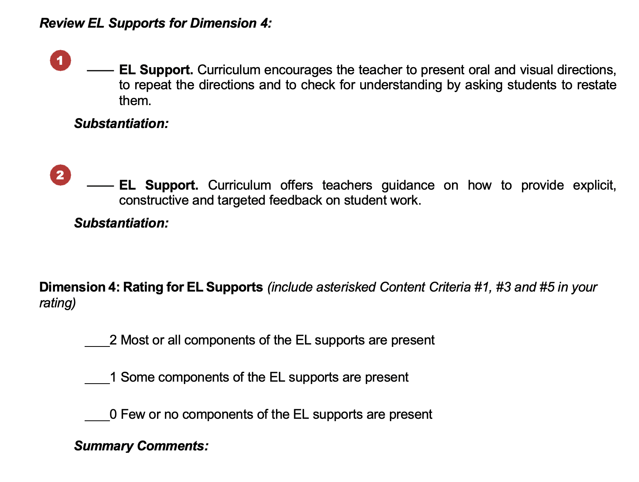
Dimension 4: Quality Mathematical Tasks
Notes:
Big idea: Show an overview of the Curriculum Review Protocol (within the Participant Workbook) for Dimension 4.
Facilitator talking points:
For this part of the session, we will concentrate on the criteria for EL supports for Dimension 4. Our focus will be on quality mathematical tasks.
Here you see two EL support criteria from the Participant Workbook for Dimension 4.
The EL support criteria are followed by a rating scale.
Facilitator notes:
Start with the first talking point and then point out the criteria and rating scale.

Slide 30
Dimension 4: EL Support Criteria
Curriculum encourages the teacher to present oral and visual directions, to repeat the directions, and to check for understanding by asking students to restate them.
Curriculum offers teachers guidance on how to provide explicit, constructive, and targeted feedback on student work.
Notes:
Big idea: Share the EL support criteria for this dimension.
Facilitator talking points:
Here are the two EL support criteria. For this dimension we also have three asterisked (*) content criteria in this cluster: Content Criteria #1, #3, #5.
Notice that these criteria describe things the instructor can influence by forming particular classroom habits.
As you read the criteria, ask yourself, “Where might we look in the curriculum to find evidence of this criteria?”
In your search for evidence of these criteria, consider what you found in earlier searches. And consider this …
Share in the chat any thoughts you’ve had on what the evidence might look like and where you might look for it in the curriculum.
Don’t forget to make a note of the places you found evidence of a criterion under “Substantiation” in the Participant Workbook.
Facilitator notes:
Read the first talking point and ask participants to locate the EL support criteria.
Then read the two EL support criteria for this cluster.
After the third and fourth talking points, give 2-3 minutes of quiet time for reading and absorbing. Then ask for ideas in the group chat about where they might look for the answers to these questions. Use the “Where to look” ideas to guide them in the right direction.
Where to look: Check in the lesson and activity introductions and in the Grade 6 Course Guide. Also look for suggestions in the sections of the lessons called “Support for English Language Learners” and/or “Support for Students with Disabilities.”
Use the last talking point to remind participants to take notes.
To make sure the meaning of the criteria is clear to the participants, use these guiding questions to steer the discussion – the first pair for Criterion 1 and the second pair for Criterion 2.
Guiding Questions to ensure understanding:
Do the teacher-facing materials include suggestions for presenting directions for a task in multiple ways?
Are teachers encouraged to check for student understanding of directions for a task or activity?
Does the curriculum include suggestions for assessing student understanding in a variety of ways?
Are teachers encouraged to use constructive feedback for students to move them toward a better understanding of the mathematics?

Slide 31
Rating for EL Supports
2 Points: Most or all components of the EL supports are present.
1 Point: Some components of the EL supports are present.
0 Points: Few or no components of the EL supports are present.
Notes:
Big idea: Prepare participants to use the rating system for this dimension.
Facilitator talking points:
As you search and record substantiation of your evidence, remember that you will be asked to rate the dimension and provide summary comments.
This is a reminder of the rating system we use for rating the dimension against its EL support criteria.
By now you know how to recognize the difference between “most,” “some,” and “few.” Your professional judgment will be an important part of your team discussion and final decision. Ask yourself, “How crucial are the missing elements? Can the gaps be easily filled by an instructor? Can a simple revision to the curriculum improve its alignment with the criteria?”
Consider all EL support criteria for Dimension 4, and for this dimension. We also have three asterisked (*) content criteria in this cluster: Content Criteria #1, #3, #5.
Remember that it is possible to award the curriculum with a 2 rating even when there are ways it could be better. In addition to key points about your decision, comments and suggestions for improvement should be recorded in Summary Comments.
Sometimes it helps the rating process to consider the difficulty of making revisions or additions to the curriculum to achieve a 2 rating
Don’t forget to keep a record of how you came to the rating decision. Record key points in your decision under “Summary Comments” in the Workbook.
Facilitator notes:
Review the rating descriptors and use the talking points to remind participants of how the rating system will work.
With the last talking point, remind participants to take notes along the way for their summary comments.

Slide 32
Breakout Time: 20 minutes
Individually scan the curriculum for evidence of each of the EL supports, including the asterisked content criteria.
Discuss with your team and agree on whether there is evidence in the curriculum for each EL support criterion.
Check those for which you found evidence and determine the “weight” of the missing supports or parts of supports.
Make notes about your findings.
Together, assign a rating for the dimension’s EL supports. (Include the asterisked content criteria.)
When we reconvene, we will ask you to share comparisons of your rating, criteria checks, substantiations, and commentary.
Notes:
Big idea: Apply Dimension 4 EL support criteria to our common sample from Illustrative Mathematics.
Facilitator talking points:
Now you get 20 minutes to try this with your team.
Here are your instructions for the breakout time.
When we come back together, we will get to see the filled-in Example Workbook. Keep in mind that we will ask you to compare your rating, checks, substantiations, and comments with the example. Then we’ll ask a couple of teams to share their findings. Choose a reporter and be prepared for that.
Don’t forget that we need to consider the asterisked content criteria when we rate for EL supports in this dimension.
Facilitator notes:
Read the first two talking points and then the instructions for the breakout time.
Read the third talking point and remind them that they need to select a “reporter” for their group. They will be asked both poll questions and chat questions about comparisons between their responses and the Example Workbook.
Check to make sure the instructions are clear. Click to the next slide for a list of the materials participants will need for the breakout.

Slide 33
Breakout Materials
Your copy of the Participant Workbook (p. 10)
Curriculum: Illustrative Mathematics:
Grade 6 Course Guide
Grade 6, Unit 3 Teacher Guide
Resource: Standards for Mathematical Practice
Resource: Critical Concepts and Fluencies of the Level
Notes:
Big idea: Check that everyone has the correct materials.
Facilitator talking points:
These are the materials you will need to have on hand during this breakout session.
Facilitator notes:
Before sending the teams to their breakout rooms, check to make sure everyone has the correct materials.
Leave this slide on the screen as groups go to their breakout sessions.

Slide 34
Welcome Back!
Notes:
Big idea: Bring state teams back together and debrief the work session.
Facilitator talking points:
Facilitator notes:
Click on this slide before breakout groups return to the main room.

Slide 35
Let’s Hear From You!
POLL: What is your rating for Dimension 4 EL Supports?
O 2 points: Most or all components of the criteria are present.
O 1 point: Some components of the criteria are present.
O 0 points: Few or no components of the criteria are present.
Notes:
Big idea: Share everyone’s rating of Dimension 4 EL supports before getting started.
Facilitator talking points:
Now that you’ve had a chance to find evidence for the EL supports, let’s see if we agree on the rating.
Enter your rating for Dimension 4 EL supports.
Let’s see how your ratings compare with the example review…
Facilitator notes:
Briefly review the dimension rating and then read the first talking point.
Create a poll or ask participants to enter their ratings in the chat.
Use the third talking point to summarize the findings in the poll or chat. [With the next slide, participants will compare the sample with their own substantiations.]
Example Workbook Dimension 4 EL Supports Rating: 2 points

Slide 36
Let’s Hear From You!
POLL: Did you check (as present) the same criteria as in the Example Workbook?
O Yes, we checked the same criteria as the example.
O No, we checked one or more criteria differently than the example.
Notes:
Big idea: Share our evidence and ratings.
Facilitator talking points:
Now let’s compare the individual checks your team decided to give for the criteria in this dimension with those checked in the example.
Did your checks match those of the example? Or did you check one or more criteria differently?
Facilitator notes:
Allow a minute for participants to enter their answer to the poll and then review the results.
Example Workbook Dimension 4 EL Support Criteria: One EL supports criterion is checked in this dimension. The other could not be fully checked.
Click to the next slide for a discussion of the substantiations for this dimension.

Slide 37
Let’s Discuss!
Let’s take 5 minutes to review the Example Workbook that contains the substantiations for the EL support criteria.
Then in the group chat, share your answer to this question:
CHAT: How do your substantiations compare to the example?
Now let’s hear from you about the evidence you found and noted in your Summary Comments.
Notes:
Big idea: Share our evidence and ratings.
Facilitator talking points:
Now that we’ve compared the rating and checks for this part of the dimension, we want to give you some individual work time. Compare your substantiations and summary comments with those in the Example Workbook.
Remember that there can be many “right” answers. But while substantiations may be different, there should be agreement on the general findings and ratings.
We’re going to take 5 minutes for you to compare what you found with those of the Example Workbook.
Take some notes about what you see as the same and different. Then we’ll ask you to share your findings in chat when we come back together.
[After work time] Let’s have everyone type one or two sentences in the group chat to describe how your substantiations compared. Feel free to share a specific commonality or difference.
Now let’s hear from a couple of teams about their comparison…
Facilitator notes:
Use the first four talking points to bring attention to the Example Workbook with substantiations and commentary.
Pause (5 minutes) for participants to compare and make some notes about what they found.
After the 5-minute comparison time, read the fifth talking point and comment on interesting chats as they appear.
Read the last talking point and select one or two states to share verbally. You might select based on a chat statement that needs to be clarified or one that is especially insightful or unique.

Slide 38
Let’s Chat!
In the group chat, share your answer to this question in one word or phrase:
CHAT: What is something you have learned today (or better understand) about the importance of quality mathematical tasks to understanding content?
We’ll ask everyone to hit “enter” at the same time so…
WAIT to hit “enter”!
Notes:
Big idea: Check for understanding using the chat feature.
Facilitator talking points:
We’d love to hear about what you learned today, in just a sentence or two, about the importance of quality tasks in mathematics.
Everyone take about 2 minutes to type in the group chat, but don’t hit “enter” until I tell you to. We want everyone’s chats to happen at once so we can scroll through and see what everyone is thinking.
OK, everyone can hit “enter” and read through all the responses.
Facilitator notes:
Read the first and second talking points and then pause for about 2 minutes.
After the pause, read the third talking point and discuss the highlights of the chats.
Coaches should read, monitor their own state participation, and comment aloud along with the presenter.

Slide 39
Overall Rating
Notes:
Big idea: State teams look at their overall rating and complete the Participant Workbook.
Facilitator talking points:
Now let’s look at the big picture and see how the curriculum is rated when all the dimensions of quality are considered together.
Facilitator notes:

Slide 40
Example Overall Rating
Let’s recall how the SIA 2.0 coaching team rated the four dimensions:
 | Content | EL Supports
Dimension 1 | 2 (Most or all) | 1 (Some)
Dimension 2 | 2 (Most or all) | 2 (Most or all)
Dimension 3 | 2 (Most or all) | 2 (Most or all with small gaps)
Dimension 4 | 2 (Most or all) | 2 (Most or all with small gaps)
Totals: | 8 (Well Aligned) | 7 (Well Aligned)
Notes:
Big idea: Discuss the overall rating for the Example Workbook.
Facilitator talking points:
Let’s take a look at the ratings for both content and EL supports for all four dimensions for our sample curriculum.
First, the content ratings. As you can see here all four dimensions were rated a 2 for content with a total of 8 for this curriculum.
Next, we look at the EL supports ratings. Here you see a 1-rating for Dimension 1 but 2 ratings for the other three dimensions. This is a total of 7 points overall.
All four dimensions were rated 2 or close to a 2. There are small gaps that would not be difficult to fill with additional instructions for the teacher or a simple revision.
This curriculum is based on the CCSS and best practices accepted internationally. It is used widely in K-12 with positive feedback and can be adapted for adult education. It is free and has clear support for instructors.
Facilitator notes:
Read the first two talking points then discuss the content ratings.
Then read the third talking point and discuss the EL supports ratings.
Read the last two talking points to further explain the overall ratings for this sample curriculum.

Slide 41
Example Overall Rating, cont’d.
Let’s recall how the team rated the four dimensions:
Notes:
Big idea: Discuss the overall rating for the Example Workbook. (continued)
Facilitator talking points:
And here is the example curriculum’s overall rating: Well Aligned for content and Well Supported for EL supports.
The summary comments point out not only the strengths but also the areas where it can benefit from improvement.
Facilitator notes:
Make sure participants have located the overall rating in their Example Workbook before reading the talking points.

Slide 42
Sustaining Your Curriculum Review Efforts
These tools are designed to help you expand the decision-making capacity of educators across your state. This will help them become skilled at making judgments about the quality of curricula in use.
As you moved through the curriculum review trainings, you have been thinking through how you will sustain the curriculum work in your state. It’s time to put those thoughts to work!
Notes:
Big idea: Sustainability is a major goal of this pilot.
Facilitator talking points:
We know we have been asking you to think about sustainability from the start, so you have been thinking about this. You likely have some ideas about the whos, whats, hows, and whens. Your coach has been keeping track of those.
We have a template to help guide your sustainability planning.
After you meet as a team (including the state director), you will meet with your coach. They will make themselves available to review your plan or answer your questions. Your coaches have had lots of experience sustaining efforts, so lean on them.
Once you have a plan, we will be holding a call for states to share their plans with one another.
Facilitator notes:
Read all four talking points and then the bullets on the slide

Slide 43
Sustaining Your Curriculum Review Efforts, cont’d.
You will be able to use the curriculum training and tools to:
Analyze the degree of alignment of curricula in use in your programs;
Assist programs in recognizing when they should replace current curricula for better aligned products;
Create a thoughtful plan to modify or combine existing resources to fill any gaps found in existing curricula; and
Make purchasing decisions about prospective curricula.
Notes:
Big idea: Sustainability is a major goal of this pilot. (continued)
Facilitator talking points:
There are good and important reasons to sustain your curriculum review efforts.
Facilitator notes:
Read the talking point and then the bullets on the slide.

Slide 44
Thank you!

