Slide 1
Introducing the Participant Workbook and Model Curriculum for Mathematics 2022
State-Based Curriculum Review

Slide 2
Welcome!

Slide 3
This presentation was produced and funded in whole with Federal funds from the U.S. Department of Education under contract number ED-991990018C0040 with StandardsWork, Inc. Ronna Spacone serves as the Contracting Officer’s Representative. There is content on the slides and additional content in the Slide Notes throughout the presentation. The content of this presentation does not necessarily reflect the views or policies of the U.S. Department of Education nor does the mention of trade names, commercial products, or organizations imply endorsement by the U.S. Government.
Notes:
Big idea: Make audience aware of contract information.
Facilitator talking points:
Please read through this slide for information about the contract.
Facilitator notes:
Allow 10-15 seconds or so for participants to review this slide for information about the contract (no need to read through).

Slide 4
Today’s Agenda
Icebreaker
Introduction to the Participant Workbook
Orientation to the Model Curriculum
Next Steps
Notes:
Big idea: Introduce the agenda for today’s session.
Facilitator talking points:
Today, we are going to take some time to introduce the Participant Workbook that we will be using to do our review work.
Then, we will introduce you to the model curriculum we will be using.
We will also share with you our process for identifying a representative sample of the model curriculum. You will be selecting a representative sample of the curriculum you have chosen to review as well.
Facilitator notes:
Read the talking points to explain the agenda for today’s session (no need to read the slide bullets).

Slide 5
Meeting Norms and Expectations
Be present and engage fully.
Ask questions.
Prepare for productive struggle.
Consider differing perspectives.
Create and maintain a safe space for professional learning.
Be mindful of different learning styles.
Notes:
Big idea: Share with participants the expectations that will guide us as we proceed through the trainings.
Facilitator talking points:
After reading through the expectations, ask if there are any comments or questions.
Remind participants that they can do so through the chat box or verbally.
Facilitator notes:
Six clicks.
Read through the slide, clicking for each statement.

Slide 6
Ice Breaker
Choose one option from the following:
One word that describes what you most like to do to relax;
Something that comes from, is made in, or stands for your place of birth;
Your favorite song;
What body of water do you think best represents your personality (or just your favorite type of water form and why); or
A book you’ve read in the past year that you liked and why.

Slide 7
SIA 2.0 Mathematics Workbook
Notes:
Big idea: Introduce the State-Based Curriculum Review Participant Workbook for Mathematics.
Facilitator talking points:
In the next few slides, we will look at the components of the Participant Workbook we will be using in this pilot work.
Facilitator notes:

Slide 8
The Participant Workbook Is Anchored in the Instructional Shifts
The three key instructional shifts in math are based on evidence of what is most important for students to learn to be prepared for college and careers.
Focus: Does the curriculum have greater focus on fewer topics?
Coherence: Does the curriculum link topics and thinking within and across the levels?
Rigor: Does the curriculum pursue conceptual understanding, procedural skills and fluency, and application with equal intensity?
Notes:
Big idea: The protocol focuses on these three instructional shifts that represent what is most important for students to learn to be prepared for postsecondary opportunities.
Facilitator talking points:
The key instructional shifts correlate closely to critical aspects of the College and Career Readiness (CCR) Standards for Adult Education. They also correlate to other college and career readiness state standards.
The curriculum review protocol is anchored in the key instructional shifts. It’s what is meant by standards-aligned curriculum. So, as we move from standards to curriculum, it is important to know if the curriculum being used includes the most critical aspects of CCR standards. Those from adult education or your state’s K-12 standards. That’s why the instructional shifts are expressed as questions.
The shifts are based on research about what students need to be prepared for college and most new century jobs.
Facilitator notes:
Three clicks.
Read the first three talking points before clicking.
Then click to show the key shifts one at a time as you read the slide.

Slide 9
Four Research-Based Dimensions of Quality for Math Curriculum
Critical Mathematical Concepts and Skills
Mathematical Progressions and Connections
Reasoning and Communicating with Mathematics
Quality Mathematics Tasks
Notes:
Big idea: Introduce the four dimensions of quality we will look for in a mathematics curriculum.
Facilitator talking points:
The four dimensions of quality referenced in the Participant Workbook offer you a structure. This is to assess the degree to which a curriculum attends to the key mathematical instructional shifts.
The numbering of the dimensions does not imply that they are listed in order of their importance. However, the first dimension is an anchor for the other three. Next, your team will do an activity to reflect on how the four dimensions of the protocol’s quality connect to the three key shifts. Some of the connections are direct and explicit; others are more implicit.
Facilitator notes:
Four clicks.
Read the first talking point and then click through and read the titles of the dimensions.
Then read the second and third talking points.
The next slide provides instructions for the breakout work session.

Slide 10
Breakout Session
Now it’s your turn!
Use the Curriculum Review Activity document to reflect on how the dimensions of quality relate to the three key instructional shifts.
You’ll have about 20 minutes for the activity and to share your thoughts with one another.
Take time to raise questions about anything that comes up as you make connections.
Then, we’ll regroup and debrief.
Notes:
Big idea: Getting set up for the work session.
Facilitator talking points:
Now we're going to send you to a breakout room to partner with 1 or 2 team members. This is an opportunity to think together about how the dimensions of quality are derived from, and connect to, the key instructional shifts.
In a minute, you will see a pop-up to join the breakout room with one or two teammates. Click on “join” and you will be moved into the breakout room.
Then for the next 20 minutes, we want you and your partners to review the Curriculum Review Activity document. Look at the four dimensions and decide how they relate to the instructional shifts in college and career readiness standards:
Note that the doc includes arrows for you to connect shifts to the dimensions of quality.
It also asks you to make notes about your rationales.
Make sure to make a note of any questions about the shifts or the dimensions that come up. This way you can share with the whole team when we return to debrief.
As you are thinking about these connections, remember that there are no wrong answers!
Facilitator notes:
Use the first two talking points to explain what is happening.
Read the remaining talking points to explain the breakout session.

Slide 11
Whole Group Debrief
Let’s go through your reflections on how the dimensions of quality connect to the key instructional shifts.
What questions or insights came up in the breakout rooms that you would like to share?
Notes:
Big idea: Time for participants to share their thoughts with one another.
Facilitator talking points:
Did your team find that some matches were almost perfect (1:1 correspondence), while others were more of a “partial” match?
Who can share your connections and your rationales?
Did others have different answers?
What questions and insights came up during your breakout session?
You can share verbally or use the chat box to do that now.
Facilitator Note:
Be prepared to review the “sample” answer sheet.
Use the first talking point to jumpstart the conversation.
Read the next three talking points.
Prompt individual teams if time passes.

Slide 12
Format of the Workbook’s Curriculum Review Protocol for Mathematics
Each of the four dimensions includes two types of criteria:
Content criteria detail the demands of high-quality college and career readiness standards. They are also the foundation of sound instruction for English learners (ELs).
EL support criteria name research-based instructional supports that bridge learning gaps and make content in academically rigorous classes comprehensive for ELs.
Notes:
Big idea: Offer further introduction to the contents of the curriculum review protocol within the Participant Workbook.
Facilitator talking points:
The curriculum review process is used to review curriculum that can guide all students’ learning.
This includes Adult Basic Education (ABE) and Adult Secondary Education (ASE) students and English learners.
The content criteria and the scaffolding and supports for each dimension will be explored in more detail in the Participant Workbook.
Facilitator notes:
One click.
Read through the text of the first criteria before clicking to show EL support criteria.
Then read all the talking points.

Slide 13
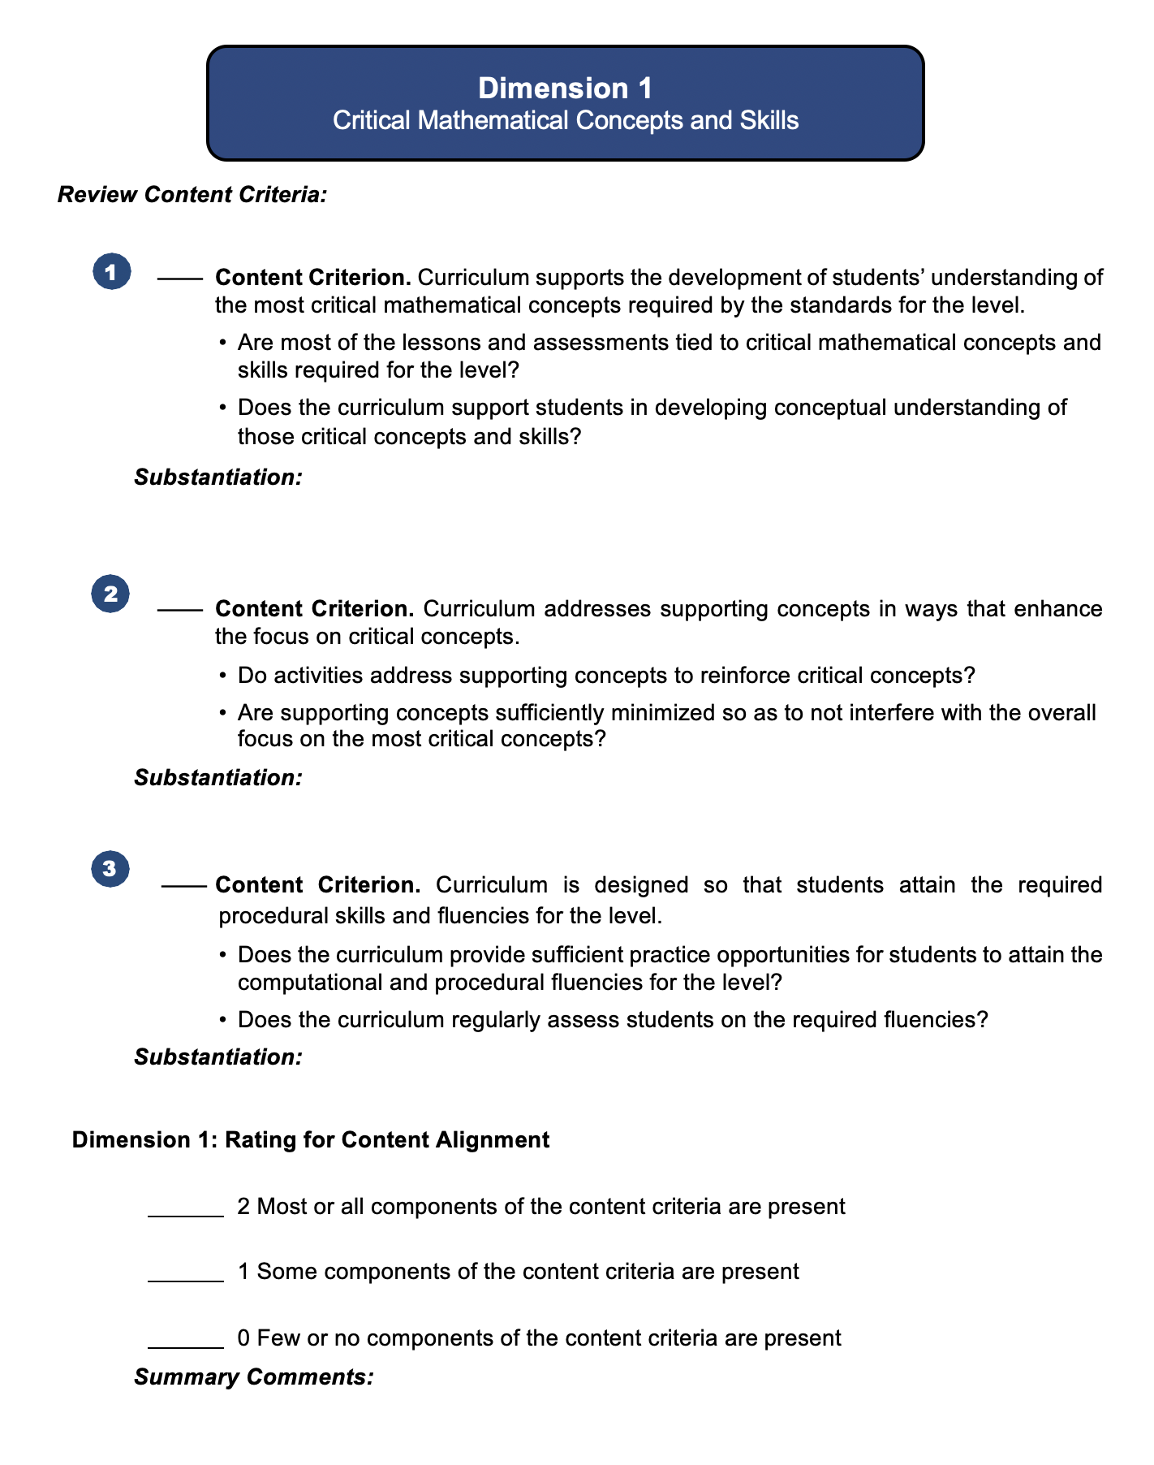
Workbook Pages for Dimension 1’s Content Criteria
Content Criteria
Guiding Questions
Substantiate your findings
Rating Scale
Summarize your rating decision
Notes:
Big idea: Show screenshot of the Participant Workbook for Dimension 1 to showcase the format.
Facilitator talking points:
During the next session, you will concentrate on the content criteria for Dimension 1.
Let’s look at page 2 of the Participant Workbook to see Dimension 1’s content criteria. You can see that there are three content criteria in this dimension.
Each content criterion is followed by a set of guiding questions. These are not a checklist. They are designed to help you understand what the criterion means and also guide your search for evidence in the curriculum.
Note the rating system after content criterion #3:
While the difference between “most,” “some,” and “few” might seem negligible at first, you can clarify it as you examine the curriculum.
As you gather and discuss the evidence you find for each criterion, you will begin to understand the nuances of the point rating system.
In some cases, there will be elements of all the criteria present but also elements that are missing.
Your professional judgment will be an important part of your team discussion and final decision. Ask yourself, “How crucial are the missing elements? Can the gaps be easily filled by an instructor?”
It will be important to keep a record of how you came to the rating decision. So don’t forget to record key points in your decision under “Summary Comments” in the Participant Workbook.
Facilitator notes:
Four clicks.
As you read the first talking point, page 2 of the workbook will come into view. Then click for each of the next three high-level bullets.
Animation will track with the second, third, and fourth talking points.
Use the sub-bullets after the fourth talking point to further explain the rating scale.
The final click will remind you to emphasize the importance of recording where in the curriculum you found evidence and to summarize the rating decision.

Slide 14
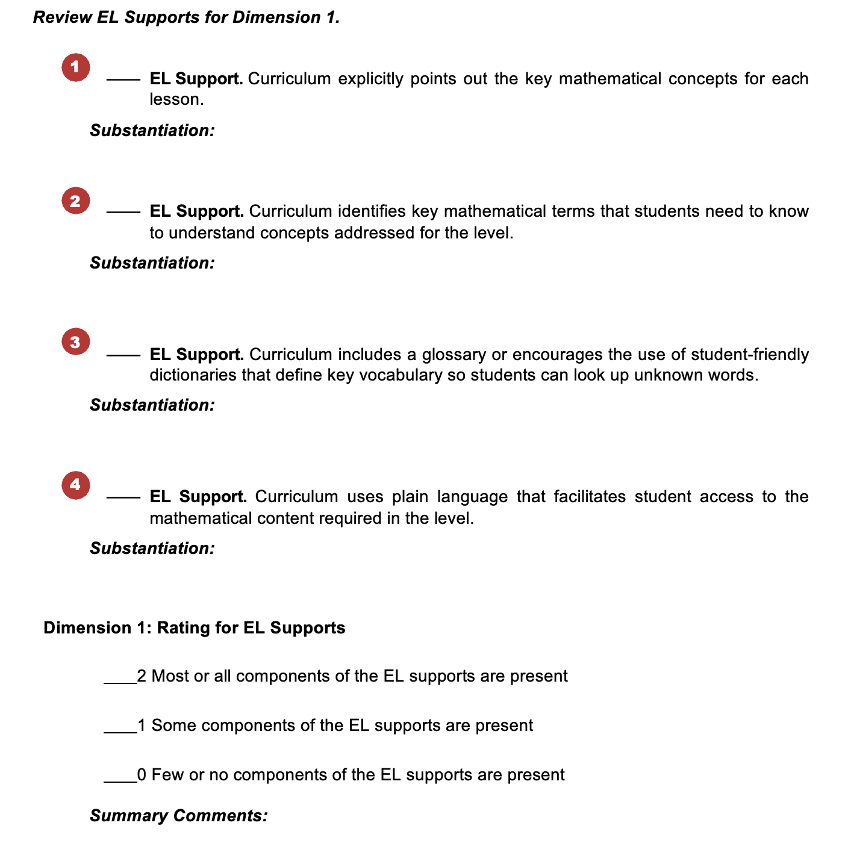
Workbook Pages for Dimension 1’s English Learner (EL) Supports
EL Support Criteria
Rating Scale
Substantiate your findings
Summarize your rating decision
Notes:
Big idea: Show screenshot of EL supports from the Participant Workbook for Dimension 1 to showcase the format.
Facilitator talking points:
Here you see page 3 of the Participant Workbook, with Dimension 1’s four EL support criteria.
We use the same rating scale for EL supports as for content.
And don’t forget to keep a record of where you found evidence and to summarize the rationale behind your rating.
Facilitator notes:
Three clicks.
As you read the first talking point, click to reveal arrows pointing to the four criteria.
With the second click, read the second talking point.
Finally, click to emphasize the importance of keeping a record of where you found evidence and a summary of the rating decision.

Slide 15
The Curriculum Review Process
Together, we will review the meaning of the content criteria for each dimension.
Then with your team, we will ask you to search the model curriculum for evidence that each criterion is met.
You will place a checkmark next to each criterion for which you find evidence. You will add a brief comment that substantiates your check mark (or the lack thereof).
Once you have reviewed all the content criteria for that dimension, you will assign a rating of 0, 1, or 2 points.
We will ask you to follow the same steps to rate the EL support criteria for each dimension.
Notes:
Big idea: Describe the review process.
Facilitator talking points:
Facilitator notes:
Five clicks.
Click and read through the slide bullets.
Then click to the next slide for more. The talking points for these bullets are on the next slide.

Slide 16
Determine the Curriculum’s Overall Ratings and Recommendations
Once you have reviewed and rated all four dimensions of quality, you will:
Determine an overall rating for content alignment by adding the total points assigned to each dimension’s content criteria. The highest possible score would be 8 points (2 points per dimension).
Determine an overall rating for EL supports by adding the total points assigned to each dimension’s EL support criteria. The highest possible score would be 8 points (2 points per dimension).
Summarize your comments and recommendations, including the key strengths and weaknesses of the curriculum you reviewed.
Then document any recommendations regarding the continued use of the curriculum in your program(s).
Notes:
Big idea: Present the last steps in the curriculum review process.
Facilitator talking points:
Remember, it is unlikely that any curriculum will contain every content criterion and every EL support included in this review tool.
Think through how important the missing criteria are to your overall rating.
Is their absence so critical that you cannot assign an overall rating of Well Aligned or Well Supported?
Alternatively, how easily could you and your fellow adult educators fill in the gaps in the curriculum?
Facilitator notes:
Four clicks.
Click through the slide bullets to explain the steps of the review process.
Then use the talking points for additional information.
Pause to ask for questions.

Slide 17
Overall Curriculum Ratings
Notes:
Big idea: Review the overall curriculum ratings.
Facilitator talking points:
We won’t be looking for a perfect curriculum; we will be looking for a strong curriculum.
For both the content criteria and the EL support criteria, add up the total points assigned to each dimension’s content criteria. The highest possible score would be 8 points (2 points per dimension).
In this way, we can determine whether the curriculum is Well Aligned, Somewhat Aligned, or not Aligned.
And we can determine whether English Learners are Well Supported, Somewhat Supported, or Not Supported by the curriculum.
Facilitator notes:
Use the talking points to explain the Overall Rating scale.

Slide 18
Supporting Resources for Your Review Work
At the end of your Participant Workbook, you will find:
Appendix A – Critical Concepts (see pages 17–19)
Appendix B – Critical Mathematical Concepts That Progress Across the Levels (see pages 20–21)
Appendix C – Standards for Mathematical Practice (see pages 22–24)
Appendix D – Determine if a Well-Aligned Curriculum Is Also a Good Fit for Your Program (see page 25)
Notes:
Big idea: Point out the resources at the end of the Participant Workbook.
Facilitator talking points:
After the Overall Ratings, you will see a set of documents that will be helpful in your understanding and application of the review process.
Appendix A shows the concepts that are primary and supporting for each level. We also call out the fluencies for the levels. Notice that we use color-coding so that you can quickly identify the domain for each concept. It is found on pages 17-19 of the workbook.
Appendix B shows the four main domains and the concepts that progress across the levels. You can find it on pages 20-21 in the workbook.
Appendix C is the full text of the Standards for Mathematical Practice. It is in the workbook on pages 22-24.
Appendix D is designed to help you determine whether a curriculum is a good fit for your program. It is on page 25 in the workbook.
Facilitator notes:
Four clicks.
After the first talking point, click through the titles of the five appendices in the slide bullets. Pause with each to point out the page numbers and to explain or answer questions about each.

Slide 19
Orientation to the Model Curriculum

Slide 20
Why We Chose Illustrative Mathematics as Our Model Curriculum
Illustrative Mathematics is:
Highly rated as being closely aligned to college and career readiness standards;
A free and open curriculum that is easy to download; and
Supportive of English learners.
Illustrative Mathematics for Grade 6, Unit 3:
Addresses a critical concept for the level: Unit Rates and Percentages (CCRS, Level D); and
Is relevant to real life and mathematical problems.
Notes:
Big idea: Explain how the unit we selected from Illustrative Mathematics meets our criteria. Also, explain why it will be the curriculum to which we apply the review rubrics.
Facilitator talking points:
For our sample curriculum, we will be using Illustrative Mathematics.
This program is highly rated for alignment to the same standards as the CCR for adult education, as well as other challenging state academic standards. During our training, we will learn how this alignment is important to the overall quality of the curriculum.
This program is considered supportive of English learners. Examining the kinds of supports it incorporates will help build our vision for what materials could provide for ABE students, including English learners.
We selected Unit 3 for our sample of the curriculum. We found that the format is consistent across the lessons, the units, and the levels. This means one unit of study is adequate to assess the quality of the entire curriculum.
The unit we’ve selected addresses Unit Rates and Percentages. This includes the CCR standards associated with Understand ratio concepts and use ratio reasoning to solve real-world problems. (Level D - 6.RP.3)
Though originally designed to be used with 6th graders, the maturity and relevance of the topic allows these lessons to easily apply to adult students. The concepts addressed, rates and percentages, are applied regularly in shopping, travel, personal finance, athletics, and many other adult activities.
Facilitator notes:
Two clicks.
Read the first bullet and then click to reveal the three bullets under the first heading.
Then read the next two talking points as the bullets appear at 1-second intervals.
Read the third talking point and then click a second time to reveal the two bullets explaining our sample unit (at 1-second intervals).
Read the last talking two points while participants read the last two bullets.

Slide 21
Illustrative Mathematics (IM)
We’ll be using four documents in our review of the IM sample:
Grade 6 Mathematics Course Guide
Grade 6 Mathematics Unit 3 Teacher Guide
Grade 7 Mathematics Course Guide (for Dimension 2)
Grade 8 Mathematics Course Guide (for Dimension 2)
Notes:
Big idea: Identify the documents needed for our sample review.
Facilitator talking points:
We will use the Grade 6 documents for all four dimensions of quality.
The Grades 7 and 8 Course Guides will be helpful for seeing connections across the levels in Dimension 2.
Facilitator notes:
Four clicks.
Read through the slide, clicking for each statement.
Then read the talking points.
Make sure participants all have these documents available to scan as we continue.

Slide 22
Let’s Look First at the Primary IM Documents for Our Sample Unit:
Notes:
Big idea: Explain the Grade 6 documents we will be using.
Facilitator talking points:
Here are the two primary documents we will use for our sample review:
The Grade 6 Mathematics Course Guide is an overview of all of the Grade 6 materials.
The Unit 3 Teacher Guide provides lesson instruction for each of the lessons.
Given the visual similarities of the documents, it’s easy to get them confused. When we refer to them, we will use the titles (Grade 6 Course Guide and Unit 3 Teacher Guide). This is to make sure we all agree on which document we are talking about.
Throughout the documents either green or blue color coding is used on each page and to highlight important parts of the curriculum. This will help us visually to remember in which document we are working on.
Let’s look a little closer at these primary documents …
Facilitator notes:
One click.
Read through the first four talking points (inclusive of the sub-points) to explain the two documents.
Then click to show the different titles (circled) as you read the last two talking points.
Emphasize the color coding used so that when citations are made, the users can quickly tell which document they are using.
The last talking point leads to a closer look in the next two slides.

Slide 23
Now Let’s Look More Closely at the IM Grade 6 Course Guide
The Course Guide:
Is helpful for seeing the big picture for the level.
Provides specific suggestions for the teacher.
Supports the Unit 3 Teacher Guide.
Provides general information about lesson organization.
Notes:
Big idea: Provide an overview of the Grade 6 Course Guide.
Facilitator talking points:
Let’s start with the Grade 6 Course Guide.
Notice that this document has a patterned, green border on each page.
Take a minute to scan through this document as we talk about the key features.
Facilitator notes:
Four clicks.
Read the talking points and then click through bullets on the slide. Allow a bit of time between bullets for participants to scan the Workbook for themselves.
Continue to the next slide for more features of the Grade 6 Course Guide as participants continue to scan the document.

Slide 24
Now Let’s Look More Closely at the IM Grade 6 Course Guide, cont’d.
The Course Guide:
Provides general instructions about how to use the materials.
Lists the lessons by standards and vice versa.
Shows a full scope and sequence for the level and across the levels.
Includes a full glossary with definitions and graphics.
Includes a list of required materials for the course.
Notes:
Big idea: Provide an overview of the Grade 6 Course Guide (cont’d).
Facilitator talking points:
As you scanned the Course Guide, did you see anything else that you found interesting? Or that you think might be relevant to our search for evidence of quality?
Facilitator notes:
Five clicks.
Click through the five bullets on the slide.
Then use the talking point to see if participants noticed other features that might indicate quality or that they found interesting.
This is a chance for participants to share other features that they find interesting. It is likely that most suggestions will overlap somehow with what we’ve already listed. Allow for a discussion without much comment or any correction.
For example, they might notice the sections with Design Principles, the Mathematical Language Routines (MLRs), or the support for English learners.
The idea is just to gently introduce them to what their searches might be like.

Slide 25
And Now a Closer Look at the IM Unit 3 Teacher Guide
The Teacher Guide:
Provides general instructions about how to use the materials.
Lists required materials for the unit.
Includes both student- and teacher-facing materials.
Contains an illustrated glossary.
Notes:
Big idea: Provide an overview of the Unit 3 Teacher Guide.
Facilitator talking points:
Now let’s look at the Unit 3 Teacher Guide.
As we talk through some of the key features, you can scan it for other important components.
Take a minute to scan through this document as we talk about the key features.
Facilitator notes:
Four clicks.
Read the talking points and then click through bullets on the slide
Continue to the next slide for more features of the Grade 6 Course Guide as participants continue to scan the document.

Slide 26
And Now a Closer Look at the IM Unit 3 Teacher Guide, cont’d.
The Teacher Guide:
Contains a Table of Contents that provides a list of all lesson titles for the unit.
Includes pre-and post-assessments.
Provides supports for English learners and students with disabilities.
Tasks include “Possible Responses” and “Anticipated Misconceptions.”
Notes:
Big idea: Provide an overview of the Unit 3 Teacher Guide. (continued)
Facilitator talking points:
As you scanned the Teacher Guide, did you see anything else that you found interesting? Or that you think might be relevant to our search for evidence of quality?
Facilitator notes:
Four clicks.
Click through the four bullets on the slide, continued from the previous slide.
Then use the talking point to see if participants noticed other features that might indicate quality or that they found interesting.
Participants might want to share other features that they find interesting. It is likely that most suggestions will overlap somehow with what we’ve already listed. Allow for a discussion without much comment or any correction.
The idea is just to get them thinking about what their searches will be like.

Slide 27
For Dimension 2, We Will Also Rely on Course Guides for Grades 7 and 8
Notes:
Big idea: For Dimension 2 we will also use the Course Guides for Grades 7 and 8.
Facilitator talking points:
In Dimension 2, we look for connections across and within the levels.
When looking for connections, it’s important to pay attention to what’s addressed before and after the unit. In addition to the lessons and units before and after Unit 3, these two Course Guides can provide more insight into the learning.
What differences and similarities do you see in these, as compared to the Grade 6 Course Guide?
Facilitator notes:
Read the first two talking points as the two covers come into view.
Then use the third talking point to invite discussion of the commonalities and differences between the grade-level documents. Here are some examples of what they might find:
The formatting of the three Course Guides is the same: the same three sections and four appendices.
Differences in the three documents begin in “Scope and Sequence” on page 41 of each guide. Thereafter, the guides use the same format, but the content is slightly different for each level.
Emphasize that the same color is used for highlighting but with different patterns in the green band on each page. (All Course Guides in IM use the green as the highlighting color. Each grade level uses a different pattern. This will be important for us to remember when we cite the places where we found our evidence in these documents.)

Slide 28
That Was a Quick Tour of the Model
At our next session, we will start digging into the specifics of each dimension.
Before then, if you haven’t already, you need to select a curriculum in use in your state to examine alongside the model.
There are more details on the following slide of what to consider.
Notes:
Big idea: This is the end of our orientation to the IM materials.
Facilitator talking points:
That’s the completion of our orientation to IM Education.
You’ll be investigating it in much more depth in the coming weeks of the training.
The other important part of this training is to apply these same criteria to a curriculum your instructors commonly use.
You’ll need to pick that before we start the training sessions.
There are more details on the next slide.
Facilitator notes:
Advance to the next slide for specific guidance for selecting materials to review.

Slide 29
Select a Representative Sample of Your Curriculum
Select a sample that…
Addresses a critical concept for the level and one that is especially relevant to the lives of adult students.
Is big enough to get a clear picture of what the whole has to offer; but
Is small enough to be handled easily; and
Is readily available.
Notes:
Big idea: Share the process used to select a valid sample from a larger curriculum.
Facilitator talking points:
When you need to select a small sample of your curriculum…
Make sure the section you select addresses a concept that is critical for the level. It is also important to choose a concept that is relevant to the lives of adults. It should be not too elementary and a concept that most adult learners would need to learn more about.
Select a large-enough section of the curriculum to give you a good picture of the whole. This could depend on how the whole curriculum is designed. If most units and lessons are set up the same way, it might be enough to look at just one unit. If there is a lot of variety in formatting across lessons and units, select a cross-section of the whole that includes most of the variations.
Also, make sure your selection is small enough that it can be easily handled in the time you have to do the review work. This could be just one or two units or perhaps about 10% of the whole curriculum.
Make sure to find a sub-section that is readily available to all participants.
Facilitator notes:
Four clicks.
Read the first talking point and then click to begin the animated bullet points (one click for each of the four bullets).

Slide 30
Our Work Together
We will always have between-session work to apply the learning from each webinar to your chosen curriculum.
We will also think through how to sustain this work when the training ends.
Notes:
Big idea: Remind participants about their in-between work session with their coach.
Facilitator talking points:
Facilitator notes:
Two clicks.
Read and click through the slide contents; use the bullets as your talking points.

Slide 31
Let’s Recap Our Preparations
We have worked to become comfortable with the tools and the technology.
We have reviewed the components of the Participant Workbook.
We have reviewed the team expectations (e.g., meeting times, attendance, assignments).
Two questions:
Have you selected a curriculum to review as a team?
Shall we schedule our standing, in-between work sessions now?
Notes:
Big idea: Recap the work that has occurred thus far with their coaches.
Facilitator talking points:
Regarding comfort, remind them you’ll be there to support their use of the Participant Workbook.
Regarding selection of a curriculum, we’ll share what state teams have selected.
Regarding the Participant Workbook, let participants know that we will review it in more detail during this session and work with it throughout the sessions.
Regarding expectations, let participants know that we’ll be talking about that in more detail later in the presentation.
Facilitator notes:
Read through the slide.

Slide 32
Our Next Session
We will begin our deep dive into Dimension 1.
Notes:
Big idea: Provide date and topic of the next virtual training session.
Facilitator talking points:
On this slide, you see information about our next session.
Facilitator notes:
Read the first bullet. Emphasize the date and time of the next session.

Slide 33
Thank you and see you soon!

