Slide 1
IET Design Camp
WELCOME!
Phase 3: Develop and Implement

Slide 2
Meeting Recording Notice
This session will be recorded, including any audio, visuals, participants, and other information sent, verbalized, or utilized. By joining this meeting, you automatically consent to such recordings. Any participant who prefers to participate via audio only should disable their video camera so only their audio will be captured. Video and/or audio recordings of any session shall not be transmitted to an external third party without permission.
Phase 3: Develop and Implement
2

Slide 3
Virtual Classroom Reminders
Make sure you are signed into the Zoom desktop client rather than through the browser version.
If your Internet speed is slow, you may need to keep your camera off to improve quality.
We recommend using your computer for audio to facilitate participation.
Please mute your microphone and turn on your camera.
During the webinar, chat the entire group for questions and comments related to the content.
Remember to take notes in your Participant Guide!
If you experience problems during the webinar, message or email __________ at ________________________.
Phase 3: Develop and Implement
3

Slide 4
Agenda
Introduction
Review Phase 2: Design and Plan
Key Tasks for Phase 3: Develop and Implement
Develop the IET Curricula
Process Steps
Example
Breakout Group Activity
Build Out Lesson Plans with Activities
Example
Breakout Group Activity
Implement the IET Program and Collect Data
Wrap-Up
Phase 3: Develop and Implement

Slide 5
Poll: IET Components
Rate your confidence level with describing each of the three IET components.
1 = I feel very confident I can describe all three.
2 = I feel somewhat confident I can describe all three.
3 = I am not very confident I can describe all three.
4 = I don’t remember what the three components are.
Phase 3: Develop and Implement
5

Slide 6
Today’s Trainers
Phase 3: Develop and Implement

Slide 7
IET Design Camp
WEEK 1 | WEEKS 2 & 3 | WEEKS 4 & 5 | WEEKS 6 & 7 | WEEKS 8 & 9
Orientation | Phase 1: Research and Assess | Phase 2: Design and Plan | Phase 3: Develop and Implement | Phase 4: Evaluate and Improve
MONDAY Toolkit reading assignment | MONDAY Toolkit reading assignment | MONDAY Toolkit reading assignment | MONDAY Toolkit reading assignment | MONDAY Toolkit reading assignment
TUESDAY Training Webinar | TUESDAY Training Webinar | TUESDAY Training Webinar | TUESDAY Training Webinar | TUESDAY Training Webinar
 | WED – MON Team Activity | WED – WED Team Activity | WED – WED Team Activity | WED – WED Team Activity
 | TUESDAY Cohort Discussion | THURSDAY Cohort Discussion | THURSDAY Cohort Discussion | THURSDAY Closing Session
Phase 3: Develop and Implement
7

Slide 8
Review of Phase 2: Design and Plan
A strong design team positions the IET program to meet business and learner needs.
Considering the learner experience is an important step in designing an IET program that support learners.
The IET program structure should be flexible in adapting to changes in funding, staffing, and business and learner needs.
An evaluation plan lays out how you will monitor your program’s progress and your program’s continuous improvement process.
Phase 3: Develop and Implement
8

Slide 9
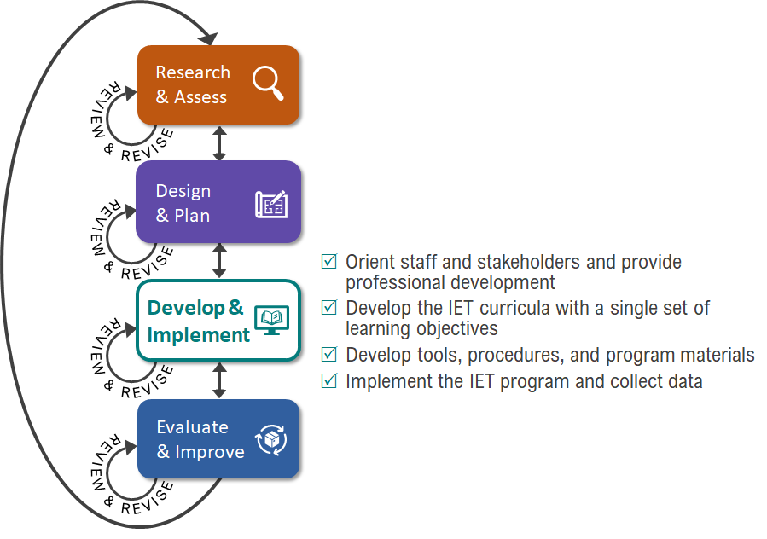
Key Tasks for Develop & Implement Phase

Slide 10
Group Discussion:
Reflect on Your Reading
In reading the Develop and Implement phase section of the IET Toolkit, what stood out as new or interesting or potentially challenging to you?
Please share your thoughts with the group.
Phase 3: Develop and Implement
10

Slide 11
Develop the IET Curricula
Creating a Single Set of Learning Objectives (SSLO)
Using the SSLO Template
Developing Standards-Based IET Curricula with an SSLO
Breakout Room Activity: Practice Creating an Objective for the SSLO
Examples of Learning Objectives Forming the SSLO
11

Slide 12
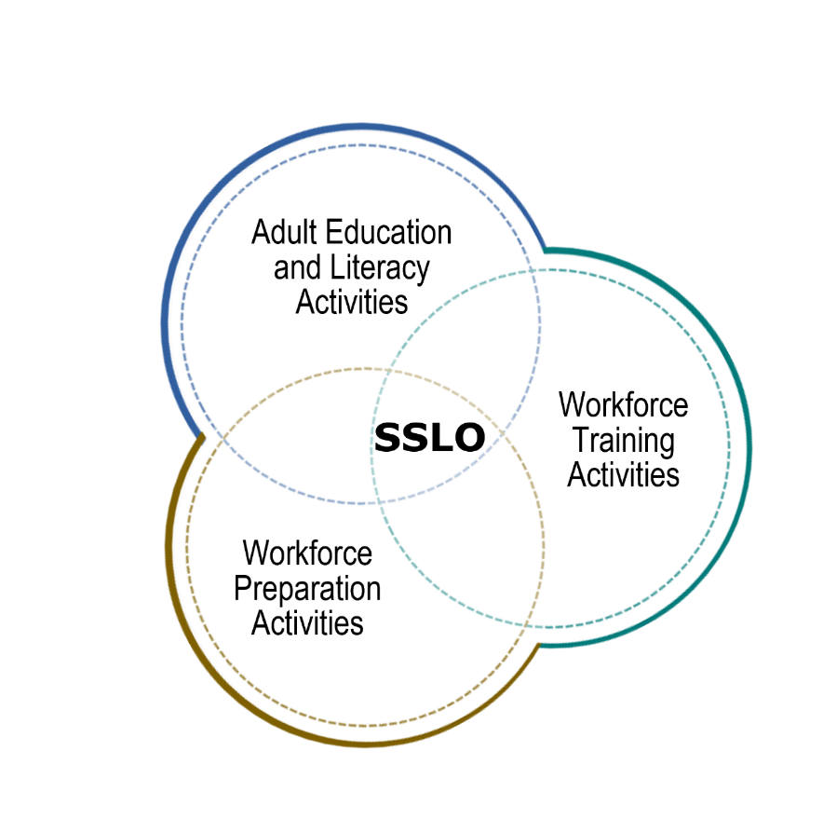
Creating Integrated Learning Objectives to Form a Single Set of Learning Objectives (SSLO)
An integrated education and training program has a single set of learning objectives that identifies the specific:
Adult education content
Workforce preparation activities
Workforce training competencies
Program activities are organized to function cooperatively.
Together, the individual integrated learning objectives become the single set of learning objectives for the IET program.
Phase 3: Develop and Implement
12

Slide 13
SSLO Template
Phase 3: Develop and Implement
13
Notes:
Facilitator Note: This slide has 1 build (click).

Slide 14
The Function of the SSLO: Approach #1
Phase 3: Develop and Implement
14

Slide 15
Steps to Developing Standards-Based IET Curricula with a Single Set of Learning Objectives: Approach #1
STEP
STEP
STEP
STEP
STEP
STEP
01
02
03
04
05
06
Revisit the learner, program, and partner goals identified in the Design and Plan Phase
Identify workforce training skills and competencies
Identify state adult education standards and academic literacy skills
Identify workforce preparation skills and competencies
Develop learning objectives for the SSLO and confirm alignment with goals
Build out contextualized units, lessons and activities
Phase 3: Develop and Implement
15

Slide 16
Revisit the program-level goals identified in the Research and Assess phase
STEP
01
Take another careful look at the program-level goals you identified in Phase 2.
Are they still valid?
Do any need to be modified, added, or eliminated?
These will provide a foundation for the SSLO. You will align the integrated learning objectives in your SSLO to these program-level goals.
Continue to revisit your program-level goals to inform the development of your SSLO and curricula.
Phase 3: Develop and Implement
16

Slide 17
Identify workforce training skills and competencies.
STEP
02
Work with the occupational training partner to identify the workforce training skills and competencies needed to accomplish the program-level goals.
EXAMPLES:
Students will be able to:
Read a 6” scale
Read a micrometer
Read a simple blueprint
Phase 3: Develop and Implement
17

Slide 18
Identify adult education standards and align adult education literacy skills and competencies
STEP
03
Analyze the occupational training curricular materials to identify the embedded adult education content standards that:
Support mastery of the training content.
Are transferable and apply in a variety of settings.
Align the standards to adult education literacy skills that:
Build literacy skills for course completion.
Support transitions to employment and ongoing educational opportunities.
Phase 3: Develop and Implement
18

Slide 19
Identify workforce preparation skills and competencies
STEP
04
What are the related transferrable skills and competencies that adult learners can apply to a variety of contexts beyond the classroom?
Phase 3: Develop and Implement
19

Slide 20
Identify workforce preparation skills and competencies
STEP
04
CONT.
Resources for identifying workforce preparation skills include:
The current occupational training curricula
O*Net
Local industry representatives or workforce development board/American Job Center staff
Employability Skills Framework
Phase 3: Develop and Implement
20

Slide 21
Develop integrated learning objectives for the SSLO and confirm alignment with goals
STEP
05
What must learners be able to do upon completion of the major instructional units within the IET program to demonstrate competency?
These become the single set of learning objectives for your program. They must:
Incorporate all three required components.
Align closely with the program-level goals/outcomes.
Integrated Learning Objective Example:
Given a micrometer, a 6” scale, simple manufacturing specification blueprint with missing measurements, and a math worksheet, learners will apply knowledge of fractions and decimals to take and record precise measurements in decimals and fractions and use the measurements to answer fraction and decimal addition and subtraction questions with 80% accuracy.
Phase 3: Develop and Implement
21
Notes:
NOTE: This screen has 1 build (click).

Slide 22
Develop integrated learning objectives for the SSLO and confirm alignment with goals (cont.)
STEP
05
CONT.
A Closer Look
Effective integrated learning objectives include three key elements:
Conditions under which the learner will demonstrate competency
Behavior the learner will perform (using action verbs)
Criteria by which competency will be measured
Please share your ideas.
Integrated Learning Objective Example:
Given a micrometer, a 6” scale, simple manufacturing specification blueprint with missing measurements, and a math worksheet, learners will apply knowledge of fractions and decimals to take and record precise measurements in decimals and fractions and use the measurements to answer fraction and decimal addition and subtraction questions with 80% accuracy.
Phase 3: Develop and Implement
22
Notes:
NOTE: This screen has 1 build (click).

Slide 23
Develop integrated learning objectives for the SSLO and confirm alignment with goals (cont. 2)
STEP
05
CONT.
Reminder
Your integrated learning objectives across the curricula combine to become the single set of learning objectives.
Phase 3: Develop and Implement

Slide 24
Develop integrated learning objectives for the SSLO and confirm alignment with goals (cont. 3)
SSLO Rubric*
STEP
05
CONT.
*Rubric developed for the IET Design Toolkit. 2021 (Hamilton & Toso)
CRITERIA | WEAK – 0 points | MEDIUM – 2 points | STRONG – 4 points
All three required IET components are evident in the SSLO. Note: If this score is weak or medium, revisit the SSLO before proceeding. The three required IET components must be evident in the SSLO to meet the basic definition of an SSLO. | 0 – 1 component evident | 2 components evident | All 3 components evident
There is a demonstrated relationship among the three components so that the adult basic literacy, workforce preparation, and occupational skills and knowledge are structured within the SSLO to function cooperatively (i.e., interrelated and contextualized). | No relationship is demonstrated among the three components. | Components are somewhat structured to function cooperatively:​ Only two components are demonstrated to function cooperatively. Does not demonstrate a cooperative relationship among all three components. | All three components are structured to function cooperatively so that:​ There is a clear relationship between all three components.​ Skills and knowledge are structured to function cooperatively​.
Condition(s) under which the learner will demonstrate competency is/are clearly stated. | No condition is stated. | Condition(s) are somewhat stated, but not clearly. | Condition(s) are clearly stated.
Criteria by which competency will be measured are clearly stated and outcome is measurable. | Criteria are not stated and/or outcome is not measurable.​ | Criteria are clearly stated, but outcome is not measurable,​ or criteria are not clearly stated, but outcome is measurable. | Criteria are clearly stated. Performance outcome is measurable.
Expected behavior is clearly described using action verbs. | No behavior is stated​ and/or performance expectation is unclear.​ | Expected behavior is stated, but not stated using action verbs. | Expected behavior is clearly stated using action verbs.
Phase 3: Develop and Implement
24

Slide 25
Develop integrated learning objectives for the SSLO and confirm alignment with goals (cont. 4)
STEP
05
CONT.
Goal Alignment
Are all program-level goals and outcomes represented in the SSLO?
>>
>>
>>
Map the SSLO to the appropriate learner, program, or partner goal(s).
Identify any program-level goal(s)/outcome(s) not supported in the SSLO.
If not supported in the SSLO, determine if the program-level goal is still appropriate.
If the goal is still appropriate, revisit the SSLO to make sure it is represented. If not, eliminate it.
Phase 3: Develop and Implement
25

Slide 26
Build out the units, lessons, and activities
STEP
06
How will you organize your curricula into meaningful units of instruction?
How will you contextualize the instruction so that it:
Integrates the three required components concurrently and with sufficient intensity and quality?
Is based on the most rigorous research available?
Uses occupationally relevant instructional materials?
Incorporates college and career planning?
This is an iterative process that requires close collaboration among instructors.
Phase 3: Develop and Implement
26

Slide 27
The Function of the SSLO: Approach #2
Phase 3: Develop and Implement
27

Slide 28
Steps to Developing Standards-Based IET Curricula with a Single Set of Learning Objectives: Approach #2
STEP
STEP
STEP
STEP
STEP
STEP
01
02
03
04
05
06
Revisit the learner, program, and partner goals identified in the Design and Plan Phase
Develop learning objectives for the SSLO and confirm alignment with goals
Identify workforce training skills and competencies
Identify state adult education standards and academic literacy skills
Identify workforce preparation skills and competencies
Build out contextualized units, lessons and activities
Phase 3: Develop and Implement
28

Slide 29
Example:* Integrated Learning Objective for an SSLO
MANUFACTURING IET PROGRAM
Integrated Learning Objective(s): 1.1 Given a micrometer, a 6” scale, a simple manufacturing specification blueprint with missing measurements, and a math worksheet, learners will apply knowledge of fractions and decimals to take and record precise measurements in both decimal and fractions and use the measurements to answer fraction and decimal addition and subtraction questions with 80% accuracy.
Workforce Training Skills and Competencies | Adult Education Content Standard(s) | Adult Education Literacy Skills and Competencies | Workforce Preparation Skills and Competencies
Read a 6” scale Read a micrometer Read a simple blueprint | Extend understanding of fraction equivalence and ordering (Mathematics 4.NF.1 – 4.NF.2) Build fractions from unit fractions by applying and extending previous understanding of operations on whole numbers. (Mathematics 4.NF.3 – 4.NF.4; 5.NF.1 - 5.NF.6) Measure and estimate lengths in standard units (Mathematics 2.MD.2 - 2.MD.4) | Convert measurements from inches to centimeters Convert whole numbers to fractions Add and subtract fractions | Apply mathematical operations, concepts, and reasoning Demonstrate quality consciousness Demonstrate self-management strategies Work within a team
Phase 3: Develop and Implement
*Based on Seneca Highlands IU 9 IET program, used with permission.
29

Slide 30
Example: Learning Objectives Combine to Form the SSLO
Single Set of Learning Objectives Template
MANUFACTURING IET PROGRAM
Single Set of Learning Objectives:
1.1 Given a micrometer, a 6” scale, a simple manufacturing specification blueprint with missing measurements, and a math worksheet, learners will apply knowledge of fractions and decimals to take and record precise measurements in both decimal and fractions and use the measurements to answer fraction and decimal addition and subtraction questions with 80% accuracy.
2.1 During a demonstration of machine usage, the learner will use machine-specific safety for the purpose of maintaining a safe working environment and develop a personal job aid with 100% accurately described safety practices in both the workplace and when using specific machinery.
3.1 Given customer specifications for a product, learners will demonstrate an understanding of the manufacturing process order of operations by writing a detailed set of instructions for producing the product to the customer specifications with at least 80% accuracy, and orally explain the steps with classmates.
3.2 Given customer specifications for a product, the learner’s written instructions for manufacturing the product, and the necessary tools and equipment, learners will demonstrate the necessary knowledge and skills for using the equipment by producing the product to the customer specifications with at least 80% accuracy.
Phase 3: Develop and Implement

Slide 31
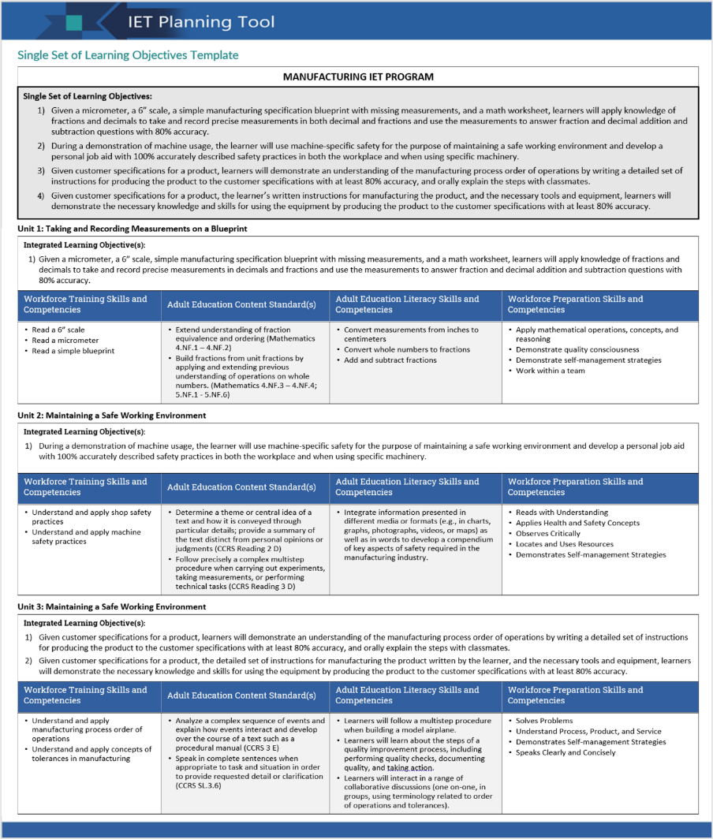
Example: Completed SSLO Template
Phase 3: Develop and Implement
31

Slide 32
Breakout Group Activity #1
Practice creating an integrated learning objective
Using the identified skills and competencies for the three required components and the adult education standards for a sample IET program:
Create at least one performance-based, integrated learning objective to include in the SSLO.
Use the SSLO rubric to evaluate your objective and make any necessary adjustments.
Be prepared to share your objective.
15 min.
Phase 3: Develop and Implement
32

Slide 33
Build Out Contextualized Lesson Plans with Activities
Developing Contextualized Instructional Materials
Repurposing or Adapting Existing Curricular Materials

Slide 34
Developing Contextualized Activities and Occupationally Relevant Materials
Contextualized activities are relevant and directly applicable to the learners’ career pathway goals and the content of the training curriculum.
Occupationally relevant activities and materials support learning content, basic literacy skills, and workforce preparation skills.
Work with your training provider or employer partners or draw on existing IET or contextualized adult basic education curricula to find ideas and resources.
Phase 3: Develop and Implement
34

Slide 35
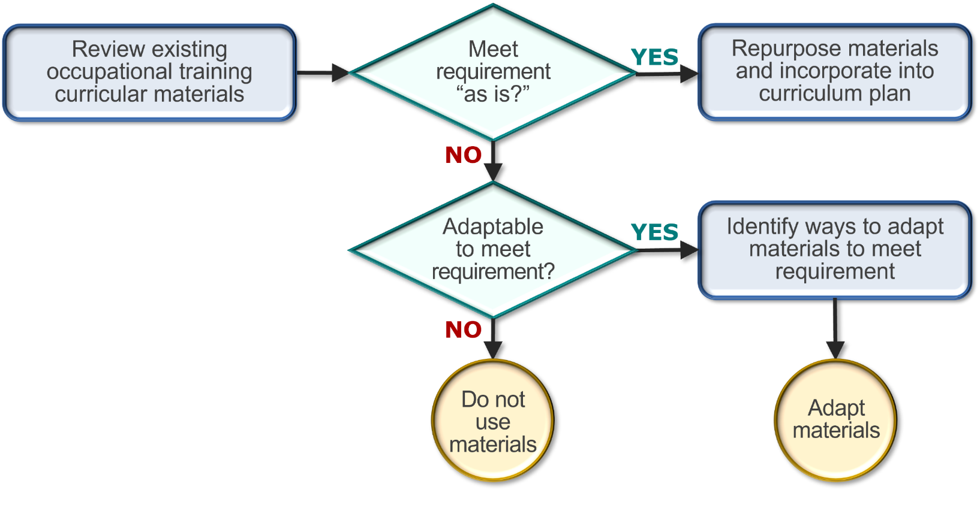
Repurpose or Adapt Existing Curricular Materials for Contextualization and Relevance
Phase 3: Develop and Implement
35

Slide 36
Developing Contextualized Activities Worksheet
Questions to Answer | Yes/No | If yes, describe how | If no, how will you modify it?
Does the lesson/activity use authentic language, materials, and tasks that are aligned with industry standards and assessments?
Is the lesson/activity contextualized to the target job or sector?
Does the lesson/activity reflect real-world situations the participant will encounter “on the job?”
Does the lesson/activity incorporate foundational basic skills content standards and technical standards to support learner comprehension and mastery?
Does the lesson/activity align with the identified learning objectives, including the SSLO?
Does the lesson/activity address the gaps in meeting all three IET components?
Does the lesson/activity allow students to practice and demonstrate relevant acquired skills?
Phase 3: Develop and Implement
36

Slide 37
Example:* Integrated Learning Objective for an SSLO (cont.)
MANUFACTURING IET PROGRAM
Integrated Learning Objective(s): 1.1 Given a micrometer, a 6” scale, a simple manufacturing specification blueprint with missing measurements, and a math worksheet, learners will apply knowledge of fractions and decimals to take and record precise measurements in both decimal and fractions and use the measurements to answer fraction and decimal addition and subtraction questions with 80% accuracy.
Workforce Training Skills and Competencies | Adult Education Content Standard(s) | Adult Education Literacy Skills and Competencies | Workforce Preparation Skills and Competencies
Read a 6” scale Read a micrometer Read a simple blueprint | Extend understanding of fraction equivalence and ordering (Mathematics 4.NF.1 – 4.NF.2) Build fractions from unit fractions by applying and extending previous understanding of operations on whole numbers. (Mathematics 4.NF.3 – 4.NF.4; 5.NF.1 - 5.NF.6) Measure and estimate lengths in standard units (Mathematics 2.MD.2 - 2.MD.4) | Convert measurements from inches to centimeters Convert whole numbers to fractions Add and subtract fractions | Apply mathematical operations, concepts, and reasoning Apply mathematical operations, concepts, and reasoning Demonstrate quality consciousness Demonstrate self-management strategies Work within a team
Contextualized Activities:
Materials: micrometer, simplified manufacturing specification blueprint (note: blueprint will need to have lengths that can be measured and meaningfully added together), recording sheet, problem sets, based on the blueprint, that require students to add and subtract fraction measurements.
Using a simplified blueprint, students will measure lengths in inches, then in centimeters and identify the length in both decimal and fractions (e.g., 1.33, and 1-1/3). Measurements will be entered on the recording sheet.
Students will pair up and verify each other’s measurements.
In pairs, students will label blueprints with verified fractions measures and complete the problem sheet.
Phase 3: Develop and Implement
*Based on Seneca Highlands IU 9 IET program, used with permission.
37

Slide 38
Breakout Group Activity #2
Brainstorm contextualized activities
Using the integrated learning objective from a sample SSLO and the skills and competencies for the three required components:
Brainstorm activities that contextualize adult education standards and literacy skills, and workforce preparation skills that support and align to the performance objective and workforce training content.
Identify possible occupationally relevant materials.
15 min.
Phase 3: Develop and Implement
38

Slide 39
Implement the IET Program and Collect Data
Launching the IET Program and Delivering Instructional Content
Collecting Data to Support and Inform Decisions
39

Slide 40
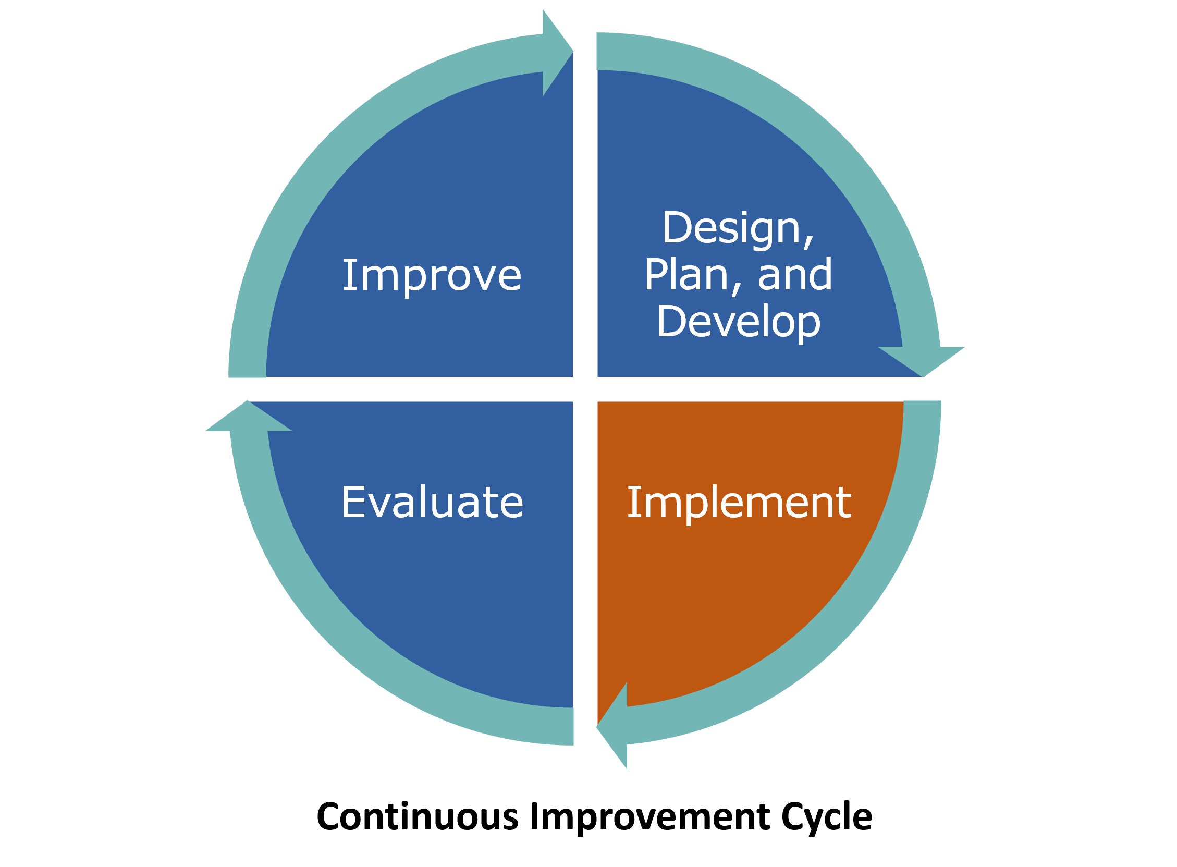
Launching the IET Program and Delivering Instructional Content
Activate the plans you created in the Design and Plan phase to launch the IET program.
Deliver the training using the curricular materials you created in the Develop and Implement phase.
Monitor the implementation of the planned strategies to ensure fidelity.
Fidelity
The degree to which a program is implemented as planned.
Phase 3: Develop and Implement
40

Slide 41
Collecting Data to Support and Inform Decisions
Observe the implementation of the IET program at each stage of the learner experience and collect data according to your evaluation plan.
Collect data that will help you answer the following types of questions:
How effective is our outreach in connecting with the target audience?
How effective is our orientation in providing learners with the information they need to successfully navigate the program?
To what extent are supportive services addressing initial learner barriers to success?
How effective is our partner communication plan?
To what extent are the intervention strategies being implemented as originally planned?
To what extent are learners able to access and use the technology that has been integrated into the curricula?
How effective is the classroom instruction in teaching workforce preparation and adult education basic skills in context with the workplace training activities?
What evidence do you have?
Phase 3: Develop and Implement
41

Slide 42
Session Wrap-Up
Key Takeaways
Reflections/Questions
Next Steps

Slide 43
Key Takeaways
5
An IET program has a single set of learning objectives that identify the specific adult education content, workforce preparation activities and workforce training competencies to ensure the IET program activities are organized to function cooperatively.
An effective integrated learning objective has three components:
Conditions under which the learner will demonstrate competency
Behavior the learner will perform to demonstrate competency (action verbs)
Criteria by which competency will be measured
Together, the integrated learning objectives across the curricula become the SSLO.
Building out the contextualized units, lessons, activities, and assessments is an iterative process that requires close collaboration.
The IET program should first be implemented with fidelity (as it was designed) in order to accurately measure the impact of your planned intervention strategies and inform continuous improvement decisions.
Phase 3: Develop and Implement
43

Slide 44
Group Discussion
Reflect on today’s topics.
How might what you learned today inform the way you develop the curricula for your IET program?
Are there any additional questions about the Develop and Implement Phase before we wrap up the session?
Phase 3: Develop and Implement
44

Slide 45
Poll: Confidence Level
How prepared are you to develop integrated learning objectives for an SSLO and build out contextualized curricula for an IET program?
Select 1:
I am very prepared.
I am somewhat prepared.
I may need more training/support first.
Phase 3: Develop and Implement
45

Slide 46
Next Steps
Phase 3: Develop and Implement
Team Activity ([ENTER DAYS TO COMPLETE])
Think about your SSLO and choose one of the following based on where you are in your development process:
If you already have an SSLO, use the SSLO rubric to evaluate the integrated learning objectives and identify opportunities to strengthen them.
If you’re in an earlier planning state, brainstorm one or two integrated learning objectives that might be part of your program’s SSLO, using either of the approaches discussed this week. Use the SSLO rubric to evaluate each objective and make necessary modifications.
Be prepared to discuss your progress in the next cohort discussion.
Cohort Discussions – [ENTER DATE AND TIME]
Phase 3: Develop and Implement
46

Slide 47
Next Steps (cont.)
Phase 4: Evaluate and Improve
Individual Assignment (before next training session on [ENTER DATE AND TIME):
Read Section 4.0 Evaluate and Improve in the IET Toolkit.
Review all desk aids for the section.
Take notes and write down your questions about the Evaluate and Improve Phase in your Participant Guide.
Next Training Session – [ENTER DATE AND TIME]
Phase 3: Develop and Implement
47

