Slide 1
IET Design Camp – Cohort Meeting #3
Phase 3: Develop and Implement

Slide 2
Quick Reminders
Make sure you are signed into the Zoom desktop client rather than through the browser version.
If your Internet speed is slow, you may need to keep your camera off to improve quality.
We recommend using your computer for audio to facilitate participation.
Please mute your microphone and turn on your camera.
During the webinar, chat the entire group for questions and comments related to the content.
Remember to take notes in your Participant Guide!
If you experience problems during the webinar, message or email __________ at ________________________.
Phase 3: Develop and Implement Cohort
2

Slide 3
Agenda
Introduction
Key Takeaways from the Develop and Implement Phase
Developing the Single Set of Learning Objectives
Where You’ve Been: Team Activity
What's Next:
Individual Assignment
Today’s Cohort Discussion and Wrap-Up from your breakout rooms
Phase 3: Develop and Implement Cohort

Slide 4
IET Design Camp
WEEK 1 | WEEKS 2 & 3 | WEEKS 4 & 5 | WEEKS 6 & 7 | WEEKS 8 & 9
Orientation | Phase 1: Research and Assess | Phase 2: Design and Plan | Phase 3: Develop and Implement | Phase 4: Evaluate and Improve
MONDAY Toolkit reading assignment | MONDAY Toolkit reading assignment | MONDAY Toolkit reading assignment | MONDAY Toolkit reading assignment | MONDAY Toolkit reading assignment
TUESDAY Training Webinar | TUESDAY Training Webinar | TUESDAY Training Webinar | TUESDAY Training Webinar | TUESDAY Training Webinar
 | WED – MON Team Activity | WED – WED Team Activity | WED – WED Team Activity | WED – WED Team Activity
 | TUESDAY Cohort Discussion | THURSDAY Cohort Discussion | THURSDAY Cohort Discussion | THURSDAY Closing Session
Phase 3: Develop and Implement Cohort
4

Slide 5
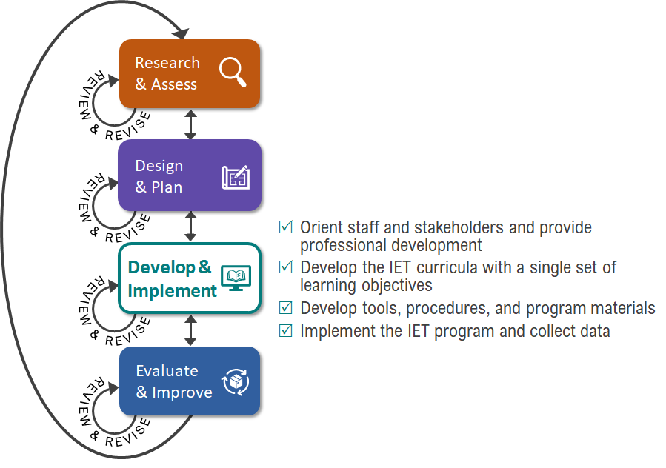
Key Tasks for Develop & Implement Phase
Phase 3: Develop and Implement Cohort

Slide 6
Poll: Your IET Development Status
Which phase of IET development are you currently in?
Select one:
Research and Assess
Design and Plan
Develop and Implement
Evaluate and Improve
I’m not sure
Other (please explain)
Phase 3: Develop and Implement Cohort

Slide 7
Key Takeaways from Phase 3: Develop and Implement
5
An IET program has a single set of learning objectives that identify the specific adult education content, workforce preparation activities and workforce training competencies to ensure the IET program activities are organized to function cooperatively.
An effective integrated learning objective has three components:
Conditions under which the learner will demonstrate competency
Behavior the learner will perform to demonstrate competency (action verbs)
Criteria by which competency will be measured
Together, the integrated learning objectives across the curricula become the SSLO.
Building out the contextualized units, lessons, activities, and assessments is an iterative process that requires close collaboration.
The IET program should first be implemented with fidelity (as it was designed) in order to accurately measure the impact of your planned intervention strategies and inform continuous improvement decisions.
Phase 3: Develop and Implement Cohort
7

Slide 8
Example:* Integrated Learning Objective for an SSLO
MANUFACTURING IET PROGRAM
Integrated Learning Objective(s): 1.1 Given a micrometer, a 6” scale, a simple manufacturing specification blueprint with missing measurements, and a math worksheet, learners will apply knowledge of fractions and decimals to take and record precise measurements in both decimal and fractions and use the measurements to answer fraction and decimal addition and subtraction questions with 80% accuracy.
Workforce Training Skills and Competencies | Adult Education Content Standard(s) | Adult Education Literacy Skills and Competencies | Workforce Preparation Skills and Competencies
Read a 6” scale Read a micrometer Read a simple blueprint | Extend understanding of fraction equivalence and ordering (Mathematics 4.NF.1 – 4.NF.2) Build fractions from unit fractions by applying and extending previous understanding of operations on whole numbers. (Mathematics 4.NF.3 – 4.NF.4; 5.NF.1 - 5.NF.6) Measure and estimate lengths in standard units (Mathematics 2.MD.2 - 2.MD.4) | Convert measurements from inches to centimeters Convert whole numbers to fractions Add and subtract fractions | Apply mathematical operations, concepts, and reasoning Demonstrate quality consciousness Demonstrate self-management strategies Work within a team
*Based on Seneca Highlands IU 9 IET program, used with permission.
Phase 3: Develop and Implement
*Based on Seneca Highlands IU 9 IET program, used with permission.
8

Slide 9
Example: Learning Objectives Combine to Form the SSLO
Single Set of Learning Objectives Template
MANUFACTURING IET PROGRAM
Single Set of Learning Objectives:
1.1 Given a micrometer, a 6” scale, a simple manufacturing specification blueprint with missing measurements, and a math worksheet, learners will apply knowledge of fractions and decimals to take and record precise measurements in both decimal and fractions and use the measurements to answer fraction and decimal addition and subtraction questions with 80% accuracy.
2.1 During a demonstration of machine usage, the learner will use machine-specific safety for the purpose of maintaining a safe working environment and develop a personal job aid with 100% accurately described safety practices in both the workplace and when using specific machinery.
3.1 Given customer specifications for a product, learners will demonstrate an understanding of the manufacturing process order of operations by writing a detailed set of instructions for producing the product to the customer specifications with at least 80% accuracy, and orally explain the steps with classmates.
3.2 Given customer specifications for a product, the learner’s written instructions for manufacturing the product, and the necessary tools and equipment, learners will demonstrate the necessary knowledge and skills for using the equipment by producing the product to the customer specifications with at least 80% accuracy.
Phase 3: Develop and Implement

Slide 10
Where You’ve Been – Team Activity
Over the last week, you used the IET Planning Tool to complete at least one of the following:
Think about your single set of learning objectives.
If you already have an SSLO, use the SSLO rubric to evaluate them and identify opportunities to strengthen them.
If you’re in an earlier planning state, brainstorm one or two learning objectives that might apply to your IET program, using the approach discussed this week.
Phase 3: Develop and Implement Cohort

Slide 11
Individual Assignment
Phase 4: Evaluate and Improve​
Before the next meeting on [INSERT DATE and TIME]:
Read Section 4.0 Evaluate and Improve in the IET Toolkit​.
Review all desk aids for the section.​
Take notes and write down your questions about the Evaluate and Improve Phase in your Participant Guide.​ May 11 at 2:00 pm (Eastern)
Phase 3: Develop and Implement Cohort

Slide 12
Cohort Discussion #3 Develop and Implement Phase
Discussion Topics:
Which team activity did you choose?
Were you able to make progress on it?
How is the SSLO approach described in the IET Toolkit and our training similar to or different from your current approach?
Ask questions and share ideas!
60-70 min.
Phase 3: Develop and Implement Cohort

