Slide 1
IET Design Camp
WELCOME!
Phase 4: Evaluate and Improve

Slide 2
Meeting Recording Notice
This session will be recorded, including any audio, visuals, participants, and other information sent, verbalized, or utilized. By joining this meeting, you automatically consent to such recordings. Any participant who prefers to participate via audio only should disable their video camera so only their audio will be captured. Video and/or audio recordings of any session shall not be transmitted to an external third party without permission.
Phase 4: Evaluate and Improve
2

Slide 3
Virtual Classroom Reminders
Make sure you are signed into the Zoom desktop client rather than through the browser version.
If your Internet speed is slow, you may need to keep your camera off to improve quality.
We recommend using your computer for audio to facilitate participation.
Please mute your microphone and turn on your camera.
During the webinar, chat the entire group for questions and comments related to the content.
If you experience problems during the webinar, message or email __________ at ________________________.
3

Slide 4
Agenda
Session Introduction
Continuous Improvement
Program Evaluation Basics
Data Sources and Evaluation Tools
Data Analysis and Improvement Strategies
Evaluation Plan Development
Session Wrap-Up

Slide 5
Today’s Trainers

Slide 6
IET Design Camp
WEEK 1 | WEEKS 2 & 3 | WEEKS 4 & 5 | WEEKS 6 & 7 | WEEKS 8 & 9
Orientation | Phase 1: Research and Assess | Phase 2: Design and Plan | Phase 3: Develop and Implement | Phase 4: Evaluate and Improve
MONDAY Toolkit reading assignment | MONDAY Toolkit reading assignment | MONDAY Toolkit reading assignment | MONDAY Toolkit reading assignment | MONDAY Toolkit reading assignment
TUESDAY Training Webinar | TUESDAY Training Webinar | TUESDAY Training Webinar | TUESDAY Training Webinar | TUESDAY Training Webinar
 | WED – MON Team Activity | WED – WED Team Activity | WED – WED Team Activity | WED – WED Team Activity
 | TUESDAY Cohort Discussion | THURSDAY Cohort Discussion | THURSDAY Cohort Discussion | THURSDAY Closing Session
6

Slide 7
Review of Phase 3: Develop and Implement
An IET program has a single set of learning objectives that identify the specific adult education content, workforce preparation activities and workforce training competencies to ensure the IET program activities are organized to function cooperatively.
An effective integrated learning objective has three components:
Conditions under which the learner will demonstrate competency
Behavior the learner will perform to demonstrate competency (action verbs)
Criteria by which competency will be measured
Together, the integrated learning objectives across the curricula become the SSLO.
Building out the contextualized units, lessons, activities, and assessments is an iterative process that requires close collaboration.
The IET program should first be implemented with fidelity (as it was designed) in order to accurately measure the impact of your planned intervention strategies and inform continuous improvement decisions.

Slide 8
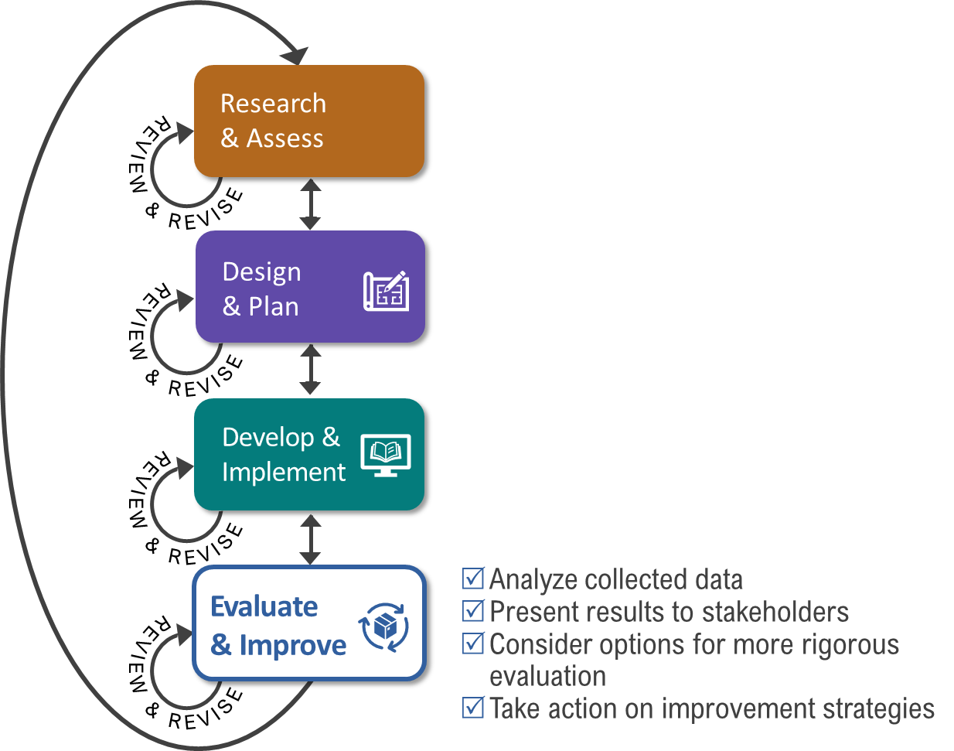
Key Tasks for Evaluate & Improve Phase

Slide 9
Poll: Current Evaluation and Continuous Improvement Efforts
Which of these statements best describes your current evaluation and continuous improvement efforts?
Choose one:
I/We have solid evaluation and continuous improvement processes in place.
I/We have started evaluation planning but haven’t thought much about continuous improvement. We could use some help.
I/We have not begun to think about evaluation or continuous improvement and aren’t sure how/where to start.
Phase 4: Evaluate and Improve
9

Slide 10
Integrate Continuous Improvement
Defining Continuous Improvement
Continuous Improvement in Practice
Benefits of Integrating Continuous Improvement
10

Slide 11
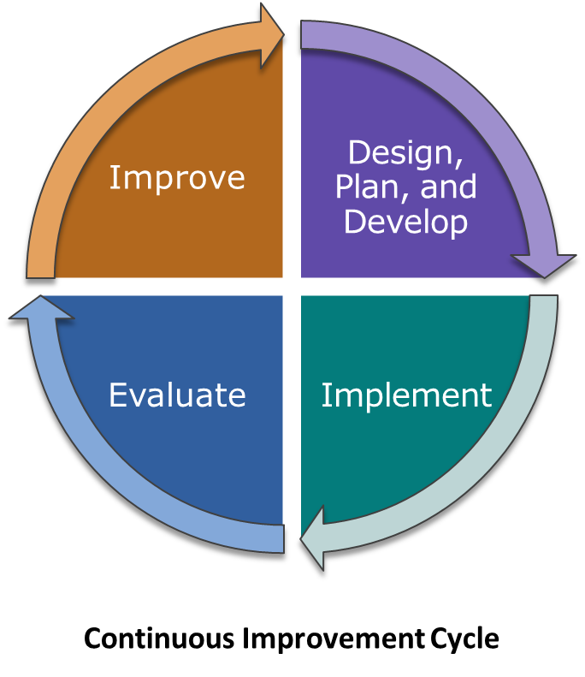
What is continuous improvement?
In Educational Programs:
Continuous improvement is the ongoing examination of program and learner outcomes and the processes that impact them. It also involves identification and implementation of strategies to improve the outcomes.

Slide 12
Continuous Improvement in Practice

Slide 13
Benefits of Integrating Continuous Improvement
Integrating continuous improvement into IET helps to:
Enhance learners’ and employers’ experiences and outcomes.
Enhance instructors’ and partners’ experiences.
Identify solutions to improve the design and delivery of training materials.
Identify equity gaps.
Build evidence for the value of the IET program.

Slide 14
Group Discussion: Continuous Improvement
Consider how results will be used with your IET program team and partners for program improvement.
How are you using evaluation results to improve your IET programs both during delivery and upon completion?
Please share your experiences and ideas with the group.

Slide 15
Program Evaluation Basics
Starting with a Plan
Reviewing the Three Types of IET Goals
Evaluating Processes and Outcomes
Exploring Process and Outcome Questions
Examining Equity
Breakout Group Activity: Practice developing process and outcome questions
15

Slide 16
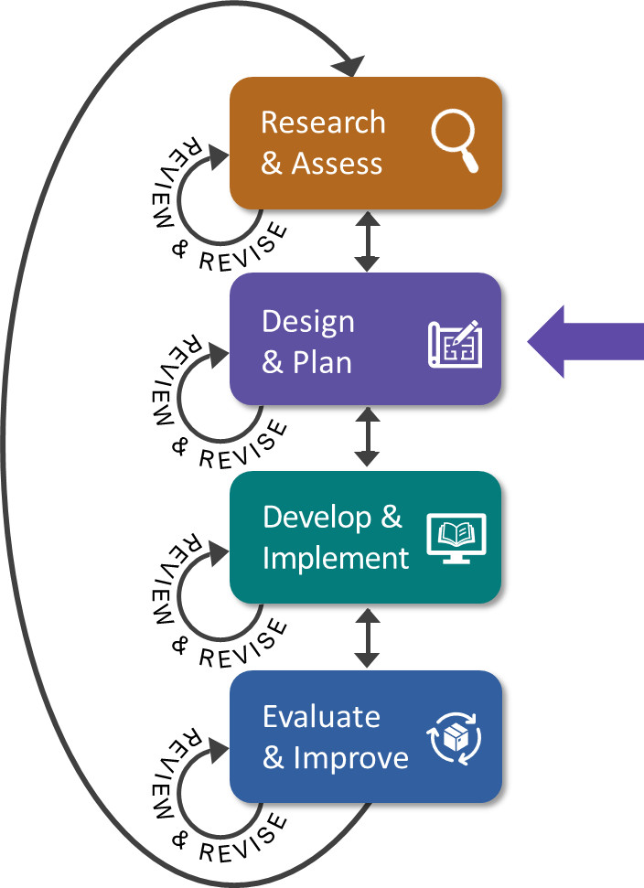
Evaluation Starts with Planning
Evaluation plans should outline:
Intended accomplishments (program goals)
Questions to answer to evaluate the goals
Data needed to answer the questions
Data sources
Timing of data collection
Analysis method(s)
Decision-making process

Slide 17
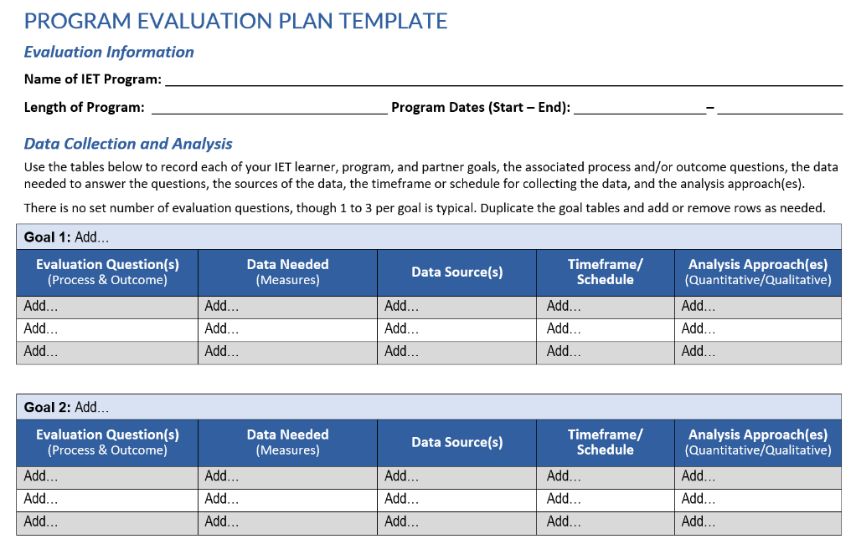
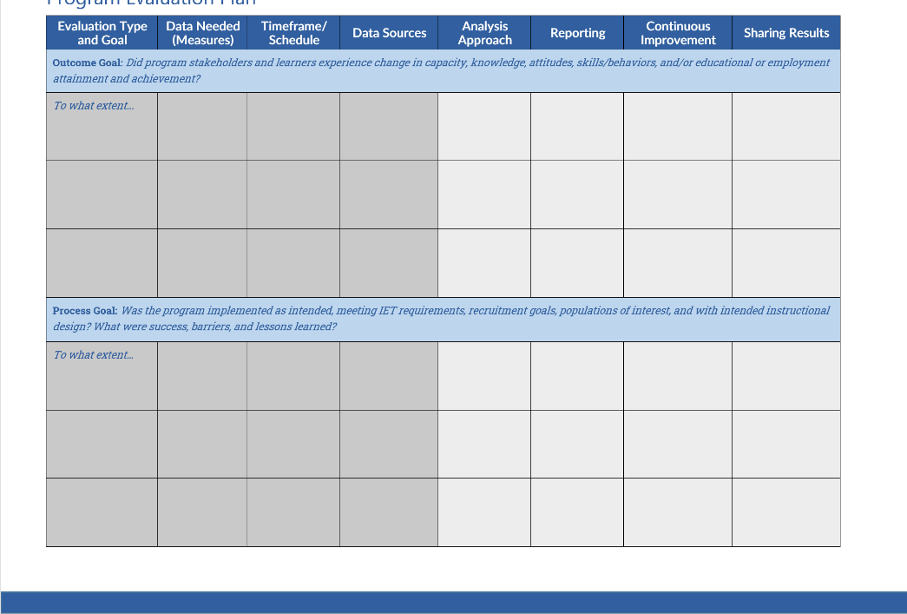
Program Evaluation Plan Template
Helps evaluators and IET program designers plan steps to conduct effective evaluations and incorporate continuous improvement into your IET program.
Toolkit Section 2.4 and IET Planning Tool

Slide 18
Three Types of IET Goals – Review

Slide 19
Three Types of IET Goals – Learner
Learner goals describe expected successful workforce and academic outcomes for the target population.
Example: Learners will gain the academic and technical skills required to attain Manufacturing Technician Level 1 Certification upon successful completion of the 12-week session.

Slide 20
Three Types of IET Goals – Program
Program goals describe the overall desired outcomes of the program.
Example: The Manufacturing Technician IET program will prepare learners at NRS levels 4 or 5 to achieve HSE testing readiness, obtain a Manufacturing Technician Level 1 certificate, transferrable postsecondary credits, and secure employment within 6 months of program completion.

Slide 21
Three Types of IET Goals – Partner
Partner goals focus on engagement or outcomes important to partners.
Example: Each term, the American Job Center will provide Individual Training Accounts (ITAs) to fund the training component and co-enroll learners into Title I where they will also receive individualized career services that prepare them to apply, interview, and obtain employment in the target IET occupation upon successful completion of the IET program.

Slide 22
Evaluating Outcomes and Processes
Outcome Evaluation (the “what”)
Measures the results (outcomes) of a program’s intervention strategies and activities against its projections.
Usually relates to:
Progress toward learner, program, and partner goals.
Achievement of learner, program, and partner goals.
Process Evaluation (the “how”)
Examines the experience and perceptions of learners, partners, and staff regarding the program’s design and development efforts and activities to determine their impact on the outcomes.
Usually relates to:
Quality of the program design process.
Fidelity of program implementation.
Effectiveness of IET curricula and instruction.

Slide 23
Outcome and Process Questions
Outcome Question Examples
What are students’ learning gains?
How many participants successfully complete the program?
What are the job placement rates for the program?
Was the outcome better for certain groups of learners than others?
Which learners are accessing available supports?
Process Question Examples
To what extent was the program implemented with fidelity?
What problems were encountered in delivering the program?
What is causing lower- or higher-than-expected learning gains?
Why are certain groups of learners accessing supports and not others? What impact is it having on their success in the program?
How engaged are employer partners in the program?
How will we know? What evidence do we need? How will we obtain it?

Slide 24
Group Discussion: Examining Equity
Questions: What questions should you ask to ensure that you are implementing an equitable program?
Data: Where do you need to collect and use demographic data to review equity?
Please share your experiences and ideas with the group.

Slide 25
Breakout Group Activity #1
Practice developing outcome and process questions
Read the scenario.
Select a learner, program, or partner goal from the provided list.
Develop one or two outcome and one or two process questions that will help you evaluate the goal.
Identify a spokesperson to summarize and report out.
15 min.

Slide 26
Identify Data Sources and Evaluation Tools
Types of Data
Exploring Data Sources
Connecting Measures and Data Sources
26

Slide 27
Two Types of Data
Quantitative
Qualitative
Numerical
Can be analyzed mathematically
Descriptive/conceptual
Can be categorized for analysis
EXAMPLE:
Demographics of IET participants:
80% male
20% female
80% white
15% black
5% other race(s)
EXAMPLE:
Employer-suggested improvements:
Workforce preparation skills training
Increase # of people with disabilities
Company site visits

Slide 28
Exploring Data Sources
Align your data with your program goals.
What data do you already have?
Where is it stored?
How will you access it?
What data will you need to collect?
How will you collect it?
How often will you collect it?
Where will it be stored?
How will you access it?
Toolkit Section 3.3

Slide 29
Connecting Measures and Data Sources
Measures | Data Sources
The quality of collaboration between adult education (AE) and English language learners (ELL) instructors, the occupational skills trainer, and programs is rated at least above average. | Survey responses of learners, adult education instructors and occupational trainers Direct observation
70% or more program participants make a measurable skill gain of at least 5%. | Course management data
At least 20% of program participants are from underrepresented populations (e.g., minorities, English language learners, etc.) identified during the needs assessment. | Needs assessment documentation Course management data
80% or more of learners earn an industry-recognized credential. | Program management data Learner responses on post-completion survey

Slide 30
Data Collection Methods and Evaluation Tools
Collection Methods | Evaluation Tools and Instruments to Prepare
Program data and document review | Performance reporting and course management data collection tools (may already exist) Lists of systems and documents that align to your program evaluation goals for tracking purposes
Direct observation and classroom visits | Observation protocols Classroom visitation checklists
Interviews and focus groups | Interview questionnaires and protocols Focus group questions
Surveys | Items or questions (electronic or paper version) Response options (e.g., multiple choice, multiple select, open-ended)
Staff and/or leadership meetings | Shared calendar/scheduling system Meeting minutes

Slide 31
Group Discussion: Data Collection
What types of data do you collect that have been helpful in your program evaluation efforts?
What types of data does your state agency or program collect that have been helpful in your program evaluation efforts?
Have you set up any unique data collection activities?
How are you getting student or partner feedback?
Please share your experiences and ideas with the group.

Slide 32
Analyze Data, Share Results, and Select Improvement Strategies
Analyzing the Data
Documenting Findings and Recommendations
Sharing Evaluation Results
Documenting Findings and Recommendations
Identifying and Selecting Improvement Strategies
32

Slide 33
Analyzing Data
What is data analysis?
The process of *cleaning, organizing, examining, and interpreting data using one or more analysis tools and techniques to extract relevant information that supports decision-making.
*Cleaning: Removing duplicate, erroneous, incorrect data before analyzing it.
TIP:
Looking at the data in different ways from different perspectives can provide insights you did not notice before.

Slide 34
Documenting Findings and Recommendations
Document the evaluation findings and recommendations for addressing any outcomes that fell below expectations.
SAMPLE EVALUATION FINDINGS AND RECOMMENDATIONS FORM
IET Goal | Findings and Evidence | Evaluator Recommendations | Selected Improvement Strategy/ies

Slide 35
Sharing Results
Refer to your evaluation plan to understand who your stakeholders are and what their communication needs are regarding evaluation results (i.e., details/timing/frequency).
Impactful evaluation reports and summaries link results to the IET program’s evaluation goals with appropriate documentation and descriptions of analysis and evaluation methods used.
Include recommendations tailored to the program goals.
See section 4.1 of the IET Toolkit

Slide 36
Identifying and Selecting Improvement Strategies
Include key stakeholders and project team members in the process of identifying potential improvement strategies.
Be open to the fact that your program evaluation may lead to the conclusion that you need to modify, redesign, or even discontinue your program.

Slide 37
Develop an Evaluation Plan
Program Evaluation Plan: Getting Started
Example Program Evaluation Plan for Sample IET Program
Breakout Group Activity
Preparing for Third-Party Evaluations
37

Slide 38
Program Evaluation Plan: Getting Started

Slide 39
Example IET Program: ABC Adult Education – Auto Technician
(Participant Guide, Appendix D, item D2)
The program integrates basic skills and workforce preparation skills within an Auto Tech training program that prepares students to test for the ASE Service Consultant Certification and apply for entry-level employment in the automotive service industry.
Prospective students take an interest inventory and AE math and reading pretests.
The program is presented as a single program with two instructors who co-teach the class.
The automotive curriculum provides an overview of major automotive systems and hands-on training for entry-level tech tasks.
Basic skills instructor provides opportunities to improve English language literacy, reading, writing, math, and soft skills through contextualized instruction.
Students also develop training goals and job seeking skills.
Completers may continue in 900 hours (3 courses) of the automotive technology training program to prepare for the A Series ASE-Certified Master Automobile Technician test.
(Adapted from https://www.calpro-online.org/documents/CALPRO2017Brief-IET-508.pdf)

Slide 40
Example Program Evaluation Plan for ABC Adult Ed. – Auto Technician IET Program
Goal 1: Learners will gain the academic, workplace preparation, and workforce training skills and competencies required to successfully pass the ASE Service Consultant Certification test upon program completion.
Evaluation Question(s) (Process & Outcome) | Data Needed​ (Measures)​ | Data Source(s) | Timeframe/ Schedule​ | Analysis Approach(es) (Quantitative/Qualitative)
How many program completers pass the ASE Service Consultant Cert. test within 90 days of completion? | Program completion dates # of participants obtaining certification within 90 days | Student outcomes data Post-Program Participant Survey | 4 months after end of program | Quantitative
What is causing lower-or higher-than expected certification results? | Participant responses on Participant Post-Program Survey End-of-term assessment scores # of participants accessing available learner supports Program curriculum alignment to certification requirements | Participant LMS or records database Learner support logs and advisor notes Program curriculum Certification requirements | Within 6 months of end of program | Qualitative
Goal 2: All IET staff involved in research, design, implementation, and evaluation will complete annual professional development training on IET program planning, pass the post-assessment with a score of at least 85%.
Evaluation Question(s) (Process & Outcome) | Data Needed​ (Measures)​ | Data Source(s) | Timeframe/ Schedule​ | Analysis Approach(es) (Quantitative/Qualitative)
How many staff members complete the training? | # of training sessions each participant logged in and out # of times participants logged in late or logged out early | Participant Daily log-in/out records | Annually | Quantitative
How many staff members pass the post-assessment with a score ≥ 85%? | Professional Development Post-assessment scores | Prof. Dev. Learning Management System (LMS) | Annually | Quantitative
40

Slide 41
Breakout Group Activity #2
Practice creating an evaluation plan
Return to your group handout with your goal and process and outcome questions from breakout activity #1.
Discuss the data you need to evaluate the goal and answer your questions.
Determine the data source(s), timing or frequency, and analysis method(s) you’ll use to evaluate the goal.
Complete the remaining columns for each question in the Program Evaluation Plan Template provided.
Identify a spokesperson to summarize and report out.
15 min.

Slide 42
Preparing for Third-Party Evaluations
WIOA emphasizes building evidence.
Documenting your goals for the program positions you well for internal and external evaluation.
Planning for and implementing data collection activities positions you well, including working through questions about data access.
More resources are available—you don’t have to go it alone.
IET Toolkit Section 4.2
Department of Labor’s Evaluation and Research Hub on the WorkforceGPS website: https://evalhub.workforcegps.org/

Slide 43
Wrap-Up
Key Takeaways
Reflections/Questions
Next Steps

Slide 44
Key Takeaways
6
Continuous improvement is more than just a philosophy or theory—it requires action in every stage of the IET design process.
Outcome evaluation focuses on “what” was accomplished compared to projections, whereas process evaluation focuses on “how” the outcome was accomplished.
There are two types of data: quantitative, which is numerical and can be analyzed mathematically, and qualitative, which is descriptive and conceptual and can be categorized by characteristics for analysis.
Data analysis is the process of cleaning, organizing, examining, and interpreting data using one or more analysis tools and techniques to extract relevant information that supports decision-making.
The Evaluation Plan Template can help IET program teams plan for conducting effective evaluations.
Include key stakeholders and project team members in the process of identifying potential improvement strategies.
44

Slide 45
Group Discussion
Reflect on today’s topics.
How might what you learned today inform the way you evaluate your IET program to support continuous improvement?

Slide 46
Poll: Confidence Level
How prepared do you feel to incorporate the continuous improvement and evaluation concepts you learned in this session into your processes?
Select 1:
I am very prepared.
I am somewhat prepared.
I may need more training/support.
Phase 4: Evaluate and Improve
46

Slide 47
Next Steps
Design Camp Closing Session: [ENTER DATE/TIME]
Focus on Phase 4, with an emphasis on continuous improvement practices and using results with stakeholders
Wrap up the Design Camp

